Slide 1

INTERNSHIP REPORT
House of PY Technologies, Surat
Student:
Panchal Krish Dipakkumar
Exam No.: 9553
Supervisor: Kavin Patel, Co-Founder
Program: BCA – Semester 6
College: BCA – Vivekanand college for Advanced Computer
and Information Science

Slide 2
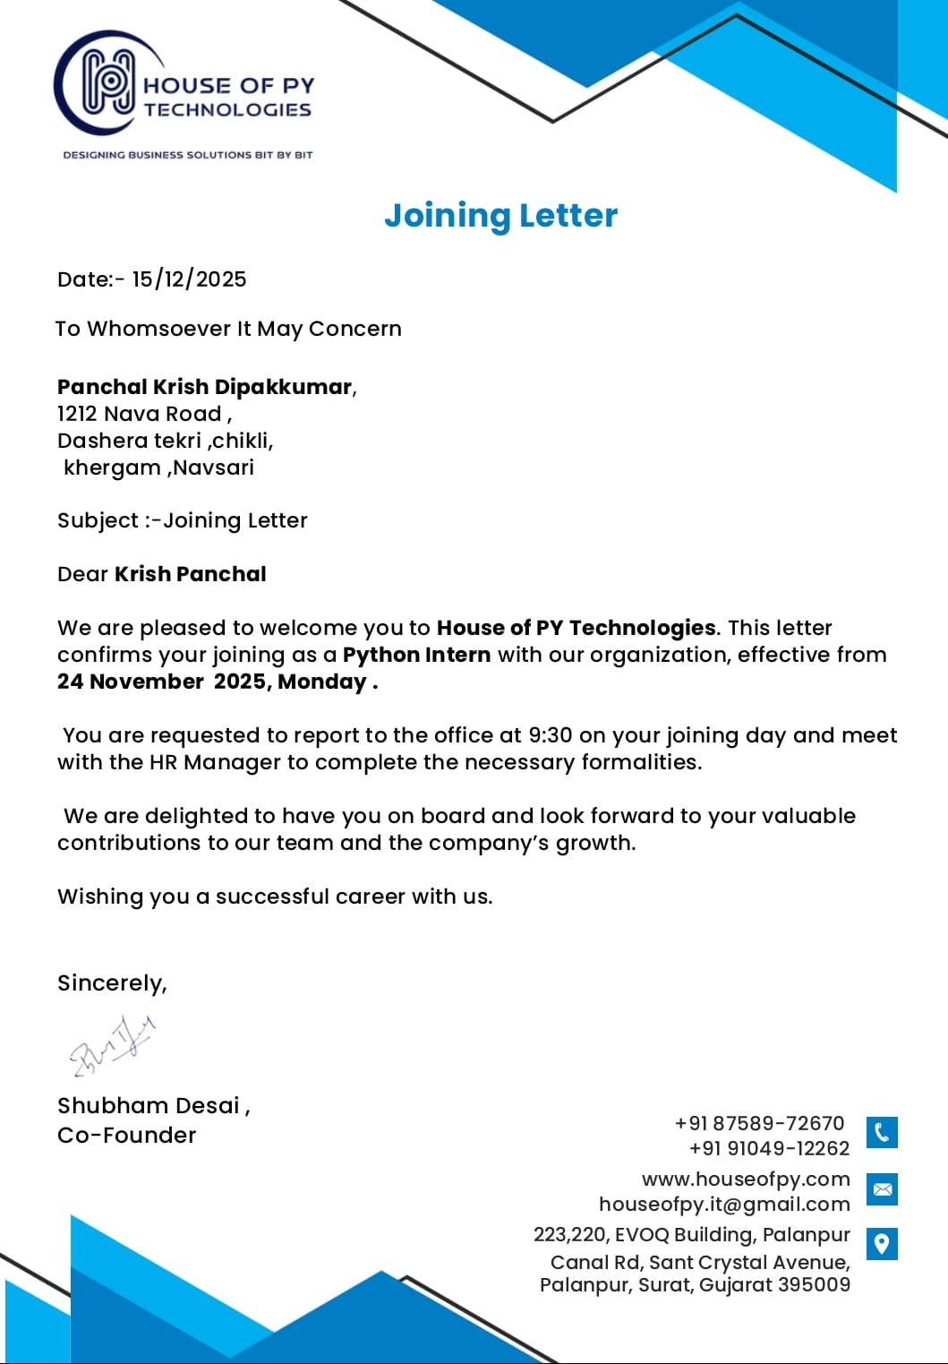
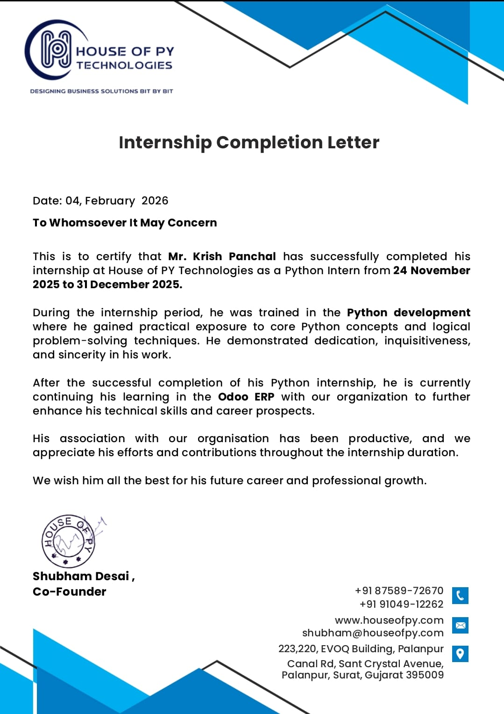
Certificates

Slide 3
About House of PY Technologies
Company Overview
Core Services
Address
223,220,EVOQ Building, Palanpur Canal Rd, Sant Crystal Avenue,Palanpur, Surat, GJ – 395003
Odoo ERP Implementation & Customization
Python / Backend Application Development
Flutter Mobile App Development
IT Consulting & Digital Transformation
SMB to Enterprise Clients (Manufacturing, Retail, Logistics)
Website
www.houseofpy.com
Email
houseofpy.it@gmail.com
Phone
+91 87589 72670

Slide 4
Internship Details
Duration
Department
Supervisor
Nov 24, 2025 – Mar 19, 2026
(~5 months)
Software Development Division
(Odoo · Python · Mobile)
Kavin Patel
Co-Founder & Senior Developer
Team Exposure
Work Culture
Time Split
Rotated across Odoo ERP, Python Backend & Flutter Mobile teams
Agile sprint model with daily stand-ups, code reviews & sprint retrospectives
Odoo 40% · Python 35% · Mobile 25%
Odoo ERP – 40%
Python/Backend – 35%
Mobile Dev – 25%

Slide 5
Objectives of the Internship
Odoo / ERP
Python / Backend
Mobile / Flutter
Professional Growth
Understand Odoo MVC & ORM system
Create custom modules & XML views
Build QWeb PDF reports
Integrate Odoo with external APIs
Strengthen OOP & core Python skills
Build REST APIs using Flask
Data processing & automation scripts
Test APIs with Postman
Understand cross-platform architecture
Learn Flutter widgets & Dart
Integrate APIs into Flutter apps
Basic state management concepts
Team communication & daily stand-ups
Time management across domains
Code documentation & version control
Client requirement understanding

Slide 6
Work Done – Odoo / ERP Development (40%)
Studied Odoo architecture: base modules, ORM layer, server framework & web client
Created custom Odoo module manifest files (odoo/addons structure)
Built Python models using fields.Char, Many2one, One2many, and @api methods
Designed form, list, kanban XML views and applied domain filters & onchange decorators
Developed QWeb PDF report templates for the Garage Management Module
Integrated the module with Odoo's Sales & Inventory apps
Completed Garage Management Module reviewed and approved by senior developer
Module deployed into the company's staging Odoo instance
Key Deliverable
Garage Management Module
✔ Custom Python Models
✔ XML Form & List Views
✔ QWeb PDF Reports
✔ Sales & Inventory Integration
✔ Deployed to Staging

Slide 7
Work Done – Python / Backend Development (35%)
🐍 Python Fundamentals
🌐 REST API with Flask
OOP, decorators, list comprehensions, file I/O, exception handling, and standard libraries in a professional codebase.
Built endpoints for user authentication, product catalog, booking management, and real-time status updates.
🔧 Data Processing Scripts
📬 Testing & Documentation
Automated data import, transformation, and export scripts to process client datasets.
Tested all endpoints with Postman, wrote API documentation, and resolved contract mismatches with mobile team.

Slide 8
Weekly Work Summary
Week
Dates
Focus Area
Work Summary
Key Outcome
Fundamentals of Programming
Solid base in multi-language programming concepts
Week 1
24 Nov – 3 Dec
Mastered core concepts in C, C++, and Python. Covered variables, loops, functions, OOP basics, and completed assigned exercises to build a strong programming foundation.
SQL & Database Management
Studied relational databases and table management using pgAdmin. Practised SELECT, JOIN, GROUP BY, and subqueries on real datasets provided by the team.
Proficient in SQL queries and database structure design
Week 2
4 Dec – 9 Dec
Odoo ERP Architecture & Module Creation
Understood Odoo module structure; built first working module
Week 3
10 Dec – 16 Dec
Explored Odoo workflow, MVC structure, and ORM system. Created first custom module with manifest, Python model, and basic XML form/list views.
Advanced Odoo Module Flows & Business Logic
Deployed Garage Management Module to staging — approved by senior developer
Week 4
17 Dec – 23 Dec
Built complex module logic: computed fields, onchange decorators, domain filters, QWeb PDF reports, and integrated the Garage Management Module with Sales & Inventory apps.
Real-time Project Tasks & Teamwork
Query time reduced from 8s to <1s; API fully integrated with mobile app
Week 5
23 Dec – 31 Dec
Contributed to live client projects: developed Flask REST API endpoints, resolved API contract mismatches with the mobile team, and optimised a slow PostgreSQL report query using EXPLAIN ANALYZE.

Slide 9
Weekly Work Summary
Week 1
24 Nov – 3 Dec
Week 2
4 – 9 Dec
Week 3
10 – 16 Dec
Fundamentals of Programming
SQL & Database Management
Odoo ERP Architecture & Module Creation
Mastered core concepts in C, C++, and Python — variables, loops, functions, and OOP basics. Completed assigned exercises to build a strong programming foundation.
Studied relational databases and table management using pgAdmin. Practised SELECT, JOIN, GROUP BY, and subqueries on real datasets provided by the team.
Explored Odoo workflow, MVC structure, and ORM system. Created first custom module with manifest, Python model, and basic XML form/list views.
Week 4
17 – 23 Dec
Week 5
23 Dec – 31 Dec
Advanced Odoo – Business Logic & Deployment
Real-time Project Tasks & Teamwork
Built computed fields, onchange decorators, QWeb PDF reports, and integrated the Garage Management Module with Sales & Inventory apps. Module deployed to staging and approved.
Contributed to live client work: developed Flask REST API endpoints, resolved API contract mismatches, and optimised a PostgreSQL report query from 8s to under 1 second using EXPLAIN ANALYZE.

Slide 10
Learning Outcomes
Odoo ERP
Python Backend
Full module development lifecycle
Python ORM models & API methods
XML views & QWeb reports
Odoo app integration patterns
Flask REST API development
OOP, decorators & file I/O
Postman testing & documentation
Data processing automation
Tools & Workflow
Professional
Git version control & branching
VS Code, PyCharm, pgAdmin
Postman API testing
Agile sprint ceremonies
Agile & sprint ceremonies
Cross-functional collaboration
Git version control
Technical documentation

Slide 11
Challenges & Solutions
⚠ Odoo Learning Curve
✔ 3-pronged study: official docs + source code + mentor guidance
⚠ Balancing 3 Domains
✔ Weekly schedule: Odoo Mon–Tue, Python Wed–Thu, Mobile Fri
⚠ Flutter State Management
✔ Learned correct setState pattern within async API call lifecycle
⚠ API Contract Mismatch
✔ Audited Postman vs Flutter models; updated Flask response formatters
⚠ PostgreSQL Query Performance (8s+)
✔ Used EXPLAIN ANALYZE; added composite indexes → <1s query time

Slide 12
Conclusion
Built a complete Garage Management Module in Odoo ERP – deployed and approved
Developed a functional Flask REST API with full Postman-tested documentation
Resolved real-world challenges: query performance, API contracts, state management
Reduced a slow PostgreSQL report query from 8s to under 1 second
Participated in Agile sprints, daily stand-ups, and code reviews
Progressed from programming fundamentals to enterprise ERP development in 5 weeks
"This internship has been a decisive milestone in shaping my career direction. I am committed to pursuing a career in Python-based enterprise and mobile application development."

Slide 13
Thank You
Panchal Krish Dipakkumar | BCA Sem-6 | Vivekanand College
House of PY Technologies, Surat
www.houseofpy.com | houseofpy.it@gmail.com | +91 87589 72670
Supervised by: Kavin Patel, Co-Founder & Senior Developer

