Slide 1

COMP264 · GROUP 4 FINAL PROJECT
Universal AI-Powered
Product Identification
Amazon S3
Rekognition
Translate
Multilingual Catalog Generator
DynamoDB
Sara Hamoleila · Teawo Kim · Syed Hussain
Chalice
AWS Cloud Services

Slide 2
AGENDA
What We'll Cover Today
01
Problem & Rationale
04
Implementation & Code
Business challenges solved
Backend, API, frontend
02
System Architecture
05
Live Demo & Testing
Cloud design overview
Results with real product images
03
Design Documents
06
Future Work & Conclusion
Use cases, interactions, UI flow
Enhancements & lessons learned

Slide 3




01 RATIONALE & SCOPE
The Problem We Solve
Our Solution
Manual Catalog Work
SMBs spend hours manually writing product descriptions for e-commerce listings.
A fully serverless AI app that:
Accepts product image uploads
Detects labels via Amazon Rekognition
Language Barriers
Most product catalogs are English-only, missing global markets.
Translates to Korean, Spanish & French
Stores results in DynamoDB
Slow Time-to-Market
Hosts images on Amazon S3
Manual translation and classification is error-prone and costly.
Exposes REST API via AWS Chalice

Slide 4
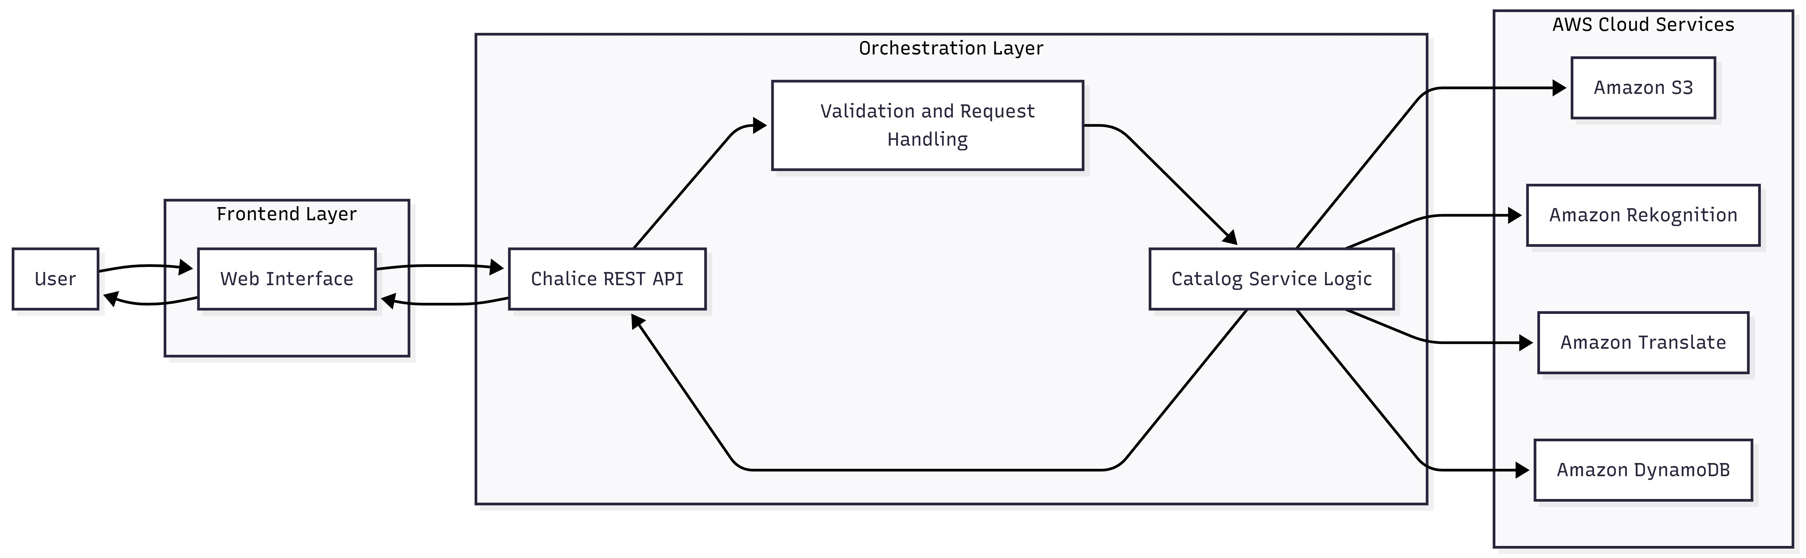
02 SYSTEM DESIGN
Architecture Overview

Slide 5





02 SYSTEM DESIGN
Technology Stack
Frontend
Static single-page interface
HTML / CSS / JavaScript
API Layer
REST endpoints: /upload, /results
AWS Chalice (Python)
AI Services
Label detection & multilingual
Rekognition + Translate
Storage
Image hosting + metadata records
Amazon S3 + DynamoDB
Language
Modular service architecture
Python + Boto3 SDK

Slide 6
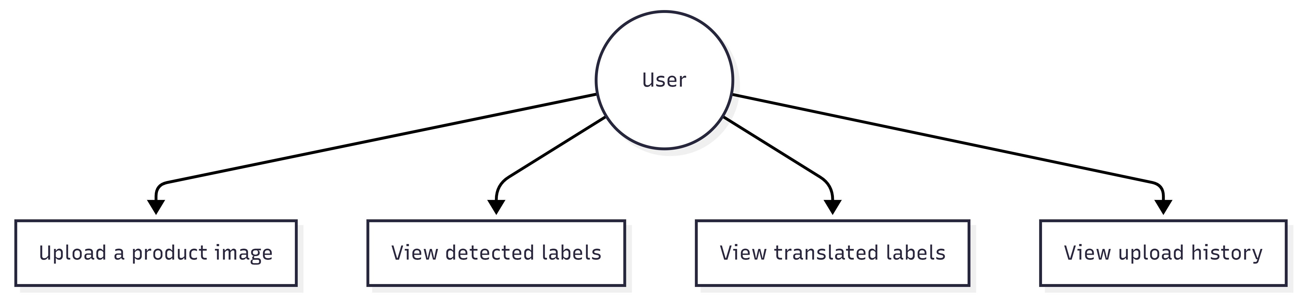
03 DESIGN DOCUMENTS
Use Case Diagram
UC-1
Upload a product image (JPG/PNG)
UC-2
View AI-detected product labels
UC-3
View translations in KO, ES, FR
UC-4
Browse previous upload history

Slide 7
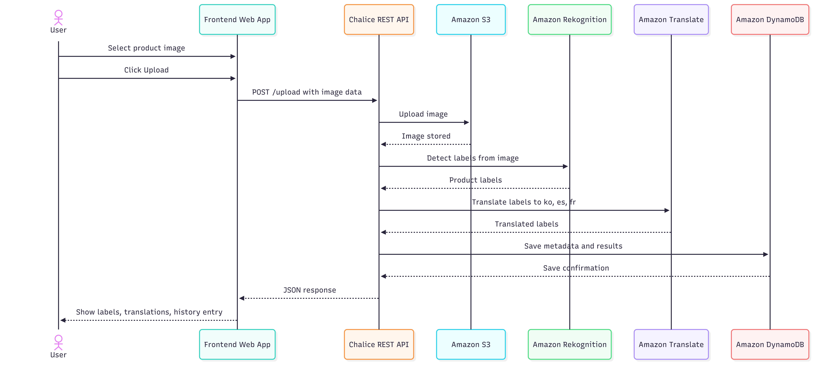
03 DESIGN DOCUMENTS
Sequence / Interaction Diagram

Slide 8
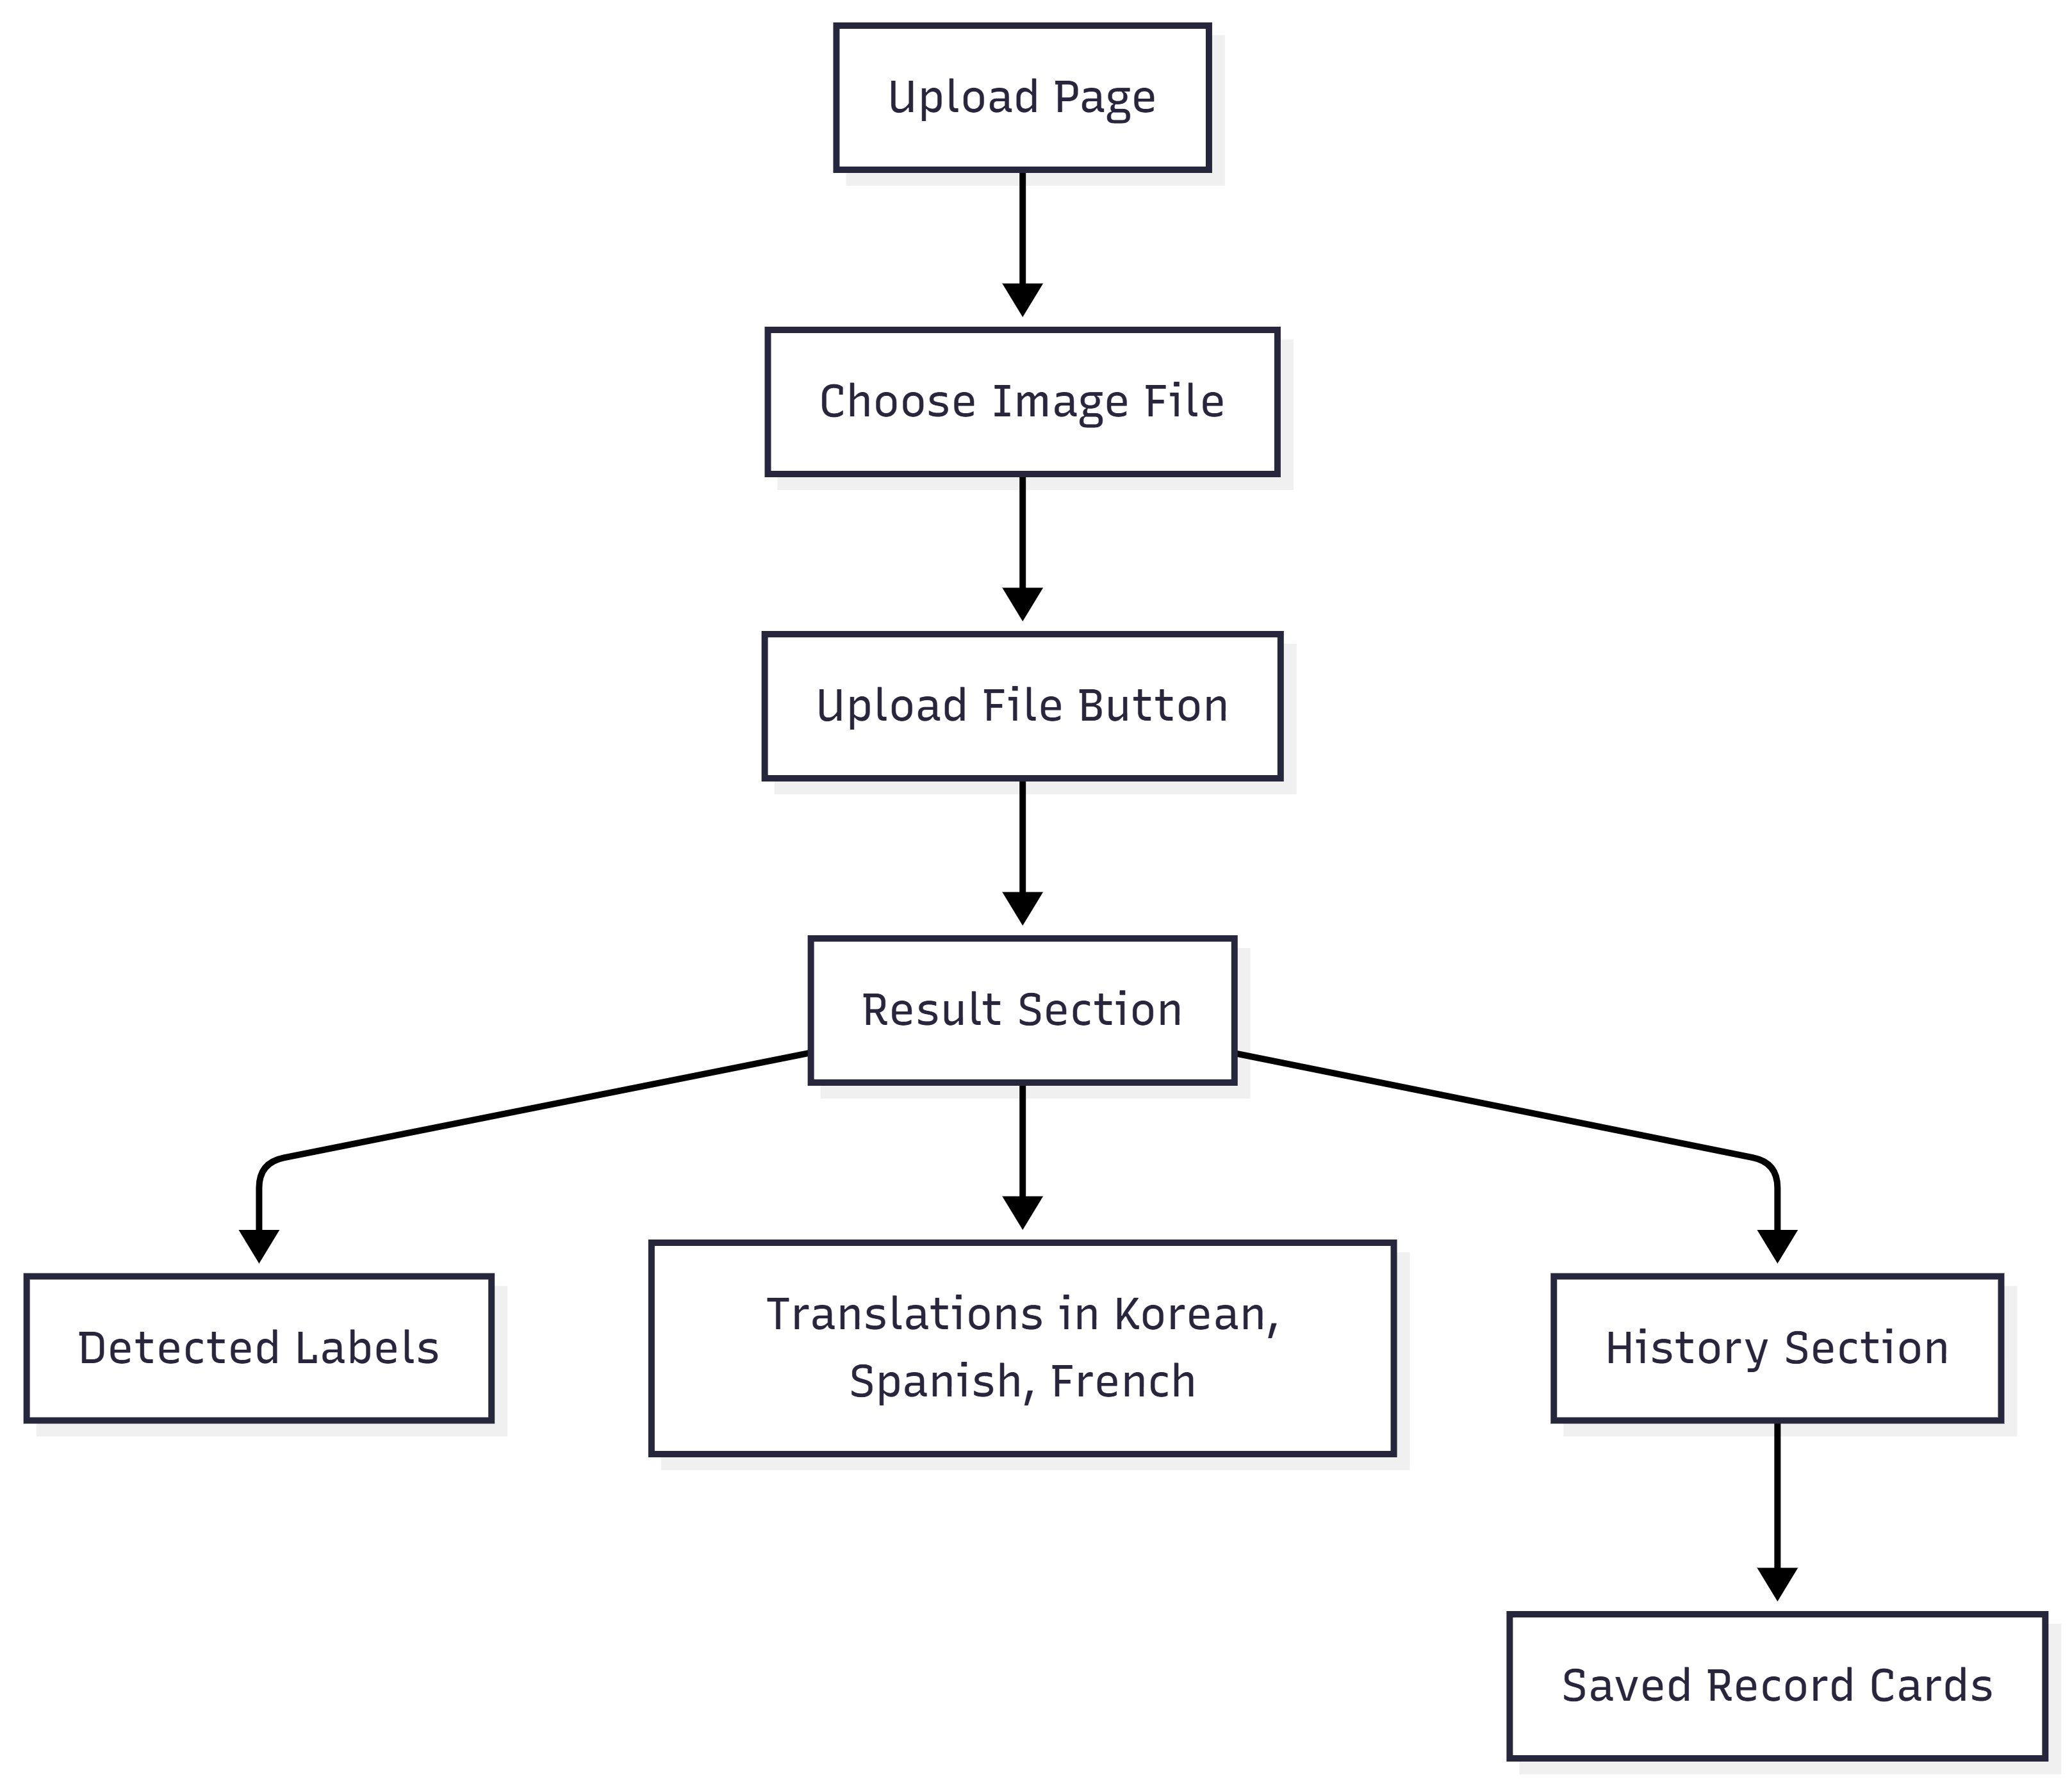
03 DESIGN DOCUMENTS
UI Mockup Flow
User Journey
1
Access Upload Page
Navigate to the web interface
2
Choose Image File
Select a JPG or PNG product photo
3
Click Upload File
POST request sent to Chalice API
4
View Detected Labels
AI-identified product categories
5
View Translations
Korean, Spanish, French labels
6
Browse History Section
Past results shown as record cards

Slide 9
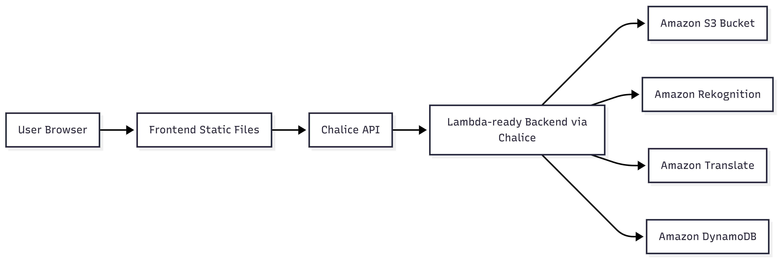
03 DESIGN DOCUMENTS
Deployment Diagram

Slide 10
04 IMPLEMENTATION
Code Structure & API Endpoints
Modular Backend Architecture
REST API Endpoints
app.py
Chalice entry point, routes
GET
/health
System health check
catalog_service.py
Main orchestrator
GET
/config
s3_service.py
Image upload to S3
AWS configuration
POST
/upload
rekognition_service.py
Label detection
Process & analyze image
translate_service.py
Multilingual translation
GET
/results
Fetch history from DynamoDB
dynamodb_service.py
Metadata storage
config.py
Environment variables
github.com/iamktw90/COMP264_Final-Project_Group-4

Slide 11
04 IMPLEMENTATION
End-to-End Data Flow
1
User Upload
2
API Processing
3
S3 Storage
Image selected in browser
Converted to base64
POST /upload
Chalice validates request
Image uploaded to S3 bucket
URL generated for record
4
AI Detection
5
Translation
6
Store & Return
Rekognition detects labels
Confidence threshold applied
Labels translated to:
KO · ES · FR
DynamoDB record saved
JSON returned to frontend

Slide 12
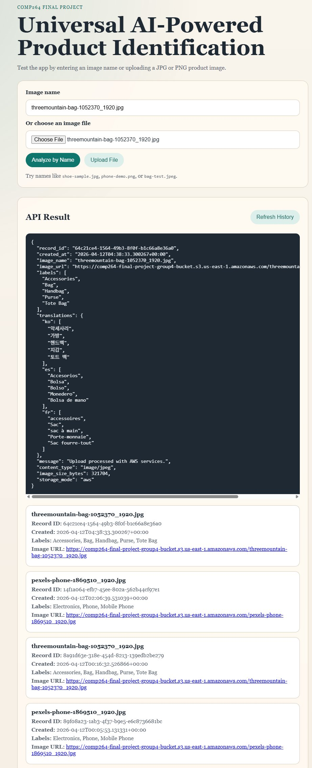
05 DEMO & TESTING
Live Application Results
Test Results
Handbag / Bag
✓
Labels: Accessories, Bag, Handbag, Purse, Tote Bag
Mobile Phone
✓
Labels: Electronics, Phone, Mobile Phone
Shoe
✓
Labels: Footwear, Shoe, Running Shoe
Bottle
✓
Labels: Bottle, Drink, Beverage Container
All labels translated to Korean · Spanish · French

Slide 13
04 IMPLEMENTATION — NEW FEATURE
Document Upload: DOCX & PDF Support
The app now accepts DOCX and PDF files in addition to product images.
How It Works
Supported Formats & Capabilities
1
User selects a DOCX or PDF file
📄 DOCX Files
Via the file chooser on the upload page
Microsoft Word documents
Text extracted page by page using python-docx. Headings and body text are parsed into analyzable content.
2
File sent to Chalice REST API
POST /upload — detects file type automatically
📑 PDF Files
3
Text extracted from document
DOCX via python-docx · PDF via PyMuPDF
Portable Document Format
PDF text extracted using PyMuPDF (fitz). Scanned PDFs with embedded text are fully supported.
4
Extracted text analyzed by Rekognition
Key terms identified as product labels
🖼️ Images (existing)
5
Labels translated & stored
JPG / PNG product photos
Same pipeline as image uploads — DynamoDB + S3
Original image upload pipeline unchanged. All three modes share the same translation and storage logic.

Slide 14

05 DEMO & TESTING
AWS Service Verification
Amazon S3
Amazon Rekognition
Product images successfully uploaded
URL generated per image record
Labels detected with confidence scores
Fallback logic for edge cases
Amazon Translate
Amazon DynamoDB
Labels translated to KO, ES, FR
All languages returned in JSON
Metadata records saved and retrieved
History accessible via /results API

Slide 15
03 DESIGN DOCUMENTS
Key Design Decisions
Serverless via Chalice
Separation of Concerns
Eliminates server management, enables auto-scaling, aligns with FaaS architecture required.
Each service (S3, Rekognition, Translate, DynamoDB) is encapsulated in its own module.
Pre-trained AI (no training)
DynamoDB over RDS
AWS Rekognition requires no custom training, reducing development time and cost.
NoSQL suits metadata records; fast, schema-flexible, serverless-native storage.
Base64 Image Encoding
Multi-language Translation
Enables direct image transfer in REST JSON payload without file upload complexity.
Korean, Spanish, French cover 3 of the top 5 global e-commerce markets.

Slide 16


06 FUTURE WORK
Enhancements & Roadmap
Public Deployment
Improved Accuracy
More Languages
Deploy via AWS API Gateway + Lambda with custom domain for real users.
Add confidence thresholding and fine-tune label filtering per product category.
Extend translations to Japanese, Portuguese, Arabic and other global markets.
Product Recommendations
User Authentication
Pricing Estimation
Use detected labels to suggest similar products from a catalog database.
Add Cognito-based user auth for personalized history and multi-user isolation.
Integrate market pricing API to auto-generate product price suggestions.

Slide 17
CONCLUSION
What We Built
Fully Working App
4 AWS Services
Serverless backend + frontend tested with 9 product types.
S3, Rekognition, Translate, DynamoDB — all integrated.
3 Languages
Clean Code Architecture
Korean, Spanish, French translations via Amazon Translate.
Modular, documented, following separation of concerns.
github.com/iamktw90/COMP264_Final-Project_Group-4

