Slide 1
PREDICTING
CUSTOMER CHURN
78%
of actual churners
identified on unseen data
Who should the retention team call first?
TELCO · CLASSIFICATION
Useful, not magic.
Alex · Project 2 · Data Science & Machine Learning
Notes:
Timing: ~30 seconds
I wanted to make this a business problem rather than a model-shopping exercise. The question is simple: if a retention team cannot call everyone, who should they call first?
The final model catches about 78% of the customers who actually churn on completely unseen data. That is useful. It is not a crystal ball, and I am not going to pretend it is. The point is to prioritise attention better than doing nothing.

Slide 2
1 · THE PROBLEM
The prediction has a job to do
Target
WHO USES IT?
COST OF A MISS
Churn = Yes
Customer retention team
False negative
Positive class
A genuine churner is missed.
The business loses the chance to intervene.
WHAT DECISION?
Who gets contacted first?
TRADE-OFF
I would rather make some extra calls than miss most of the people leaving.
Notes:
Timing: ~45 seconds
The target is Churn, with Yes as the positive class. The user is a retention team and the decision is who to contact first.
That immediately changes what I care about. A false positive wastes a call or perhaps a small retention offer. A false negative means someone genuinely leaves and we never even tried. So I decided the more expensive mistake was missing a churner. That is why recall became my main metric, with precision and F1 there to stop me cheating by simply predicting Yes for everybody.

Slide 3
2 · THE DATA
7,043 customers — and a few traps
7,043
26.5%
11
1 column
Customers
Churn rate
Blank TotalCharges
Identifier removed
one row = one customer
moderately imbalanced
all tenure = 0
customerID dropped
What the row contains
Demographics and household information
Cleaning choices that mattered
TotalCharges
text → numeric; 11 new customers filled with 0
Services, contract, billing and payment behaviour
customerID
dropped: it identifies people, not churn risk
Tenure, monthly charges and total charges
Source: IBM Telco Customer Churn sample · Apache 2.0
Notes:
Timing: ~45 seconds
The dataset has 7,043 customers. About 26.5% churned, so it is imbalanced enough that accuracy on its own is a bit flattering.
There were two useful data traps. TotalCharges looked numeric but was actually text, with 11 blanks. Every one of those customers had tenure zero, so rather than binning perfectly valid new customers I converted the field and treated their accumulated charges as zero. I also removed customerID because it is just an identifier.
I kept the cleaning boring on purpose. Boring and defensible beats clever and leaky.

Slide 4
3 · METRIC + BASELINE
Recall is the score I care about
Why recall?
The score to beat
Of the customers who really churn…
how many did I actually catch?
0.000
Dummy baseline recall
False negative = missed retention opportunity
The dummy predicts “No churn” for everyone.
Great accuracy. Completely useless for finding churners.
Precision still matters, because calls and offers are not free.
Same 5-fold stratified CV used for every model
Notes:
Timing: ~40 seconds
Recall answers the question I actually care about: of the people who genuinely left, how many did the model identify?
The baseline is deliberately stupid. It predicts the majority class, so everybody stays. That gives a churn recall of zero. It is a useful reality check because a model is only interesting if it beats doing essentially nothing.
I used the same five stratified folds for every model so the comparison is fair rather than each model getting a different exam paper.

Slide 5
4 · WHAT I TRIED
Three model families. Same folds.
Mean CV recall
Logistic Regression
0.544
Decision Tree
0.500
Random Forest
0.486
Dummy baseline
0.000
Winner before tuning: Logistic Regression · simple, strongest recall, easy to explain
Notes:
Timing: ~45 seconds
I compared three genuinely different model families: Logistic Regression, a Decision Tree and a Random Forest. Same preprocessing pipeline, same folds, same recall scorer.
Logistic Regression came out best at about 0.544 recall. The tree was reasonably close, Random Forest slightly lower. The spread across folds also matters, so I did not treat a tiny difference as gospel.
I took Logistic Regression and the Decision Tree forward for tuning. The feature-engineering experiment I tried — a tenure band — actually made recall slightly worse, so I dropped it. No point keeping complexity just because I made it.

Slide 6
5 · FINAL MODEL
Tuning changed the picture
0.801
0.783
0.504
0.614
CV recall
Test recall
Precision
F1
5-fold spread ± 0.038
only 0.018 below CV
about half of flags churn
precision/recall balance
Chosen model
Threshold
I tested the precision/recall trade-off using cross-validated training probabilities. 0.50 already met the ≥80% recall target with the best precision.
Logistic Regression
0.50
C = 1
class_weight = balanced
Untouched test set used once — after model + threshold were fixed.
Notes:
Timing: ~50 seconds
Tuning mattered a lot. With balanced class weights, Logistic Regression moved from about 0.54 recall to 0.80 in cross-validation. The tuned tree reached about 0.78, so Logistic Regression still won and it stayed the easier model to explain.
I also tested the classification threshold rather than blindly accepting 0.5. My rule was: catch at least 80% of churners, then take the best precision I can get. 0.5 already did that on cross-validated training probabilities.
Then, finally, I opened the test set once. Recall was 0.783 — only 0.018 below the CV estimate. That is exactly the sort of boring consistency I wanted.

Slide 7
6 · WHERE IT GOES WRONG
The mistakes are the trade-off
TRUE LABEL
Predicted stay
Predicted churn
747
288
Pattern in the errors
Actually stayed
correct stays
false alarms
False negatives
long tenure · 1–2 year contracts · often DSL / automatic pay
81
293
False positives
Actually churned
short tenure · month-to-month · fibre · electronic check
missed churners
caught churners
The model is behaving consistently with the historical patterns — people can still surprise it.
Notes:
Timing: ~45 seconds
This is the cost of choosing recall. The model caught 293 of the 374 churners and missed 81. But it also flagged 288 people who stayed.
The interesting bit is that the errors make sense. The missed churners looked like classic loyal customers: long tenure, longer contracts, often automatic payment. The false positives looked like classic churn risks: short tenure, month-to-month, fibre, electronic cheque.
So the model has learned a sensible population pattern. It is just not clairvoyant at an individual level — which is exactly why I would use it to prioritise outreach, not make automatic decisions.

Slide 8
7 · WHAT DRIVES IT
Tenure matters most — by a mile
tenure
0.236
Contract
0.104
InternetService
0.038
MonthlyCharges
0.021
PaymentMethod
0.003
Drop in recall when the original feature is shuffled
Coefficients agreed:
month-to-month + fibre ↑ churn
long tenure + 2-year ↓ churn
Notes:
Timing: ~45 seconds
I used permutation importance because it answers a very practical question: if I scramble this original feature, how much worse does recall get?
Tenure is comfortably the biggest driver. Contract type is next, then internet service and monthly charges. The coefficient analysis told the same story in more detail: month-to-month and fibre push churn risk up; long tenure and two-year contracts push it down.
I am deliberately saying association, not causation. The model is describing patterns in this dataset. It is not proving that fibre optic internet causes somebody to leave.

Slide 9
8 · RECOMMENDATION
Would I use it? Yes — with boundaries.
USE IT FOR
DO NOT PRETEND IT KNOWS
Prioritising retention outreach
What this data cannot see
Ranking who gets attention first
Complaints, outages or recent support experiences
Low-cost contact where some false alarms are acceptable
Competitor offers and changing prices
A human decision with context, not an automatic action
Future behaviour drift — monitor and retrain
Model = prioritisation tool, not a crystal ball.
Notes:
Timing: ~45 seconds
Would I use it? Yes, but only for the job I designed it for. I would use it to prioritise a retention queue where contacting somebody is relatively cheap and a false alarm is tolerable.
I would not let it automatically hand out discounts or make expensive customer decisions, because precision is only about 50%.
And there are obvious blind spots: complaints, outages, service quality, competitor offers — none of that exists here. So in a real business I would monitor recall and precision over time and retrain when customer behaviour shifts. The model is useful because it narrows where to look first.

Slide 10
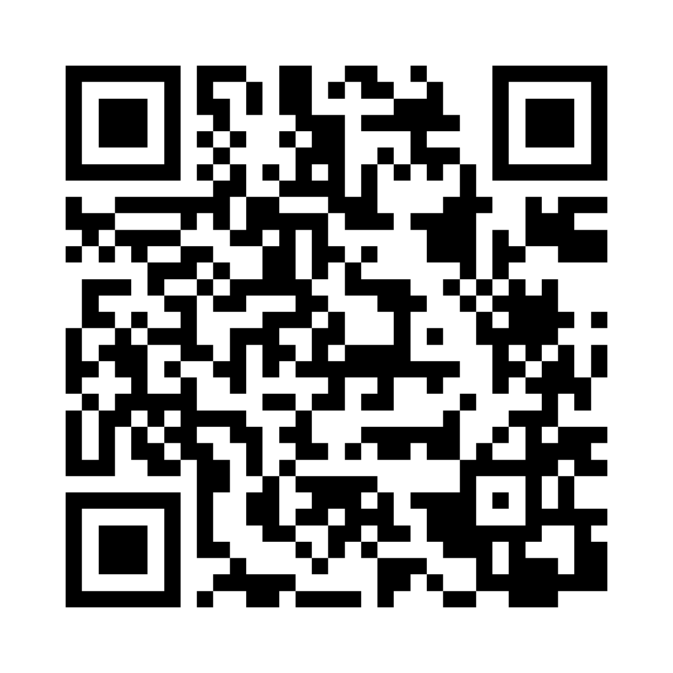
78% of churners caught.
Now let’s make it tangible.
LIVE DEMO
High risk
Low risk
Borderline-ish
89.2%
2.1%
62.6%
3 months · month-to-month
fibre · electronic cheque
60 months · two-year
DSL · automatic bank transfer
18 months · one-year
fibre · automatic card
The app will load the saved pipeline and score a customer live — same preprocessing, same threshold, no notebook magic.
Thank you
Notes:
Timing: ~30 seconds to close, then move into the 3-minute demo
So the headline is: the model catches roughly 78% of genuine churners on unseen data, and it does it with a simple, interpretable pipeline. I would trust it to prioritise a queue. I would not trust it to make the decision for me.
For the demo I will switch to the live Streamlit app. I have three example profiles here just to show the range: a very obvious high-risk customer, a very low-risk customer, and one in the middle.
[Once Streamlit is deployed: point the audience to the public link or QR and let them try their own customer profile.]
Then I will show that the app is using the same saved model and threshold as the notebook — not a separate toy model.

Slide 11
https://alex-retention-control-room.streamlit.app

