Slide 1
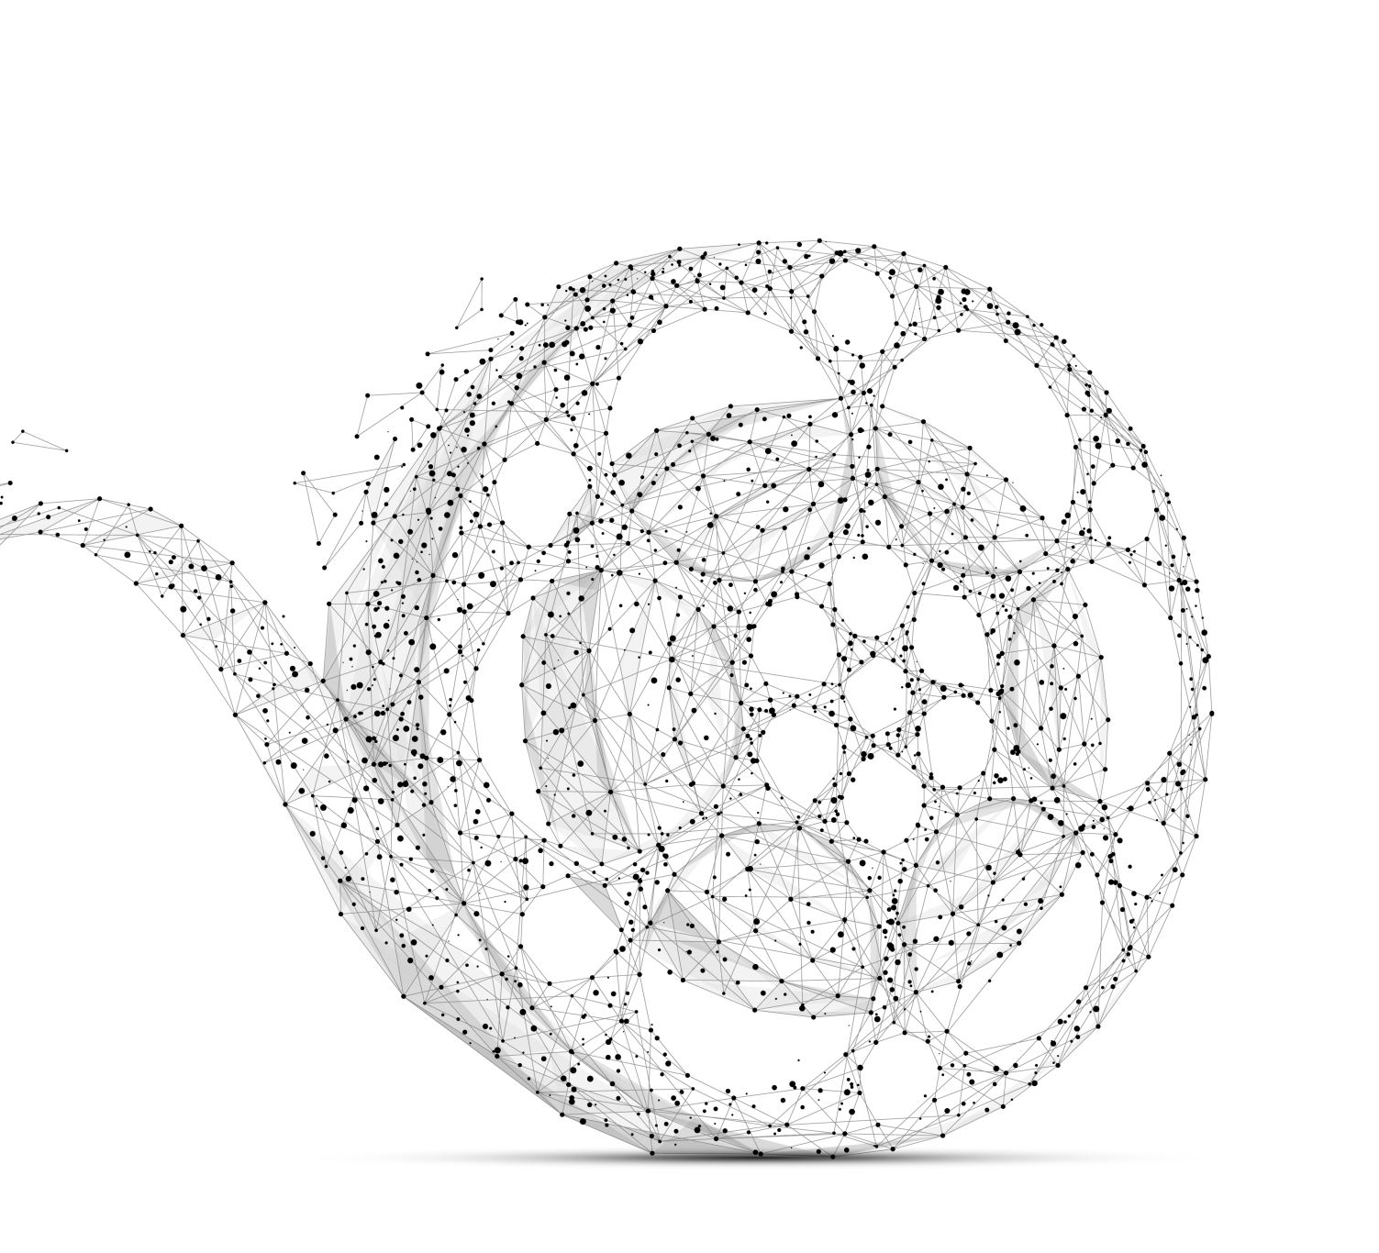
Violence in Movies over Time
Lauren Beard
26 March 2020

Slide 2
Background and Relevance
Violence has increased in movies over time
Established in popular media, psychological, economic, and other academic studies, etc.
Relevant to questions of increased desensitization and violent tendencies
Especially relevant to children and adolescent viewers

Slide 3
What is Violence?
Previous Studies: “visual portrayals of acts of physical aggression by one human or human-like character against another”
World Health Organization: “the intentional use of physical force or power, threatened or actual, against oneself, another person, or against a group or community, which either results in or has a high likelihood of resulting in injury, death, psychological harm, maldevelopment, or deprivation”

Slide 4
Brief Literature Review
American Academy of Family Physicians
Increased levels of violence in movies, video games, and more
Children and adolescents in the U.S. spend an average of about seven and a half hours a day
American Association of Pediatrics
Violence in films has more than doubled since 1950
Gun violence in PG-13-rated movies has tripled since 1985
Fumie Yokota and Kimberly Thompson
Statistically significant increase in the duration of violence
Increased weapons use (e.g. body, sword, poison, gun, explosive, etc.)

Slide 5
Brief Literature Review Cont.
Established studies on the relationship between viewing violence and increased violent or aggressive tendencies (Huesmann 2007)
Josephson: elementary-school boys
Bjorkqvist: preschoolers
Leyens, Parke, Camino, and Berkowitz: older adolescents with histories of delinquency

Slide 6
Project Sample
Davies Corpora: The Movie Corpus
Consists of 200 million words in movie scripts
Time period: 1930-2018
Truncated at the year 1940
Two subsamples:
1940-1960 (N=75)
2000-2020 (N=75)

Slide 7
Violence Keywords
Developed based on literature review and WHO definition of violence
Three categories:
State: ‘die’, ‘dead’, ‘death’
Action: ‘kill’, ‘shoot’
Emotion: ‘afraid’, ‘fuck’

Slide 8
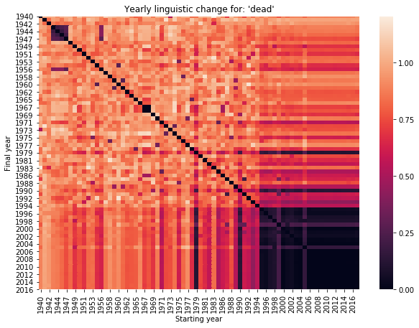
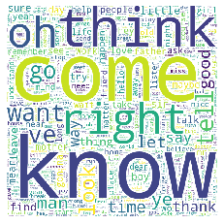
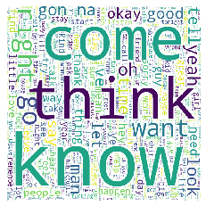
Establishing the Phenomenon
Establish interest in examining earlier movie scripts (1940-1960) in relation to more recent movie scripts (2000-2020).

Slide 9
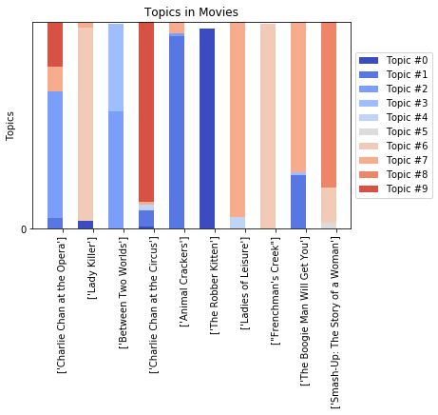
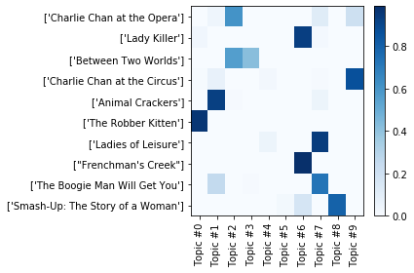
Topic Modeling: 1940-1960
Figure 9. Words within Topics (1940-1960)
 | Topic 0 | Topic 1 | Topic 2 | Topic 3 | Topic 4 | Topic 5 | Topic 6 | Topic 7 | Topic 8 | Topic 9
0 | majesty | uh | johnny | uh | doc | majesty | uh | uh | johnny | majesty
1 | uh | captain | picture | mary | shoot | highness | picture | gentle-man | ma | uh
2 | shoot | police | lie | john | wan | child | majesty | john | gilbert | john
3 | dr | school | uh | child | gun | johnny | child | captain | pa | picture
4 | king | paint | madam | police | sister | goodbye | dr | paint | circus | child
5 | pete | alright | eye | lie | alright | uh | wan | lie | gentle-man | gentle-man
6 | lie | gentle-man | tommy | captain | uh | steve | rock | police | child | circus
7 | guard | horse | captain | gentle-man | mary | papa | ship | child | bye | papa
8 | order | avalan- che | uncle | sister | ta | bye | gentle-man | mary | eye | tommy
9 | hit | doc | mary | george | car | daddy | doc | bye | car | horse

Slide 10
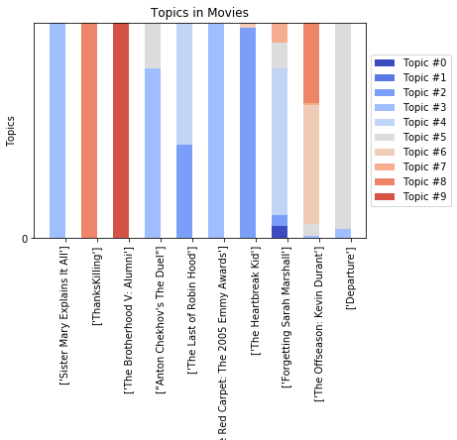
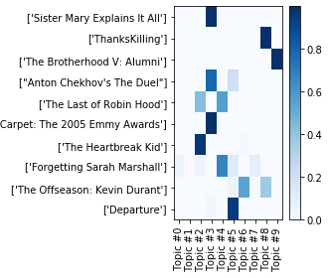
Topic Modeling: 2000-2020
 | Topic 0 | Topic 1 | Topic 2 | Topic 3 | Topic 4 | Topic 5 | Topic 6 | Topic 7 | Topic 8 | Topic 9
0 | buddha | fuck | jerry | song | fuck | fuck | fuck | fuck | johnny | fuck
1 | fuck | ron | fuck | fuck | ron | dude | jerry | tick | billy | betty
2 | george | ralph | lewis | jersus | christmas | shoot | dad | song | darren | shoot
3 | violin | game | dad | vote | dad | dad | princess | dude | kristen | vampire
4 | genre | shoot | sam | die | connor | send | love | ron | turkey | amy
5 | teach | dad | eddie | child | shoot | party | center | shoot | edward | lose
6 | mickey | win | laugh | thomas | truth | lady | lewis | lose | fuck | george
7 | death | medal | honey | lie | dude | fight | charlie | life | die | ted
8 | frank | drive | ride | sin | lose | lose | drive | nell | ali | rock
9 | peter | alright | lose | lose | song | dance | whoa | death | dad | music

Slide 11
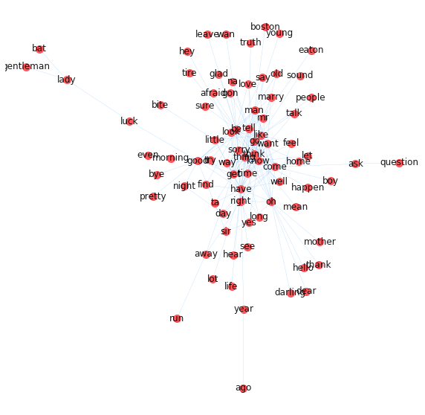
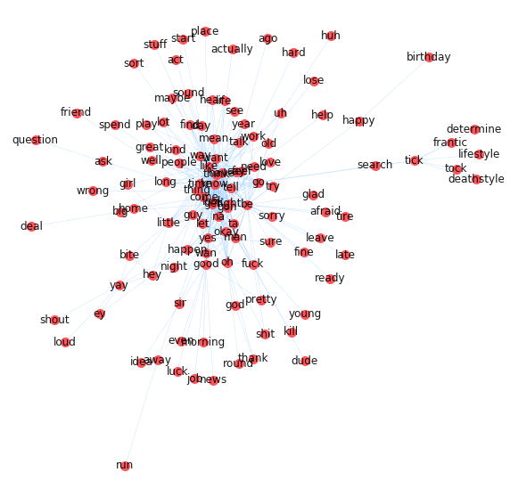
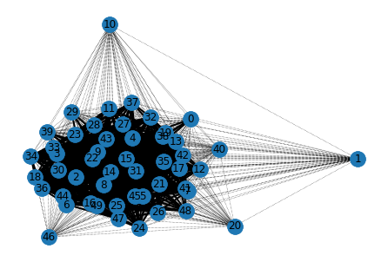
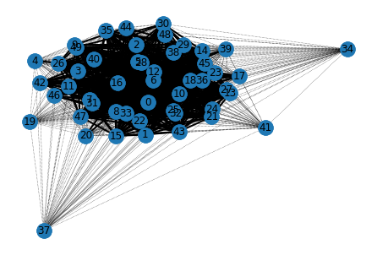
Network Analysis
Notes:
Network analysis
Overall document networks are similar between two time periods
Left 1940-1960 – no violent cluster
Right 2000-2020 – violent cluster

Slide 12
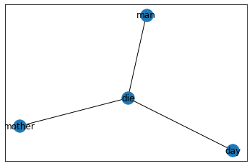
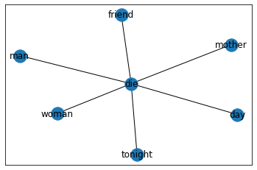
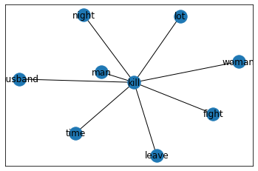
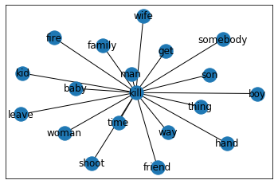
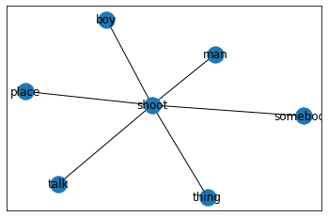
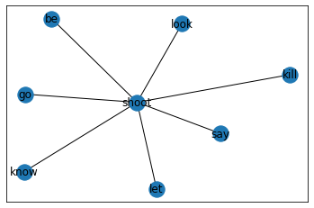
Ego-Centric Networks
Increased number of connections to violent words from time point one to time point two

Slide 13
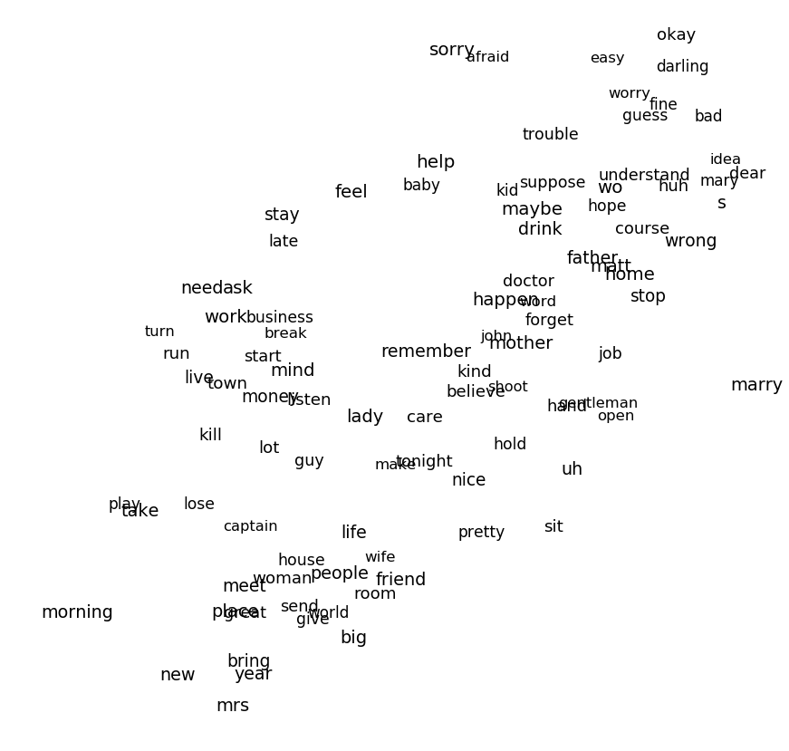
Co-occurrence 1940-1960
Presence of only one violence-related cluster:
kill

Slide 14
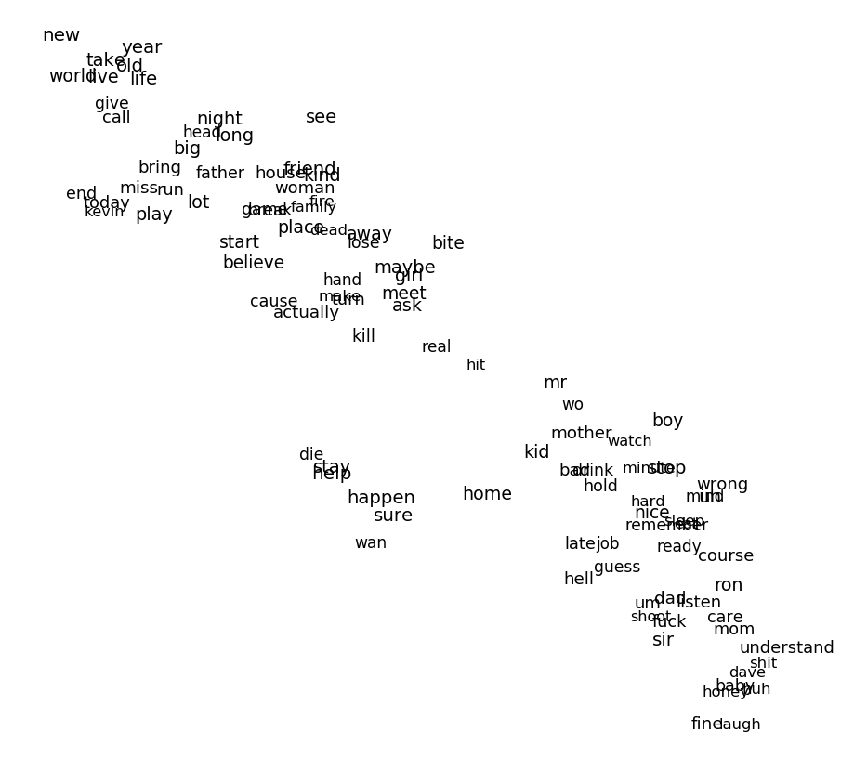
Co-occurrence 2000-2020
Presence of two violence-related clusters:
die-stay-help
shoot-fuck

Slide 15
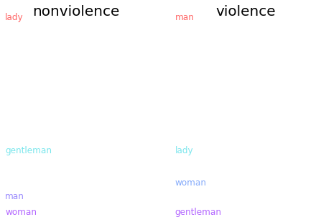
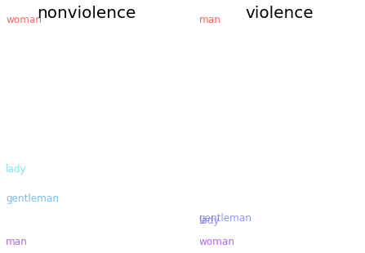
Violence-Gender
Feminine words remain associated with nonviolence
Masculine words remain associated with violence

Slide 16
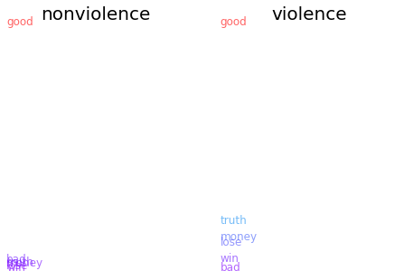
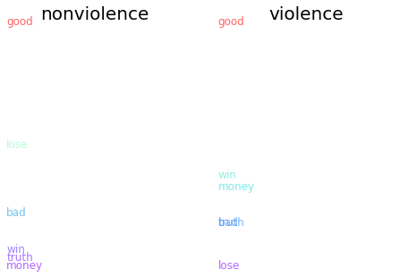
Violence-Incentive
Good remains associated with nonviolence over time. More concepts become associated with nonviolence as well.
Good remains associated with violence over time. Winning becomes more associated with violence, losing less associated.

Slide 17
Text Prediction
"The definition of violence is”:
The definition of violence is to kill. - What's the use of killing? - I don't know. I don't know what it means to kill. (-0.999) | The definition of violence is that it's a way of life. (+0.709)
"Guns are"
Guns are not allowed in the house. - No, no, no. (-0.999) | Guns are not the only thing that makes you feel good. (+0.992)
Fuck who?
Fuck who? - I'm sorry. (-0.999) | Fuck who? - I'm not gonna be able to find you. (-0.999)
Notes:
Text prediction + sentiment scores

Slide 18
Limitations
Only includes movie scripts from the Davies Movie Corpus
Alt.: Previous studies assessed top grossing movies
Only address movies in 1940-1960 and 2000-2020
Alt.: Inclusion of intermediate time periods
Looks at small subset of keywords
Alt.: explicit-only, weapons-only, etc.

Slide 19
Conclusion
Violence has increased in movies over time
Physical and psychological
Similar relationships between violence and gender
Primarily masculine-leaning
Change in relationship between incentives and violence
Particularly for winning/losing

Slide 20
References
Björkqvist Kaj. (1985). Violent films, anxiety and aggression: experimental studies of the effect of violent films on the level of anxiety and aggressiveness in children. Helsinki, Finland: Soc. Scientiarum Fennica.
Bushman, B. J., Jamieson, P. E., Weitz, I., & Romer, D. (2013). Gun Violence Trends in Movies. Pediatrics, 132(6), 1014–1018. doi: 10.1542/peds.2013-1600d
Definition and typology of violence. (2011). Retrieved from https://www.who.int/violenceprevention/approach/definition/en/.
English-Corpora.org. Retrieved from https://www.english-corpora.org/.
Huesmann, L. R. (2007). The Impact of Electronic Media Violence: Scientific Theory and Research. Journal of Adolescent Health, 41(6), S6–13. doi: 10.1016/j.jadohealth.2007.09.005
Josephson, W. L. (1987). Television violence and children's aggression: Testing the priming, social script, and disinhibition predictions. Journal of Personality and Social Psychology, 53(5), 882–890. https://doi.org/10.1037/0022-3514.53.5.882
Leyens, J.-P., Camino, L., Parke, R. D., & Berkowitz, L. (1975). Effects of movie violence on aggression in a field setting as a function of group dominance and cohesion. Journal of Personality and Social Psychology, 32(2), 346–360. doi: 10.1037/0022-3514.32.2.346
Yokota, F., & Thompson, K. M. (2000). Violence in G-Rated Animated Films. Jama, 283(20), 2716–2720. doi: 10.1001/jama.283.20.2716
Violence in the Media and Entertainment (Position Paper). (2019). Retrieved from https://www.aafp.org/about/policies/all/violence-media.html.

