Slide 1
Persistent Political Logics: Geographical Differences and Temporal Continuities within the Women's Movements in Chicago and New York City
Lauren Beard
14 February 2020

Slide 2
Foundational Background
Scholars have shown that organizations are structured by the broad worldviews or discourses of the society in which they are based, but they disagree on whether these worldviews are shaped by macro, social-structural factors or regional, institutionalized belief structures.

Slide 3
Paper Approach
Women's movement in Chicago and New York City from 1900 to 1975
Operationalize worldview by using the concept of political logics.
Typical accounts of U.S. women's movements stress differences between the first and second wave
this article points to the equal importance of city-level differences within each wave and the continuity of these differences over time.

Slide 4
Case Study
The U.S. women's movement is an ideal case study to investigate regional influences versus temporal master frame influences for three reasons
One: as social movements seek to mobilize the public, they typically produce literature outlining their beliefs for public consumption. Unlike the data produced by other types of organizations that may be more secretive, data on the political beliefs of social movements is relatively easy to collect.
Two: the women's movement has a long history that includes the first wave, which was similar to the national and modular movements of the nineteenth century (Buechler 1990), and the second wave, which was a paradigmatic example of the new, identity-based social movements of the 1960s
Three: there was a major debate within the second wave that was exemplified by a geographical divide between Chicago feminists and New York City feminists

Slide 5
Methods
Computational grounded theory
combines the rigor and reproducibility of computer-assisted text analysis with the substantive expertise and ability to interpret brought by human readers.
This method can be used by researchers to identify institutional logics in other domains.
To compare the women's movement along these two dimensions – temporal and geographic – I treat the women's movement as four local fields (Armstrong 2002; Fligstein and McAdam 2012), one in each city in the two periods, the first wave (1848-1920) and the second wave (1964-1984).

Slide 6
Methods Cont.
Grounded theory was developed as a method to systematically and rigorously allow categories and theories to inductively emerge from data.
A combined approach: computational grounded theory -- utilizes computational techniques to make qualitative analysis more reliable and reproducible, but also leverages the interpretive ability of humans via a deep engagement with the text to add interpretation to the computational output.

Slide 7
Methods Cont.
Using vocabularies (for simplicity, here-forward I will refer to as vocabularies as words) as the basic cultural element, the computational grounded theory framework involves three steps.
The first step involves a computational but inductive exploration of the text designed to aid researchers in identifying patterns in the data.
The second technique is Structural Topic Modeling (STM), a form of probabilistic topic modeling which estimates common topics across the full corpus (Roberts et al. 2014).

Slide 8
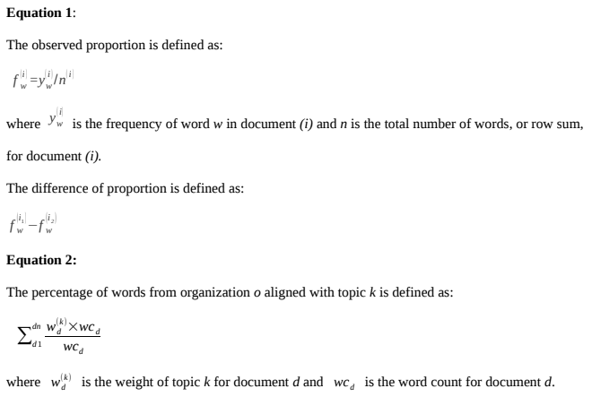
Methods Cont.

Slide 9
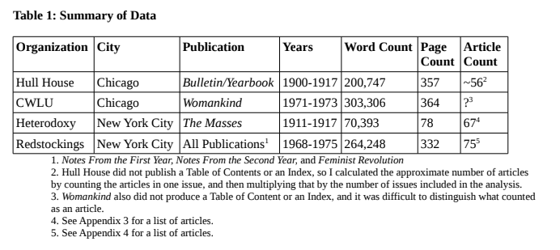
Data
The women's movement fields in these two cities were quite diverse, consisting of close to one hundred women's organizations across the first and second waves.

Slide 10
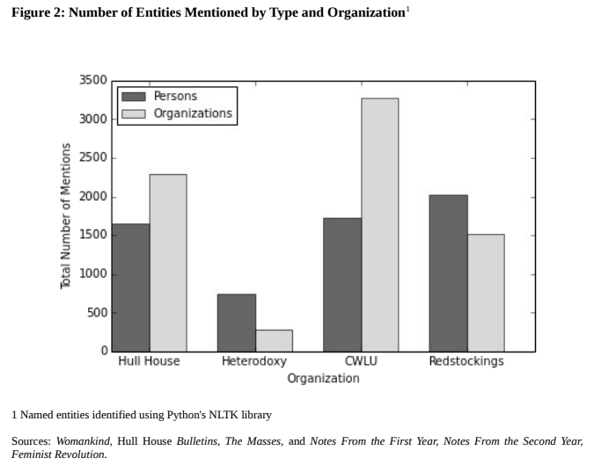
Data Cont.

Slide 11
Findings
The core women's movement organizations in Chicago in both the first and second waves: policy-oriented community
fought to win policy reforms around the concrete needs of the community.
The core women's movement organizations in New York City, again in both waves: narrative-based consciousness-raising
leveraged personal narratives to raise awareness of the social causes of women's oppression and to change society by mobilizing this awareness

Slide 12
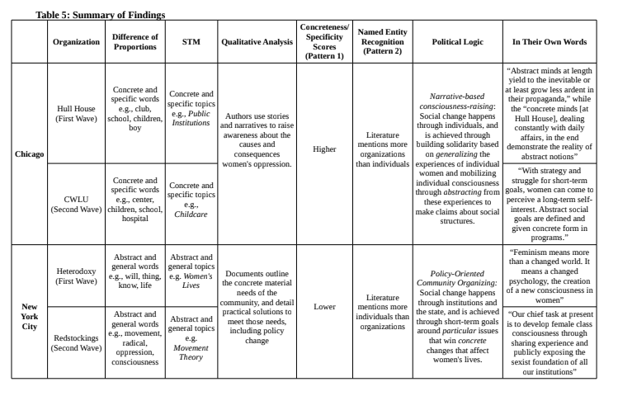
Findings Cont.
Notes:
Text prediction + sentiment scores

Slide 13
Implications
One: otherwise similar social movement organizations may have distinct motivations for action that are shaped by local contexts.
Cities exhibit not only different organizational capacities (Greve and Rao 2012; Molotch, Freudenburg, and Paulsen but also distinct models of political action

Slide 14
Implications Cont.
Two: city-based differences that were institutionalized in the early 1900s persisted through the 1950s post-industrial shift that according to some, fundamentally changed the nature of social movements

Slide 15
Implications Cont.
Three: challenges the commonly accepted history of U.S. feminist movements that identifies a temporal disruption as a leading factor producing the unique second wave feminism
instead show that women's organizations in New York City in both waves were more similar to rather than different from each other, and that these organizations were distinct from their counterparts in Chicago in both waves.
suggests a fundamentally new historical account of U.S. women's movements.

Slide 16
Discussion & Conclusion
There is an ongoing question plaguing organizational and cultural scholars: are organizations shaped by homogeneous macro social-structural beliefs that shift over time, or by institutionalized and heterogeneous local beliefs that persist over time?
The evidence uncovered suggests that, despite changes and progress made by the women's movement over time, the core women's movement organizations in New York City and Chicago embodied fundamentally oppositional political logics that persisted between the first and second wave and the social-structural changes that are said to have produced the “new” social movements of the 1960s.

Slide 17
Discussion & Conclusion Cont.
Identifying these persistent political logics has historical, theoretical, and methodological implications.
Historically, this analysis profoundly challenges our understanding of U.S. women's movements.
First, it decenters the new left, anti-war, and civil rights movements as the main explanation for the structure and political content of women's liberation groups.
Second, while the wave metaphor used to describe U.S. women's movements is useful in some respects—for example drawing attention to periods of heightened collective political action—this metaphor has served to mask systematic within-wave differences and between-wave continuities.

Slide 18
Discussion & Conclusion Cont.
This conclusion does not mean that organizations in the 1970s were replicas of organizations in the 1910s. The second wave women's movement organizations analyzed here unquestionably achieved significant tactical and political innovation and are rightly remembered for this.

Slide 19
Limitations
One: show that embodied political logics persist over time but does not examine the mechanisms of persistence.
Two: does not examine why these cities adopted particular political styles in the first place.
Three: restriction to four core organizations in two cities.

Slide 20
References
Nelson, Laura K. (n.d.). Persistent Political Logics: Geographical Differences and Temporal Continuities within the Women's Movements in Chicago and New York City.

