Slide 1

MALLAREDDY UNIVERSITY
DEPARTMENT OF CYBER SECURITY
Smartify: Transforming Traditional Appliances into Smart Devices for Seamless Home Automation
Batch No. : 07
Team Details :
2011CS040018 Ch. Venkata Vishnu Vardhana Raju
2011CS040019 D. Akshaya
2011CS040027 J. Shiva Kumar Reddy
2011CS040036 K. Nikhitha
Guided By :
V Vijaykumar Dasari
Assistant Professor

Slide 2
Table of Contents
Abstract
1. Introduction
1.1 Problem Definition & Description
1.2 Objectives of the Project
1.3 Scope of the project
2. System Analysis
2.1 Existing System
2.2 Proposed System
2.3 Software & Hardware Requirements
2.4 Feasibility Study

Slide 3
Table of Contents
3.Architectural Design
3.1 Modules Design
3.2 Method & Algorithm Design
3.3 Project Architecture
4. Implementation & Testing
4.1 Coding Blocks
4.2 Sample Code
4.3 Execution Flow
4.4 Testing

Slide 4
Table of Contents
5. Results
5.1 Result Screens
5.2 Result Analysis
6. Conclusions & Future scope
6.1 Conclusion
6.2 Future Scope

Slide 5
Abstract
Smartify proposes a cost-effective solution to upgrade conventional household appliances into smart devices, enabling seamless control and management through a mobile application. In today's era of IoT (Internet of Things) and home automation, the demand for smart appliances continues to rise. However, many households still possess non-Wi-Fi enabled devices, limiting their integration into smart home ecosystems. Smartify bridges this gap by providing a retrofitting solution that empowers users to convert their existing appliances into smart devices without the need for expensive replacements. The project focuses on leveraging smart plugs and switches to enable remote control of power supply to various appliances such as air conditioners, televisions, lamps, and more. By incorporating Wi-Fi connectivity and integrating with a dedicated mobile application, users gain the ability to monitor and manage their appliances from anywhere, at any time. The intuitive user interface of the Smartify app offers features such as scheduling, energy monitoring, and personalized settings, enhancing convenience and efficiency in household operations.
Implementation involves straightforward installation procedures, ensuring accessibility for users with varying technical expertise. Additionally, the system prioritizes security measures to safeguard user data and protect against unauthorized access. Smartify represents a practical and scalable solution for modernizing homes and transitioning towards smart living environments.

Slide 6
1.Introduction
1.1 Problem Specification & Description
Problem Specification
Non-Wi-Fi Enabled Appliances
Integration Limitations
Technological Gap
User Accessibility Challenges
Problem Description
Manual Operation Hassles
Energy Inefficiency
Market Demand Discrepancy
Convenience Gap

Slide 7
1.2 Objectives of the project
Aim of the Project
Cost-Effective Retrofitting
Enhanced User Experience
Seamless Integration
Accessible Control
Tasks and Deliverables
Retrofitting Solution Development
Mobile Application Creation
Integration with Smart Plugs and Switches
User Training and Documentation

Slide 8
1.2 Objectives of the project
Aim of the Project
Cost-Effective Retrofitting
Enhanced User Experience
Seamless Integration
Accessible Control
Tasks and Deliverables
Retrofitting Solution Development
Mobile Application Creation
Integration with Smart Plugs and Switches
User Training and Documentation

Slide 9
1.3 Scope of the project
Determining Goals
Clear Objectives Establishment
Stakeholder Engagement
Timeline and Milestone Definition
Resource Allocation
Data & Constraints
User Preferences Analysis
Appliance Compatibility Assessment
Budget and Technical Limitations
Data Privacy and Security Measures
Workflow Management Strategies
Agile Development Methodology
Regular Progress Evaluation
Stakeholder Collaboration Channels
Risk Management

Slide 10
2.System Analysis
2.1 Existing System:
Conventional Household Appliances: Many households rely on conventional appliances that lack smart capabilities and Wi-Fi connectivity.
Limited Integration: Due to the absence of Wi-Fi connectivity, these non-smart appliances cannot be seamlessly integrated into smart home ecosystems.
High Replacement Costs: Traditional methods of upgrading to smart appliances involve expensive replacements, which may not be feasible for all users.
Lack of Remote Control: Users are unable to remotely control and manage their non-smart appliances, resulting in limited convenience and efficiency in household operations.

Slide 11
1.3 Scope of the project
Determining Goals
Clear Objectives Establishment
Stakeholder Engagement
Timeline and Milestone Definition
Resource Allocation
Data & Constraints
User Preferences Analysis
Appliance Compatibility Assessment
Budget and Technical Limitations
Data Privacy and Security Measures
Workflow Management Strategies
Agile Development Methodology
Regular Progress Evaluation
Stakeholder Collaboration Channels
Risk Management

Slide 12
2.System Analysis
2.1 Existing System:
Conventional Household Appliances: Many households rely on conventional appliances that lack smart capabilities and Wi-Fi connectivity.
Limited Integration: Due to the absence of Wi-Fi connectivity, these non-smart appliances cannot be seamlessly integrated into smart home ecosystems.
High Replacement Costs: Traditional methods of upgrading to smart appliances involve expensive replacements, which may not be feasible for all users.
Lack of Remote Control: Users are unable to remotely control and manage their non-smart appliances, resulting in limited convenience and efficiency in household operations.

Slide 13
Background & Literature Survey (Existing System):
Rise of Smart Home Technology: The advent of smart home technology has revolutionized the way households manage their appliances and interact with their living spaces.
Evolution of IoT: The Internet of Things (IoT) has played a pivotal role in enabling connectivity and communication between devices, facilitating the creation of smart home ecosystems.
Research on Retrofitting Solutions: Existing literature has explored various retrofitting solutions aimed at upgrading conventional appliances into smart devices, addressing the limitations posed by non-smart appliances.
User Adoption Patterns: Studies have examined user preferences and adoption patterns regarding smart home technology, highlighting the growing demand for seamless integration and remote control functionalities

Slide 14
Limitations of Existing System:
Technological Obsolescence: Conventional appliances without smart capabilities risk becoming obsolete in the rapidly advancing landscape of smart home technology.
Interoperability Challenges: The lack of standardized communication protocols may lead to compatibility issues when attempting to integrate non-smart appliances into existing smart home ecosystems.
Financial Constraints: High costs associated with replacing conventional appliances with smart alternatives may deter users from adopting smart home solutions.
User Experience Limitations: The absence of remote control features hinders users' ability to efficiently manage and monitor their appliances, compromising convenience and efficiency in household operations.

Slide 15
2.2 Proposed System:
Smartify offers a comprehensive retrofitting solution designed to upgrade conventional household appliances into smart devices, addressing the growing demand for smart home automation while overcoming the limitations of non-Wi-Fi enabled devices.
The proposed system leverages smart plugs and switches to enable remote control of power supply to various appliances, including air conditioners, televisions, lamps, and more.
By incorporating Wi-Fi connectivity and integrating with a dedicated mobile application, Smartify empowers users to seamlessly monitor and manage their appliances from anywhere, at any time.

Slide 16
Advantages of Proposed System
Cost-Effectiveness: Smartify offers a cost-effective solution for upgrading conventional appliances into smart devices without the need for expensive replacements. This makes smart home technology more accessible to a wider range of users, regardless of their budget constraints.
Seamless Integration: By leveraging smart plugs and switches, Smartify enables the seamless integration of non-Wi-Fi enabled appliances into existing smart home ecosystems. This ensures that users can enjoy the benefits of smart technology without having to replace their entire appliance inventory.
Remote Control and Monitoring: With Smartify's dedicated mobile application and Wi-Fi connectivity, users gain the ability to remotely control and monitor their appliances from anywhere, at any time. This enhances convenience and flexibility in managing household operations, even when users are away from home.
Intuitive User Interface: The Smartify app offers an intuitive user interface with features such as scheduling, energy monitoring, and personalized settings. This enhances user experience by providing easy access to essential functions and customization options, further improving convenience and efficiency in household operations.

Slide 17
2.3 Software & Hardware Requirements
Software Requirements:
IDE (Integrated Development Environment): An IDE such as Arduino IDE is required for coding and programming the ESP32 microcontroller.
Hardware Requirements:
ESP32
5V Relays
5V AC to DC Power Supply
Screw Terminal 3-pin Connectors
Jumping Wires

Slide 18
2.4 Feasibility Study
Technical Feasibility:
Smartify's technical feasibility lies in its ability to effectively retrofit non-Wi-Fi enabled appliances with smart functionality using smart plugs and switches. The integration of Wi-Fi connectivity and a dedicated mobile application ensures seamless control and monitoring of appliances from anywhere, enhancing user convenience. The straightforward installation procedures make it accessible to users with varying technical expertise, contributing to its technical feasibility.
Robustness & Reliability:
Smartify's robustness and reliability are ensured through its implementation of security measures to safeguard user data and protect against unauthorized access. Additionally, the system's focus on leveraging established technologies like Wi-Fi connectivity and smart plugs ensures stability and reliability in its operation. This robustness and reliability make Smartify a dependable solution for modernizing homes.

Slide 19
Economic Feasibility:
Smartify's economic feasibility is evident in its cost-effective approach to upgrading conventional appliances into smart devices. By offering a retrofitting solution that eliminates the need for expensive replacements, Smartify makes smart home technology more accessible to a wider range of users. Furthermore, the potential energy savings and efficiency enhancements offered by Smartify contribute to its economic feasibility by providing long-term value to users.

Slide 20
3.Architectural Design
3.1 Modules Design
3.1.1 Data Pre-processing
1. Data Retrieval: Extract raw data from Firebase Realtime Database in JSON format.
2. Parsing JSON: Parse the JSON data to extract relevant information and attributes.
3. Data Conversion: Convert necessary data fields to appropriate variable types, such as integers or strings, based on their usage.
4.Variable Assignment: Store the parsed data into variables, ensuring each variable holds the correct data type for efficient processing.

Slide 21
3.Architectural Design
3.1 Modules Design
3.1.1 Data Pre-processing
Non-Wi-Fi Enabled Appliances
Integration Limitations
Technological Gap
User Accessibility Challenges
Problem Description
Manual Operation Hassles
Energy Inefficiency
Market Demand Discrepancy
Convenience Gap

Slide 22
3.1.2 Connection Establishment Module:
Responsible for establishing a connection to the local Wi-Fi network.
Enables the device to communicate with the Firebase database over the internet.
Ensures that the device has internet access for data exchange.
3.1.3 Authentication and Streaming Module:
Manages communication with the Firebase Realtime Database (RTDB).
Handles authentication with the Firebase server using API keys and authentication tokens.
Facilitates reading, writing, and updating data in the Firebase RTDB.
Utilizes stream callbacks to receive real-time updates from the database.
3.1.4 Authentication and Authorization Token Generation and Management Module:
Assists in the generation and management of authentication tokens required for Firebase authentication.
Ensures secure authentication and authorization of the device with the Firebase server.
3.1.5 RTDB Helper Module:
Provides helper functions for handling Realtime Database (RTDB) operations effectively.
Helps in parsing and processing RTDB payloads received from the Firebase server.

Slide 23
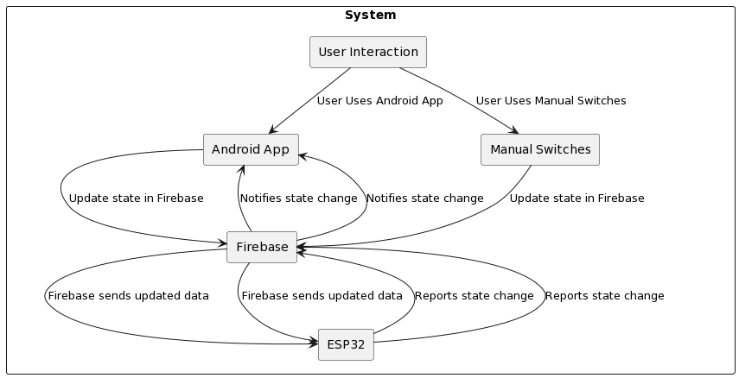
3.2 Project Architecture
3.2.1 Complete Architecture (Block Diagram)

Slide 24
Manages stream callbacks to handle real-time data updates from the database.
3.1.6 GPIO Module:
Controls the General Purpose Input/Output (GPIO) pins of the microcontroller.
Manages the interface with relay and switch components connected to the GPIO pins.
Allows the microcontroller to toggle the state of relays based on commands received from the Firebase RTDB.
3.1.7 User Interface Module (Implicit):
Although not explicitly defined in the provided code, the user interface could be implemented through a mobile or web application.
Users interact with the home automation system through the user interface, sending commands to the Firebase RTDB.
The Firebase Module receives these commands and triggers GPIO actions accordingly, controlling the home appliances.
3.1.8 IR remote Module:
This module is responsible for processing IR remote control signals received by the system and translating them into actions to control various appliances or devices connected to the system

Slide 25
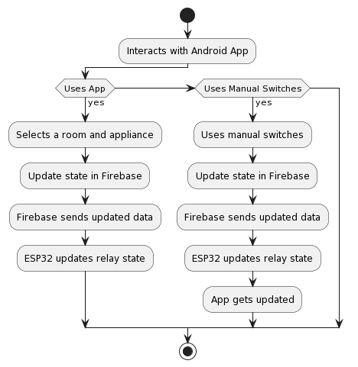
3.2.2 Data Flow / Process Flow Diagrams

Slide 26
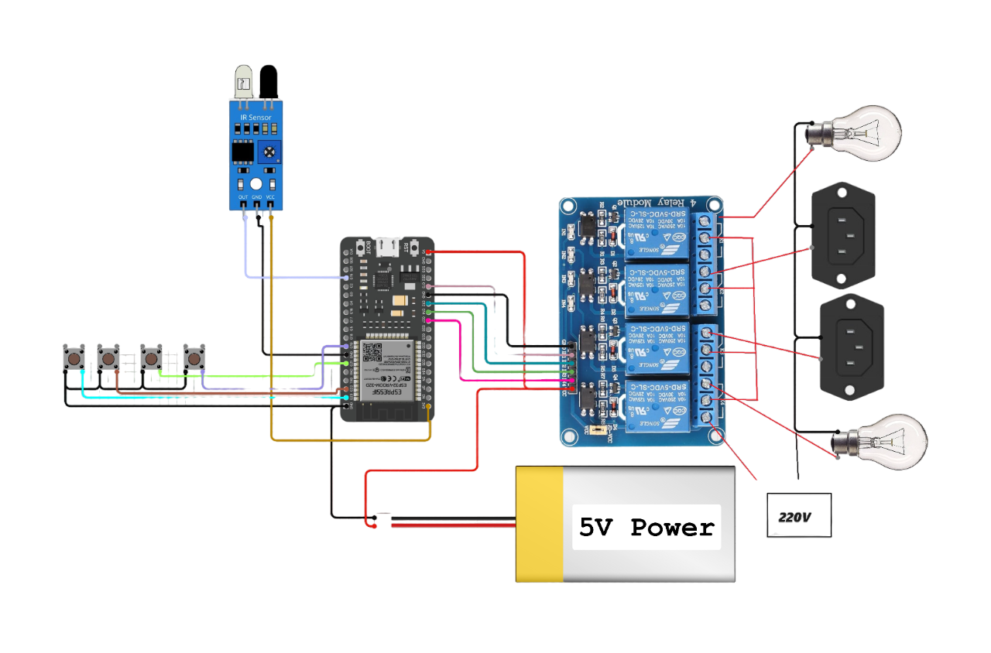
3.2 Project Architecture
3.2.1 Complete Architecture (Block Diagram)

Slide 27
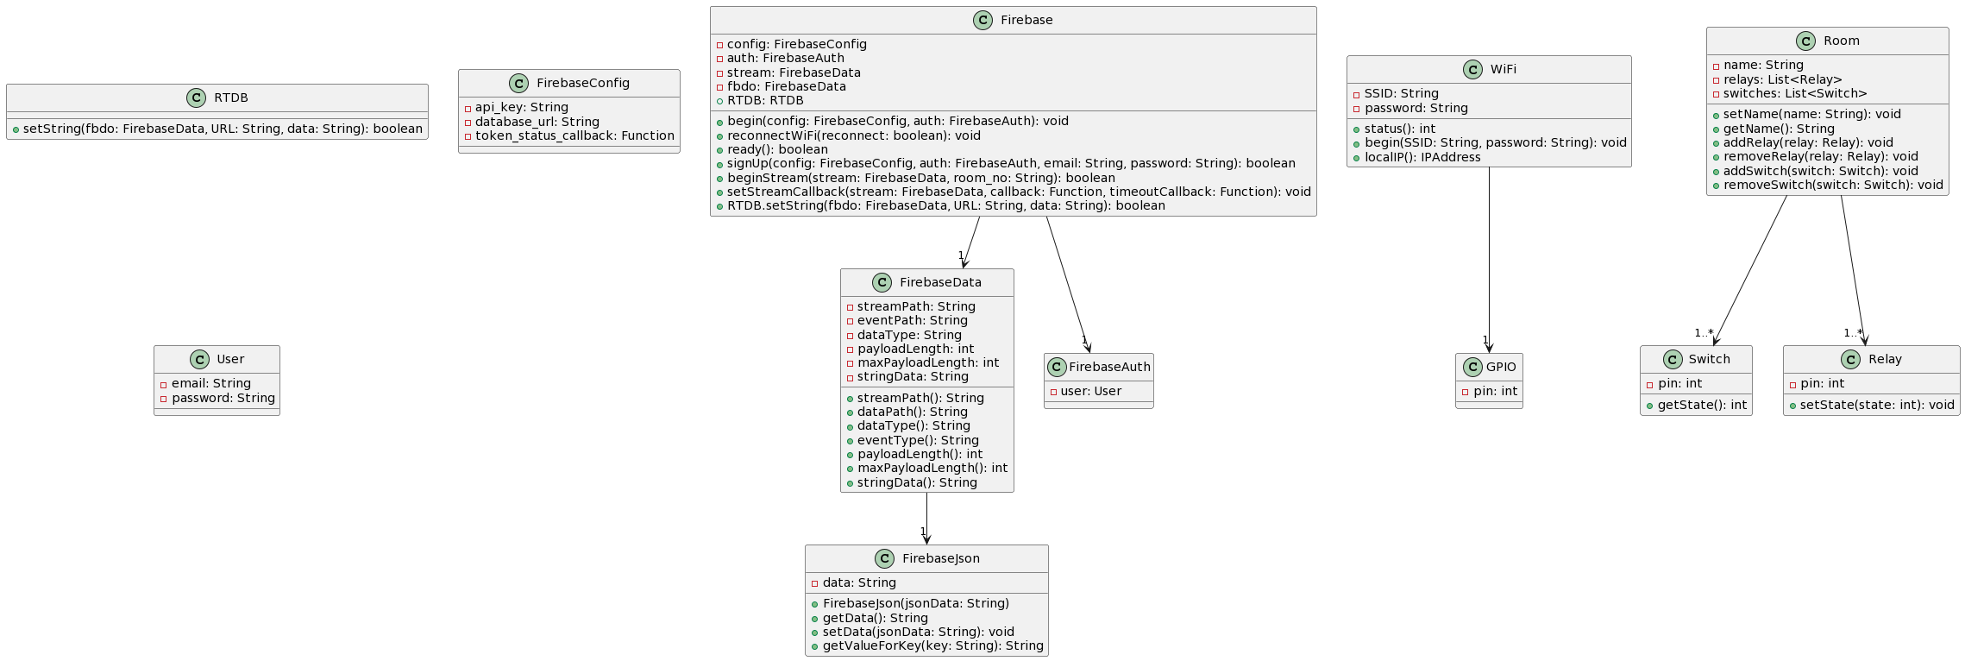
3.2.3 Class Diagram

Slide 28
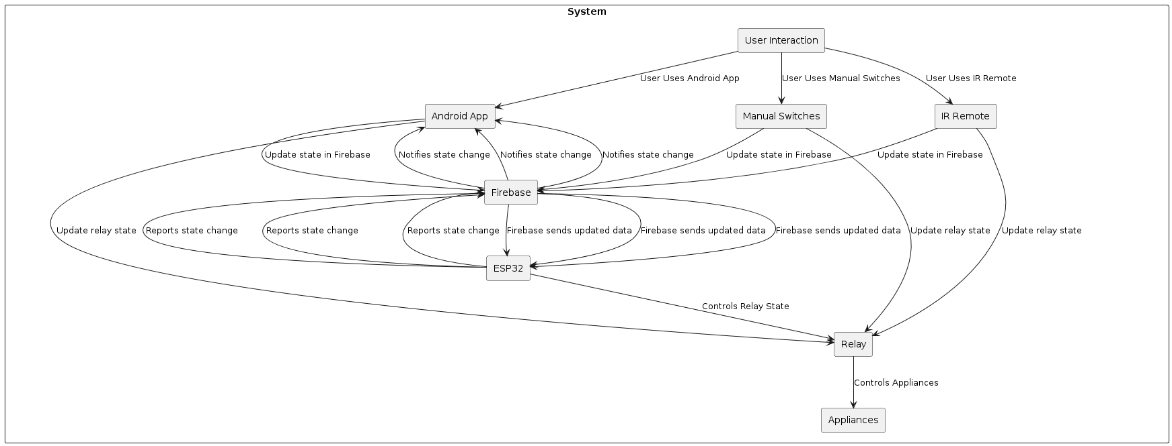
3.2 Project Architecture

Slide 29
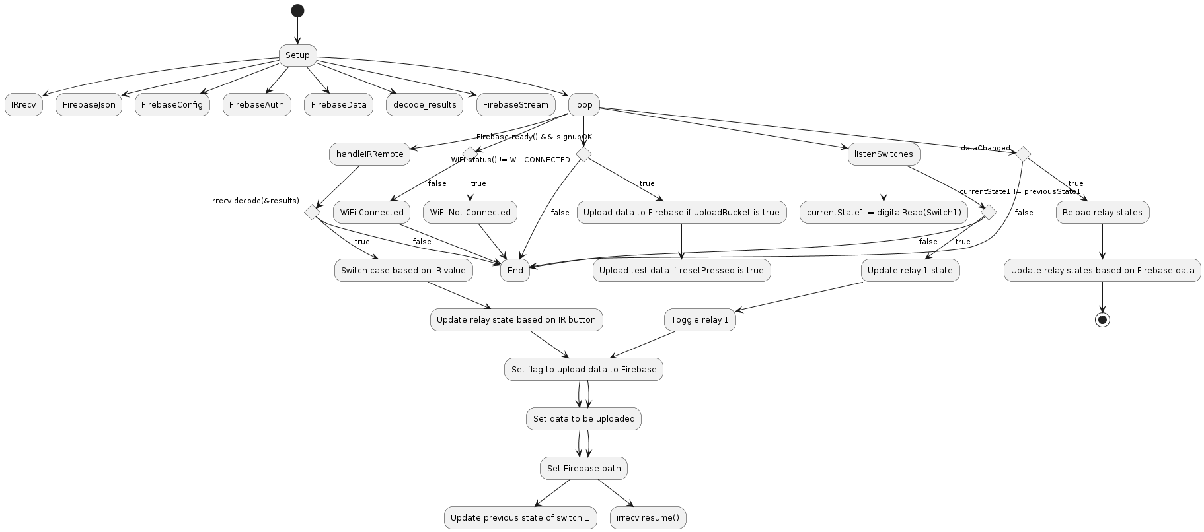
3.2.1 Data Flow / Process Flow Diagrams

Slide 30
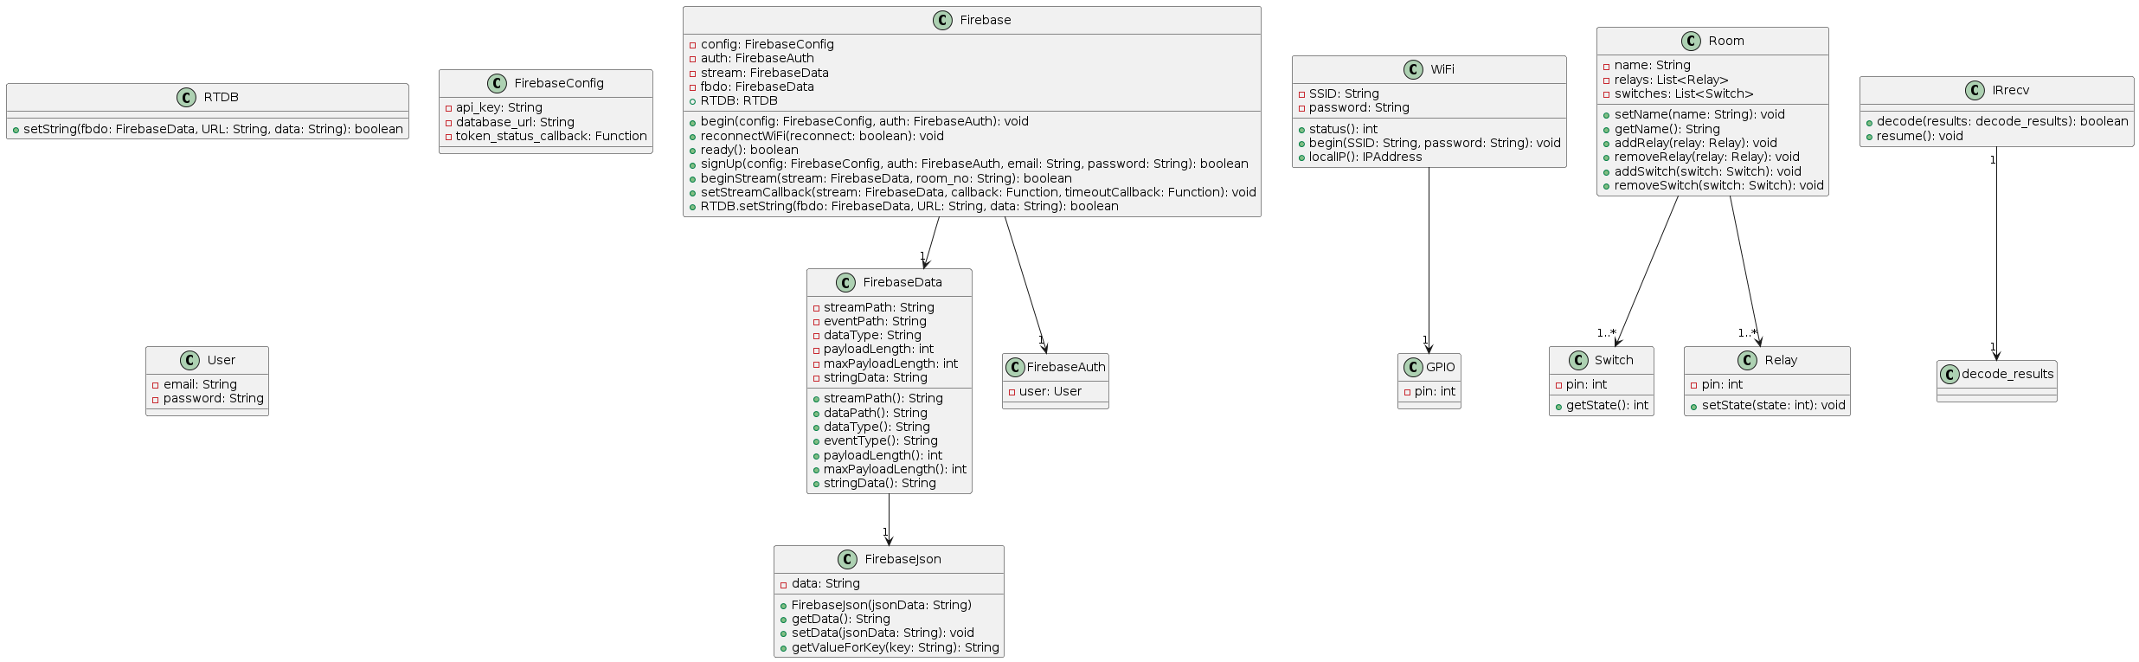
3.2.2 Class Diagram

Slide 31
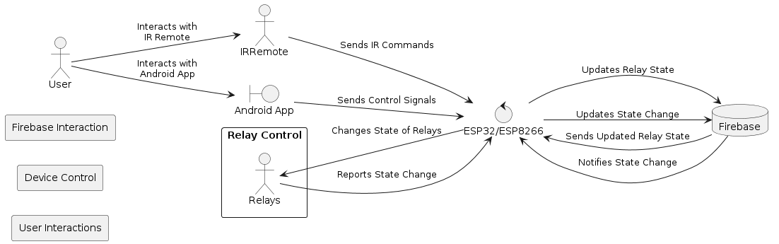
3.2.3 Use case Diagram

Slide 32
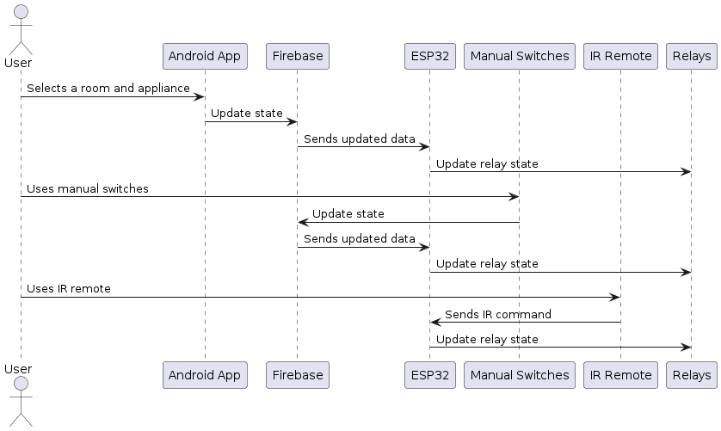
3.2.4 Sequence Diagram

Slide 33
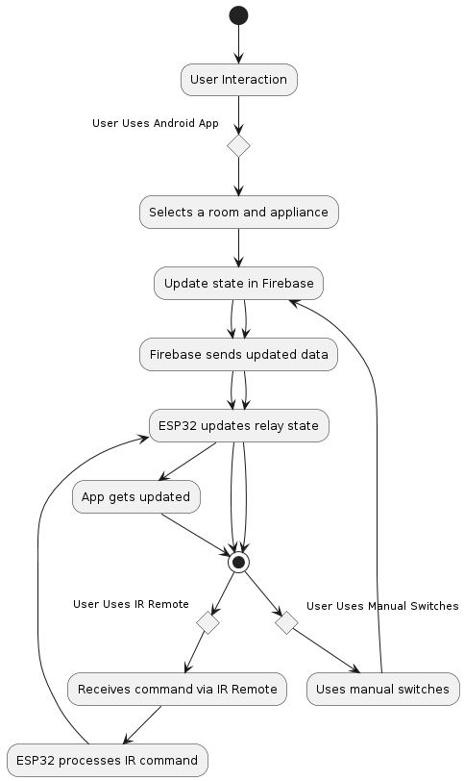
3.2.5 Activity Diagram

Slide 34
4.Implementation
4.1 Sample Code
void setup()
{
Serial.begin(115200);
//-----------------------------------------------------------------------
pinMode(Relay1, OUTPUT); digitalWrite(Relay1, LOW);
pinMode(Relay2, OUTPUT); digitalWrite(Relay2, LOW);
pinMode(Relay3, OUTPUT); digitalWrite(Relay3, LOW);
pinMode(Relay4, OUTPUT); digitalWrite(Relay4, LOW);
pinMode(WIFI_LED, OUTPUT);
pinMode(Switch1, INPUT_PULLUP);
pinMode(Switch2, INPUT_PULLUP);
pinMode(Switch3, INPUT_PULLUP);
pinMode(Switch4, INPUT_PULLUP);
//-----------------------------------------------------------------------
WiFi.begin(WIFI_SSID, WIFI_PASSWORD);
Serial.print("Connecting to Wi-Fi");

Slide 35
4.1 Sample Code
while (WiFi.status() != WL_CONNECTED)
{
Serial.print(".");
delay(300);
}
Serial.println();
Serial.print("Connected with IP: ");
Serial.println(WiFi.localIP());
Serial.println();
//-----------------------------------------------------------------------
Serial.printf("Firebase Client v%s\n\n", FIREBASE_CLIENT_VERSION);
/* Assign the api key (required) */
config.api_key = API_KEY;
/* Assign the RTDB URL (required) */
config.database_url = DATABASE_URL;
/* Assign the callback function for the long running token generation task */
config.token_status_callback = tokenStatusCallback; //see addons/TokenHelper.h
//-----------------------------------------------------------------------
/*Or Sign up */

Slide 36
4.1 Sample Code
if (Firebase.signUp(&config, &auth, "", "")){
Serial.println("Firebase signUp ok");
signupOK = true;
}
else{
Serial.printf("%s\n", config.signer.signupError.message.c_str());
}
//-----------------------------------------------------------------------
//-----------------------------------------------------------------------
Firebase.begin(&config, &auth);
Firebase.reconnectWiFi(true);
//-----------------------------------------------------------------------
//Recommend for ESP8266 stream, adjust the buffer size to match your stream data size
#if defined(ESP8266)
stream.setBSSLBufferSize(2048 /* Rx in bytes, 512 - 16384 */, 512 /*

Slide 37
4.1 Sample Code
Tx in bytes, 512 - 16384 */);
#endif
//-----------------------------------------------------------------------
if (!Firebase.RTDB.beginStream(&stream, room_no))
Serial.printf("sream begin error, %s\n\n", stream.errorReason().c_str());
//-----------------------------------------------------------------------
Firebase.RTDB.setStreamCallback(&stream, streamCallback, streamTimeoutCallback);
//-----------------------------------------------------------------------
}

Slide 38
4.2 Coding Blocks
1.Setup Initialization Block: void setup() {
// Initialize Serial communication
Serial.begin(115200);
// Initialize GPIO pins for relays, switches, and WiFi LED
pinMode(Relay1, OUTPUT);
pinMode(Relay2, OUTPUT);
pinMode(Relay3, OUTPUT);
pinMode(Relay4, OUTPUT);
pinMode(WIFI_LED, OUTPUT);
pinMode(Switch1, INPUT_PULLUP);
pinMode(Switch2, INPUT_PULLUP);
pinMode(Switch3, INPUT_PULLUP);
pinMode(Switch4, INPUT_PULLUP); // Connect to WiFi connectToWiFi(); // Initialize Firebase configuration initFirebase(); // Begin Firebase Realtime Database stream beginFirebaseStream()

Slide 39
2. WiFi Connection Check Block:
void connectToWiFi() {
WiFi.begin(WIFI_SSID, WIFI_PASSWORD);
Serial.print("Connecting to Wi-Fi");
while (WiFi.status() != WL_CONNECTED) {
Serial.print(".");
delay(300);
}
Serial.println();
Serial.print("Connected with IP: ");
Serial.println(WiFi.localIP());
Serial.println(); }
3. Firebase Initialization Block:
void initFirebase() {
// Configure Firebase API key and database URL
config.api_key = API_KEY;
config.database_url = DATABASE_URL;
// Initialize Firebase client Firebase.begin(&config, &auth);
Firebase.reconnectWiFi(true);
}

Slide 40
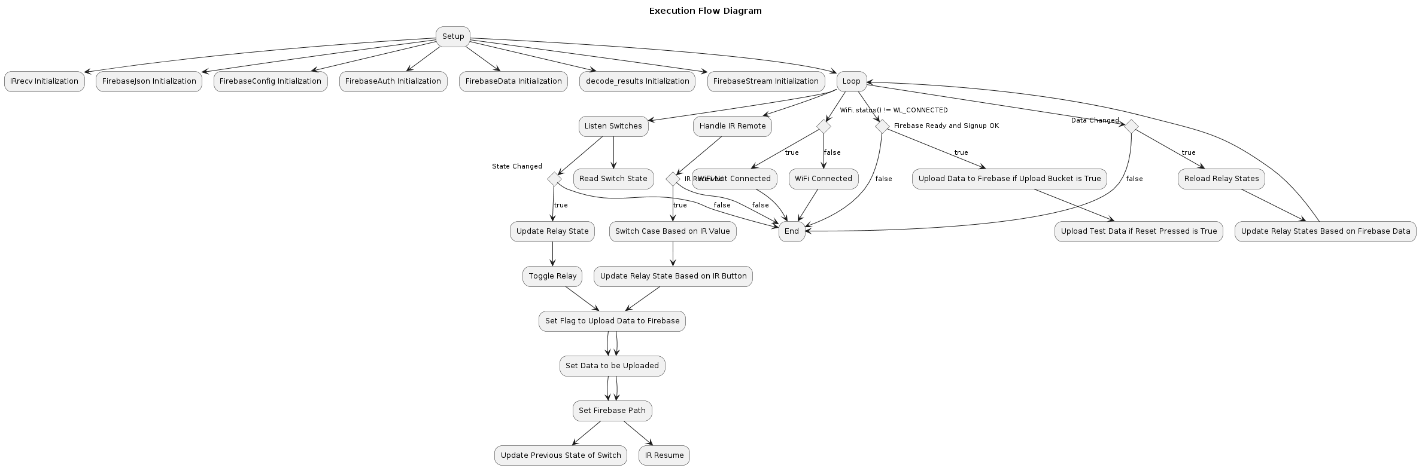
4.3 Execution Flow

Slide 41
4.4 Testing
Scenario: Turning on an appliance using a manual switch.
Test Case: This test verifies that the manual switch effectively activates the appliance.
Expected Result: Upon toggling the manual switch to the "on" position, the appliance should power on, and its corresponding status should be updated in both the Android app and IR remote interfaces.
Scenario: Turning off an appliance using the IR remote after it was turned on using a manual switch.
Test Case: This test ensures that the IR remote can deactivate the appliance after it was initially activated using the manual switch.
Expected Result: After turning on the appliance via the manual switch, using the IR remote to send a "power off" command should successfully switch off the appliance. The status update should reflect in both the Android app and manual switch.
Scenario: Turning off an appliance using the Android app after it was turned on using a manual switch.
Test Case: This test validates that the Android app can control the appliance state after it was

Slide 42
4.4 Results & Testing
initially turned on using the manual switch.
2. Expected Result: Following the manual switch activation of the appliance, utilizing the Android app to issue a "power off" command should effectively turn off the appliance. The status update should propagate to both the IR remote and manual switch interfaces.
4.Scenario: Ensuring status synchronization between all control methods.
Test Case: This test guarantees that the status updates are accurately synchronized across all control interfaces.
Expected Result: Upon turning on the appliance using the manual switch, the Android app and IR remote should promptly update to reflect the appliance's powered-on state. Similarly, any changes made via the Android app or IR remote should be immediately mirrored in the other interfaces.
5.Scenario: Turning on and off an appliance using different control methods interchangeably.
Test Case: This test examines the seamless interchangeability of control methods in activating and deactivating the appliance.
Expected Result: Performing multiple cycles of turning the appliance on and off using various methods (manual switch, IR remote, Android app) should consistently update the appliance status across all interfaces, ensuring reliable and synchronized control.

Slide 43
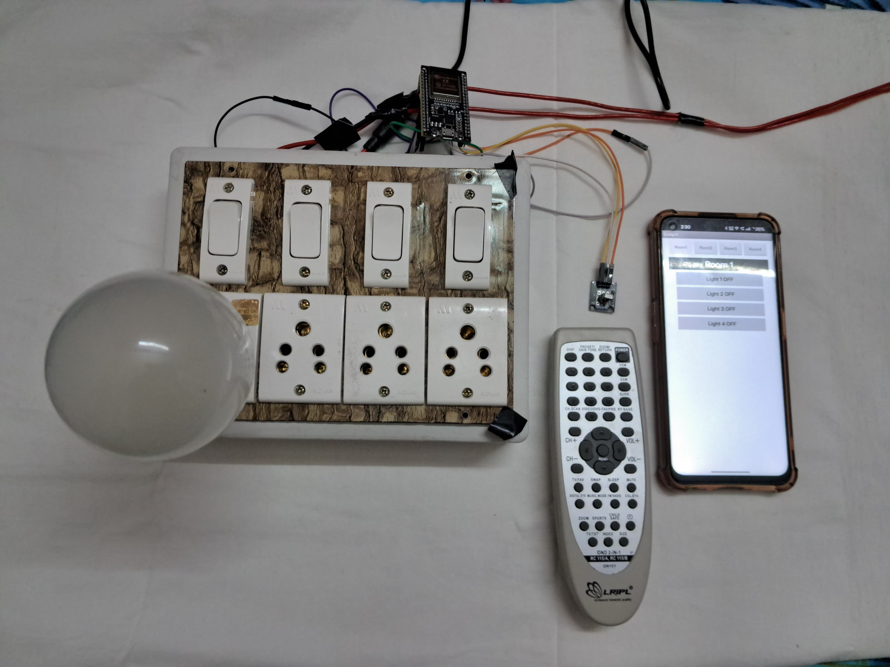
5.Results
5.1 Results Screen

Slide 44
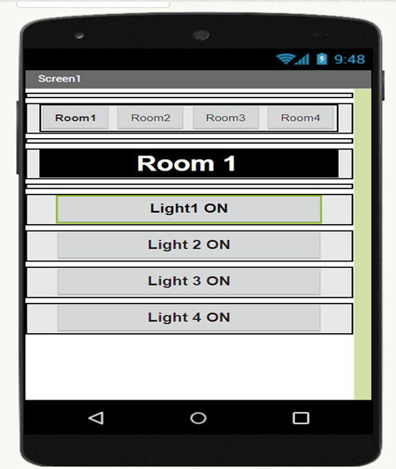
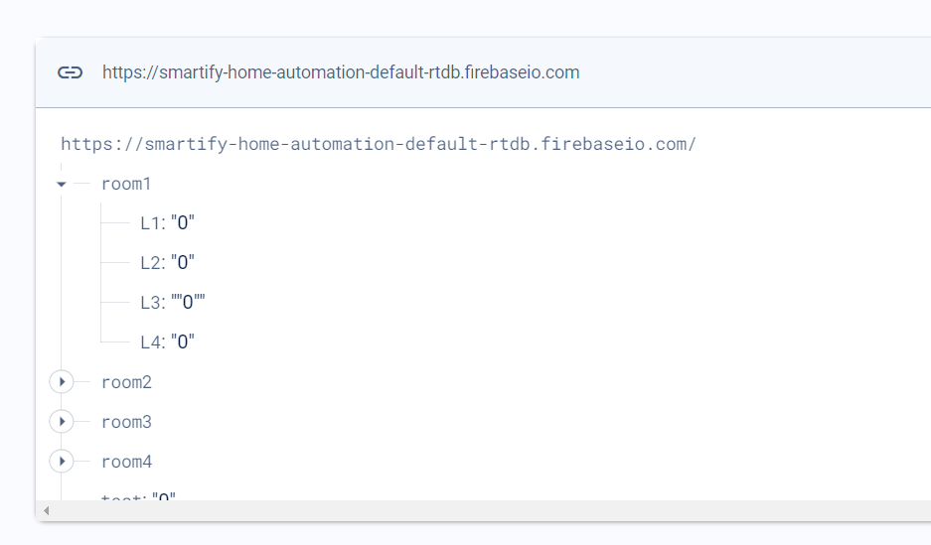
5.Results
5.1 Results Screen

Slide 45
5.2 Result Analysis
1. Test Results:
All test cases were executed successfully, demonstrating the core functionalities of the Samartify appliance control system.
The manual switches, IR remote, and Android app were all able to control the appliances effectively.
Synchronization between control methods was verified, with updates in one interface reflecting accurately in the others.
2. Analysis:
Functionality Validation:
The successful execution of test cases confirms that each method of appliance control (manual switches, IR remote, and Android app) works as intended.
Interchangeable Usage:
Users have the flexibility to use any of the three methods interchangeably to control their appliances. This enhances user convenience and accessibility.

Slide 46
5.2 Result Analysis
Status Synchronization:
The synchronization of appliance status across all control interfaces ensures a consistent user experience. Users can rely on any interface to accurately reflect the current state of their appliances.
System Flexibility:
The system's ability to accommodate different control methods reflects its flexibility and adaptability to user preferences.
User Experience:
With seamless integration between physical switches and digital interfaces, users can effortlessly interact with their appliances using their preferred method.

Slide 47
6.Conclusions & Future Scope
6.1 Conclusion
The successful execution of test cases for the Smartify project marks a significant milestone in its journey to redefine the way users interact with their home appliances. Smartify offers users three distinct methods for accessing and controlling appliances: manual switches, an IR remote, and an Android app. This multifaceted approach provides users with unparalleled flexibility and convenience, allowing them to choose the method that best suits their preferences and needs.
One of the key strengths of Smartify is its ability to cater to the diverse needs of its users. By segmenting users into two distinct roles – landowners and farmers – Smartify ensures that the platform's features and functionalities are tailored to meet the specific requirements of each group. For example, landowners may require features related to property management and security, while farmers may need functionalities related to irrigation scheduling and crop monitoring. This segmentation enhances usability and effectiveness, empowering users to seamlessly integrate Smartify into their daily routines.

Slide 48
6.1 Conclusion
The successful execution of test cases also underscores the reliability and accuracy of Smartify's synchronization mechanism. Regardless of the control method used – whether it's through manual switches, the IR remote, or the Android app – users can trust that changes made in one interface will be promptly and accurately reflected in the others. This real-time synchronization ensures that users always have up-to-date information about the status of their appliances, leading to enhanced overall user satisfaction.

Slide 49
6.2 Future Scope
While the successful execution of test cases marks a significant milestone for the Smartify project, there are several avenues for future development and enhancement:
Expansion of Supported Devices:
As the project evolves, expanding the range of supported devices and appliances will be crucial to accommodate a wider variety of user needs. Integrating with additional smart home devices and platforms will enhance the versatility and utility of Smartify.
Enhanced User Interfaces:
Improving the user interfaces of the manual switches, IR remote, and Android app will further enhance usability and user experience. Intuitive design elements, streamlined workflows, and personalized features will make it easier for users to interact with Smartify and manage their appliances effectively.

Slide 50
6.2 Future Scope
Integration of Advanced Features:
Incorporating advanced features such as voice control, machine learning algorithms, and energy management capabilities will add value to Smartify and differentiate it from competitors. These features will enhance automation, optimize energy usage, and provide users with actionable insights into their appliance usage patterns.
Enhanced Security Measures:
Strengthening security measures to protect user data and privacy will be crucial to maintaining user trust and confidence. Implementing robust encryption protocols, authentication mechanisms, and access controls will safeguard sensitive information and prevent unauthorized access.
User Feedback and Iterative Development:
Gathering feedback from users through surveys, focus groups, and usability testing will provide valuable insights for iterative development and refinement. Incorporating user feedback into future updates and releases will ensure that Smartify continues to meet the evolving needs and preferences of its user base.

Slide 51


