Slide 1

Q-Learning Neural Network
in Autonomous Quadrotor Path Planning
with Limited Environment Perception
Yupeng Li, Junfan Pan, Jiatong Sun

Slide 2
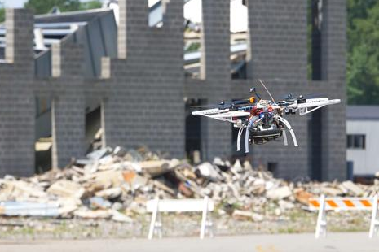
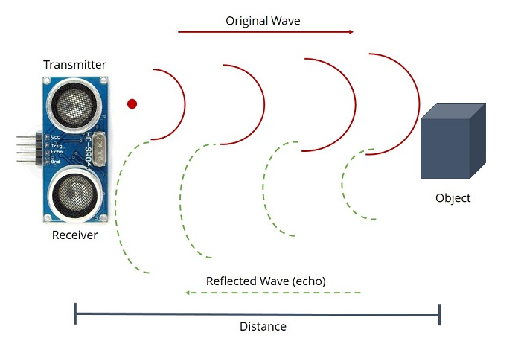

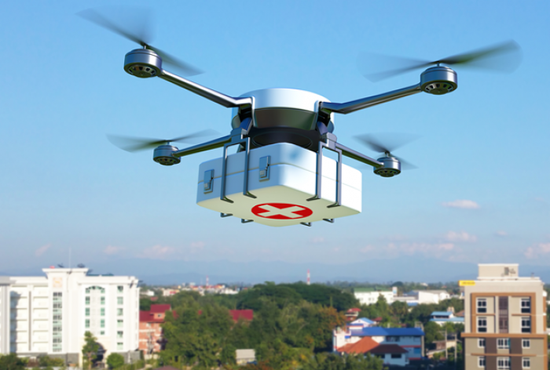

Quadrotor Path Planning in Unknown Environment with Q-Learning Neural Network
Yupeng Li, Junfan Pan, Jiatong Sun
What We Need
A path planning method for quadrotors to navigate in unknown and complex environments.
What We Have
On board sensors that provide information about surrounding environment instantly
What We Expect
A well-trained agent that utilizes sensor data as state to choose the optimal action

Slide 3
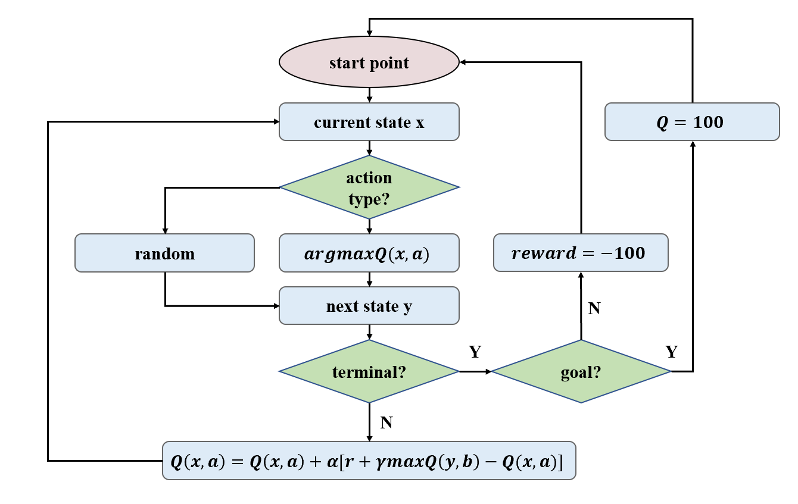

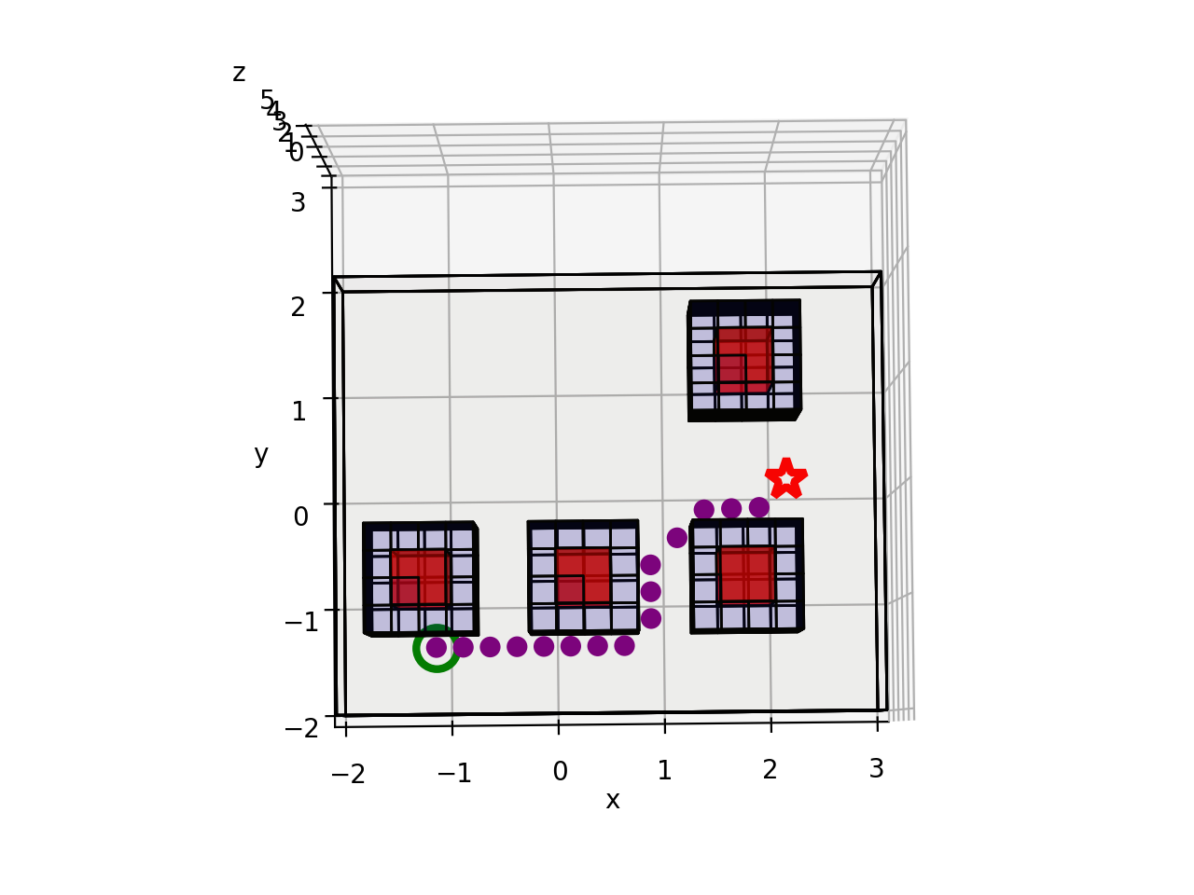
Quadrotor Path Planning in Unknown Environment with Q-Learning Neural Network
Yupeng Li, Junfan Pan, Jiatong Sun
What We Devise
Q-Learning Neural Network: Update target Q as the dataset labels and train the neural network to learn the respective Q given state-action pairs
Note: Q(x,a) is not obtained from the Q matrix directly; Instead, a neural network is used to predict Q(x,a)
What We Get
The quadrotor finds a path that bypasses obstacles and reaches the goal in a completely unknown environment

