Slide 1
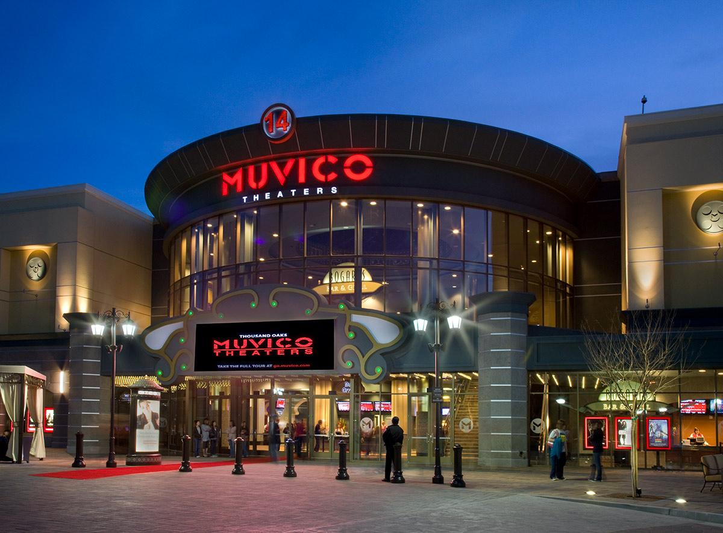

Muvico
11.17.25
Wesley Ledesma
Rayhan Alcena
CAP 5610

Slide 2
Project Purpose
Muvico
Muvico is a Large Language Model (LLM) that recommends users movies to watch based on their interests.

Slide 3

MovieLens 1M Dataset
Dataset Selection
Muvico
The dataset we used to fine-tune the LLM was the “MovieLens 1M Dataset”.
The dataset was released February 2003 by GroupLens Research at the University of Minnesota.
Contains 1 million ratings from 6,000 users on 4,000 movies.
The rating scale ranges from 1-5.
Each user have rated at least 20 movies.

Slide 4
Dataset Selection
Muvico
Users Data
Format:
UserID
Gender
Age
Occupation
Zip-code
Ratings Data
Format:
UserID
MovieID
Rating
Timestamp
Movies Data
Format:
MovieID
Title
Genre

Slide 5
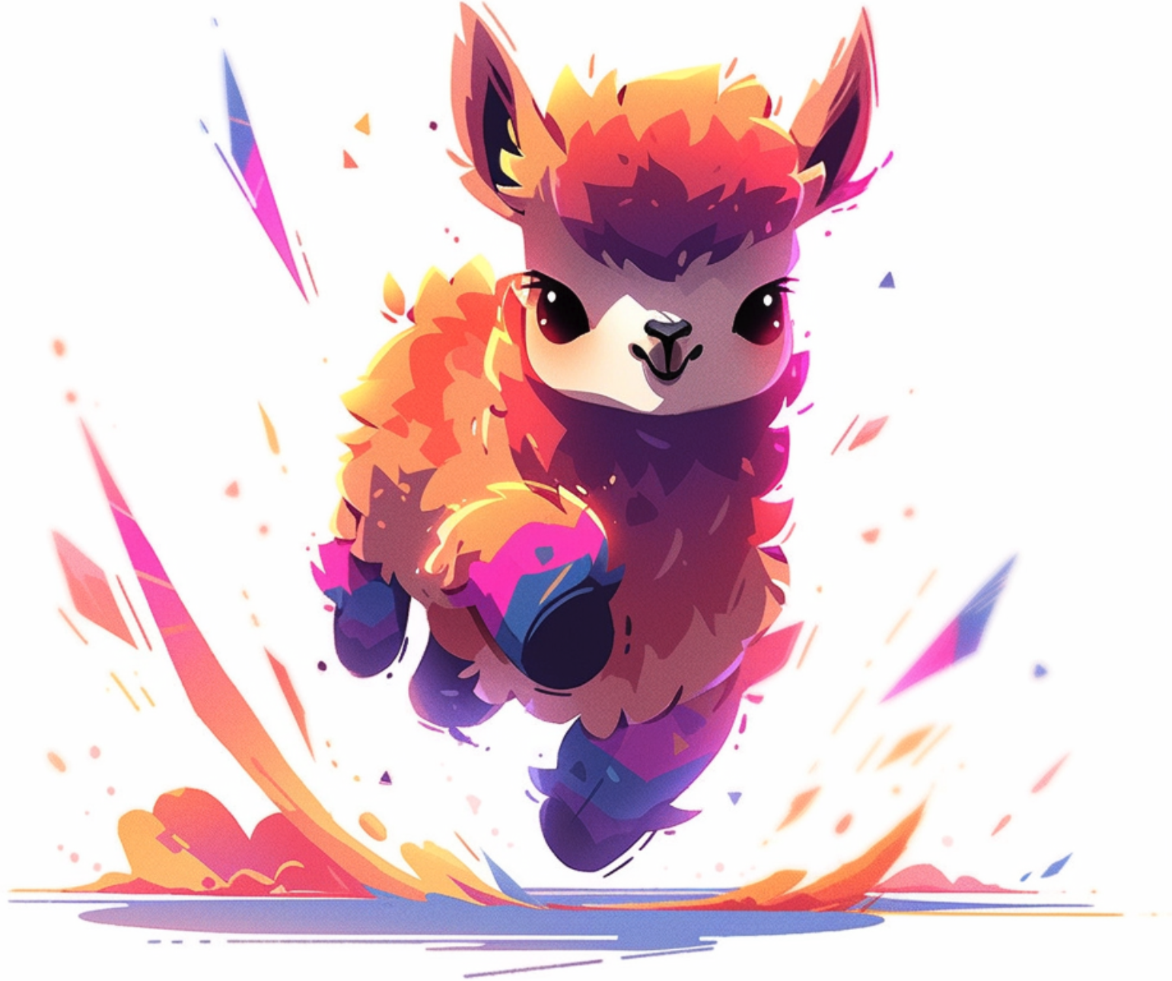
Tiny Llama-1.1B
Model Selection
Muvico
Tiny Llama is a pertain and compact model.
The Model size is 1.1 billion parameters.
The training data consists of 3 trillion tokens.
This compactness is best suited for applications with limited computing power and memory resources.

Slide 6

Low-Rank Adaptation (LoRa)
Fine-Tuning
Muvico
LoRa is an efficient fine-tuning technique that updates a small portion of a LLM’s parameters without having to retrain the entire model.
Adds small matrices alongside existing layers.
Only the new matrices get updated during fine-tuning.
The original pre-trained weights remain unchanged.
Trains 0.1-1% of the original parameters.
Often matches full fine-tuning quality despite parameter reduction.

Slide 7
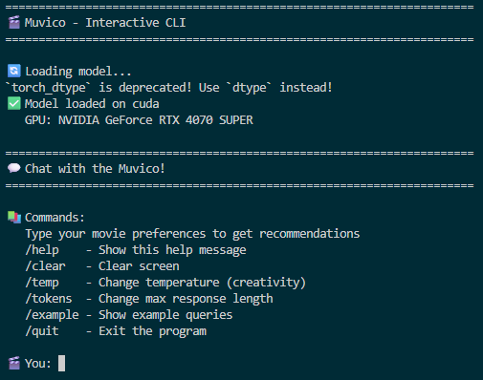
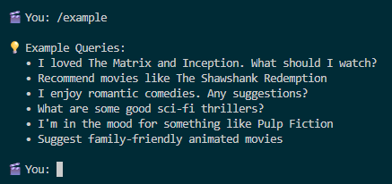
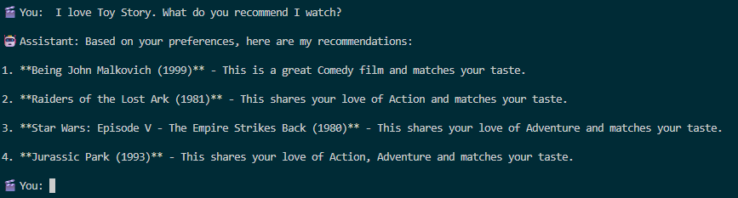
Muvico App
Muvico
Image 1:
Running the Muvico LLM.
Image 2:
Output of example queries the user can use when prompting the LLM.
Image 3:
Generated response from the LLM after being prompted by the user.

Slide 8

Challenges & Pitfalls
Muvico
The Dataset is missing Movie ratings (e.g. PG, PG-13, etc) which may be leading to inaccurate recommendations.
The model may be too limited, may have to look into Llama 3 3B or 8B Instruct.
The Nvidia GPU we are using is good but not good enough for fine-tuning LLMs with many parameters or for the LLM to generate responses quickly.

Slide 9
Thank You
Muvico
Thank You!
Any Questions?

