Slide 1
FarMTech
(Portable Real Time Soil Quality Monitoring System)
Project Mentor : Dr. Rinkle Rani
Mr. Harpreet Singh
Submitted By : Baldeep Singh (101690002)
Jaskaran Singh (101510032)
Jaswinder Singh (101510033)
Lovejot Singh (101510042)

Slide 2
Table Of content
Background of project
Working
Investigative technique
Scope and Utility
Standards
Design analysis
Architecture of project
Techniques and Tools
Snapshots
Experimentation and Implementation
Key Highlights
Consultants
Individual Roles

Slide 3
Background of project
KEY REASONS FOR CHOSING THIS PROJECT:
To eradicate the role of labs since visiting labs is time consuming and inconvenient.
Estimated use of fertilizers.
Making farmers independent.
PREREQUISITES :
Basic knowledge of raspberry pi 3.
Basics of Python.
Electronic circuits interfacing.
Basics of App development.

Slide 4
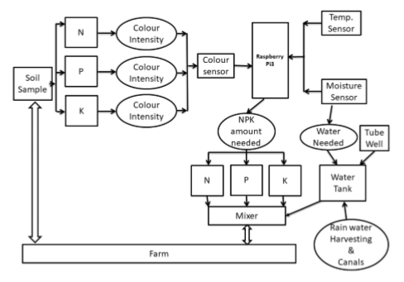
Working

Slide 5
Investigative Technique
The investigative technique used in our project is experimental.
The experiments aims at preparing the colored solutions in a test tube.
The color obtained gives a lot of information regarding these soil nutrients.
By using the capsules from soil testing kit and adding them to mixture of soil and water in a test tube a particular color is developed.
We will put the soil sample in front of a color sensor that will observe the reflected light by the sample.
The RGB values are calculated from transmitted light.
We will conduct experiments in soil testing labs to get the npk values from color sensor.

Slide 6
Scope and utility
Scope of the Development Project
FarmTech is a portable real time soil quality monitoring system.
Aims to reduce inconvenience caused to farmers.
To detect Fertilizer required.
Mobile Application.
Future Scope
Crop Prediction(Machine Learning).
Crop Disease Detection(Image Processing).
Fertigation System.

Slide 7
Scope and utility continued..
Cost Analysis
Item | Cost(₹)
Temperature sensor | 195
Moisture sensor | 150
Colour sensor | 445
Raspberry pi3 kit | 5500
Soil testing kit | 650
ADC(MCP3002) | 310
TOTAL | 7250

Slide 8
standards

Slide 9
Standards for IOT
Infrastructure-UDP (User Datagram Protocol), DTLS (Datagram Transport Layer), NanoIP, Time Synchronized Mesh Protocol (TSMP).
Discovery-mDNS (multicast Domain Name System), Physical Web, HyperCat, UPnP (Universal Plug and Play).
Communication / Transport layer-Ethernet like WirelessHart, DigiMesh, ISA100.11a, IEEE 802.15.4 or wifi like WiMax.

Slide 10
Raspberry Pi 3
UART: setting up and reading/writing fron/to a UART port is fairly easy.
I2C: since the master drives the clock, there are no issues with clock synchronization on the slave side.
SPI: as with i2c, the master drives the clock, so there are no clock synchronization issues to speak of.
GPIO: some people try to emulate a true parallel bus with this method, but personally, I would forget about this option because of the complexity.

Slide 11
Android Application
Communication protocol which will be http. you can use socket, ftp or smtp but those are for specific purpose and won't be needed in general.
For security purpose you can choose https which will come with some additional cost of security certificates. So in any communication protocol there is request and response.
http protocol is stateless protocol so you(client) make one request to get some data and it (server) returns you the required data for that request again you make another call to get another data.

Slide 12
Design Analysis

Slide 13
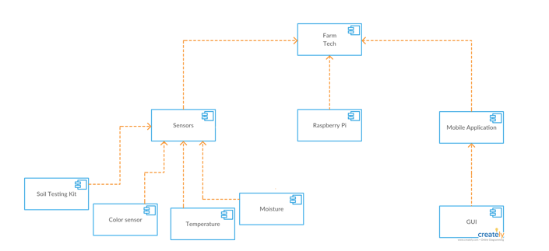
Component Diagram

Slide 14
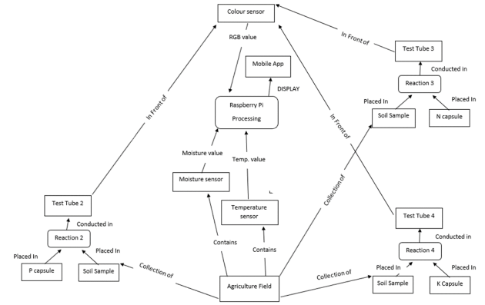
Data flow diagram

Slide 15
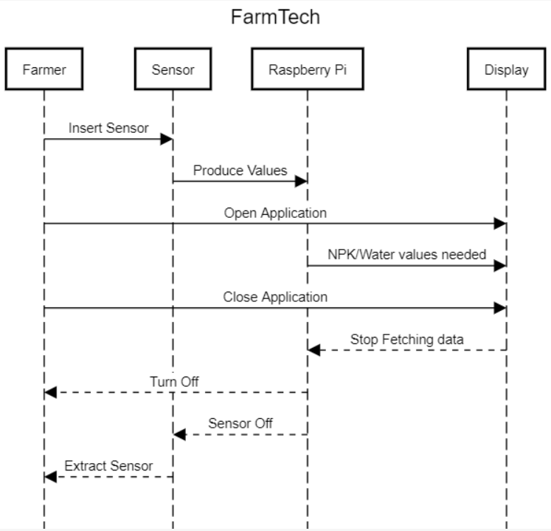
Sequence diagram

Slide 16
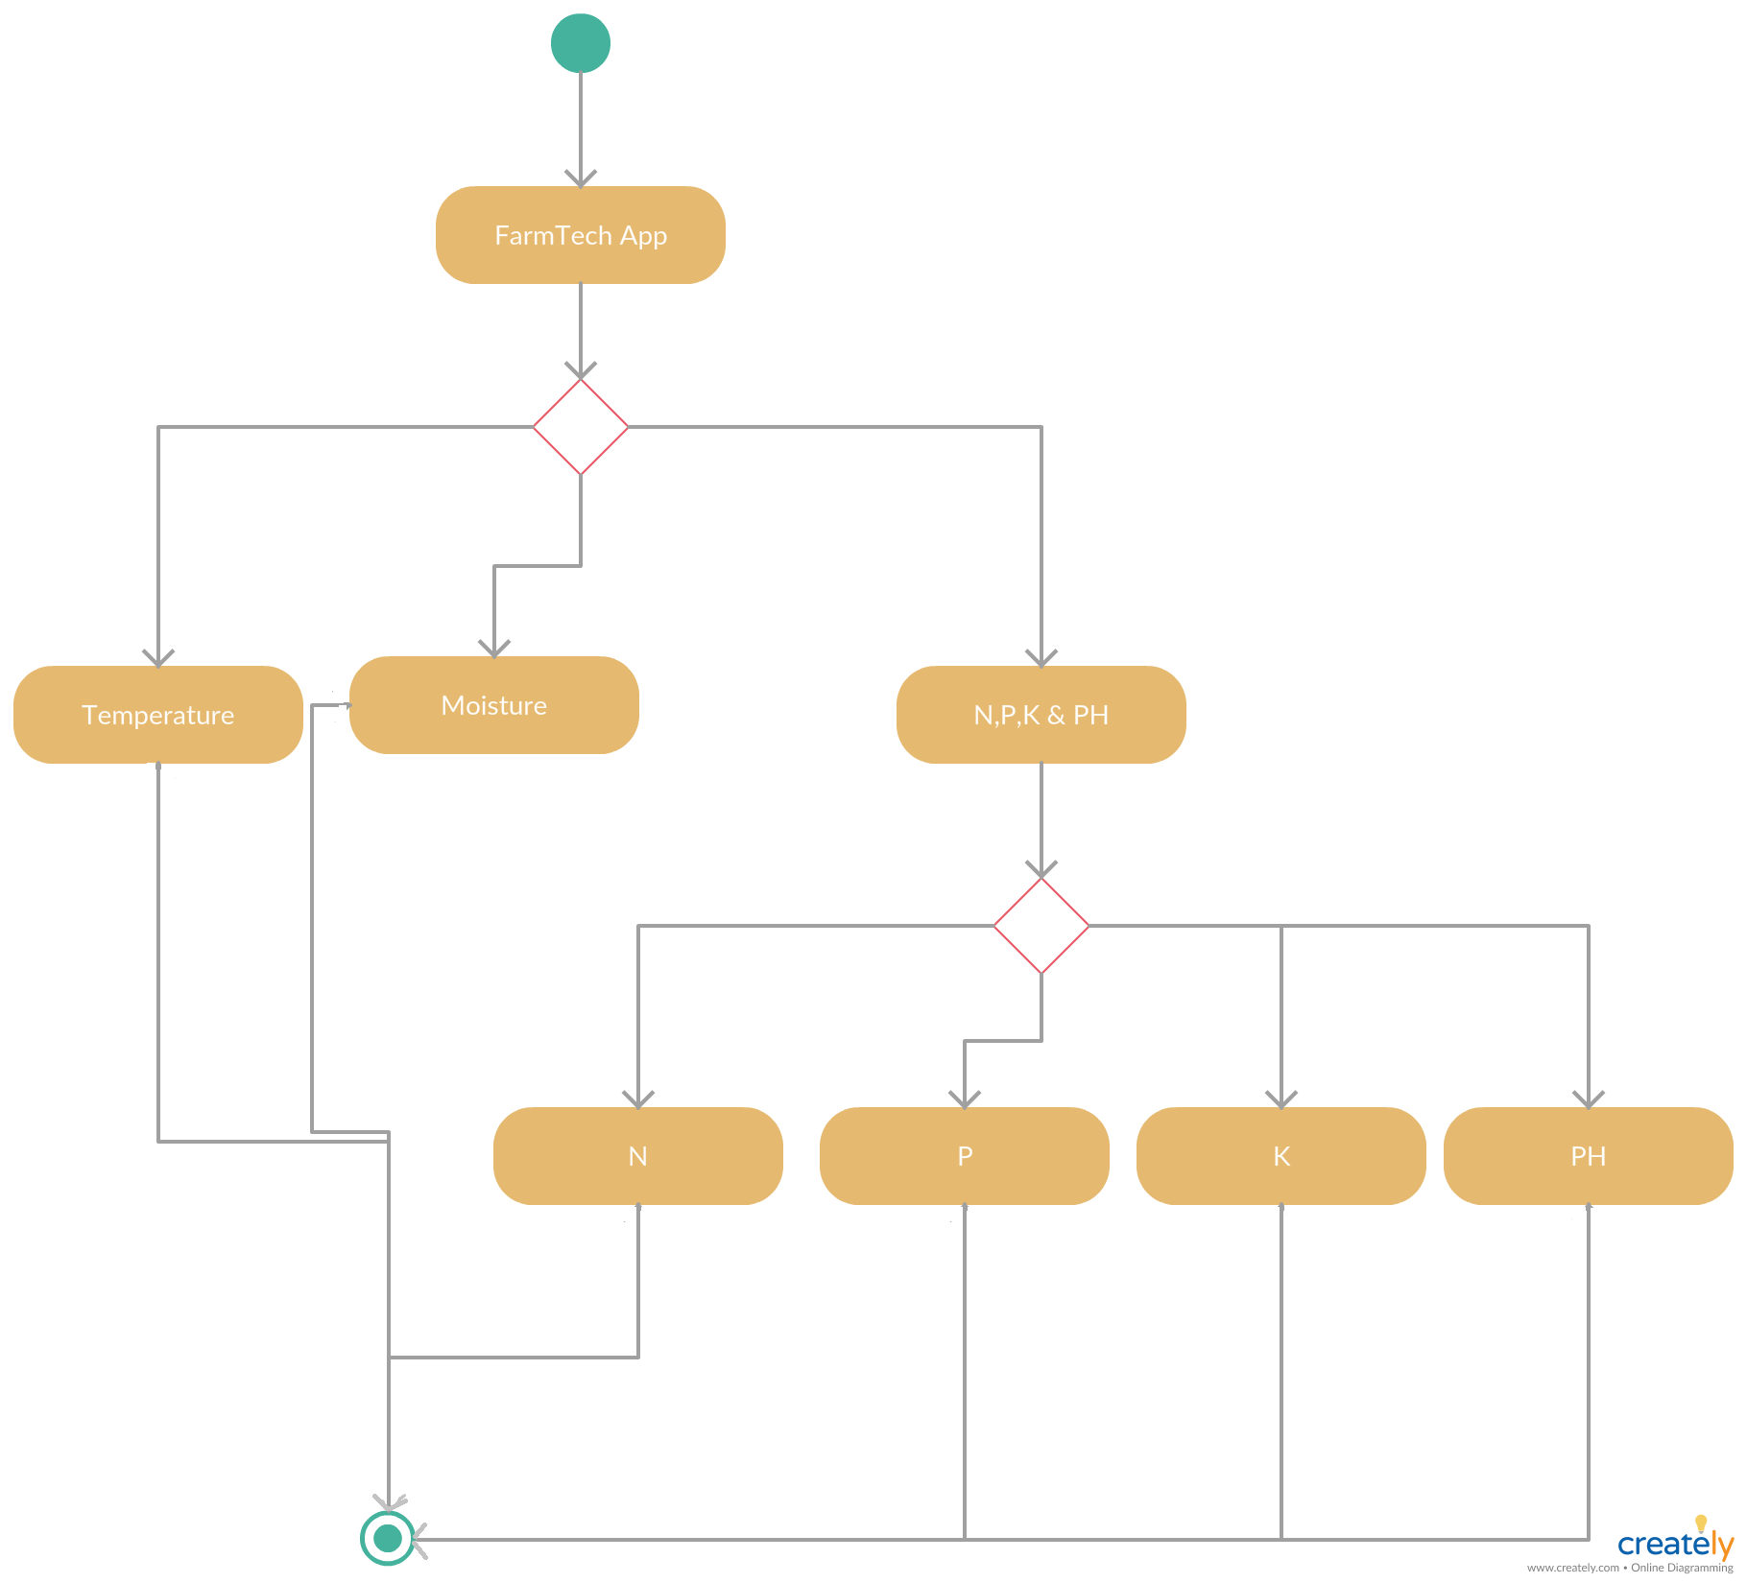
activity Diagram

Slide 17
Architecture of Project

Slide 18
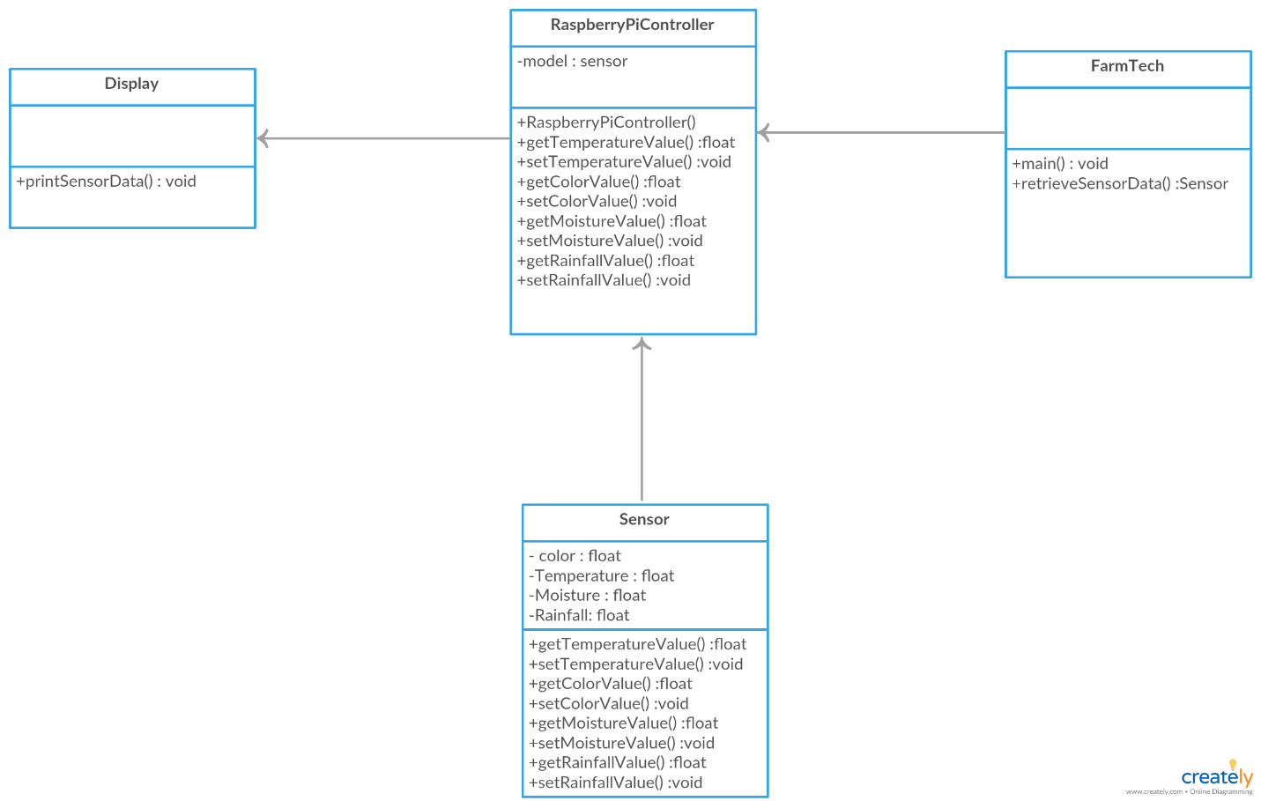
Model View Controller

Slide 19
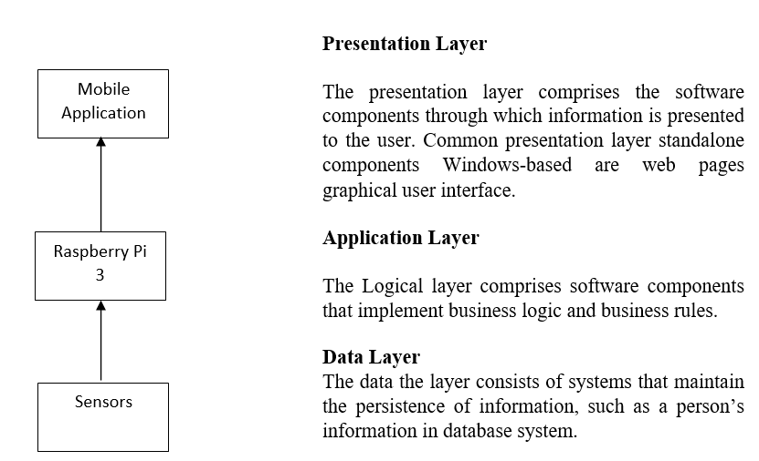
Three – Tier

Slide 20
Techniques and tools used
Raspberry Pi 3
Colour Sensor
Temperature Sensor
Moisture Sensor
Soil Testing Kit

Slide 21
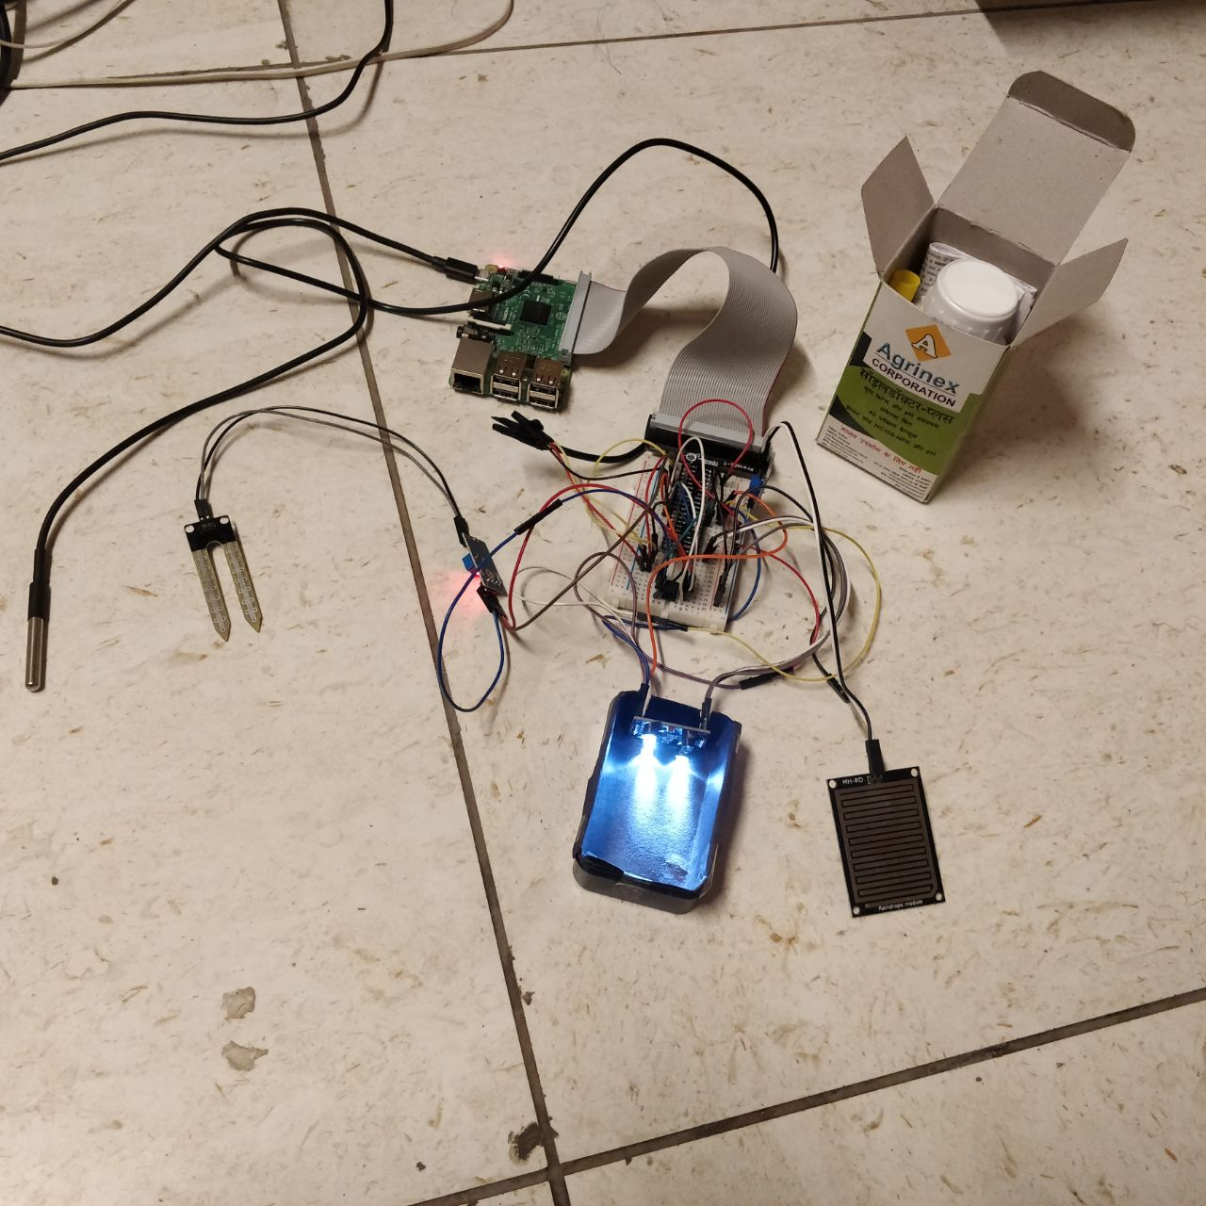
snapshots

Slide 22
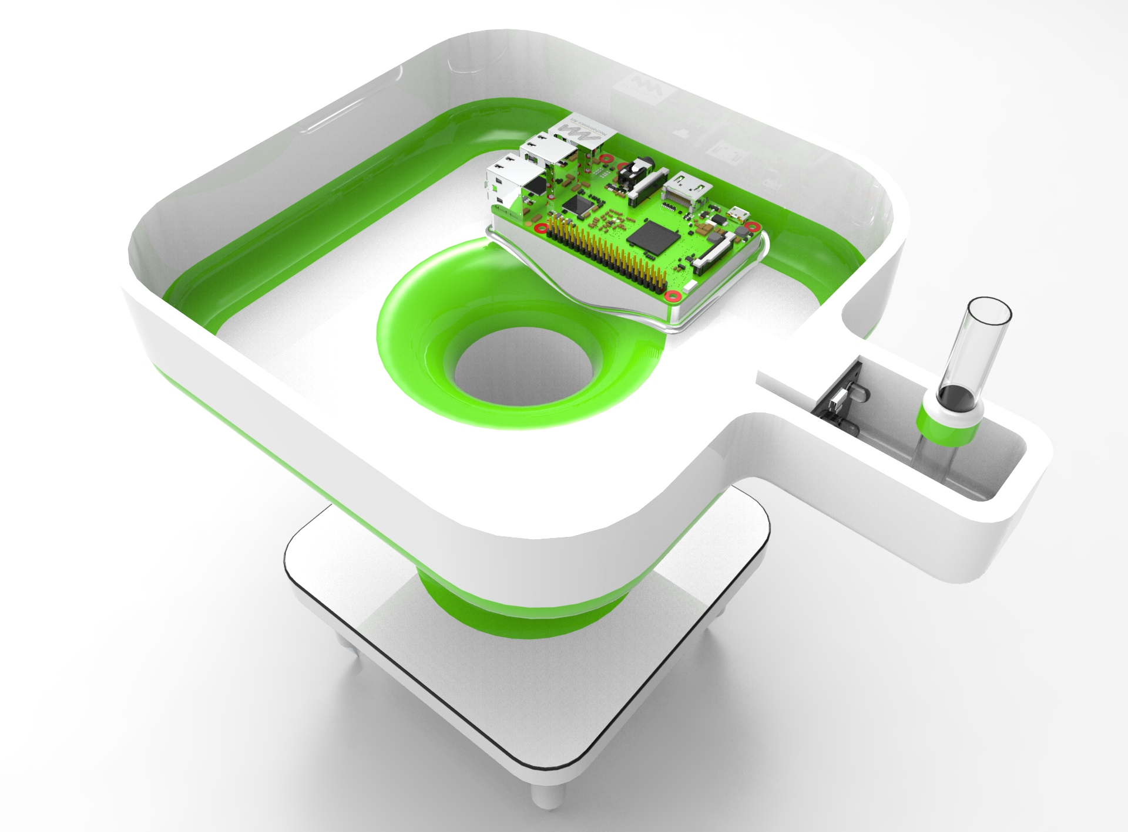
Future Snapshots

Slide 23
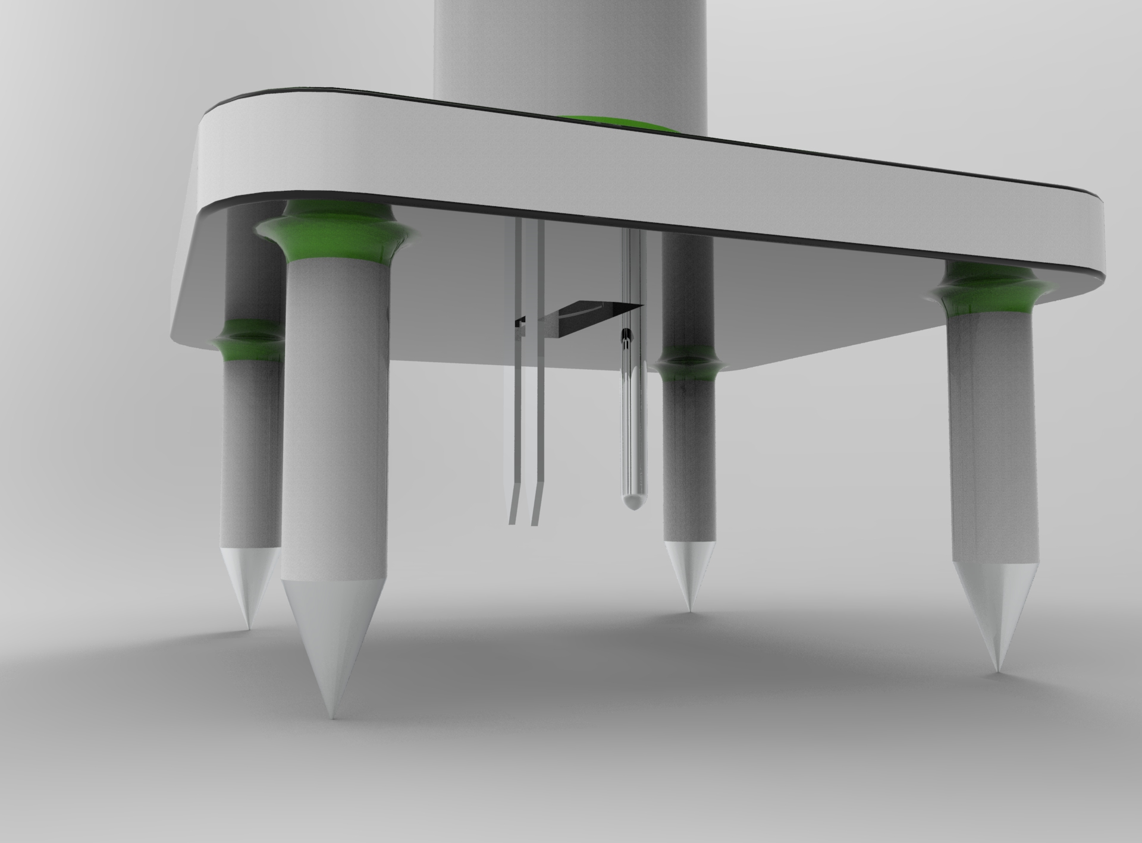
Snapshots continued

Slide 24
Experimentation AND IMPLEMENTATION

Slide 25
Preparation of Soil Sample (Extract Solution)
Take 3 to 4 soil samples of half kilograms each from different locations of a fertile soil field with depth of 15 cm. Now mix these samples and take a half kilogram sample from it
Mix this soil sample with water (use rain water OR distilled water) with 1:2 ratios in volume (i.e. one cup of soil with 2 cap water) and mix it thoroughly.
Wait 10-30 min for settling soil in bottom and clear water separation (wait at least water upper soil extract should be clear in case of not clear up to 30 min please try to filter by normal filter paper).

Slide 26
tests
NITROGEN-Open nitrogen capsule carefully. Put the chemical inside the test tube and transfer 4.0 ml clear soil extract with dropper. Cap it and mix gently until the chemical is dissolved. Wait 20 minutes for the color to develop.
PHOSPHOROUS-Open phosphorous capsule carefully. Put the chemical inside the test tube and transfer 4.0 ml clear soil extract with dropper and add 4 drop of TCA reagent carefully. Cap it and mix gently until the chemical is dissolved. Wait 20 minutes for the color to develop.
POTASSIUM-Open potassium capsule carefully. Put the chemical inside the test tube and transfer 4.0 ml clear soil extract with dropper and mix gently until the chemical is dissolved. Wait 20 minutes for the colour to develop.

Slide 27
Results and Discussions
The following tables have been obtained as the output of the color sensor
Concentration | Color intensity | Mg/ml
High | 165.206 | 40
Medium | 187.552 | 30
Low | 204.905 | 25
Trace | 219.098 | 20
Concentration | Color intensity | Mg/ml
High | 132.68 | 40
Medium | 127.734 | 33
Low | 134.685 | 30
Trace | 157.558 | 25
Potassium
Nitrogen
Concentration | Color intensity | Mg/ml
High | 113.798 | 18
Medium | 114.702 | 15
Low | 118.895 | 12
Trace | 121.7694 | 10
Phosphorous

Slide 28
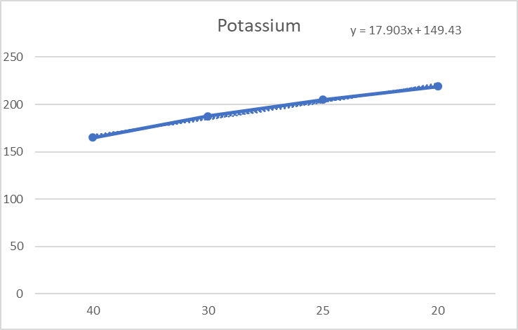
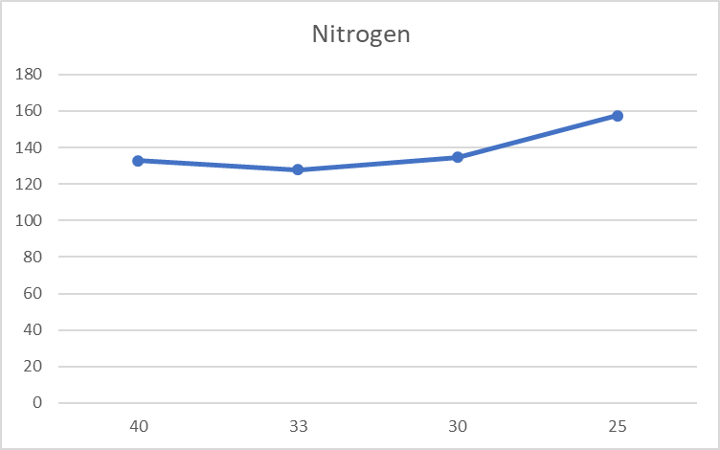
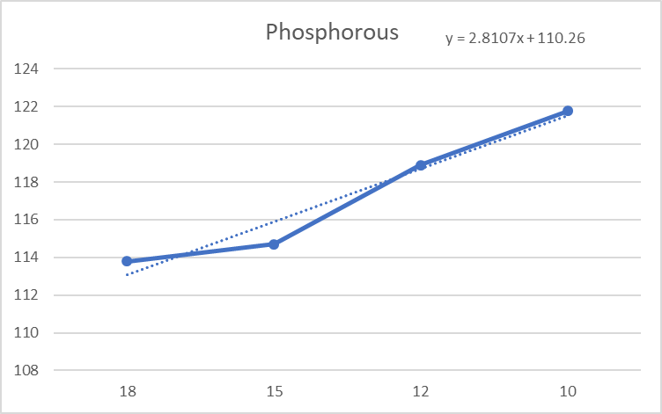
y = 8.1585x + 117.77

Slide 29
Inference drawn
After performing the experiments for phosphorous, nitrogen, potassium, the following color intensity thresholds have been obtained for the optimum level of NPK in soil for wheat.
Now any unknown sample can be tested and a comparison between it and standard curve will depict the amount of fertilizer is in excess or less or optimum in the soil.
 | Color intensity | Optimum value
Phosphorous | 114.702 | 23kg/ha
Nitrogen | 127.734 | 49.5kg/ha
Potassium | 187.552 | 45kg/ha
Result

Slide 30
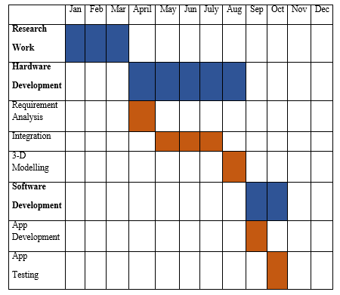
Key Highlights

Slide 31
Consultants
Biotechnology Department T.I.E.T
Prof. Dinesh Goyal regarding soil testing.
Biotech Testing Lab (Step Building) T.I.E.T
Mr. Nirmalya Halder Research scholar regarding calibration of colour sensor
Krishi Vigyan Kendra ,Patiala
Dr. Jaswinder Singh (Director) regarding datasets.
ECED Department T.I.E.T
Mr. Divneet Singh Kapoor Research scholar ECED T.I.E.T regarding colour sensor and raspbery pi integration.

Slide 32
Individual Roles
Table 7.2 Roles
 | Baldeep | Jaskaran | Jaswinder | Lovejot
Interfacing of raspberry pi with colour sensor | * | - | * | -
Implementation of colour sensor code | * | - | * | -
Literature Survey | * | * | * | *
Hardware Requirement Analysis | * | * | - | -
Software Requirement Analysis | - | - | * | *
Documentation
Report | * | * | - | -
Presentation | - | - | * | *
Interfacing of raspberry pi with temperature and moisture sensor | - | * | - | *
Implementation of temperature and moisture sensor code | - | * | - | *
Design analysis
DFD | * | * | - | -
Sequence diagram | * | - | - | -
Activity diagram | - | - | * | *
MVC | - | - | * | *
3 tier architecture | - | * | - | -
Experimentation | * | * | * | *

Slide 33
Thank You

