Slide 1
Outcomes-based Education

Slide 2

What are learning outcomes?
Learning outcomes represent one of the essential building blocks for transparency within higher education systems and qualifications;
Learning outcomes have been defined above as:
Statements of what a learner is expected to know, understand and/or be able to do at the end of a period of learning.

Slide 3
What is OBE?
Outcomes Based Education focuses on student learning by:
Clearly focusing and organizing everything in an educational system around what is essential for all students to be able to do successfully at the end of their learning experiences.
This means starting with a clear picture of what is important for students to be able to do, then organizing the curriculum, instruction and assessment to make sure this learning ultimately happens (Spady, 1994).

Slide 4
What is OBE?
Outcomes Based Education focuses on student learning by:
Using learning outcome statements to make explicit what the student is expected to be able to know, understand or do;
Providing learning activities which will help the student to reach these outcomes;
Assessing the extent to which the student meets these outcomes through the use of explicit assessment criteria.

Slide 5
Cherry is a staff in Mall X. Her work is to get the products in the stock room as requested by the sales lady. Cherry has been working in Mall X for two months right after her graduation. Cherry finished a course in computer science and she is expected to develop softwares. One time the HR called her and asked her to make a program for the payroll system of the employees in the computer for an extra pay.
She begged off honestly and said “Sorry I do not know how to make a program, perhaps you can ask other computer science graduates from other schools.”

Slide 6
Cheryl conducted a graduate tracer study to determine if the teacher education program of the school is adequate. She found in the survey that:
100% of the graduates were employed as teachers in different sectors.
100% of the graduates were able to get a job in two months.
100% of the graduates passed the licensure exam for teacher.
60% of the faculty are receiving a salary of less than Php15,000
80% of them working as a teacher were rated satisfactory in their teaching performance by the school administrators.

Slide 7
Principles of OBE
Designing Backwards
Expanded Opportunities
Clarity of focus
High Expectations

Slide 8
Teaching- Learning in OBE
1. Teacher must help students to bring each learning to a personal closure
2. Teachers must prepare students adequately
3. Teachers must create a positive learning environment
4. Teachers must provide students with enough opportunities
5. Teachers must use a variety of teaching methods
6. Teachers must help their students to understand

Slide 9
Assessment of learning outcomes
1. Assessment should reflect the knowledge and skills
2. Assessment should tell both the teacher and the students are progressing
3. Assessment should support every student’s opportunity
4. Assessment should allow individuality and uniqueness

Slide 10
Outcomes-based Education Stages in the backward design process
Learning outcomes/ Desired results
Assessment/ acceptable evidence
Learning Experiences and instruction

Slide 11
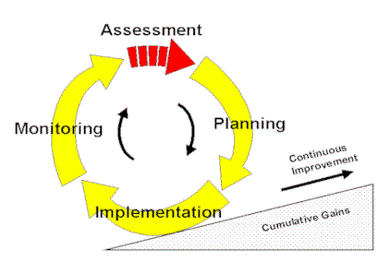
Dynamic Quality Assessment cycle

Slide 12
Example
Learning outcomes | Indicators | Assessment
At the end of the course students should be able to: decide which inferential statistics can be used for a specific hypothesis Encode data acceptable in SPSS use SPSS to compute for the inferential statistics | Suggest which type of statistics to be used given a hypothesis Use SPSS to encode survey data Click appropriate menu in SPSS when computing for ANOVA, t-test etc. | Test: Given a hypothesis, write the correct stats to be used Performance based: encode the data from a survey to the SPSS worksheet Checklist: step by step procedure in using SPSS

Slide 13

THANK YOU!!

