Slide 1


WHY WE CHOOSE INTELLIJ IDEA?

Slide 2


IntelliJ IDEA is a fully featured IDE developed by JetBrains. This IDE supports many languages from Java, Kotlin, Scala, Android, Mercurial, Groovy …

Slide 3

Features which make IntelliJ IDEA a truly intelligent

Slide 4
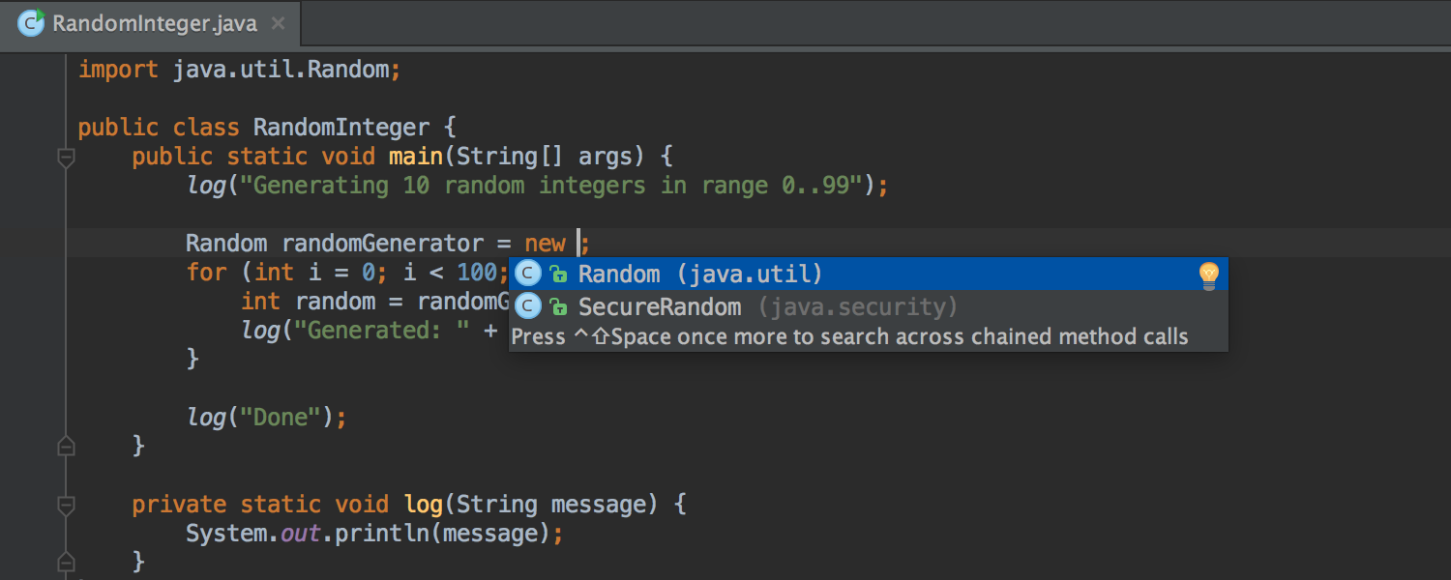

Completion
IntelliJ IDEA brings you several completion types that are really something, because they are based on the deep code intelligence mentioned earlier, and therefore are able to save you a lot of time (and typing.)

Slide 5
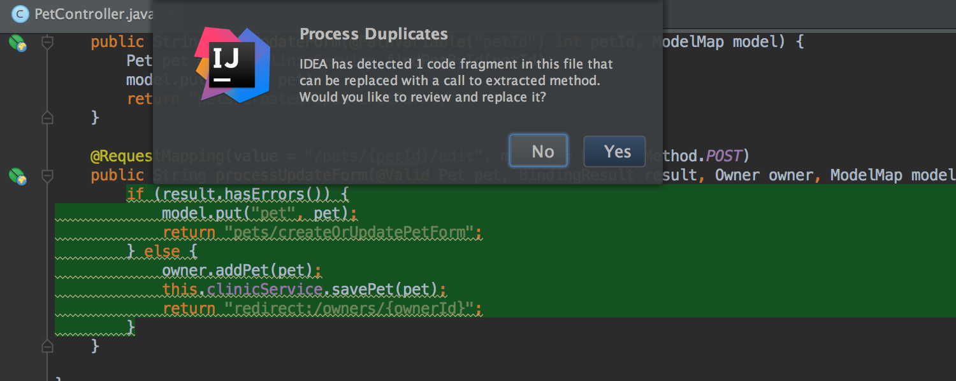
Detecting duplicates
IntelliJ IDEA knows your code so well it can detect duplicate blocks on the fly.
If you extract a variable, constant, or method, the IDE will check if there are other similar code within the scope that could be replaced with the new variable, constant, or method as well.

Slide 6
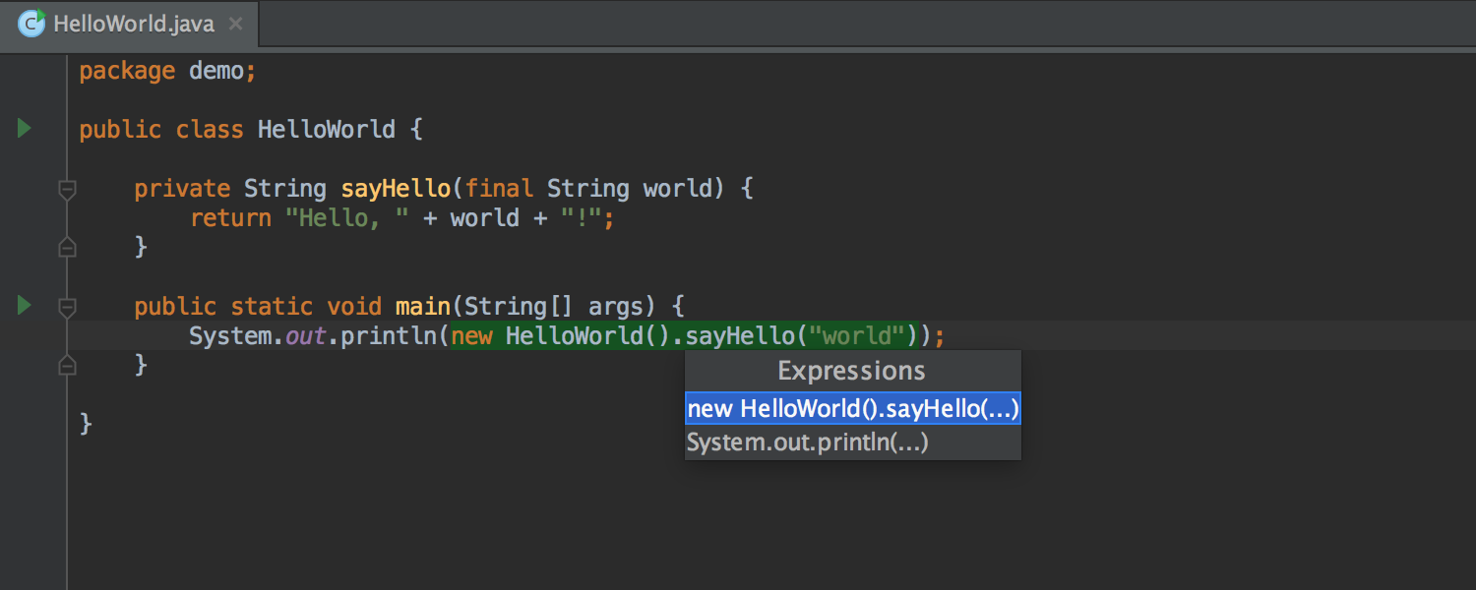
Undo refactorings
IntelliJ IDEA can easily rollback even the most complicated refactorings – with just one click. So it’s perfectly safe to experiment with the code in any way you like.
Selection
In the most cases, IntelliJ IDEA will guess the statement automatically or will offer you to choose from a list of available variants.

Slide 7
About GitHub
GitHub offers plans for free, professional, and enterprise accounts. Free GitHub accounts are commonly used to host open source projects

Slide 8
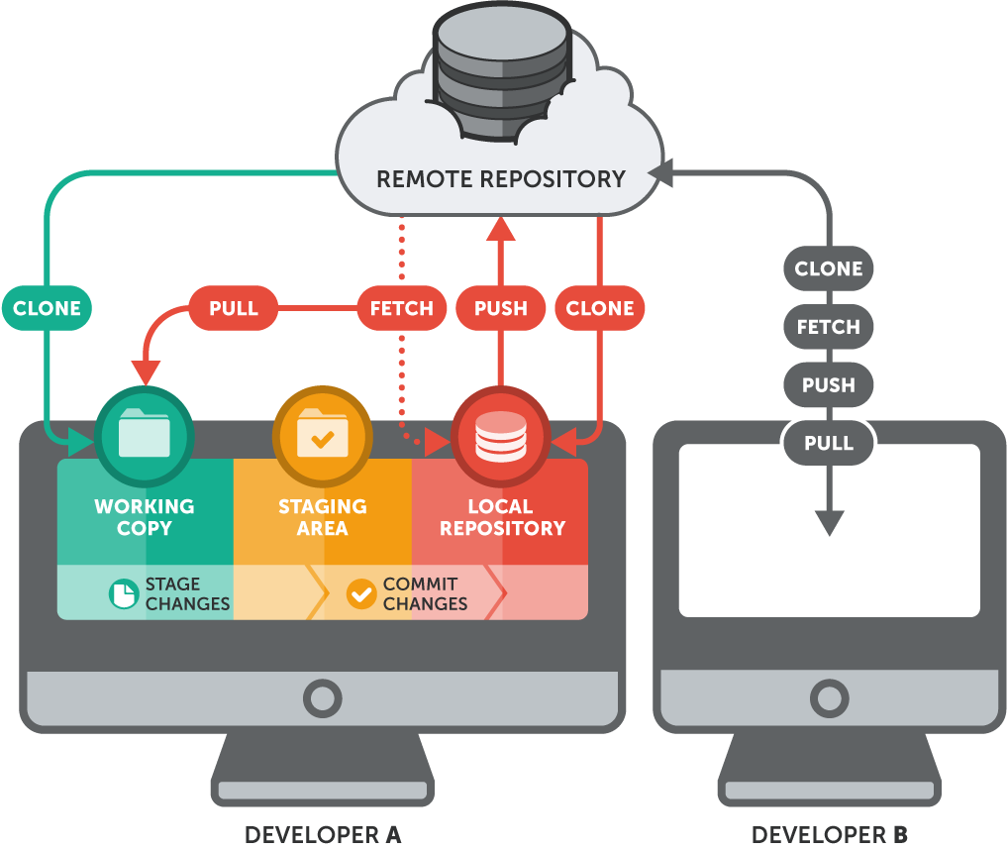
OPERATING PRINCIPLES

