Slide 1

Image Editing with
Diffusion Models
Authors:
Luca Conti (1702084)
Daniele Sabatini (1890300)
Neural Networks
A.A. 2024/2025
Exam date: 2025/09/05

Slide 2
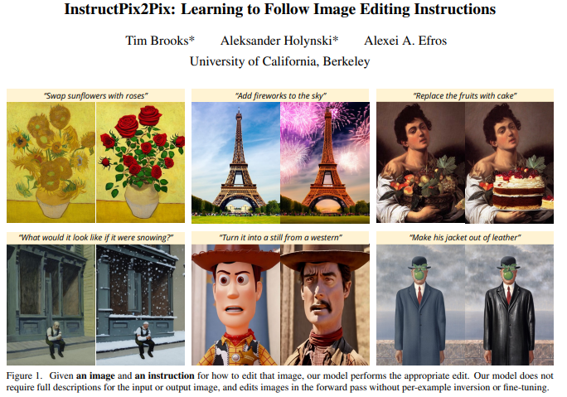

Task
This project follows the approach introduced in “InstructPix2Pix: Learning to Follow Image Editing Instructions”
Main steps:
Generating instructions and paired captions
Generating paired images from paired captions
Fine-tuning Stable Diffusion

Slide 3

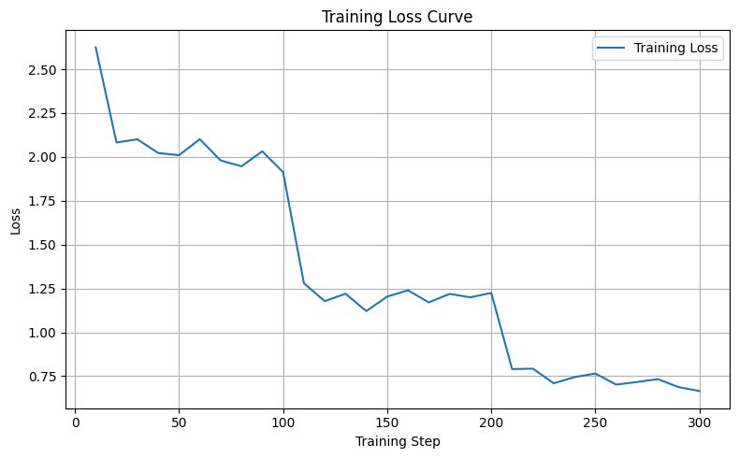
o generate an edit_prompt and an edited_prompt given an original_prompt.
o generate an edit_prompt and an edited_prompt given an original_prompt.
Generating Instructions and Paired Captions
We fine-tuned Gemma 2B to generate an edit prompt and an edited prompt given an original prompt
original prompt:
“A squirrel eating a burger”
Input:
Implementation details
GPU: 40GB A100
dataset size: 800
epochs: 3
batch size: 4
grad. acc. steps: 2
Gemma 2B
edit prompt:
“Replace the squirrel with a lion”
+
edited prompt:
“A lion eating a burger”
Output:

Slide 4
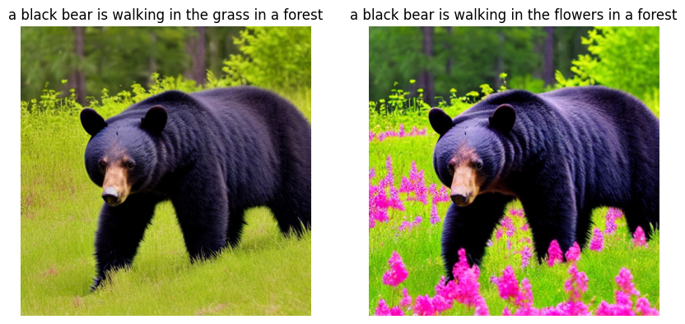
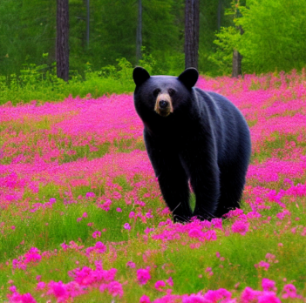
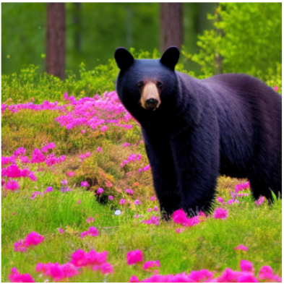
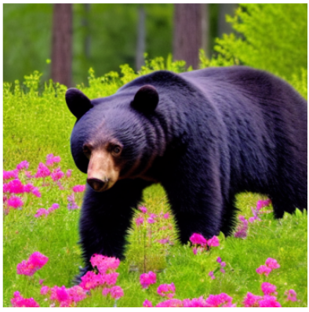
Generating Paired Images from Paired Captions
Stable Diffusion
w/o Prompt2Prompt
w/ Prompt2Prompt
w/ Prompt2Prompt
original prompt:
“a black bear is walking in the grass in the forest”
edited prompt:
“a black bear is walking in the flowers in the forest”
alpha=0.8
replace_ratio=0.9
weight=1.5
alpha=0.4
replace_ratio=0.8
weight=5
…but Prompt-to-Prompt requires tuning several hyperparameters (e.g., alpha, replace_ratio, weight, etc.).

Slide 5
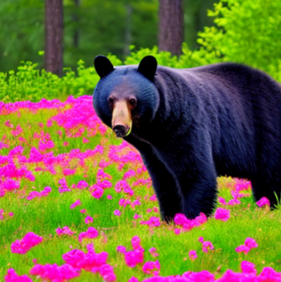
Generating Paired Images from Paired Captions
Stable Diffusion
w/o ControlNet
w/ ControlNet
w/ ControlNet
original prompt:
“a black bear is walking in the grass in the forest”
edited prompt:
“a black bear is walking in the flowers in the forest”
scale=0.10
scale=0.15
Image Filtering Metrics:
dir. similarity (>0.15)
img–img similarity (>0.65)
img–cap similarity (>0.20)
original prompt
Stable Diffusion v1.5
original image
Canny Edge
ControlNet
edited
image
edited prompt

Slide 6
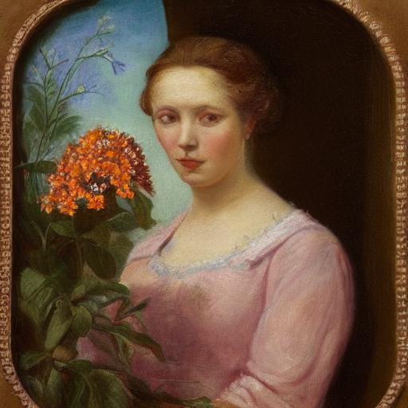
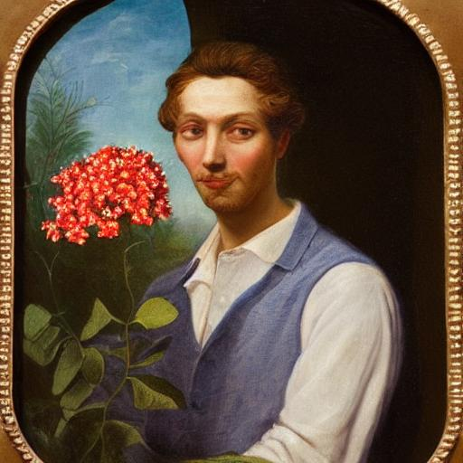
Fine-tuning of Stable Diffusion
We fine-tuned only the U-Net of Stable Diffusion v1.5 to follow textual editing instructions
original image:
Input:
+
edit prompt:
“Make her a man”
Implementation details
GPU: 40GB A100
dataset size: 1001
resolution: 256x256
batch size: 32
learning rate: 5e-5
grad. acc. steps: 4
max grad. norm: 1
steps: 300
edited image:
Output:

Slide 7
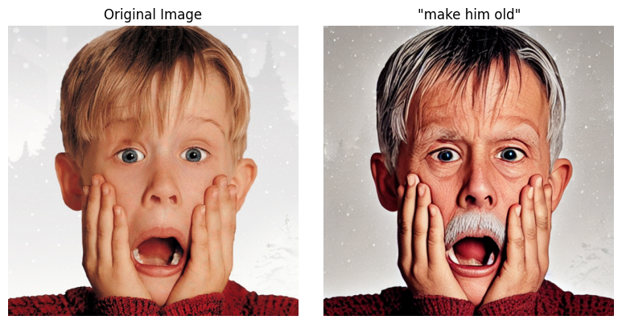
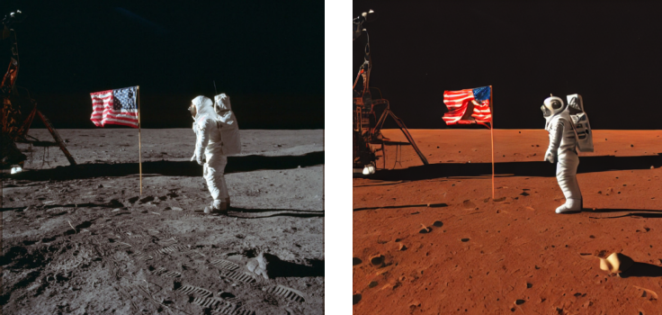
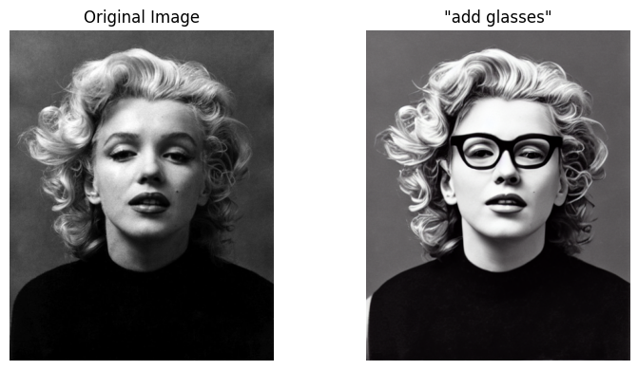
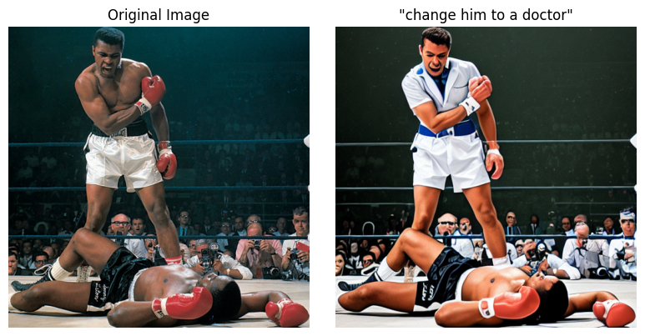
Results
“make him old”
“move it to Mars”
“add glasses”
“change him to a doctor”

Slide 8
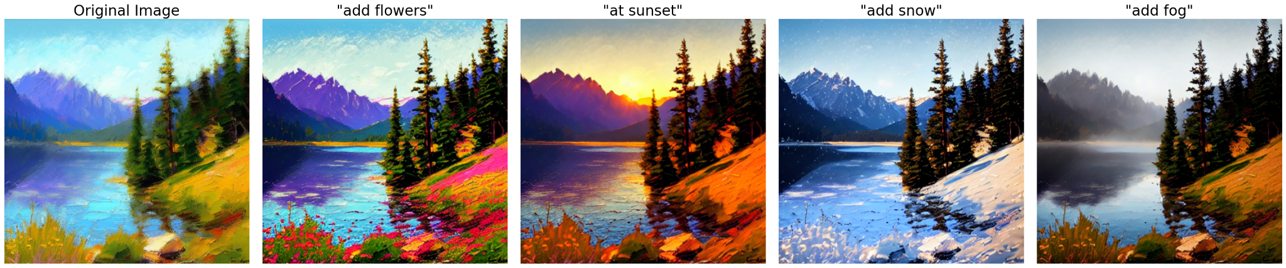
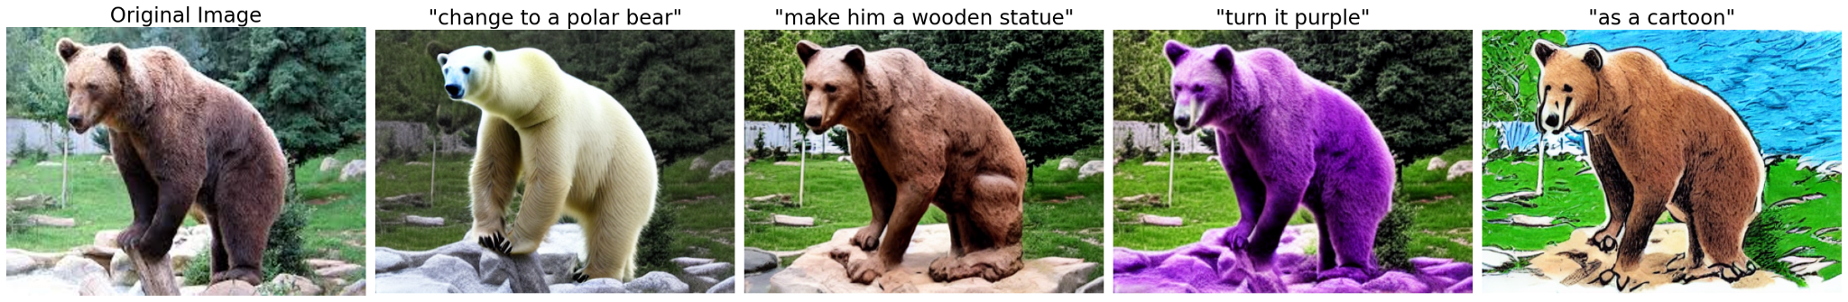
Results
Different contextual edits
“add flowers”
“at sunset”
“add snow”
“add fog”
“change to a polar bear”
“make him a wooden statue”
“turn it purple”
“as a cartoon”

Slide 9
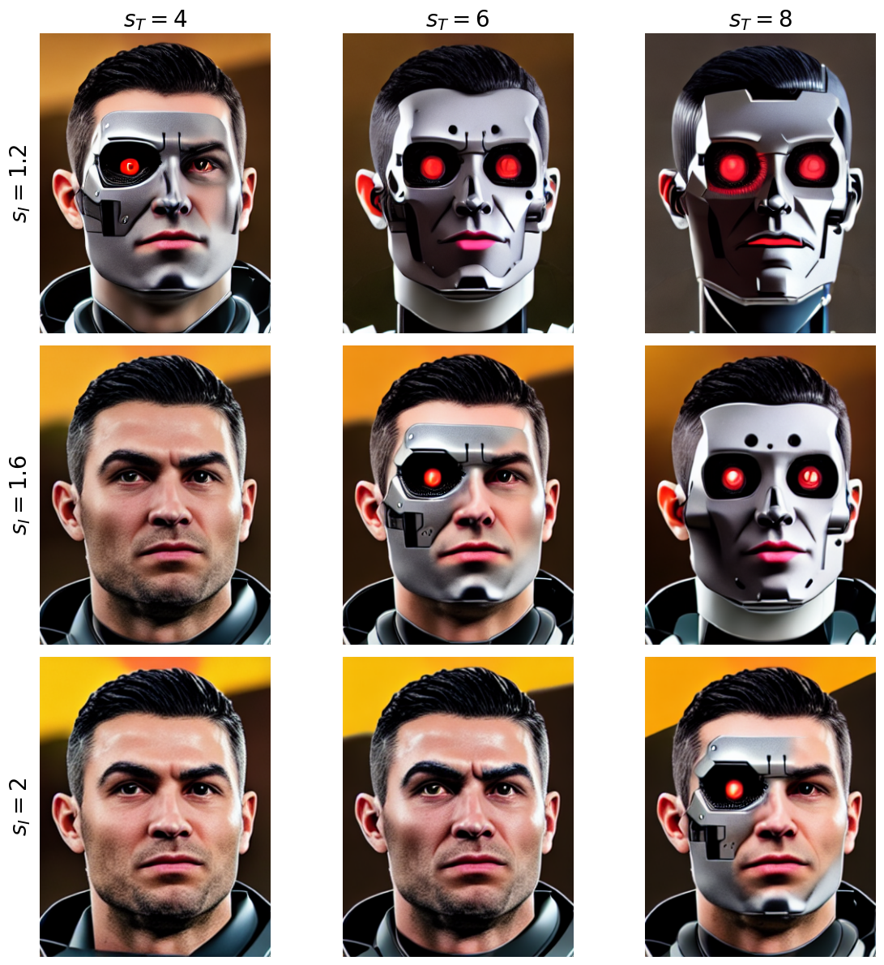
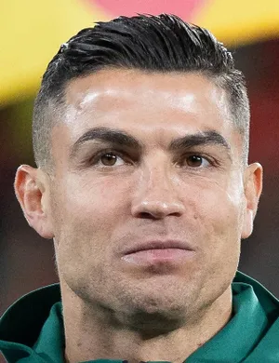
Results
Classifier-free guidance weights over two conditional inputs
“turn into a cyborg”

Slide 10
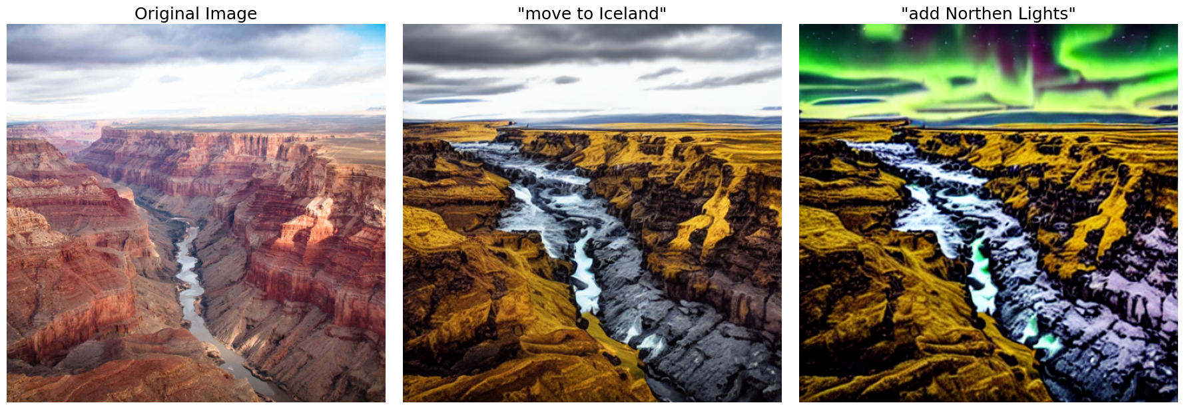
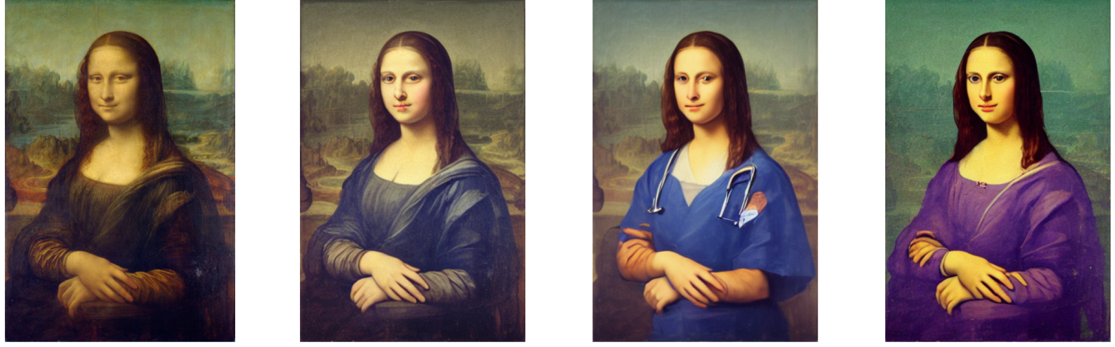
Results
“move to Iceland”
“add Northen Lights”
Sequential
Edits
“she’s a nurse”
Different latent noise

Slide 11
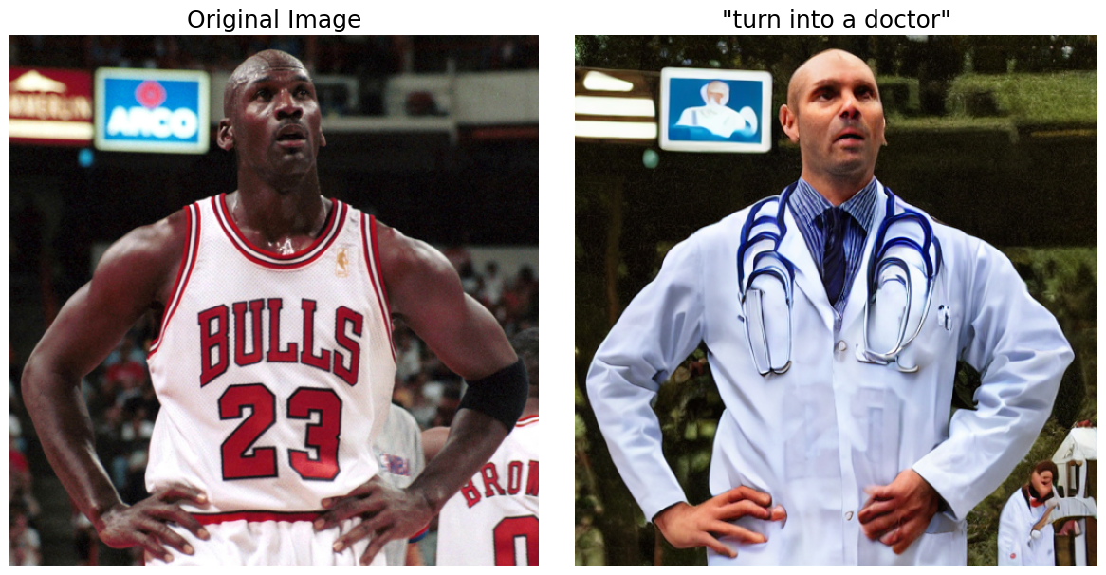
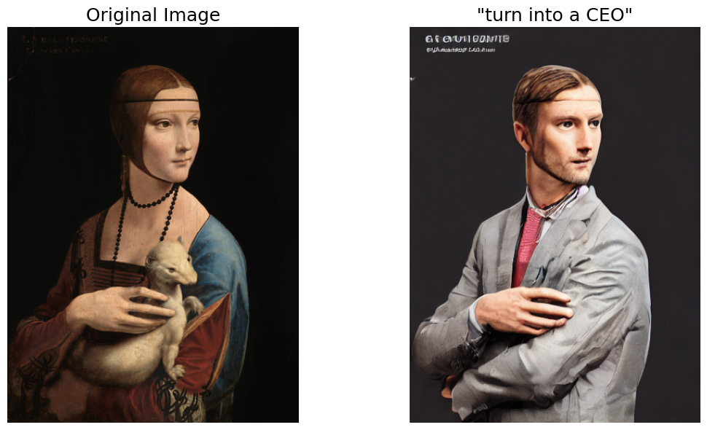
Conclusions
“turn into a doctor”
Limitations:
The dataset quality is limited by the ability of:
Gemma 2B to generate instructions
SD to generate images
Limited fine-tuning data
Resolution constraints
Difficulty with complex instructions
Accumulated errors in sequential edits
Biases
1
“turn into a CEO”
Future works:
Use newer SD versions for dataset generation
Fine-tune a newer SD versions to follow instructions
Fine-tune on larger, high-quality data
Address Biases
Enhance robustness to complex instructions

Slide 12
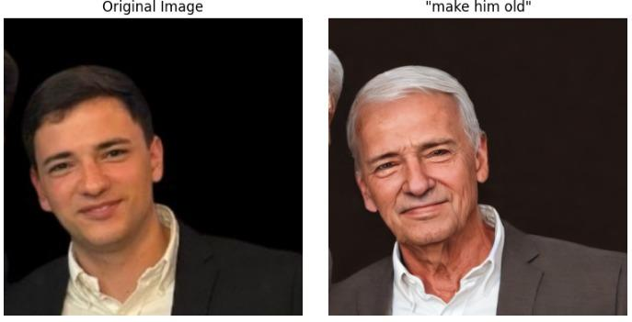
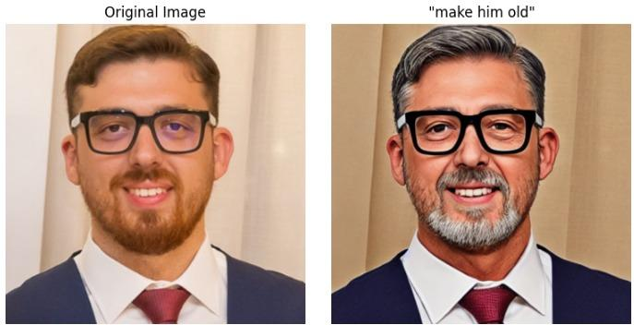
Thanks for your attention
“after the university”
“after graduated”
Daniele Sabatini
Luca
Conti

Slide 13
References:
Tim Brooks, Aleksander Holynski, Alexei A. Efros. InstructPix2Pix: Learning to Follow Image Editing Instructions. arXiv:2211.09800, 2022. https://arxiv.org/abs/2211.09800
Amir Hertz, Ron Mokady, Jay Tenenbaum, Kfir Aberman, Yael Pritch, Daniel Cohen-Or. Prompt-to-Prompt Image Editing with Cross Attention Control. arXiv:2208.01626, 2022. https://arxiv.org/abs/2208.01626
Lvmin Zhang, Maneesh Agrawala. Adding Conditional Control to Text-to-Image Diffusion Models. arXiv:2302.05543, 2023. https://arxiv.org/abs/2302.05543
Robin Rombach, Andreas Blattmann, Dominik Lorenz, Patrick Esser, Björn Ommer. High-Resolution Image Synthesis with Latent Diffusion Models.CVPR 2022.

