Slide 1

Corso di Laurea in Scienze Informatiche
Fondamenti dell’IA
Sentiment Analysis sul dataset IMDB Reviews
Pier Luigi Trespidi

Slide 2

IMDB Dataset of 50k Movie Reviews
IMDB dataset having 50K movie reviews for natural language
processing or Text analytics.
This is a dataset for binary sentiment classification containing substantially
more data than previous benchmark datasets.
We provide a set of 25,000 highly polar movie reviews for training and 25,000 for testing.
So, predict the number of positive and negative reviews using either classification or deep learning
algorithms.
https://www.kaggle.com/datasets/lakshmi25npathi/imdb-dataset-of-50k-movie-reviews
Obiettivo del progett

Slide 3
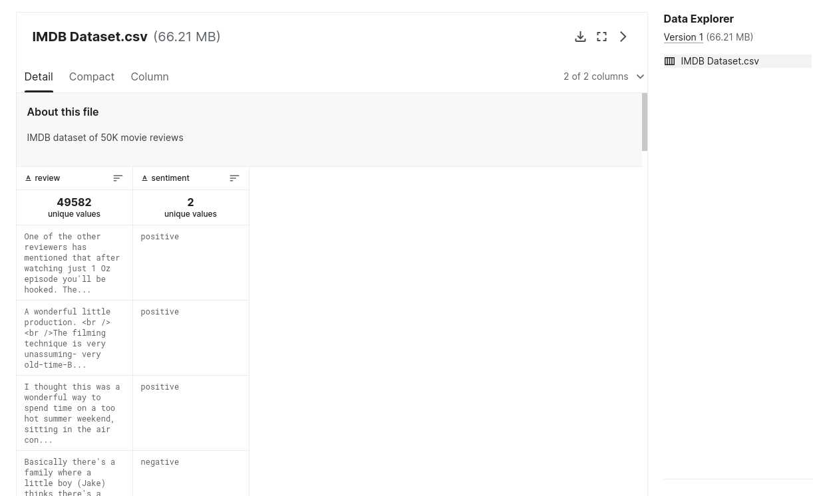
Dataset

Slide 4
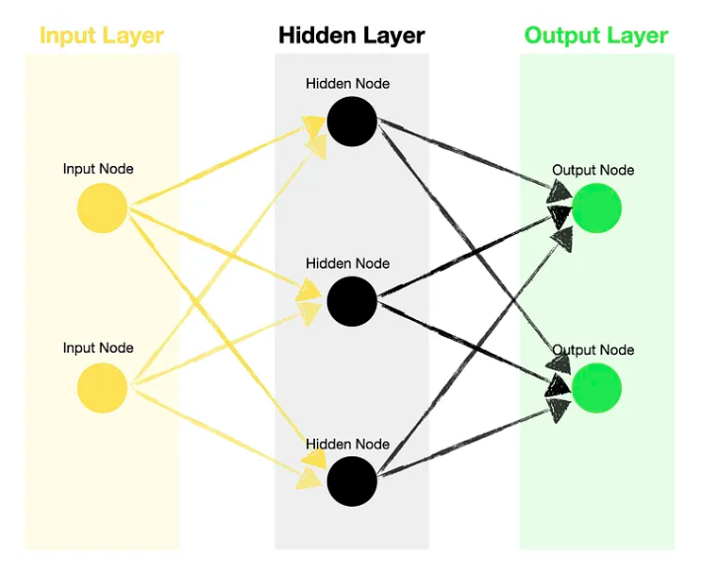
Feed Forward NN

Slide 5
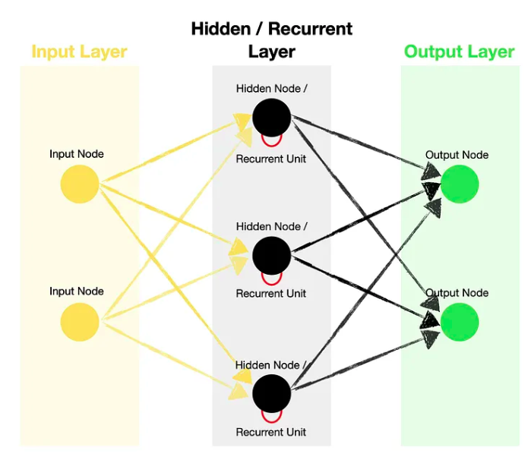
Recurrent NN

Slide 6
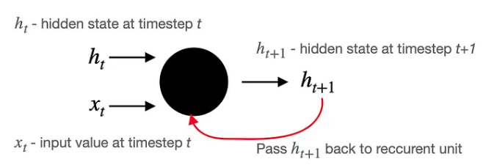
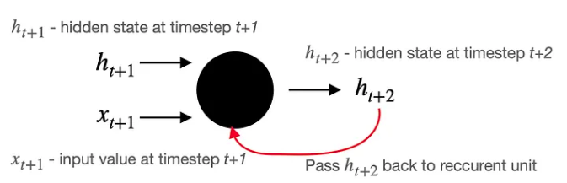
Feedback loop

Slide 7
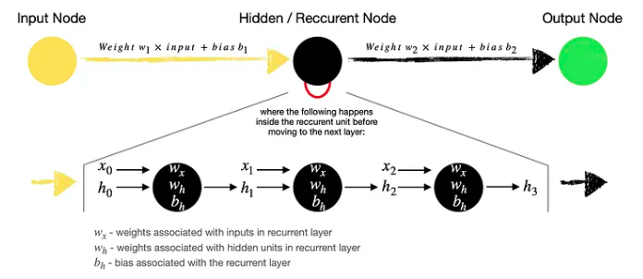

+ BPTT (Back Propagation Through Time)
Recurrent NN

Slide 8
Vantaggi
Dati sequenziali
Storico (cronologia modelli)
Input di varie lunghezze
Svantaggi
Vanishing Gradient
Perdita informazioni su lunghe sequenze
Memoria breve termine
Vantaggi e Svantaggi

Slide 9
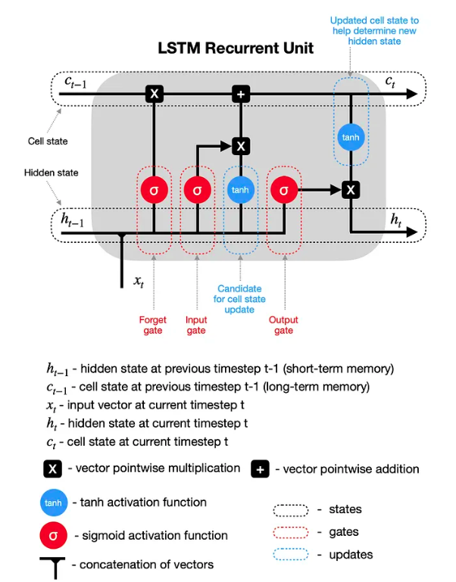
LSTM

Slide 10
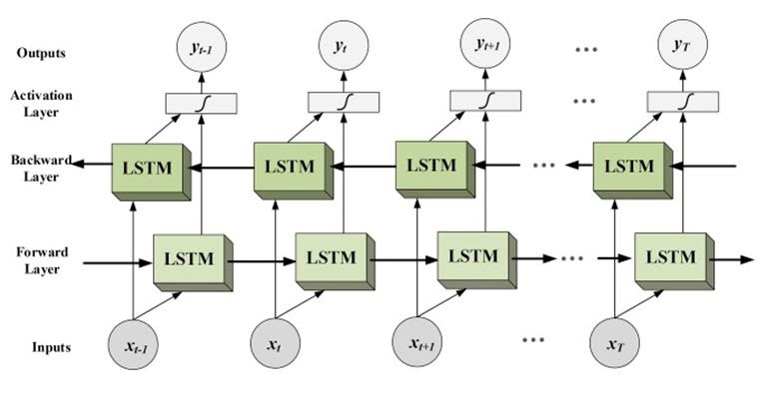
Bidirectional LSTM

Slide 11
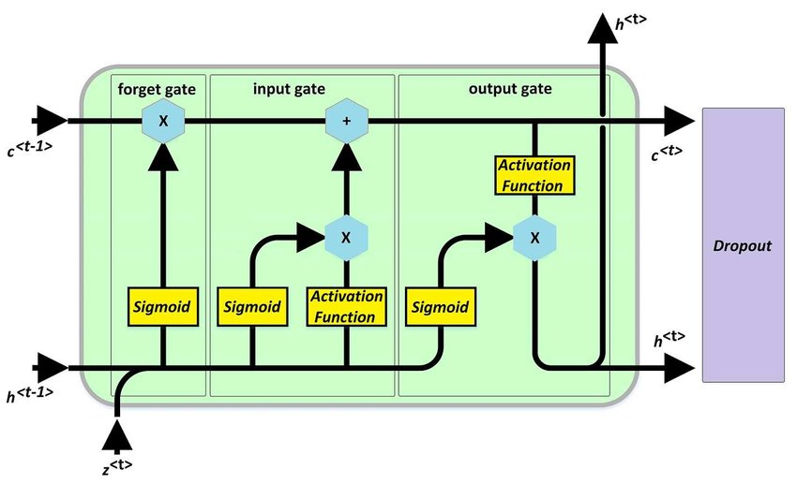
LSTM + Dropout Layer

Slide 12
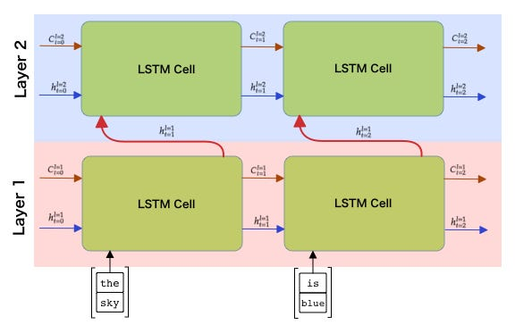
Multi-layer LSTM

Slide 13
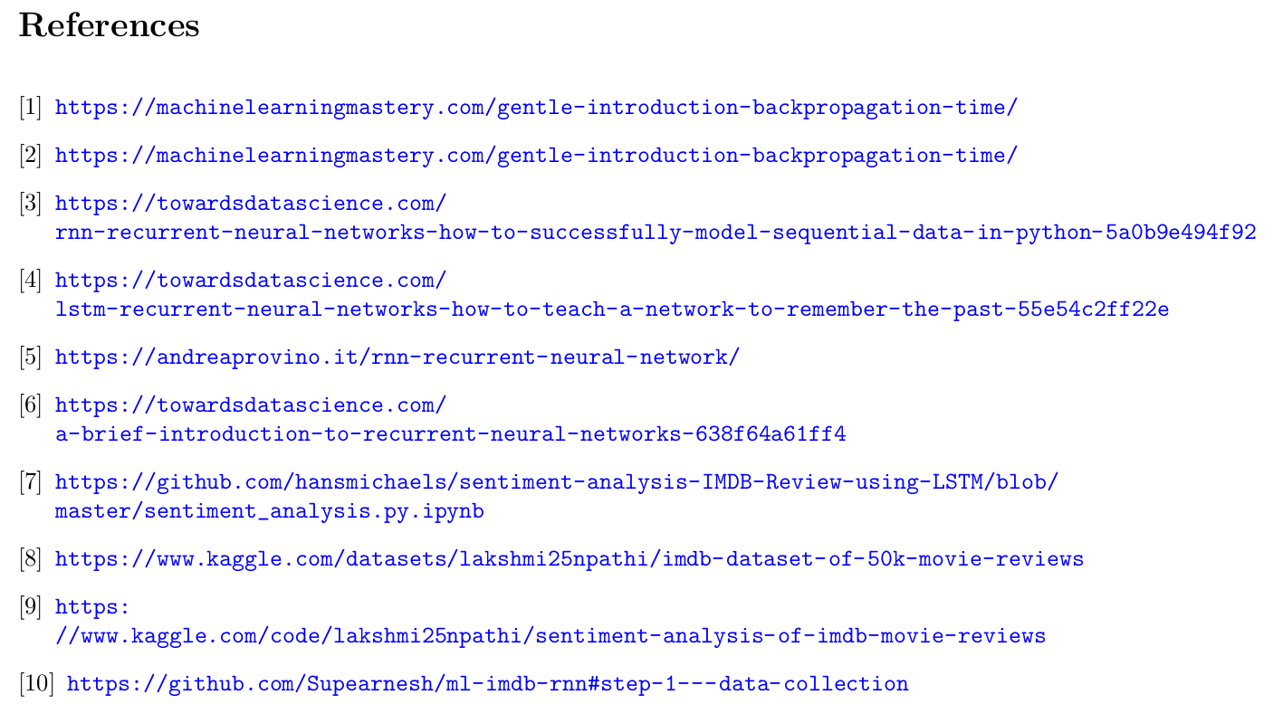
Riferimenti

