Slide 1
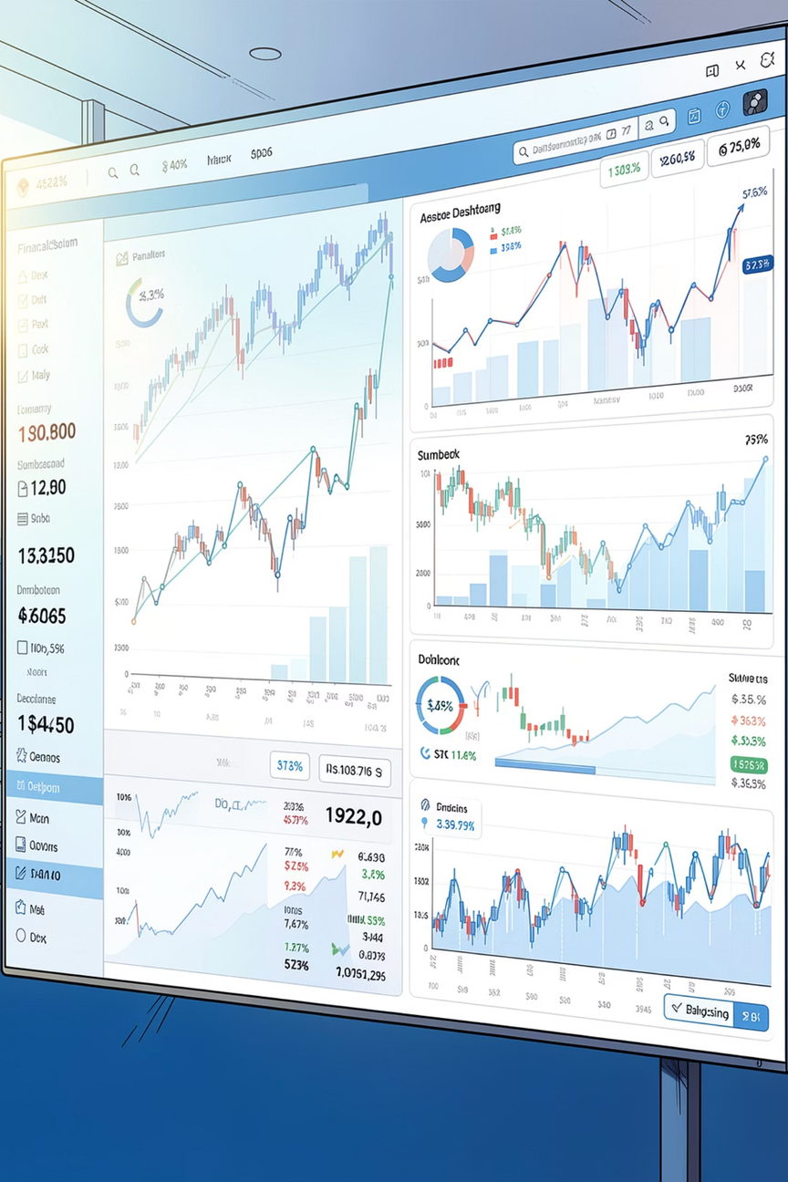

Mutual Fund Analytics and Investment Insights Platform
End-to-End Data Analytics & Financial Intelligence Solution
Author: Manoj BM - Data Analyst Intern
GitHub: github.com/iammanoj-dev/mutual-fund-analysis
Notes:
1

Slide 2


Business Problem
Evaluation Complexity
Manual Analysis Limitations
Investors struggle to compare funds across large volumes of NAV and transaction data.
Manual methods are slow, error-prone and don't scale for cross-scheme comparisons.
Need Risk-Adjusted Metrics
Actionable Insights
Investors need clear, interpretable recommendations aligned to risk appetite.
Standard returns miss downside risk — requires Sharpe, Sortino, VaR and drawdown analysis.
Speaker note: Emphasise the gap between raw data availability and usable investment intelligence.
Notes:
2

Slide 3



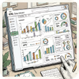


Project Objectives
Automated ETL
Data Quality
Data Management
Analytics & Dashboards
Ingest raw NAVs & transactions, schedule processing and persist to SQLite.
Validate, normalise dates, handle missing NAVs and standardise scheme identifiers.
Efficient storage and schema design for analytics workflows and reproducibility.
Exploratory and performance analytics surfaced in Tableau for stakeholder review.
Advanced Analytics
Recommendation Engine
Compute Sharpe, Sortino, VaR, CVaR, rolling metrics and concentration measures (HHI).
Rule-based fund recommendations mapped to Low / Moderate / High risk profiles.
Notes:
3

Slide 4

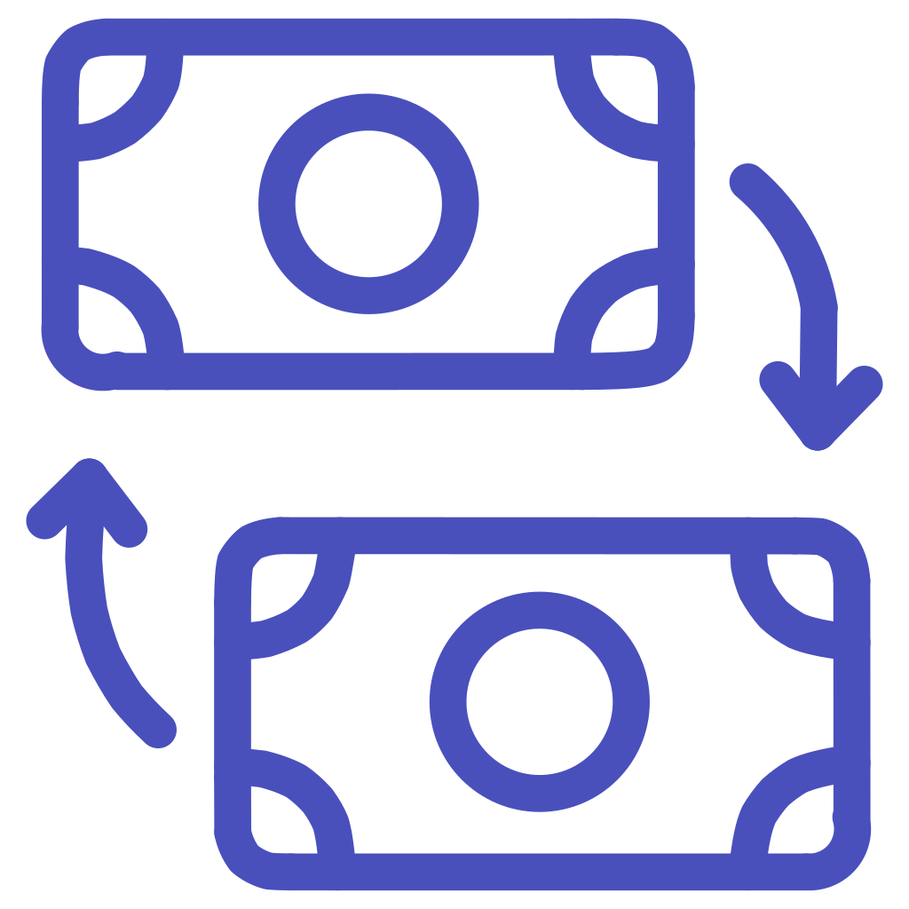
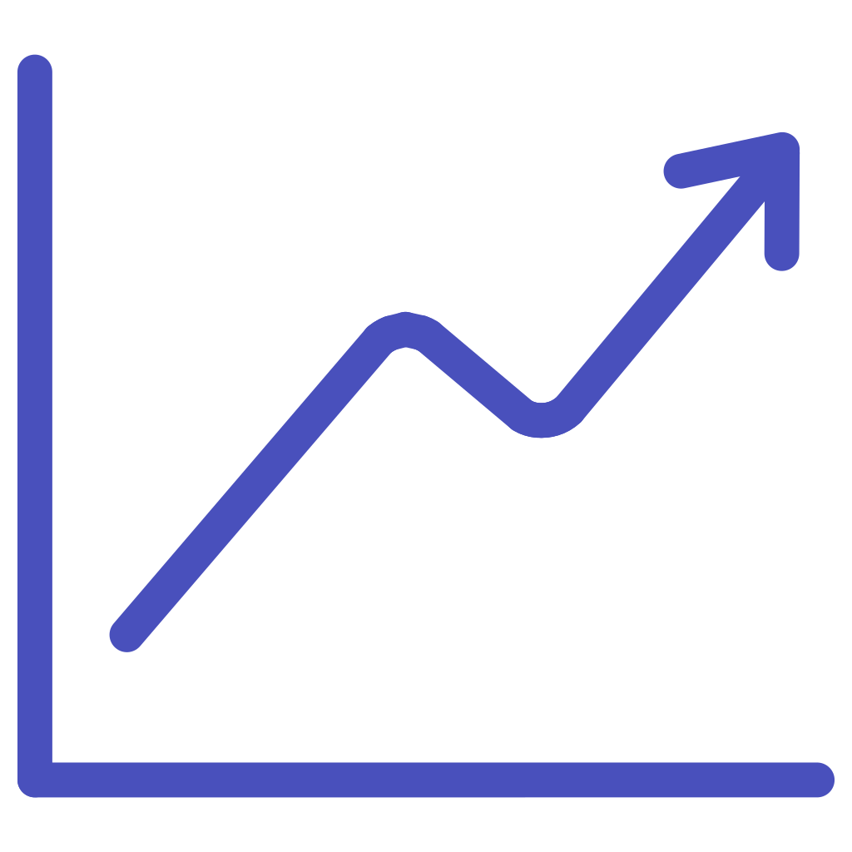
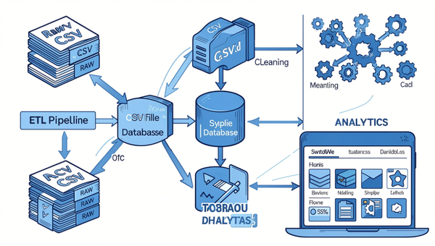



Data Sources & Dataset Overview
NAV History Dataset
Daily NAVs per scheme — price history and missing-value flags.
Investor Transactions
SIP/STP lumpsum transactions and folio-level flows.
Scheme Performance
Pre-computed returns, AUM snapshots and category metadata.
Benchmark Data
Index series for relative performance and alpha/beta estimation.
Portfolio Holdings
Sector & security weights used for concentration and HHI calculations.
Fund Master
Scheme identifiers, fund house, category and launch dates.
Notes:
4

Slide 5
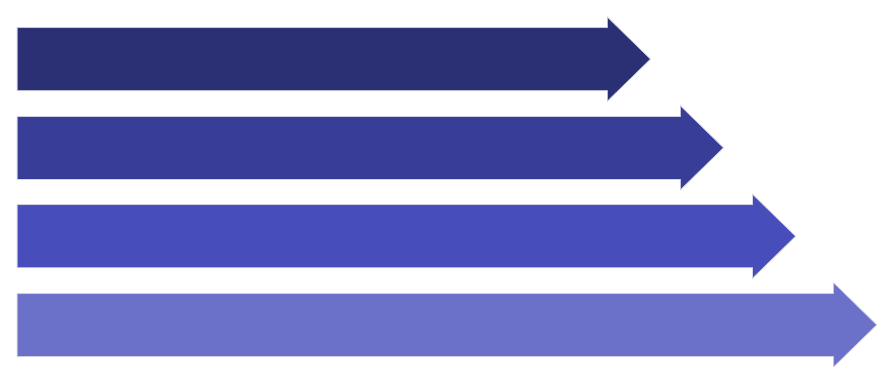
Project Architecture & Workflow
Ingest CSV
Clean & Validate
Store & Explore
Analyze & Dashboard
Key technologies: Python (scripts & modules), Pandas, NumPy, SQLite, Tableau, GitHub for version control and reproducibility.
Notes:
5

Slide 6
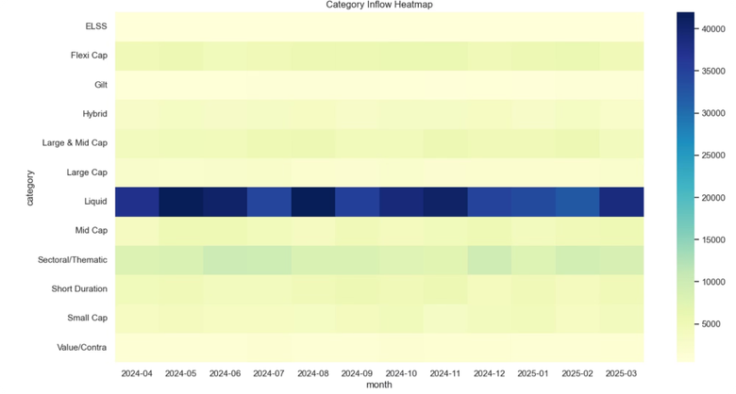
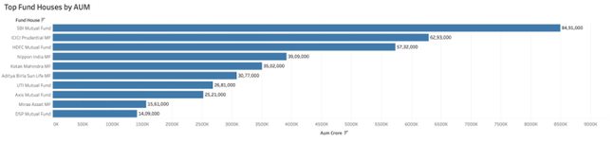
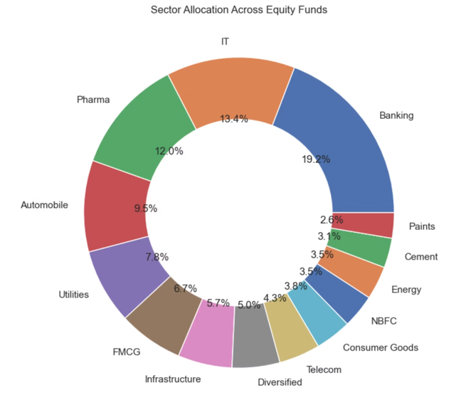
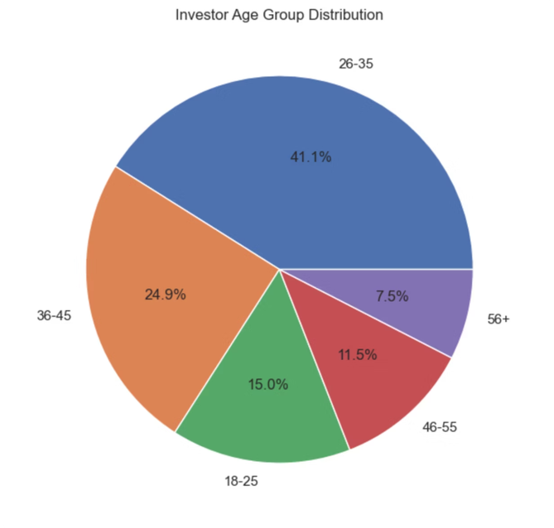
Exploratory Data Analysis (EDA)
Fund House Analysis: Concentration among top 10 houses; long tail of smaller managers.
CATEGORY INFLOW HEATMAP
Scheme Distribution: Equity-dominant universe with sizeable debt allocation in conservative portfolios.
INVESTOR AGE GROUP DISTRIBUTION
Notes:
6

Slide 7
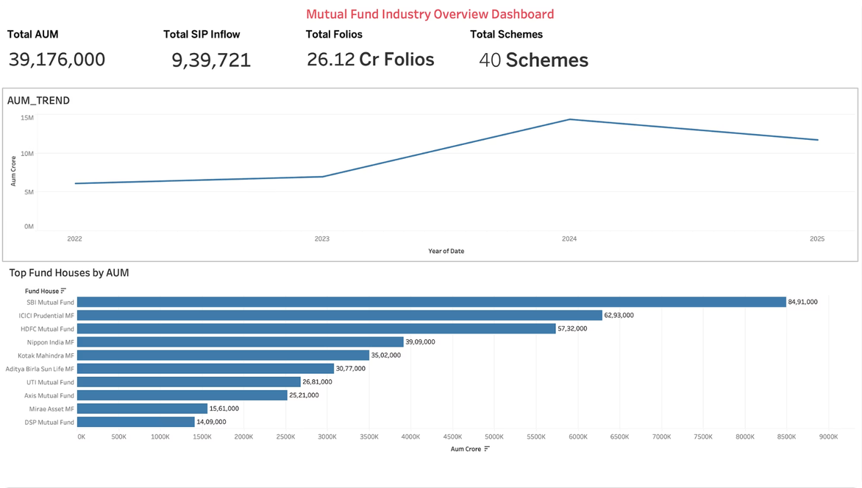

Performance Analytics
CAGR
Sharpe Ratio
Annualised return over chosen horizon — baseline performance metric.
Return per unit volatility; used for risk-adjusted ranking.
Sortino Ratio
Alpha & Beta
Downside-risk-focused version of Sharpe — penalises negative volatility.
Relative return vs benchmark and systematic risk exposure.
How metrics help: Combine return and risk to prioritise funds that deliver consistent, risk-aware performance rather than raw returns.
Max Drawdown
Largest peak-to-trough decline — crucial for downside tolerance.
Speaker note: Briefly explain calculation windows (e.g., rolling 3Y annualised) and data adjustments (annualisation, risk-free rate assumption).
Notes:
7

Slide 8
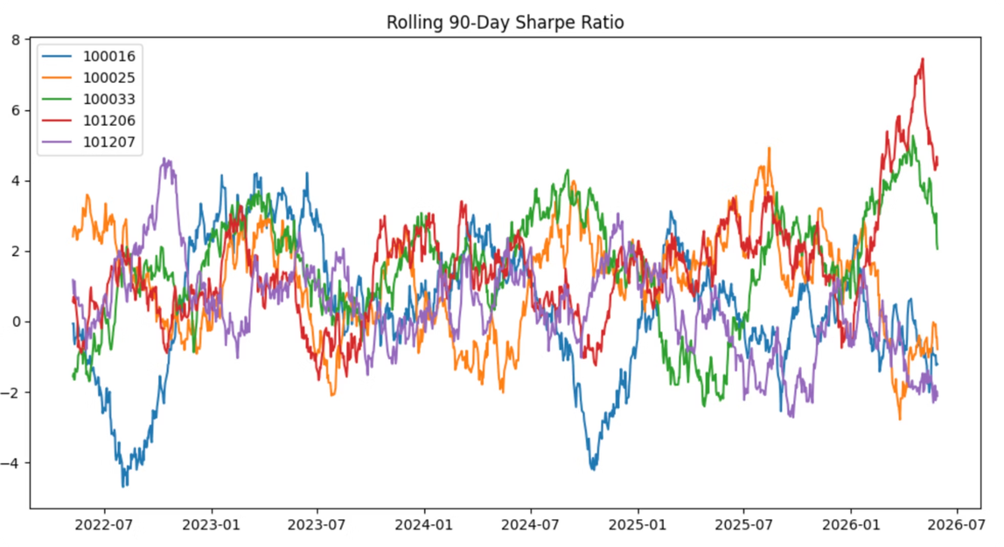
Advanced Risk Analytics
Historical VaR (95%) & CVaR: Estimate tail losses to quantify extreme downside risk.
Rolling 90-Day Sharpe: Short-term signal to detect recent performance regime shifts.
Sector Concentration (HHI): Measure portfolio concentration — higher HHI implies sector risk exposure.
Notes:
8

Slide 9

Fund Recommendation Engine & Tableau Showcase
Input metrics
Sharpe, Risk Grade, History
Tableau Dashboard Showcase
Placeholders for project images (insert provided screenshots):
Output
Fund Recommendation Workflow
Risk appetite mapping
Top N recommended funds
Low, Moderate, High profiles
Dashboard screenshot — Total AUM KPI (image placeholder)
SIP Inflow KPI (image placeholder)
Total Folios & Total Schemes KPIs (image placeholder)
AUM Trend Analysis chart (image placeholder)
Top Fund Houses by AUM (image placeholder)
Rules & filters
Scoring & ranking
Sharpe threshold, HHI, drawdown
Apply Sharpe & concentration
Recommendation logic: Score funds on Sharpe, downside metrics and concentration; apply risk-grade filters to match investor profile.
Notes:
9

Slide 10

Dashboard
Notes:
10

