Slide 1

A Hospital Medical diary
By:
Marko Ludaic, Denis Expósito , Nikola Panajotovikj

Slide 2
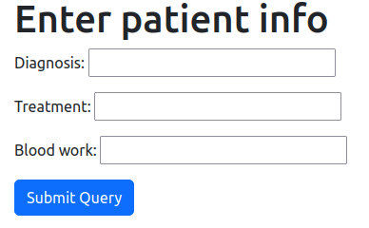
General concept
User management = different users will have different privileges
ex. nurse, doctor, receptionist, etc.
Different users will enter data into tables depending on their jobs
Summary information from all tables in the database will be displayed on one page where all staff have access

Slide 3



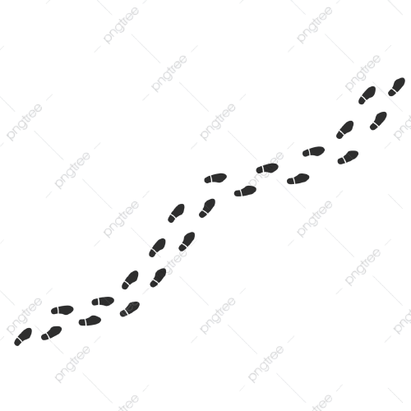





Nurse
Doctor
Receptionist
Patient

Slide 4

Summary Table - searchable by field
…
…

Slide 5
