Slide 1
Unsupervised Seismic Anomaly Detection
Srija Chakraborty
Maxfield Thompson
Mentors: James Theiler, Diane Oyen
08/10/2017

Slide 2
Outline
Motivation
Dataset
Unsupervised Approach
Approaches
- Short Term Average-Long Term Average (STA-LTA)
- Spectrogram as Feature
- Mahalanobis Distance
- Autoencoder
Results
Future Work

Slide 3
Motivation
Anomalies : Data samples that are unlike the rest of the data
Uninteresting Events
Large Incoming Dataset
Anomaly Detector
Detected Anomalies
Interesting Events
Further Analysis
Final Objective – In a large seismic dataset, identify events that are interesting to seismologists.
Intermediate Objective - Find events that are unusual (includes both interesting and uninteresting events).
Notes:
In a large dataset, we can have observations that are different from most of the data. These different observations are anomalies and it is interesting to study anomalies because they are unusual. Anomalies can just arise due to noise/interference (uninteresting), But it may arise because something unusual or different and interesting actually happened (which we call events) and this requires further analysis. The purpose of anomaly detection is to identify observations that are unlike the rest of the data. The number of anomalies detected is much smaller in number compared to the size of the dataset itself and can potentially be analyzed further by human experts.
In our work, we are interested in detecting seismic anomalies. Seismc signals are electronic records of vibrations recorded due to some motion on the ground.
The final objective in that would be to detect events that are interesting to seismologists such as eq and mine blasts. To reach that objective, we have this intermediate step where we find the anomalies that includes what is interesting and uninteresting. So hopefully, we find all the interesting events.
3

Slide 4
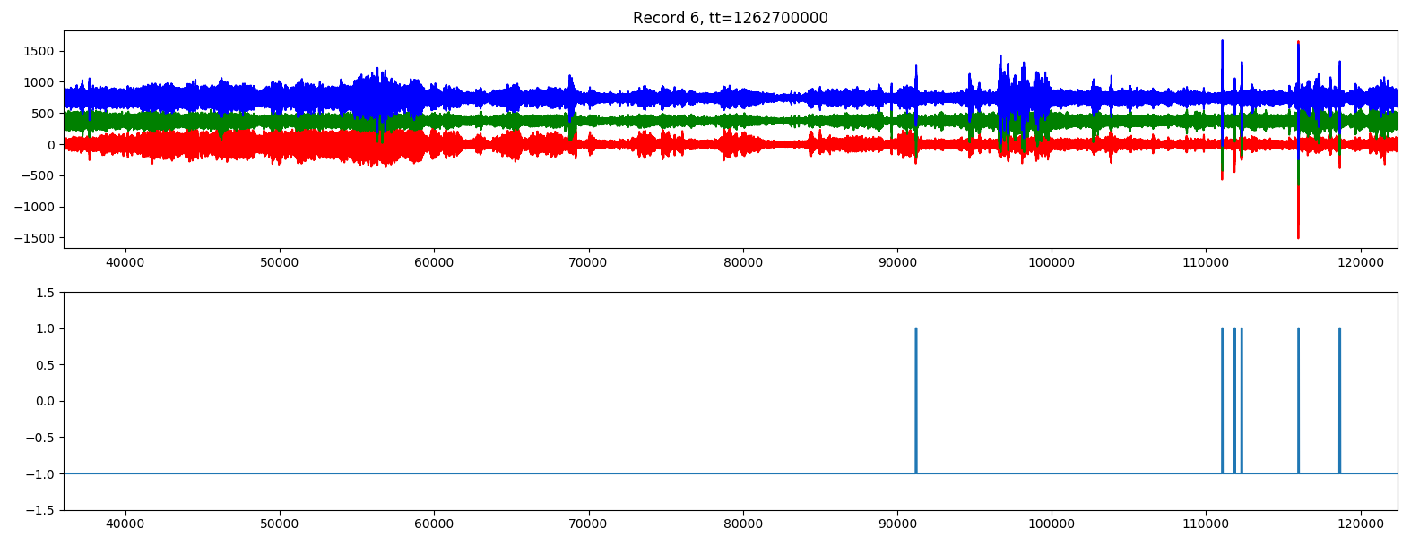
Dataset
Seismic data from a single station
Three channels
Labeled events (earthquakes, mine blasts)
Has events that are not labeled
Top – Signal from all sensors
Bottom – Labeled Events
Notes:
Our dataset consists of seismic signals recorded over 3 channels in a seismic station. We have 252 records where each record corresponds to a day. Our data has anomalies that are uninteresting (such astraffic – truck driving by or weather phenomemon) and interesting events such as earthquakes and mine blasts. Some of the interesting events are labeled by experts – but not all of them. Ideally we want to develop an approach that detects all the labeled events and events that are interesting but not labeled.

Slide 5
Unsupervised Learning
Arrival time of primary (P) and secondary (S) waves
- regional Geology
- distance of event from sensor
Incomplete labels
Generic model independent of local properties
Notes:
In unsupervised learning we have a training set, that may or may not be labeled. But the labels are not used in the training process. In our woek we have some labels available. But we take a unsupervised approach where we don’t use the labels. There are 2 reasons for this:
Seismic events are characterized by P (primary wave) followed by S wave. Arrival times of these waves at a sensor are affected by regional geology and the distance from the sensor. In order to make our approach independent of these factors (because we don’t want to encode these properties such as distance/ geology in our training and make it very specific) avoid regional geological property encoding in our training set(which would also be expensive to acquire), we take an unsupervised approach.
Incomplete labels – not all events are labeled. If an event is different from other labels a supervised approach would not detect this event.

Slide 6
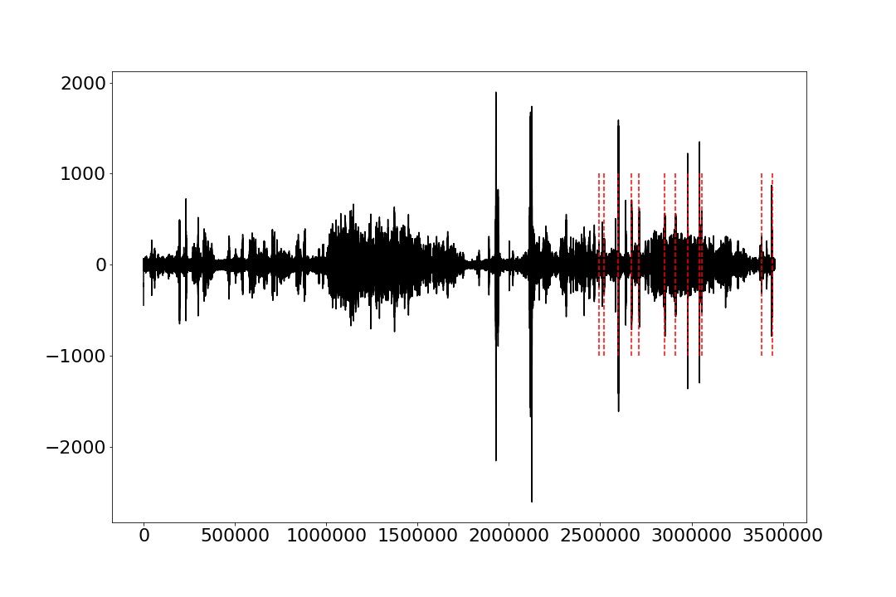

Short Term Average/Long Term Average
Short Term Average/Long Term Average, STA/LTA(t) = $\frac{\frac{1}{\left|sta\right|}}{\frac{1}{\left|lta\right|}}\frac{\sum_{i=1}^{\left|sta\right|}{x_{i+t}^{2}}}{\sum_{j=1}^{\left|lta\right|}{x_{t−j}^{2}}}$
STA/LTA (t)
LTA window
Signal Magnitude [sensor]
STA window
Time [samples]
Notes:
A standard approach used in seismology is the STA LTA, where the ratio of the average magnitude sq of the signal in a short term window over the average magnitude square of the signal in the long term window is taken to detect events.

Slide 7
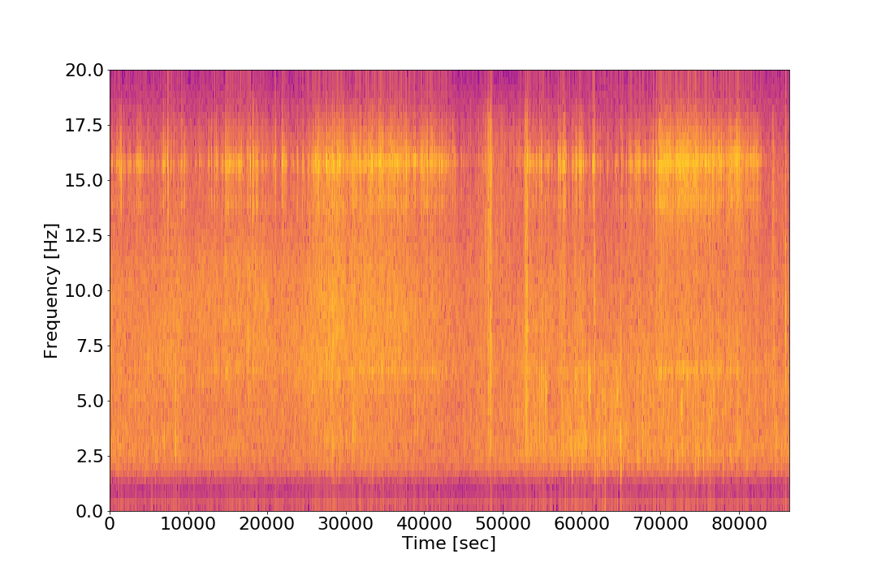
Spectrogram as Feature
Magnitude Square of Short Term Fourier Transform (STFT)
Signal Magnitude [sensor]
Time [samples]
Represents raw signal as a time varying power spectrum
Spectrogram

Slide 8
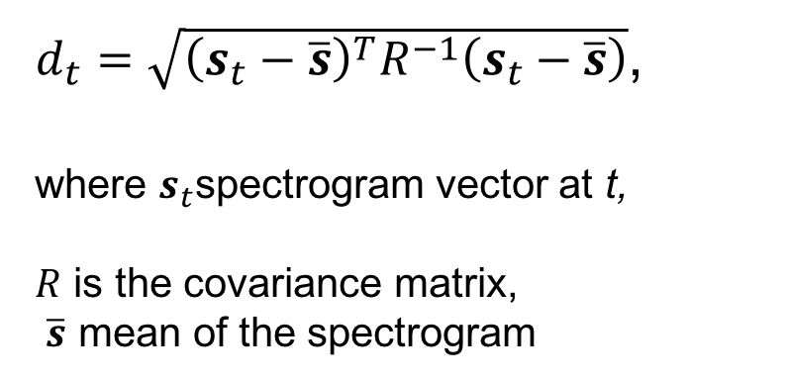


Mahalanobis Distance
Mahalanobis distance $d_{t},$ to spectrogram mean
$$s_{t}$$
$$s_{t}$$
20 Hz
$d_{t}=\sqrt{{\left(s_{t}−\overline{s}\right)}^{T}R^{−1}\left(s_{t}−\overline{s}\right)}$,
where $s_{t}$spectrogram vector at t,
$R$ is the covariance matrix,
$\overline{s}$ mean of the spectrogram
.
.
.
Over a day
0 Hz
Spectrogram over a day
Notes:
We developed a basic anomaly detection approach using the mahalanobis distance of the spectrogram vector st at each window to the mean of the spectrogram s. As the spectrogram is split over several frequency bins,We use the mahalanobis distance to capture the distance of spec at each window to the mean in a multivariate sense. So this captures the overall relationship between the frequencies

Slide 9
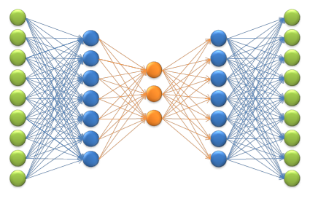
Autoencoder
Input Layer [spectrogram vector]
Output Layer [spectrogram vector]
Compression Layer
Hidden Layers
https://velesnet.ml/docs/_images/autoencoder.png

Slide 10
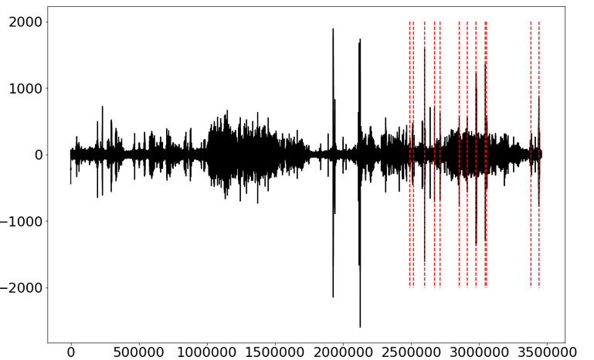
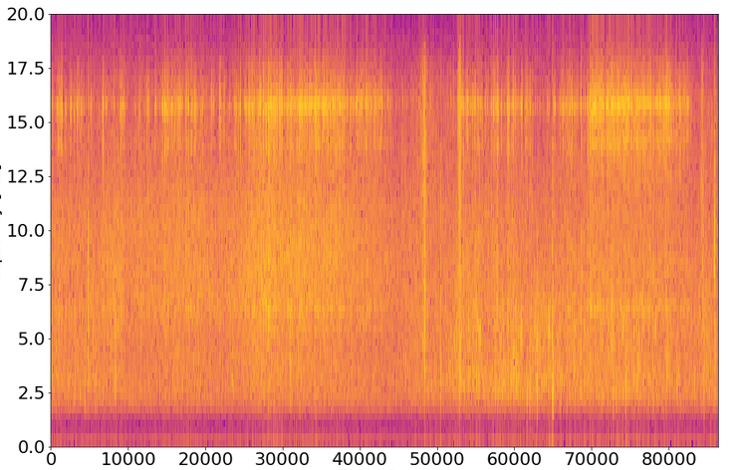

Autoencoder Approach
Unsupervised Learning Approach:
Autoencoder: Learn a compressed spectrogram representation of the background class
Input Feature: Three spectrogram vectors
Assumption: High reconstruction error implies anomalies
Expectation: Labeled and unlabeled events lie in top k% of reconstruction error
Original Signal – Day 89
Spectrogram of Signal – Day 89
Frequency [Hz]
Signal Magnitude [sensor]
Time [samples]
Time [sec]

Slide 11
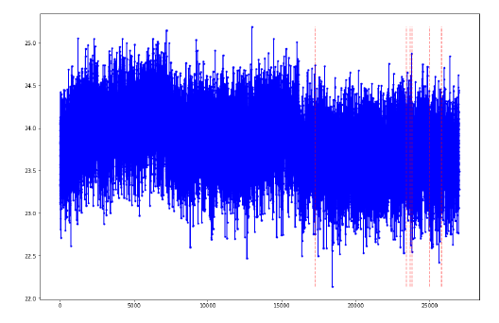
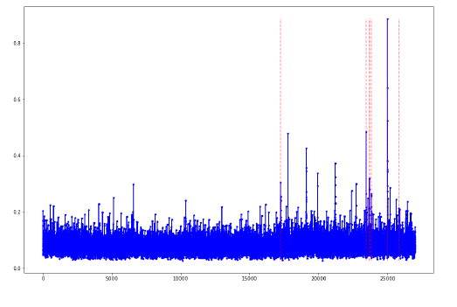
Hyper-parameter Selection
In order to create the best autoencoder, a series of experiments were created to select the optimal parameters. These experiments systematically ran through hundreds of autoencoders and examined their reconstruction errors on a series of days to see which set of parameters best caught the labeled anomalies.
Reconstruction Error – Day 6
Reconstruction Error – Day 6
Reconstruction Error
Reconstruction Error
Time [3.2 sec window]
Time [3.2 sec window]

Slide 12
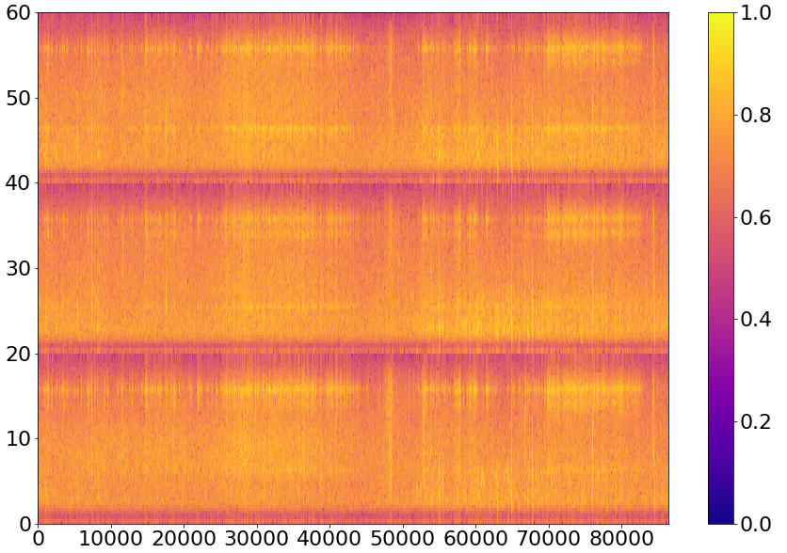
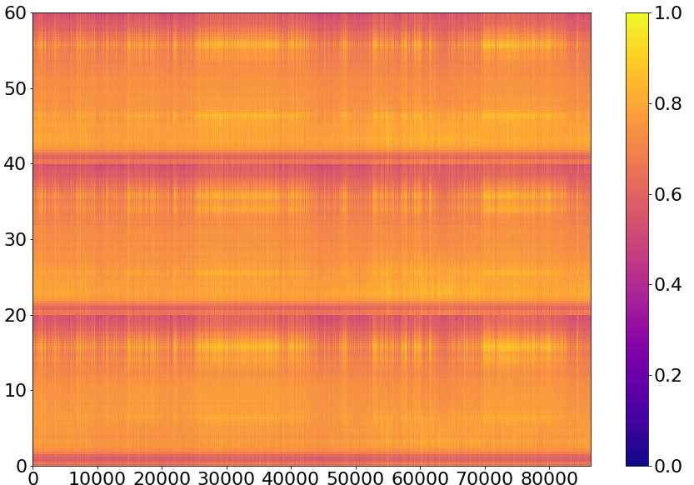
Spectrograms
Original Spectrogram
Reconstructed Spectrogram
Frequency [Hz]
Frequency [Hz]
Time [sec]
Time [sec]

Slide 13
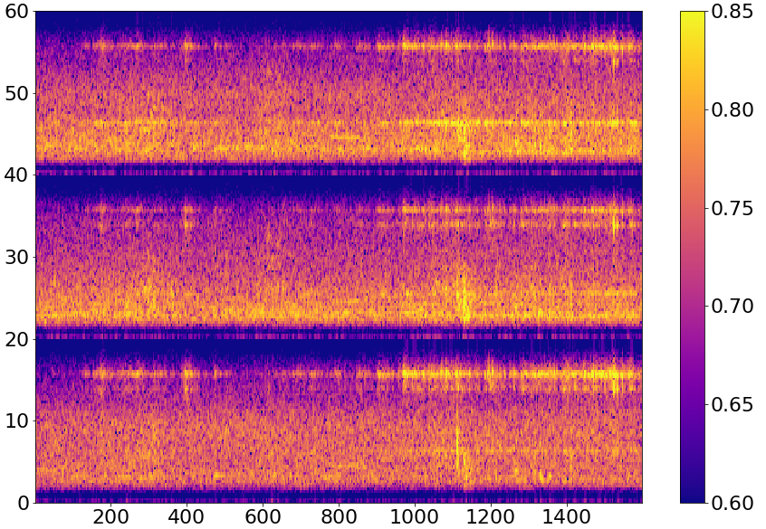
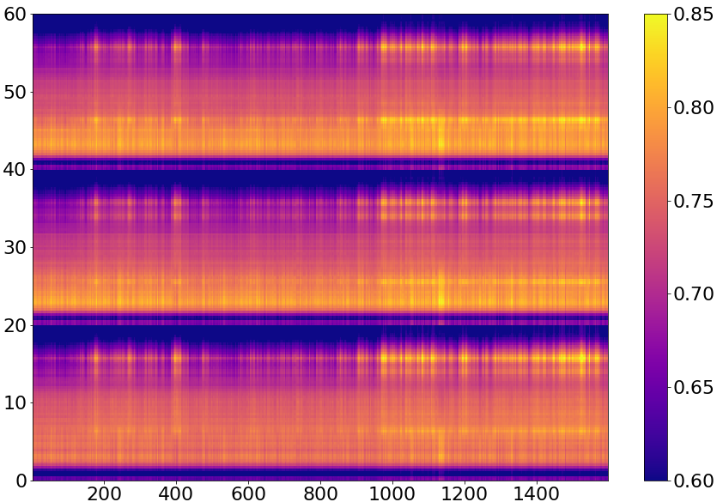
Spectrograms In-depth
Original Spectrogram
Reconstructed Spectrogram
Frequency [Hz]
Frequency [Hz]
Time [sec]
Time [sec]

Slide 14
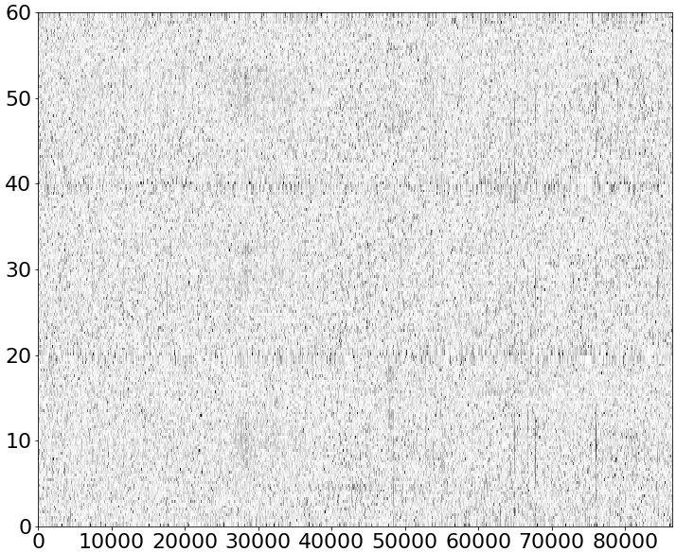
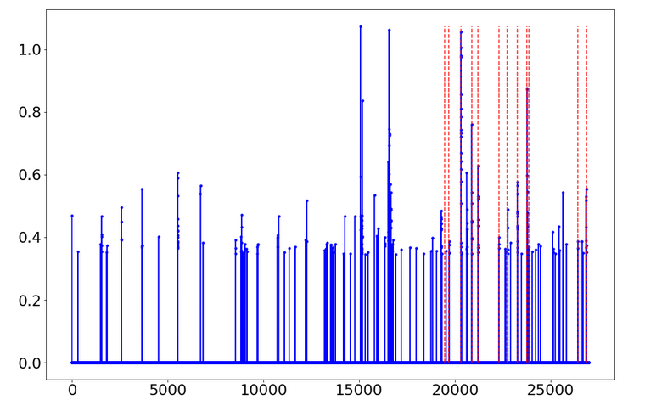
Reconstruction Error Spectrogram
Frequency [Hz]
Time [sec]
Original Signal
Reconstruction Error [after threshold]
Reconstruction Error
Signal Magnitude [sensor]
Time [samples]
Time [3.2 sec window]

Slide 15
Channel Selection Experiments
P wave [4 to 12 Hz] and S wave [1 to 4 Hz]
Autoencoder on 4-12 Hz
Significantly lowered the overall accuracy of the autoencoder.
There is important information that characterizes an earthquake in frequency bands not classically associated with the p and s waves.

Slide 16
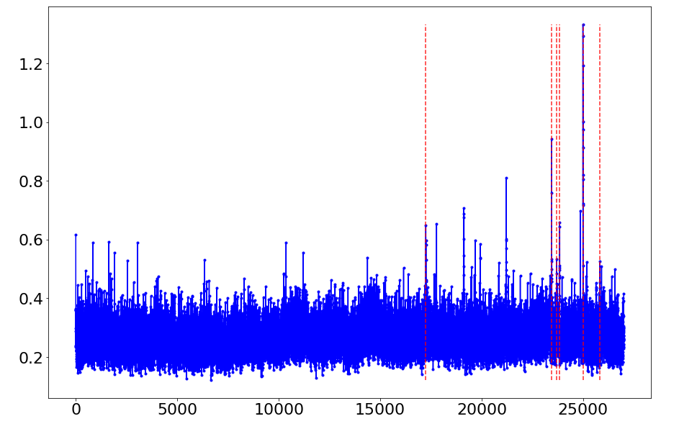
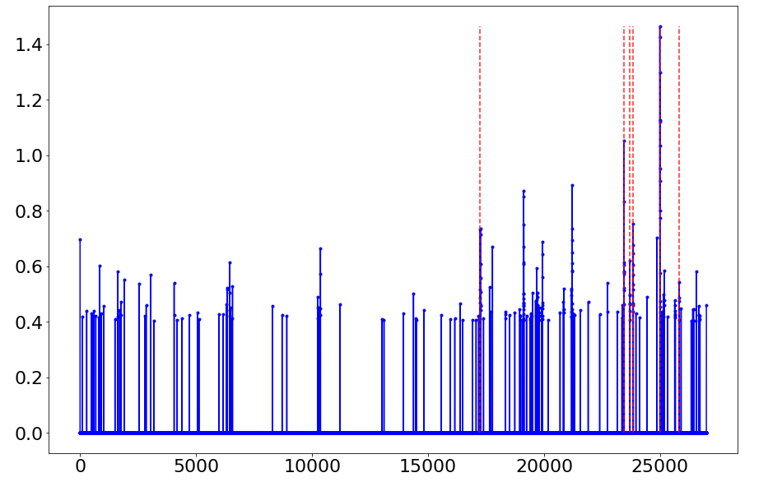
Threshold Selection
Various thresholds were selected as methods to filter the reconstruction error. The most effective threshold tested was a raw percentile distribution cut. For all anomaly detection methods tested, we chose to examine the top 1 percent of reconstruction error values.
Reconstruction Error – Before Threshold
Reconstruction Error – After Threshold
Reconstruction Error
Reconstruction Error
Time [3.2 sec window]
Time [3.2 sec window]

Slide 17
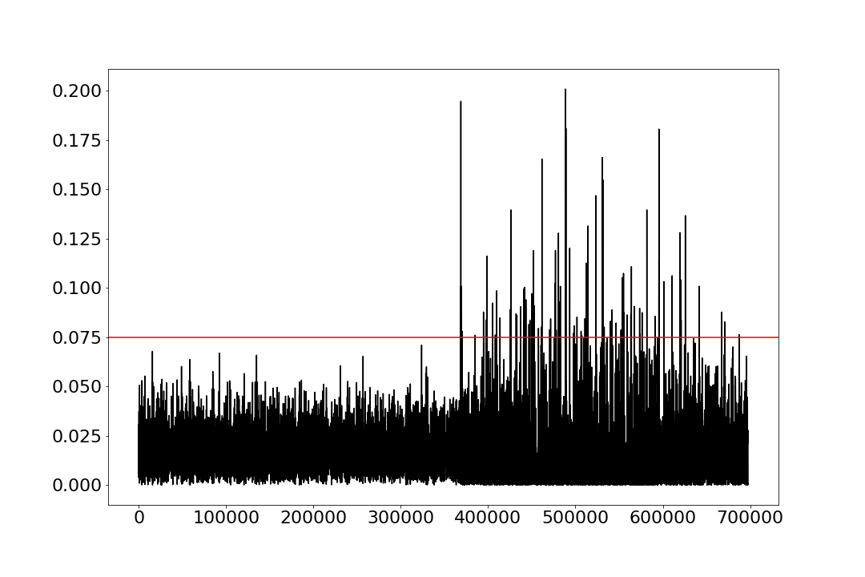
Results
Comparison with other anomaly detectors:
Mahalanobis distance to mean of the spectrogram
Metric: percentage of labeled events detected
STA/LTA
Approach | True Events Detected [threshold = top 1% of reconstruction error]
Autoencoder | 86.45%
Mahalanobis Distance | 65.45%
Time (samples)
Notes:
We evalute this appraoch by comparing it with another anomlay detector we developed (mahal) and the starte of art used by seismologists (stalta - ). We use the percebtage of true events detected at top 1% recon error as our metric. The autoencoder outperforms the mala approach. Our stalta code is running and it should be ready for our final talk where will also discuss and analyze our techniques in details.

Slide 18
Future Work
Other anomaly detectors
Modeling trend on multiple days
Optimum training data size - diurnal and short term patterns
Geographic Associations – multiple sensors

