Slide 1
Fake News Detection Using NLP and Machine Learning M.Harshavardhana(2015103012) V.RamKumar(2015103018)

Slide 2
INTRODUCTION:
The term 'fake news' became common parlance for the issue, particularly to describe factually incorrect and misleading articles published mostly for the purpose of making money through page views.
It has the potential to mold opinions and influence decisions.
The proliferation of fake news on social media and Internet is deceiving people to an extent which needs to be stopped.
OBJECTIVES:
To classify news articles into fake or true.
To use NLP applications like Stemming, Tokenization, stop-word removal for feature selection
To use Machine Learning algorithm-Random Forest to train the given dataset
To improve the accuracy of prediction of the fake news from real ones.

Slide 3
PROBLEM DEFINITION:
Develop a machine learning program to identify when a news source may be producing fake news.
We aim to use a corpus of labeled real and fake new articles to build a classifier that can make decisions about information based on the content from the corpus.
The model will focus on identifying fake news , based on multiple articles originating from a source.

Slide 4
LITERATURE SURVEY:
NO. | AUTHOR –PUBLICATION-YEAR | METHODOLOGY | ADVANTAGES | LIMITATIONS
1. | Mykhailo Granik, Volodymyr Mesyura IEEE - 2017 | Naive Bayes classifier | 74% accuracy in predicting output | IMPROVE CLASSIFIER: Use stemming Remove stop words from the news articles Get more data and use it for training
2. | James Thorne, Mingjie Chen, Giorgos Myrianthous EMNLP Workshop on Natural Language Processing meets Journalism -2017 | Ensemble method | 78% accuracy in predicting the output | Use temporal Splitting of dataset

Slide 5
NO. | AUTHOR - PUBLICATION – YEAR | METHODOLOGY | ADVANTAGES | LIMITATIONS
3. | Veronica P ´ erez-Rosas, Bennett Kleinberg, Alexandra Lefevre, Rada Mihalcea 2017 | SVM classifier | 74% accuracy in prediction | To gain further insights into the semantic classes that are associated with fake and legitimate content
4. | Manisha Gahirwal Sanjana Moghe Tanvi Kulkarni Devansh Khakhar Jayesh Bhatia International Journal of Advance Research, Ideas and Innovations in Technology -2018 | Stance detection | Calculation of F-score | Use of different NLP and ML algorithms
5. | Victoria L. Rubin Niall J. Conroy Yimin Chen University of Western Ontario- 2015 | vector space model | 63% accuracy | Improving accuracy

Slide 6
S.NO | AUTHOR-PUBLICATION - YEAR | METHODOLGY | ADVANTAGES | LIMITATIONS
6. | Gisel BastidasGuacho- SaraAbdali -EvangelosE.Papalexakis | Tensor Embeddings And Label Propagation | 70% ACCURACY With few labeled news | No limitations specified Only the performance
7. | Claire Li Deep Learning Research & Application Center 2017 | Feature Vectors Network Structure | Application of RNN | No limitations specified Only the performance
8. | Matthew N O Sadiku, Tochukwu P Eze, and Sarhan M Musa International Journal of Advances in Scientific Research and Engineering 2018 | Details of FakeNews | Importance of detecting fake news | Social impact of fake news

Slide 7
PROBLEMS IDENTIFIED:
SOCIAL PROBLEMS:
“Fake news spreads faster than true news on Twitter—thanks to people, not bots”
“Public opinion on outside groups or agents planting fake news stories in mainstream media in the United States as of March 2018”
“Most popular fake election stories in the United States in 2016, by Facebook engagement* (in thousands)”
PROBLEMS WITH DEVELOPED MODELS:
ACCURACY
DATASET
FEATURE SELECTION METHODS

Slide 8
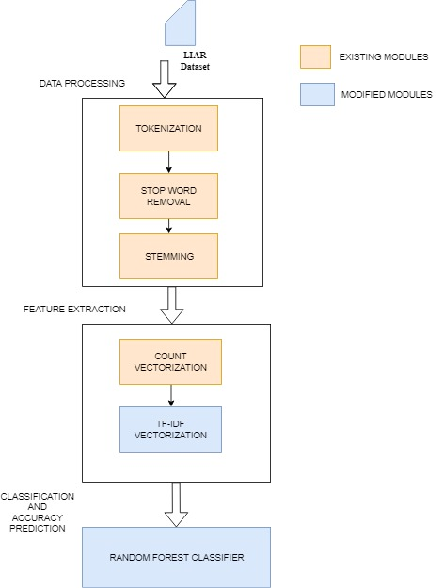
BLOCK DIAGRAM

Slide 9
MODULES DESCRIPTION:
INPUT:
DATASETS : train.csv
OUTPUT:
Accuracy of Prediction, F-Score, Precision, Recall, Confusion Matrix
EVALUATION METRICS:
Confusion Matrix
Accuracy Calculation
Precision Calculation
Recall value Calculation
F-Score calculation
METHODOLOGY:
DATA PREPARATION : Tokenization, Stop-word Removal, Stemming
FEATURE SELECTION: Count-Vectorizer, Tf-idf Weighting
MODEL USED : Random Forest Classifier

Slide 10
Methodologies
Stemming:
Stemming is the process of reducing inflected (or sometimes derived) words to their word stem, base or root form—generally a written word form.
Tokenization:
Given a character sequence and a defined document unit, tokenization is the task of chopping it up into pieces, called tokens, perhaps at the same time throwing away certain characters, such as punctuation.
TF-IDF Weighting:
The tf-idf weighting scheme assigns to term t a weight in document d.

Slide 11
PSEUDOCODE:
Algorithm Pseudocode:
Randomly select “k” features from total “m” features.
Where k << m
Among the “k” features, calculate the node “d” using the best split point.
Split the node into daughter nodes using the best split.
Repeat 1 to 3 steps until “l” number of nodes has been reached.
Build forest by repeating steps 1 to 4 for “n” number times to create “n” number of trees.
Prediction Output:
Takes the test features and use the rules of each randomly created decision tree to predict the outcome and stores the predicted outcome (target)
Calculate the votes for each predicted target.
Consider the high voted predicted target as the final prediction from the random forest algorithm.

Slide 12
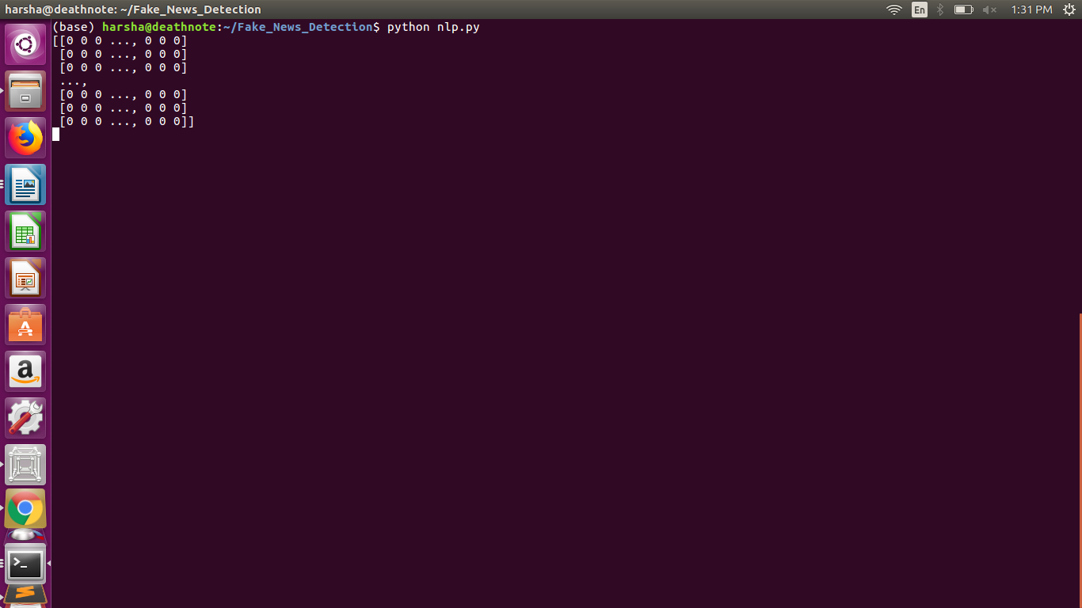
Module Description
Count Vectorizer Input
It is an array consisting of stemmed tokens.
Count Vectorizer Algorithm
cv=CountVectorizer()
X=cv.fit_transform(stemmed tokens).toarray()
Count Vectorizer Output
It is a sparse matrix consisting of 0s and 1s.

Slide 13
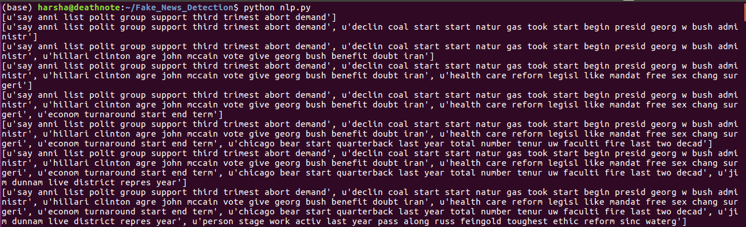
Stemmer and tokenizer Input
It is the input sentence.
Stemmer and Tokenizer Algorithm
ss=SnowballStemmer(‘english’)
Review=[ps.stem(word) for word in review if not word in stopword]
Stemmer and Tokenizer Output

Slide 14
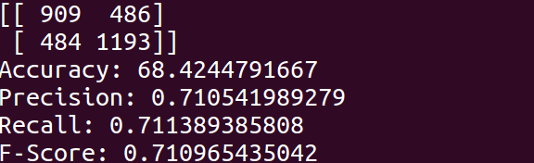
Confusion Matrix Generation Input
It is the classifier’s predicted output and actual output.
Confusion Matrix And Evaluation Metrics Output

Slide 15
DATASET DESCRIPTION
The data source used for this project is LIAR dataset
LIAR: A BENCHMARK DATASET FOR FAKE NEWS DETECTION
Dataset contains:
Column 1: Statement (News headline or text).
Column 2: Label (Label class contains: True, False)
Dataset reduction is done by:
True -- True
Mostly-true -- True
Half-true -- True
Barely-true -- False
False -- False
Pants-fire -- False

Slide 16
REFERENCES:
Steve Fuller [online]
Statistics & Facts about Fake News
Available: https://www.statista.com/topics/3251/fake-news/
Natasha Lomas[online] Fake news is an existential crisis for social media Available: https://techcrunch.com/2018/02/18/fake-news-is-an-existential- crisis-for-social-media/
Katie Langin[online]
Fake news spreads faster than true news on Twitter—thanks to people, not
bots Available: http://www.sciencemag.org/news/2018/03/fake-news-
spreads-faster-true-news-twitter-thanks-people-not-bots

Slide 17
Mykhailo Granik, Volodymyr Mesyura ,Fake News Detection Using Naive Bayes Classifier [online]
JamesThorne ,MingjieChen ,GiorgosMyrianthous ,JiashuPu ,XiaoxuanWang, AndreasVlachos , FakeNewsDetectionusingStackedEnsembleofClassiﬁers [online]
Manisha Gahirwal,Sanjana, MogheTanvi ,KulkarniDevansh, KhakharJayesh Bhatia, Fake News Detection [online]
Niall J. Conroy, Victoria L. Rubin, and Yimin Chen , Automatic Deception Detection: Methods for Finding Fake News [online] Available: https://onlinelibrary.wiley.com/doi/pdf/10.1002/pra2.2015.145052010082
Ver´onica P´erez-Rosas1, Bennett Kleinberg2, Alexandra Lefevre1 Rada Mihalcea1, Automatic Detection of Fake News[online]
Matthew N O Sadiku, Tochukwu P Eze, and Sarhan M Musa , FAKE NEWS AND MISINFORMATION [online] Available: https://ijasre.net/uploads/1/3629_pdf.pdf

