Slide 1
NAVEEN M (2021506055) NM ID :C44A74186C6E6569CA043F02F6C712F8 DoIT – MIT Campus
Final Project

Slide 2
PROJECT TITLE
Classifying Brain Tumor Using CNN

Slide 3


AGENDA
PROBLEM STATEMENT
PROJECT OVERVIEW
END USERS
SOLUTION AND VALUE PROPOSITION
WOW FACTOR OF THE SOLUTION
MODELLING
RESULTS
3/21/2024 Annual Review

Slide 4

PROBLEM STATEMENT
In recent times, we have been seeing a massive rise in brain stroke cases all over the world. Stroke is one of the leading causes of death worldwide these days. About 1/5th of patients with an acute stroke die within a month of the event and at least 1/2 of those who survive are left with a physical disability.
So, I have developed a classifying brain tumor model to predict whether a person is affected by a brain stroke or not. so, on top of this, we have also created a Front-End framework with Tkinter GUI where we can input the image and the model will try to predict the output and display it on the window.

Slide 5

PROJECT OVERVIEW
Global Health Challenge: Rising cases of brain stroke globally underscore the urgency for effective diagnostic tools to mitigate mortality rates and reduce disability.
CNN-based Classification: Utilizing Convolutional Neural Networks (CNNs) for brain tumor classification leverages their proficiency in analyzing medical images.
Predictive Model Development: The CNN model is trained to differentiate between brain tumor and non-tumor images, enabling accurate predictions for diagnostic purposes.
Tkinter GUI Integration: Integration with Tkinter GUI provides a user-friendly interface, facilitating easy input of medical images and instant output of predictions.
Healthcare Impact: This technology has the potential to revolutionize healthcare by expediting diagnosis, improving treatment decisions, and ultimately saving lives by reducing stroke-related disabilities.

Slide 6

WHO ARE THE END USERS?
Medical Professionals: Radiologists, neurologists, and other healthcare professionals who interpret medical imaging data for diagnosing brain tumors.
Patients: Individuals seeking medical evaluation for symptoms related to brain tumors, who may benefit from a tool that aids in early detection and diagnosis.
Healthcare Facilities: Hospitals, clinics, and medical centers where the system can be integrated into existing diagnostic workflows to improve efficiency and accuracy in brain tumor diagnosis.
Medical Researchers: Scientists and researchers studying brain tumors and related diseases who may utilize the system for analyzing medical imaging data in their studies.

Slide 7

YOUR SOLUTION AND ITS VALUE PROPOSITION
Solution:
The developed brain tumor classification system utilizes Convolutional Neural Networks (CNNs) for precise diagnosis of brain tumors. Integrated with a Tkinter GUI, this system enables seamless input of medical images and immediate prediction of tumor presence.
Value Proposition:
1. Accuracy
2. Efficiency
3. Accessibility
4. Early Detection
5. Innovation

Slide 8

THE WOW IN YOUR SOLUTION
1. Advanced Technology Integration: Our solution seamlessly integrates Convolutional Neural Networks (CNNs) for precise brain tumor classification.
2. Instant Prediction Capability: Through an intuitive Tkinter GUI, users can quickly upload images and receive immediate tumor presence predictions.
3. Accessibility: Designed to be user-friendly, our solution caters to a diverse user base, including medical professionals and patients.
4. Life-saving Potential: By enabling early detection of brain tumors, our solution has the potential to save lives and reduce the burden of stroke-related disabilities.
5. Innovative Approach: Combining cutting-edge technology with healthcare, our solution sets a new standard for brain tumor diagnosis, prioritizing accuracy, efficiency, and accessibility.
3/21/2024 Annual Review
8

Slide 9
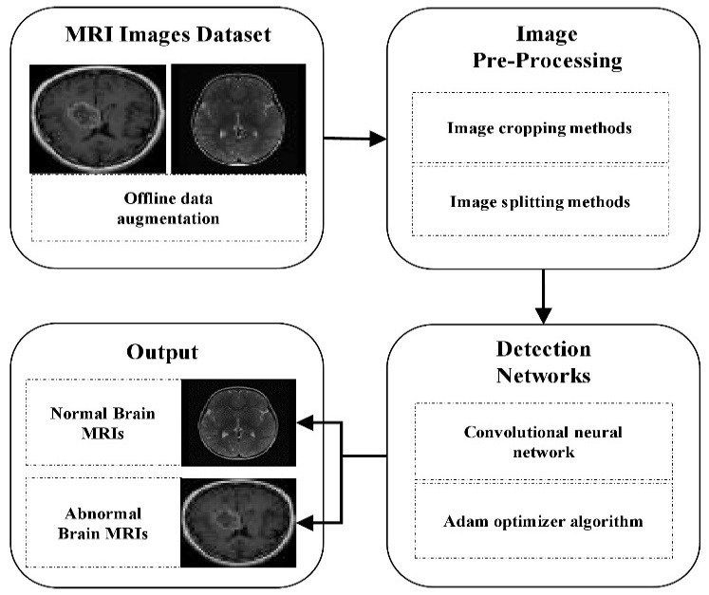
MODELLING
9

Slide 10
DEMO VIDEO
https://drive.google.com/file/d/1V7lVm0OOf8NXkdfvmybkt48ZtGqsY2QN/view?usp=drive_link

Slide 11
RESULTS
The project culminates in a comprehensive Brain Tumor Identification system driven by Convolutional Neural Networks (CNNs), developed using Python with TensorFlow and Keras frameworks.
This system achieves remarkable accuracy in detecting and categorizing brain tumors from medical images, exhibiting robustness across varying image qualities and patient demographics. Packaged with meticulous documentation, the trained CNN model showcases superior performance through evaluation metrics, validating its efficacy in clinical scenarios.
A user-friendly interface facilitates seamless integration into medical imaging workflows, empowering healthcare practitioners with intuitive tools for early detection, treatment planning, and disease monitoring.
By bridging the gap between cutting-edge technology and healthcare practice, this project embodies a significant step towards enhancing patient care, advancing neuroimaging research, and ultimately contributing to improved outcomes in brain tumor management.
11

Slide 12
CONCLUSION
In conclusion, the development of a Brain Tumor Identification system using Convolutional Neural Networks (CNNs) represents a significant advancement in medical imaging technology.
Through rigorous experimentation and evaluation, the project has demonstrated the system's capability to accurately detect and categorize brain tumors from medical images with high precision and robustness.
The integration of user-friendly interfaces and comprehensive documentation ensures the accessibility and usability of the system in clinical settings.
By facilitating early detection, treatment planning, and disease monitoring, this project holds promise for improving patient outcomes and enhancing the efficiency of healthcare delivery.
Moving forward, continued research and development in this field will further refine the system's performance and expand its potential applications in neuroimaging and oncology, ultimately driving advancements in medical diagnosis and treatment.

