Slide 1
ESGenuine
Claim-level extraction and auditing of corporate ESG reports
Parse → extract → deterministically repair → ground → store with provenance
[Team names] · [Institution] · [Date]
Notes:
Open with the one-line pitch: we turn a 90-page sustainability PDF into structured, page-cited claims, and we measure how far that extraction can be trusted.
Replace the bracketed team / institution / date line before presenting.

Slide 2
ESG reports are read by people and audited by nobody
Nothing checks the individual numbers a report asserts
Ratings disagree. Six major ESG raters correlate at only ~0.54 on average (Berg, Kölbel & Rigobon, 2022). A rating cannot serve as ground truth.
Reports have no schema. The same metric is a table cell in one report, a sentence in another and a footnote in a third.
LLM extraction fails silently. The model returns a plausible number, with no signal when it is wrong.
So we change the unit of analysis: from the company to the individual claim, tied to its page and source sentence.
31.7%
of a 70B model's extracted values on a statutory filing do not appear on the page they cite
ESGenuine
2
Notes:
Three problems. Ratings disagree so badly that none can be ground truth. Reports have no schema. And LLM extraction fails quietly: 31.7% of llama-3.3-70b's values on the Tata Power BRSR filing do not occur on the page they cite. That motivates a claim-level system where every number carries its provenance.

Slide 3
What we built
An end-to-end pipeline and a dashboard over it
PDF report
Layout-aware
parsing
LLM
extraction
Deterministic
repair S1–S5
Grounding &
provenance
Claim store
(Supabase)
no model · no network · 0.45 ms/claim
What the dashboard shows
Portfolio globe
companies at a glance
Claim explorer
every claim with page + source sentence
Integrity audit
greenwashing flags & scores
Contradictions
cross-report NLI
Satellite evidence
Sentinel-2 NDVI checks
ESGenuine
3
Notes:
Left to right: layout-aware parsing splits text and tables; an LLM extracts candidate claims; then the part we study — a deterministic repair layer with no model and no network; values are checked against the source page; claims are stored with provenance. The React dashboard reads that store.

Slide 4
It runs end to end on real reports
Counts from the live database, not a mock-up
1,730
claims extracted
6
sustainability reports
461
PDF pages
4
companies
16
cross-report contradictions
82
satellite evidence rows
80.6% carry a numeric value · 1,263 performance / 370 narrative / 97 target · Tata Power (statutory BRSR), Shell, Infosys, Microsoft
ESGenuine
4
Notes:
This is not a scaffold — it has been run end to end. 1,730 claims from six reports, 461 pages, four companies. The NLI contradiction step and the Sentinel-2 satellite checks have both genuinely executed and persisted results.

Slide 5
LLMs extract easily — and normalise badly
Three failure families, all taken from our own corpus
Vocabulary drift
The model writes “GHG emissions” or “carbon footprint”; the claim store needs emissions.scope1.co2e. Free text cannot be compared across reports.
Structural misreads
In a wide fiscal-year table the value comes from the neighbouring column, so the FY23 row carries the FY24 number — fluent, plausible, wrong.
Furniture & fabrication
The form header “No. of employees covered as a % of total employees” becomes a claim of 100%; “Differently abled employees and workers” becomes 44 employees. Neither number is in the table.
None of these is a fluency problem a bigger model obviously fixes — but all of them can be checked after generation, against the parsed page.
ESGenuine
5
Notes:
These are real examples from the Tata Power filing. The point: these are failures of vocabulary alignment and document structure, and a deterministic layer that can read the parsed page can catch them.

Slide 6
The deterministic repair layer
Five cumulative stages. No model, no network, 0.45 ms per claim
S1
Taxonomy normalisation
free text → one of 51 taxonomy nodes across 7 pillars (word-boundary matching, so “diversity” never becomes “biodiversity”)
S2
Fiscal-year column repair
row label names FY23 but the value came from FY24 → re-read the correct cell from the parsed table
S3
Value-in-table check
flag table values that do not appear on the source page (handles Indian 3,86,71,851 and Western 38,671,851 digit grouping)
S4
Rule-based gate
~40 rules: Scope 1/2/3 from row text, gender vs biodiversity, waste vs water, commitment phrasing → target; implausible units flagged
S5
Furniture filter
drop form questions and short labels carrying numbers they cannot contain — the only stage that removes claims
ESGenuine
6
Notes:
Walk through the five stages. Emphasise that none calls a model: this is post-hoc, rule-based and effectively free — 168 ms for a 373-claim report on a laptop CPU.

Slide 7
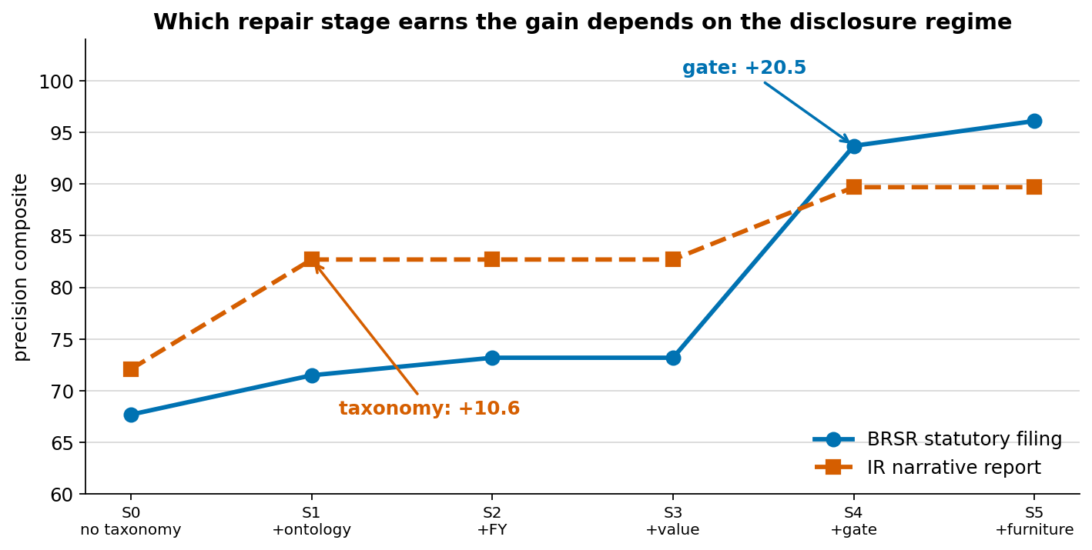
Which repair matters depends on the kind of report
Ablation across two disclosure regimes, 95% CIs from a paired bootstrap
+20.5 from the gate
on the statutory BRSR filing
95% CI [16.3, 25.2]
+10.6 from the taxonomy
on the narrative report
95% CI [7.8, 13.5]
+24.6 and +7.0 points
whole layer over an LLM + vocabulary baseline, at zero inference cost
The two intervals do not overlap: one pipeline tuned on one regime under-serves the other.
ESGenuine
7
Notes:
This is the central finding. On the form-heavy statutory filing, the rule-based gate carries the gain; on the narrative report, taxonomy mapping does. The confidence intervals do not overlap. Because the layer costs almost nothing, a deployment can carry rules for every disclosure format and pick per document.
If asked: we quote S1→S5, not S0→S5, because S0's taxonomy accuracy is 0% by construction. And the fixtures were already partly repaired, so these gains are a lower bound.

Slide 8
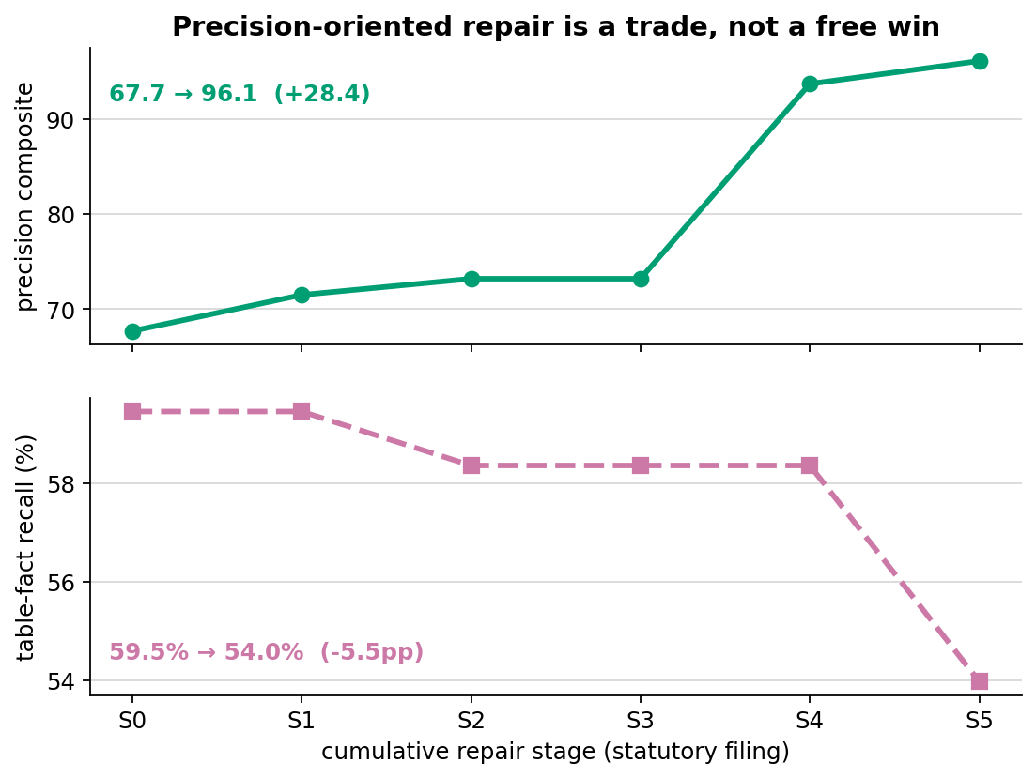
Precision gains cost recall — so we measure both
Statutory filing, same repair stages
Precision composite 67.7 → 96.1 across the repair stages.
Table-fact recall 59.5% → 54.0%: the filters drop some genuine facts.
Recall without annotation. Parsed tables keep row labels and column headers, so every numeric fact on a page can be enumerated mechanically — a denominator independent of the system under test.
Why it matters: a precision-only evaluation would never see this trade.
ESGenuine
8
Notes:
Most pipelines report precision against a gold set sampled from their own output, which structurally cannot count what they missed. We built a recall measure that needs no annotation, and it shows repair trades 5.5 points of table recall for 28.4 points of precision.

Slide 9
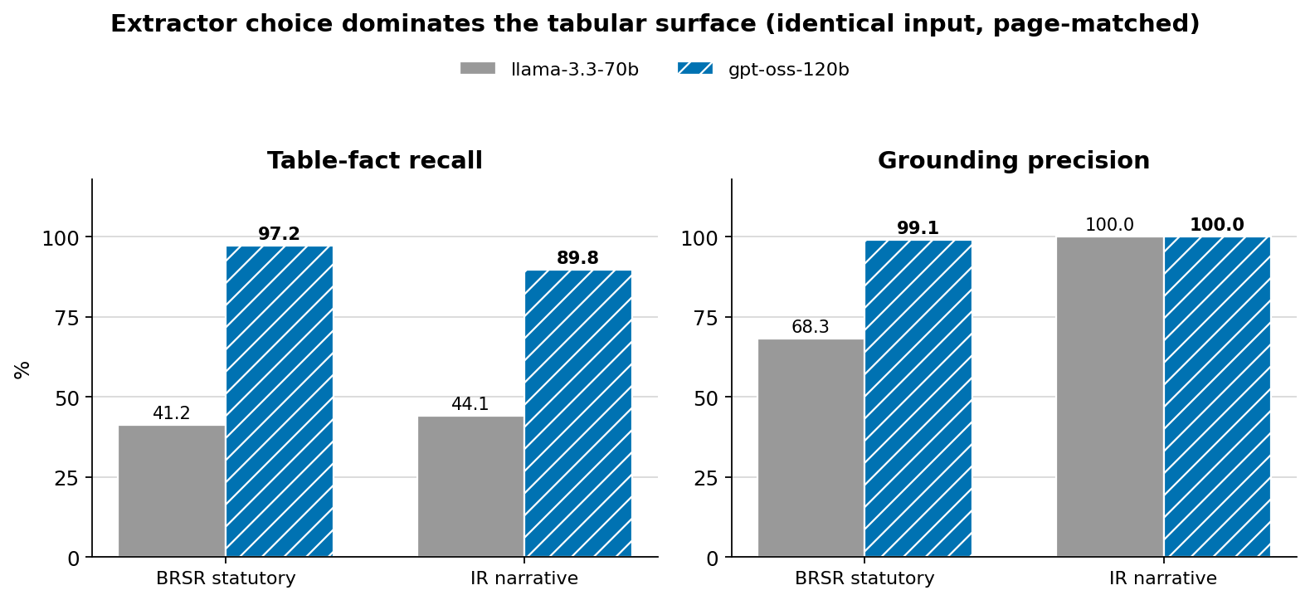
A stronger extractor moves recall far more
gpt-oss-120b vs llama-3.3-70b on identical input, page-matched
31.7% → 0.9%
values not found on the cited page (statutory filing)
Honest null: this cannot tell us whether repair survives a model upgrade.
The gate does not go quiet: it changes 37.7% of the stronger model's taxonomy labels, vs 15.4%.
ESGenuine
9
Notes:
We ran a larger open-weight model on the same page markdown through the same code path. Recall jumps from 41% to 97% on the statutory filing, and misattributed values fall from 31.7% to 0.9%. We report plainly that this experiment cannot answer whether the repair layer's value survives a better model — no metric we have is both sensitive to the layer and comparable across models. What we can say: the gate intervenes more on the stronger model, not less.

Slide 10
Evaluation we can defend
Built so the numbers cannot quietly drift
Confidence intervals everywhere
Bootstrap, 2,000 resamples; paired for ablation deltas.
Tamper-gated ground truth
CI fails the build if a gold label changes without a version bump.
Offline reproduction
Frozen fixtures: every number recomputes in seconds, with no API key.
Self-correcting
We retracted one of our own findings when a cross-check disproved it, and reported a null instead of a win.
ESGenuine
10
Notes:
This slide is what separates the project. Every rate has a confidence interval; the gold sets are protected by a CI gate; every figure regenerates offline from frozen fixtures. And when a cross-check showed the fixtures were already partly repaired, we retracted the finding it affected rather than keep it.

Slide 11
What this does not show
Stated up front, not left for someone else to find
Development sets, not held-out: the taxonomy and rules were tuned on both annotated sets, so absolute scores are not generalisation evidence. The paired deltas are unaffected.
Single annotator, 100 labels, no agreement statistic yet.
One document per regime: the regime result contrasts two documents, not two populations.
Unmeasured components: the integrity score's weights are hand-set and uncalibrated; satellite verification has been exercised on two locations.
ESGenuine
11
Notes:
Say these before a panel asks. The ablation deltas are the result least exposed to them, because every stage is scored on identical claims.

Slide 12
Live demo
One claim, from the globe down to its source sentence
1
Portfolio globe pick a company from the map
2
Claim explorer open a claim: value, unit, taxonomy node, page, source sentence
3
Integrity audit greenwashing flags and cross-report contradictions
4
System transparency the pipeline and models behind every number
ESGenuine
12
Notes:
Demo path, about 3 minutes. Have the dashboard already open and loaded before this slide — the globe takes a few seconds on first load. Backup: keep a screenshot of each step open in another window in case the venue network fails.

Slide 13
Next steps
A held-out test set on a report never tuned on (Infosys, the corpus's hardest).
Calibrate the integrity score against an external signal: analyst ratings, restatements, controversies.
Source-anchored gold labels, so different extractors can be scored on the same ground truth.
More sectors and disclosure formats: a bank, a retailer, a heavy-industry firm.
Thank you
Questions?
ESGenuine
13
Notes:
Close on the held-out set: it retires the largest limitation and is the obvious next step.

