Slide 1

VERIFIED ON-DEVICE SLEEP REPORTING
Knowledge-Distilled Sleep Staging, Evidence Packets, a Fine-Tuned Small Language Model & an Agentic Edge Pipeline
B.Tech CSE (AI) — Project Phase I (22AIE498) | Amritapuri Campus | Nov 2026
Guided by:
Dr. Simi Surendran, Dept. of Computer Science & Engineering, Amrita Vishwa Vidyapeetham
  Arjun K Indunesh — AM.SC.U4AIE23109
  M Ruthik Reddy— AM.SC.U4AIE23129
  Nishant Shah— AM.SC.U4AIE23166

Slide 2

Outline
Official 17-Section Institutional Final Review Presentation Agenda
  01. Introduction: Overnight PSG workflow, AASM scoring bottleneck, and 3 core research trends.
  02. Problem Definition: Subject leakage, 5–7% label shift, naive KD failure, and LLM hallucinations.
  03. Objectives: Measurable targets O1–O5 for leak-free staging, verification, and edge safety.
  04. Research Contribution: 6 technical novelties (N1–N6) from pre-release verifier to gated EOG fusion.
  05. Literature Review: Benchmark comparison across published Sleep-EDF-78 and LLM reporting systems.
  06. Research Gap: 5 structural gaps separating hypnogram classifiers from verified local reports.
  07. Dataset Description: Sleep-EDFx (197 nights, 100 subjects), subject-disjoint splits & label audit.
  08. Methodology: End-to-end 5-stage offline pipeline wrapped by a deterministic state machine.
  09. Design / Architecture: 175,599-parameter N6adv student, Schema 1.3 packet, and 2-layer verifier.
  10. Algorithms: Ensemble KD loss (T² scaling), verified GBNF decoding, and two-pass Path B.
  11. Evaluation Metrics: Cohen's κ, 15-bin ECE, night-confidence r, 5/5 completeness & fault invariants.
  12. Result Analysis: Release v2 test (κ 0.756), B1 (κ 0.769–0.775), 28/29 verified & 0 flawed released.
  13. Limitations: Single-dataset scope, 29-night test resolution, and analytical Pi 5 estimates.
  14. Conclusion: Six-stage summary and the safe headline claim the evidence supports.
  15. Phase II Plan: Physical Pi 5 soak (L1–L5), MESA/CFS cohorts, clinician rating & 1.5B SLM.
  16. Publication Plan: Two-track submission strategy for IEEE JBHI/TBME and IEEE EMBC/ICASSP.
  17. Reference (APA Style): Curated APA 7th Edition bibliography of foundational sleep and LLM works.
2
Verified On-Device Sleep Reporting: KD, Evidence Packets, Fine-Tuned SLM & Edge Agent

Slide 3
Introduction
Overnight Polysomnography (PSG) Scoring Bottlenecks & Three Converging Edge-AI Trends
Clinical Context of Polysomnography (PSG)
  AASM 5-Stage Standard: Overnight PSG records EEG, EOG, and EMG signals divided into 30-second epochs.
  Hypnogram to Metrics: Technicians classify each epoch as Wake (W), N1, N2, N3, or REM to build a hypnogram.
  Clinical Quantities: Drives Total Sleep Time (TST), Sleep Efficiency (SE), WASO, and REM Latency.
  Manual Scoring Bottleneck: Requires 1–2 hours per night; two human experts agree on ~80% of epochs (κ ≈ 0.75–0.79) and only 25–45% on transitional stage N1.
Three Trends Shaping This Project
  1. Model Compression (KD): Staging models span 21M params (DeepSleepNet) down to <0.2M; Knowledge Distillation (KD) trains a compact student on teacher soft targets.
  2. Local SLMs for Clinical Text: LLMs write fluent text but hallucinate numbers; small open models (≤3B params) run locally for privacy but need strict verification.
  3. Offline Edge Deployment: A home device producing a morning sleep report without cloud uploads must fit a CPU-only power budget and a few GB of RAM.
30-Second Epochs
100 Hz EEG Fpz-Cz + horizontal EOG across 5 AASM stages
25–45% N1 Agreement
Human inter-scorer floor on transitional stage N1 (~80% overall)
100% Offline & Local
Zero cloud telemetry; designed for Raspberry Pi 5 (16 GB)
3
Verified On-Device Sleep Reporting: KD, Evidence Packets, Fine-Tuned SLM & Edge Agent

Slide 4
Problem Definition
Why Existing Sleep Stagers and Post-Hoc LLM Reporters Cannot Be Trusted Unattended
Overarching Engineering Problem: No prior offline system goes from a raw overnight EEG+EOG recording to a written sleep report that is staged accurately on unseen subjects, explicit about metric reliability, and checked deterministically before release.
  Gap 1 — Subject Leakage & 5–7% Label Shift: Inherited 649K model's κ = 0.6663 came from a leaked recording split (unseen subject κ = 0.5066, N3 F1 = 0.000), while drop-then-trim preprocessing shifted 5.17%–7.10% of Sleep-EDF labels.
  Gap 2 — Naive KD Hurt Student Accuracy: Under subject-disjoint splits, single-teacher KD degraded the 121K student (κ = 0.5925 vs 0.6449 control) because the student outgrew its teacher and the 0.25 s encoder missed sleep waveforms.
  Gap 3 — Bare Hypnograms Hide Uncertainty: Conventional staging pipelines output a raw stage sequence with no calibration or error bounds, failing to distinguish robust metrics (3/24) from fragile (13/24) or unreliable (8/24) values.
  Gap 4 — Unverified SLM Hallucinations: Untrained small models fail the reporting contract (best candidate Llama-3.2-3B base got 2/31 valid reports and released 31/31 flawed reports without a gate), while prior works check post-hoc.
  Gap 5 — Fragile Unattended Edge Execution: No deterministic offline pipeline orchestrated signal-quality gates, automatic study-period cropping, missing-channel fallback, thermal waits, and crash-safe resume for one page per night.
4
Verified On-Device Sleep Reporting: KD, Evidence Packets, Fine-Tuned SLM & Edge Agent

Slide 5
Objectives
Pre-Registered Measurable Primary Objectives (O1–O5) & Secondary System Goals
ID | Primary Objective | Evaluation Measure | Pre-Registered Target | Release v2 Achieved
O1 | Leak-free staging evaluation | Subject-disjoint splits checked in code | 0 subjects in two splits | 0 leaked subjects (69 / 16 / 15 split)
O2 | Compact, accurate student | Parameter count & held-out test κ | < 200K params; κ ≥ teacher | 175,599 params; κ 0.756 vs 0.732 (incl. label fix + EOG)
O3 | Verified report safety | Flawed reports released on locked test | 0 flawed reports released | 0/29 flawed released (28 verified, 1 blocked)
O4 | Report completeness | Nights at 5/5 mandatory items on dev | ≥ 25/31 (bar) / ≥ 30/31 | 31/31 on dev; 28/29 on locked test
O5 | Fault-tolerant edge agent | Fault scenarios reaching expected outcome | All scenarios + I1–I8 hold | 14/14 passed; 31/31 byte-identical reruns
Secondary Engineering & Deployment Objectives
  Calibrated Epistemic Confidence: Validation temperature scaling (Tc = 1.0021, test ECE = 0.0134) and empirical reliability tiers for all 24 derived sleep metrics.
  Graceful Modality Degradation: Retain strong accuracy when the horizontal EOG lead is absent (test κ = 0.744 without EOG, outperforming EEG-only v1 at κ = 0.718).
  Raspberry Pi 5 Edge Budget: Design and budget deployment on a 16 GB Raspberry Pi 5 (6–9 min and 6–8 GB peak RAM per night) with pre-registered L1–L5 acceptance bars.
5
Verified On-Device Sleep Reporting: KD, Evidence Packets, Fine-Tuned SLM & Edge Agent

Slide 6
Research Contribution and Innovation
Six Core Innovations Bridging Compact Signal Distillation and Verified Clinical Language Generation
N1 — Pre-Release Verification Gate
  Every claim cites an evidence-packet field and passes a frozen 30-rule, 2-layer verifier with exact numeric matching before release (28/29 test verified, 0 flawed released).
N2 — Uncertainty Enforced in Wording
  Calibrated probabilities, night-confidence, and measured error tiers across 24 metrics force the SLM to hedge fragile/unreliable values.
N3 — Ensemble Distillation Mechanism
  Proved single-teacher KD fails when the student outgrows its teacher; solved via a 3-student ensemble (412K params) and 8.75 s RF, yielding a 175.6K student at κ = 0.756.
N4 — Zero-Init Gated Fusion
  EOG and STFT branches join through zero-initialized projections and −4 biased sigmoid gates, starting at the exact v1 function and retaining κ = 0.744 without EOG.
N5 — Hash-Pinned Crash-Safe Agent
  Deterministic state machine governs workflow (QC, study-period crop, retries, fallbacks) but never clinical content; passed 14/14 fault scenarios and 31/31 byte-identical reruns.
N6 — Sleep-EDF Label Alignment Fix
  Discovered that drop-then-trim preprocessing shifts 5.17%–7.10% of Sleep-EDF labels by dropping unscored epochs before slicing; rebuilding recovers ~3% accuracy.
6
Verified On-Device Sleep Reporting: KD, Evidence Packets, Fine-Tuned SLM & Edge Agent

Slide 7
Literature Review Summary (Table)
Comparison with Published Sleep-EDF-78 Staging Models (Table 2.1) & LLM Reporting Systems (Tables 2.2 & 2.4)
System / Work | Inputs | Params | EDF-78 Acc / F1 / κ | Written Report | Output Check | Key Limitation vs. Ours
DeepSleepNet (2017) | EEG | 21.0 M | 78.5% / 75.3 / 0.73 | No (Hypnogram) | None | 120× larger; no calibration or report
SeqSleepNet (2019) | EEG | 0.16 M | 82.6% / 76.3 / 0.76 | No (Hypnogram) | None | Lower N1 F1 (46.0 vs 53.1); no report
TinySleepNet (2020) | EEG | 1.30 M | 83.1% / 78.1 / 0.77 | No (Hypnogram) | None | 7.4× larger; uncalibrated outputs
SleepTransformer (2022) | EEG | 3.70 M | 81.4% / 74.3 / 0.74 | No (Entropy only) | None | 21× larger; no report generation
MultiChannelSleepNet | 2 EEG+EOG | 13.0 M | 85.0% / 79.6 / 0.79 | No (Hypnogram) | None | 74× larger; requires 3 leads; no report
ChatGPT-4o / OSA LLMs | Text only | Cloud / local 7–12B | N/A (No staging) | Yes (Free text) | Physicians after | 4o: cloud, therapy 22/50; local OSA LLMs: 'needs improvement'
SleepVLM / SleepLM (2026) | PSG / VLM | Large FM | κ 0.767 (MASS) | Yes (Rationale) | Post-hoc audit | No pre-release blocker; heavy compute
NeuraDock (2026, EEG) | EEG pack | Engine + LLM | N/A (Not sleep) | Yes (Context) | Grounded input | No per-claim numeric/hedging verifier
Ours (Release v2) | EEG + EOG | 0.176 M + 3B | 83.0% / 78.4 / 0.769 | Yes (Cited JSON) | 30-Rule Pre-Gate | Single dataset (Sleep-EDFx); Pi 5 analytical
7
Verified On-Device Sleep Reporting: KD, Evidence Packets, Fine-Tuned SLM & Edge Agent

Slide 8
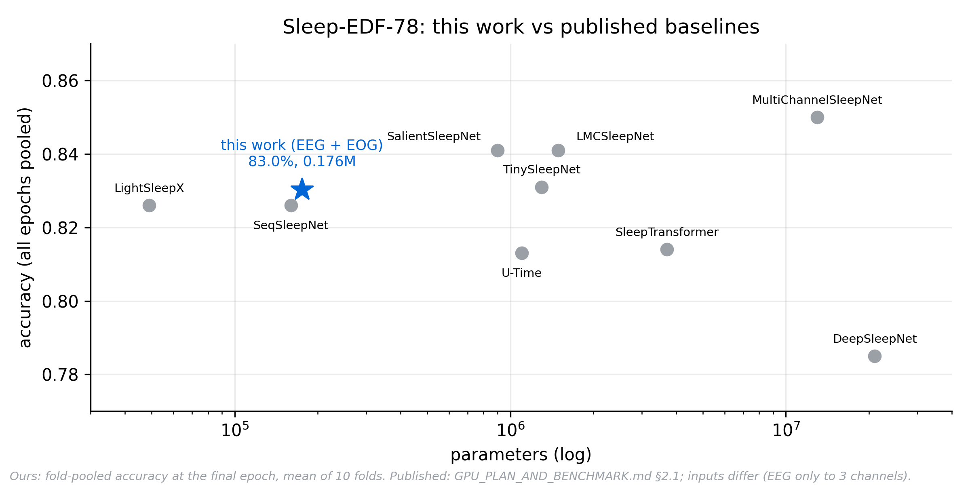
Comparison with Existing Work
Where Release v2 Stands: Sleep-EDF-78 Benchmark (Fig. 4.12) & Head-to-Head Scorecard (Table 4.11)
7
ahead
3
level
8
behind
Ahead: pre-release verifier (0 flawed released), gate ablation (base 31/31 → 0/31 flawed), hedging enforced from measured error, fully offline, byte-identical reruns, student vs teacher (qualified).
Level: size for accuracy (LightSleepX 49K, κ 0.77), N1 F1 (SalientSleepNet 54.2), REM F1 (85.8).
Behind: overall κ vs MultiChannelSleepNet 0.79 (74× larger), N3 F1, external cohort, clinician rating, training scale, clinical scope, clearance, measured Pi 5.
Safe claim: "competitive with models 5–74× larger at 0.18M parameters" — not "state of the art".
Ours pooled like the papers, final epoch (83.0%). Published rows from secondary tables: verify against originals.
8
Verified On-Device Sleep Reporting: KD, Evidence Packets, Fine-Tuned SLM & Edge Agent

Slide 9
Research Gap
Five Structural Gaps in Prior Literature & How Phase I vs. Phase II Addresses Them
# | Identified Research Gap | Impact in Prior Work / Baseline | Phase I Resolution (Completed on x86)
G1 | Subject Leakage & Label Shift | Recording split inflated κ by +0.16 (0.5066 unseen); drop-then-trim shifted 5–7% labels. | Enforced subject-ID splits in code and rebuilt aligned labels from raw hypnograms (+3% acc).
G2 | Unverified Teacher in KD | Single-teacher KD hurt student κ (0.5925 vs 0.6449 control); 0.25 s encoder missed waves. | Proved teacher-ceiling rule; built 8.75 s multi-scale encoder + 3-student ensemble (ENSmc).
G3 | No Metric Trust Contract | Hypnograms output all derived values with equal trust despite 8/24 metrics being unreliable. | Built Schema 1.3 Evidence Packet with Tc scaling, entropy tiers, and 24-metric error tiers.
G4 | Post-Hoc LLM Report Checks | Prior LLM systems check text after release; untrained 3B base released 31/31 flawed reports. | Paired GBNF grammar (temp=0) with a frozen 30-rule pre-release verifier (0/29 flawed).
G5 | No Fault-Safe Edge Agent | Research scripts fail on flat leads, 49/50 Hz line noise, missing EOG, or power loss. | Built hash-pinned state machine passing 14/14 fault scenarios (I1–I8) & budgeted for Pi 5.
Scope Boundary (Phase I vs. Phase II): Phase I resolves Gaps 1–5 end-to-end on Sleep-EDFx (x86 measured + Pi 5 analytical budget). Offline Docker container and ARM64 staging parity were also run in Phase I (3 Nov). Phase II extends to external cohorts (MESA, CFS), blinded clinician rating, ARM64 report parity, and physical Raspberry Pi 5 soak measurements.
9
Verified On-Device Sleep Reporting: KD, Evidence Packets, Fine-Tuned SLM & Edge Agent

Slide 10
Dataset Description
Sleep-EDF Expanded (PhysioNet) Cohorts, Subject-Disjoint Splits (Table 3.1) & Label Correction
Split / Protocol | Subj | Nights | SC / ST | Pipeline Role
Train | 69 | 137 | 54 / 15 | Staging KD & SLM LoRA training (123+14 nights)
Validation (Dev) | 16 | 31 | 12 / 4 | Calibration Tc, entropy tiers, metric error, selection
Test (Locked) | 15 | 29 | 12 / 3 | One logged evaluation per release (33,365 epochs)
5-Fold CV | 85 | 168 | Non-test | Like-for-like architecture ablation (base/eeg/full)
Sleep-EDFx Corpus & Signal Specs
  Total Volume: 197 whole-night PSG recordings from 100 subjects (237,950 scored 30-s epochs).
  Two Cohorts: Sleep Cassette (SC: 153 nights, 78 healthy subjects) & Sleep Telemetry (ST: 44 nights, 22 mild sleep-difficulty subjects).
  Input Modalities: 100 Hz EEG Fpz-Cz (3,000 samples/epoch) + 34 Welch PSD features + Horizontal EOG (v2) + 8 hand-crafted EOG features.
  5-Class Share: N2: 37.4% | Wake: 29.5% | REM: 14.4% | N1: 10.6% | N3: 8.2%.
  Label-Alignment Fix: Rebuilding from raw hypnograms fixed 5.65% (Train), 7.10% (Val), and 5.17% (Test) of labels shifted by drop-then-trim slicing (+~3% acc).
Leak-Free Subject Invariant: Almost every subject has 2 consecutive nights. Splitting by the 5-character subject prefix guarantees zero subject overlap across Train, Validation, and Test—verified automatically by unit tests.
10
Verified On-Device Sleep Reporting: KD, Evidence Packets, Fine-Tuned SLM & Edge Agent

Slide 11
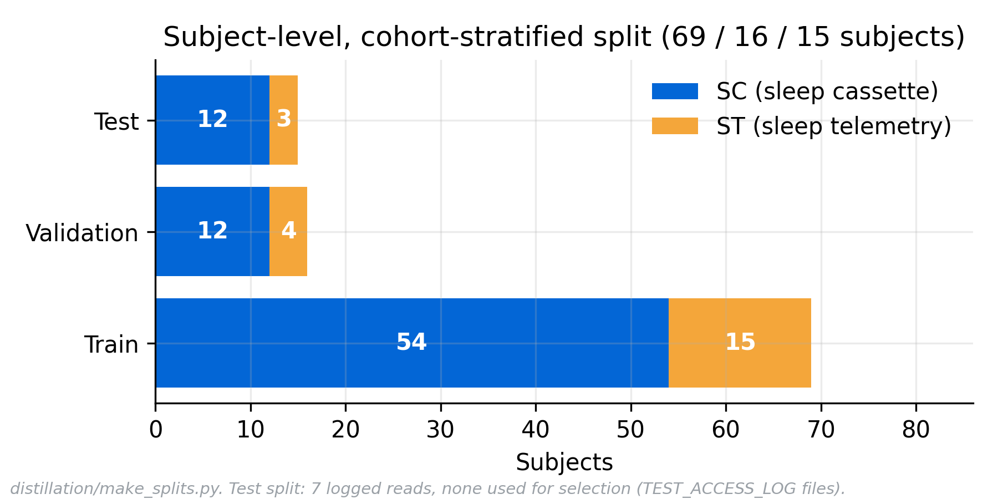
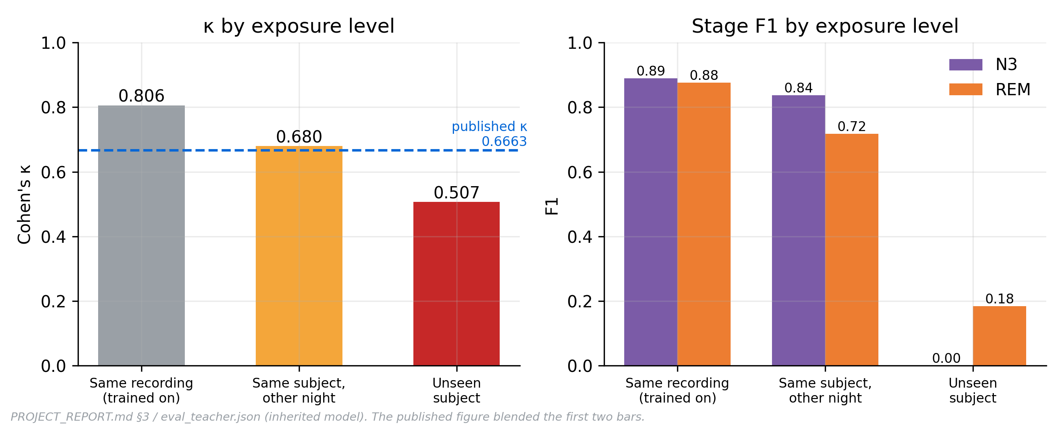
Dataset Split & Leakage Audit
Subject-Disjoint Split (Fig. 3.2) and the Exposure Gradient That Exposed the Inherited Model (Fig. 4.1)
Fig. 3.2 — 69 / 16 / 15 subjects; every test read logged, none used for selection
Fig. 4.1 — same recording → same subject → unseen subject
Why it matters: the inherited model scored κ 0.806 on nights it trained on, 0.680 on the same person's other night, and 0.5066 on an unseen person, with N3 F1 = 0.000. Splitting by subject removed a +0.16 κ inflation before any modelling began.
11
Verified On-Device Sleep Reporting: KD, Evidence Packets, Fine-Tuned SLM & Edge Agent

Slide 12
Methodology / Proposed Method
Five-Stage Offline Pipeline Wrapped by a Deterministic, Hash-Pinned Agentic State Machine (Fig. 3.1)
1. Distilled Staging
  175,599-param EEG+EOG student (N6adv) distilled from 3-student ensemble (ENSmc). Labels 30-s epochs in 256-epoch windows.
2. Evidence Packet
  Schema 1.3 JSON builder applies Tc = 1.0021 scaling, decodes stages, computes 24 metrics + error tiers & 19 evidence items.
3. Constrained SLM
  Llama-3.2-3B-Instruct + LoRA (Q4_K_M, 2.02 GB) run via llama-completion at temp=0, seed=0 under GBNF grammar citing IDs.
4. 30-Rule Verifier
  Frozen 2-layer deterministic gate checks JSON structure (L1), exact numeric match, hedging of fragile items & 5/5 coverage (L2).
5. Page Delivery
  Renders verified claims + V-HTML provenance scan into outbox. Any failure routes to FALLBACK, REVIEW_ONLY, or REJECTED.
Wrapping Deterministic Agentic Workflow (Decides Workflow, Never Clinical Content)
  End-to-End Orchestration: Ingests raw EDF (Path B) or packet (Path A), runs two-pass study-period detection, checks flat leads (Q01) & 49/50 Hz noise (Q03/W10), enforces thermal/RAM waits, and resumes via hash(input, policy, release).
  Four Terminal Outcomes: VERIFIED_REPORT (passed L1+L2+V-HTML) | FALLBACK_SUMMARY (packet numbers only on F01–F04) | REVIEW_ONLY (R04, Q01, Q03, W05, I01, V01) | REJECTED (R01, R03, R10).
12
Verified On-Device Sleep Reporting: KD, Evidence Packets, Fine-Tuned SLM & Edge Agent

Slide 13
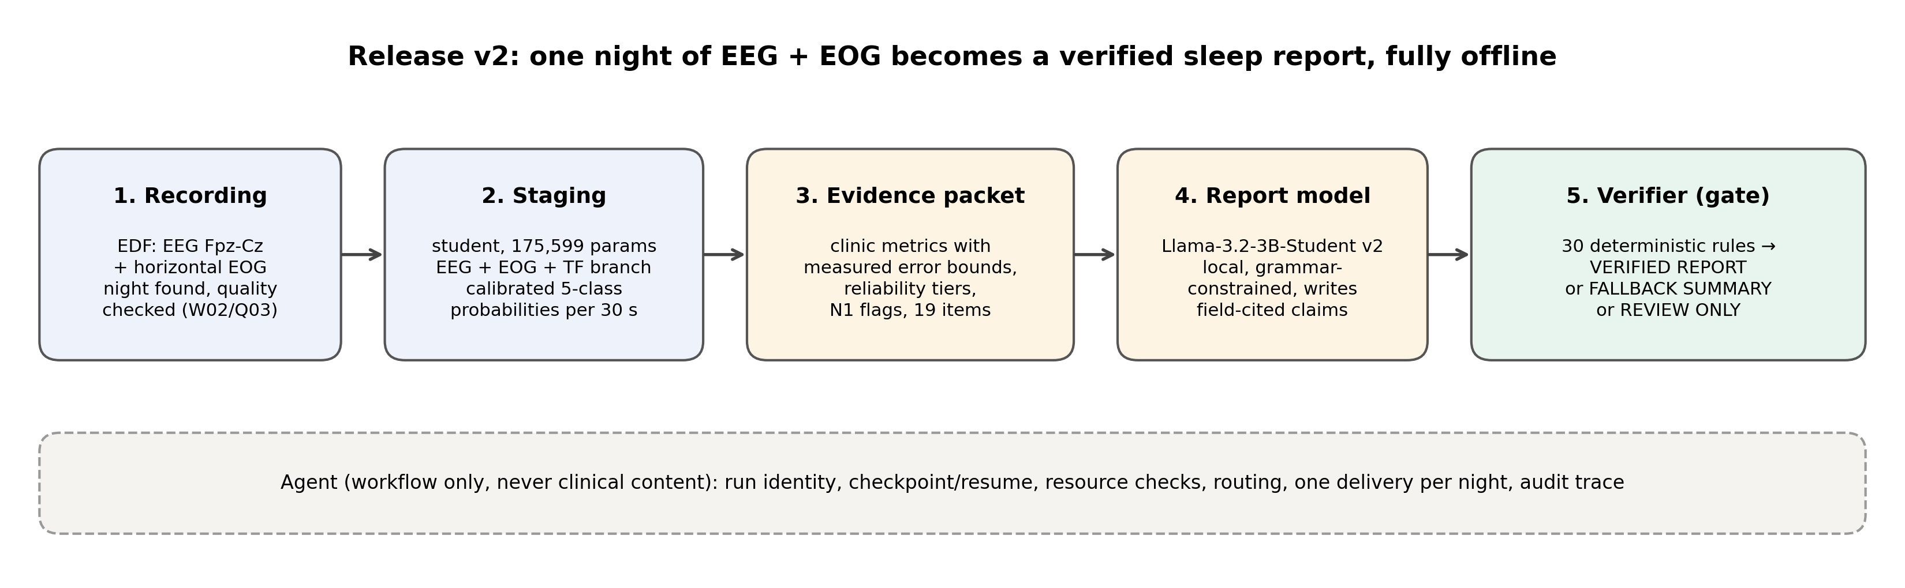
System Overview
Five Offline Stages Wrapped by an Agent That Decides Workflow, Never Clinical Content (Fig. 3.1)
Fig. 3.1 — staging → evidence packet → constrained SLM → verifier gate → one delivered page per night
Every number from the packet
Stages come from the student; numbers come from the schema 1.3 packet; claims must cite packet fields.
Checked before release
The frozen 30-rule verifier runs before rendering; any violation gives a fallback summary, never a wrong report.
Exactly one page per night
Verified report, fallback summary, review notice or rejection, each traced, hash-pinned and crash-safe.
13
Verified On-Device Sleep Reporting: KD, Evidence Packets, Fine-Tuned SLM & Edge Agent

Slide 14
Design / Architecture
Block-Wise Staging Student N6adv (175,599 Params, Table 3.2) & Schema 1.3 Contract (Table 3.3)
Student Component (Release v2 — N6adv) | Architectural Specification | Params
v1 Multi-Scale EEG Backbone | Fine (k50) + Coarse (k200) CNN (8.75 s RF) + 34 PSD → 2-layer Transformer | 139,606
EOG Encoder Branch | Saccade (Conv k50) + Slow-eye (Conv k400) + 8 EOG features → 32-d vector | 6,768
EOG Gated Projection | Zero-init Linear(32→64) + Sigmoid gate on [h, EOG] with bias −4 (closed start) | 8,320
Time-Frequency (STFT) Branch | STFT (2 s window, 1 s hop, 0.5–30 Hz at 0.5 Hz bins) + 2 convs → 32-d | 7,848
TF Gated Projection | Zero-init Linear(32→64) + Sigmoid gate initialized with bias −4 | 8,320
Local Context & Aux Head | Zero-init Depthwise Conv (k=7 over ±3 epochs, 4,672) + Transition head (65) | 4,737
Total Staging Student (N6adv) | 0.70 MB (fp32) | Starts at exact v1 function; opens gates when val F1 improves | 175,599
Schema 1.3 & Verifier Design
  Provenance & Stages: Puts model, sha256, git commit, Tc, hypnogram, calibrated 5-class probabilities, and per-stage reliability in one JSON contract.
  24 Derived Metrics: 24 clinical metrics each tagged robust (3), fragile (13), or unreliable (8) from validation MAE, plus 19 citable evidence_items.
  Night Confidence: Mean prediction entropy classifies nights into High, Medium, or Low confidence tertiles without ground truth.
  Two-Layer Verifier: Layer 1 checks closed-world JSON/enums/IDs; Layer 2 enforces exact value matching, mandatory hedging & 5/5 coverage (30 rules).
14
Verified On-Device Sleep Reporting: KD, Evidence Packets, Fine-Tuned SLM & Edge Agent

Slide 15
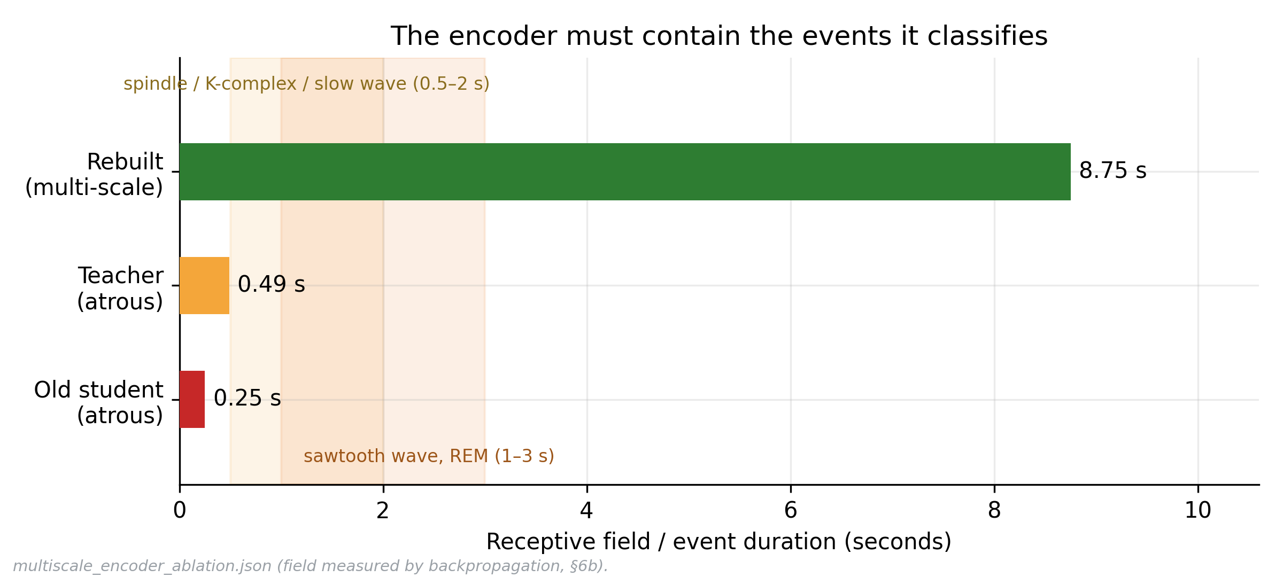
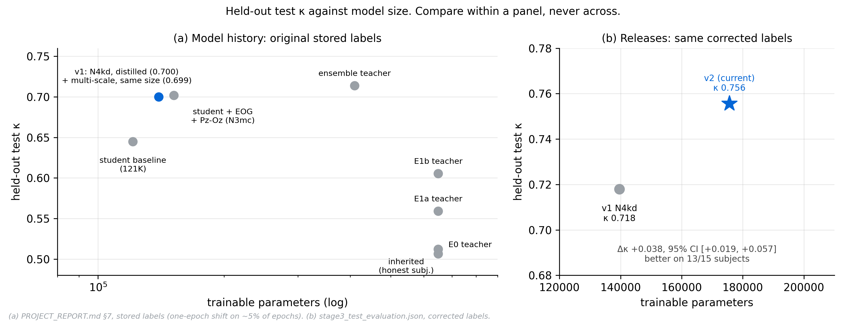
Receptive Field & Model Size
The 0.25 s → 8.75 s Encoder Fix (Fig. 3.3) and κ Against Parameters, v1 vs v2 on the Same Labels (Fig. 4.6)
Why the encoder changed
0.25 s → 8.75 s: the old encoder could not fit a spindle, K-complex or slow wave; widening it moved raw EEG from contributing nothing to driving 71% of predictions.
Gates start closed: EOG, time-frequency and local-context branches join through zero-initialised projections (gate bias −4), so training starts at v1's exact function.
Size vs accuracy: v2 (175,599 params) reaches κ 0.756 vs v1's 0.718 on identical labels; Δκ CI +0.019 to +0.057.
Fig. 3.3 — measured receptive field, original vs multi-scale encoder
Fig. 4.6 — model history (stored labels) and v1 vs v2 (corrected labels)
15
Verified On-Device Sleep Reporting: KD, Evidence Packets, Fine-Tuned SLM & Edge Agent

Slide 16
Algorithms
Ensemble Knowledge Distillation (Alg. 1), Verified Report Generation (Alg. 2) & Agentic Path B (Alg. 3)
Algorithm 1 — Ensemble-Teacher KD & Modality Dropout
  Ensemble Teacher Cache: Cache z_t[r] = log((1/3) Σ_k softmax(S_k(r))) across 3 diverse students (412,311 params) on subject-disjoint R_train.
  KD Loss with T² Scaling: L = α·CE(z_s, y) + (1−α)·T²·KL(softmax(z_t/T) ‖ softmax(z_s/T)) + 0.1·L_trans (α=0.5, T=3.0), unit-tested in code.
  Warm-Start & Dropout: Freeze v1 backbone 10 epochs (then 0.1× lr), label smoothing (ε=0.2), quality mask, EMA (0.999) & 0.25 EOG/TF dropout.
Algorithm 2 — Deterministic Verified Report Generation
  Step 1–2 (Integrity & Resource Gate): Verify SHA-256 of GGUF model, grammar, template, verifier & renderer against v2.yaml (else REVIEW_ONLY I01); wait for SoC temp < 70 °C and free RAM ≥ 6 GB, up to 12 × 5 min (else FALLBACK F01).
  Step 3 (Grammar-Constrained SLM): Execute llama-completion(model, prompt P1, claims.gbnf, temp=0, seed=0) with up to Π.retries attempts (on crash/timeout → FALLBACK F02).
  Step 4–5 (30-Rule Gate & V-HTML): Compute V = verify_structure(text) ∪ verify_policy(text, P); if V ≠ ∅ return FALLBACK F03. Render HTML and verify every number's provenance (else REVIEW_ONLY V01).
Algorithm 3 — Agentic Path B (Raw EDF) & Edge Bandwidth Model
  Two-Pass Study Period & QC: Ingest EDF (reject R01 / <3 h R03; missing Fpz-Cz → W05) → Resample 100 Hz → Pass-1 staging → Estimate sleep window (none → R04) → Check flat (Q01) & 49/50 Hz noise (Q03/W10) → Pass-2 staging.
  CPU Memory-Bandwidth Bound: Tokens/s ≈ Effective_Bandwidth / Bytes_per_Token. For Llama-3.2-3B Q4_K_M (2.02 GB), Pi 5 ceiling is 7.43 tok/s at 17 GB/s and 3.06–4.37 tok/s at 7–10 GB/s effective (~6–9 min/night).
16
Verified On-Device Sleep Reporting: KD, Evidence Packets, Fine-Tuned SLM & Edge Agent

Slide 17
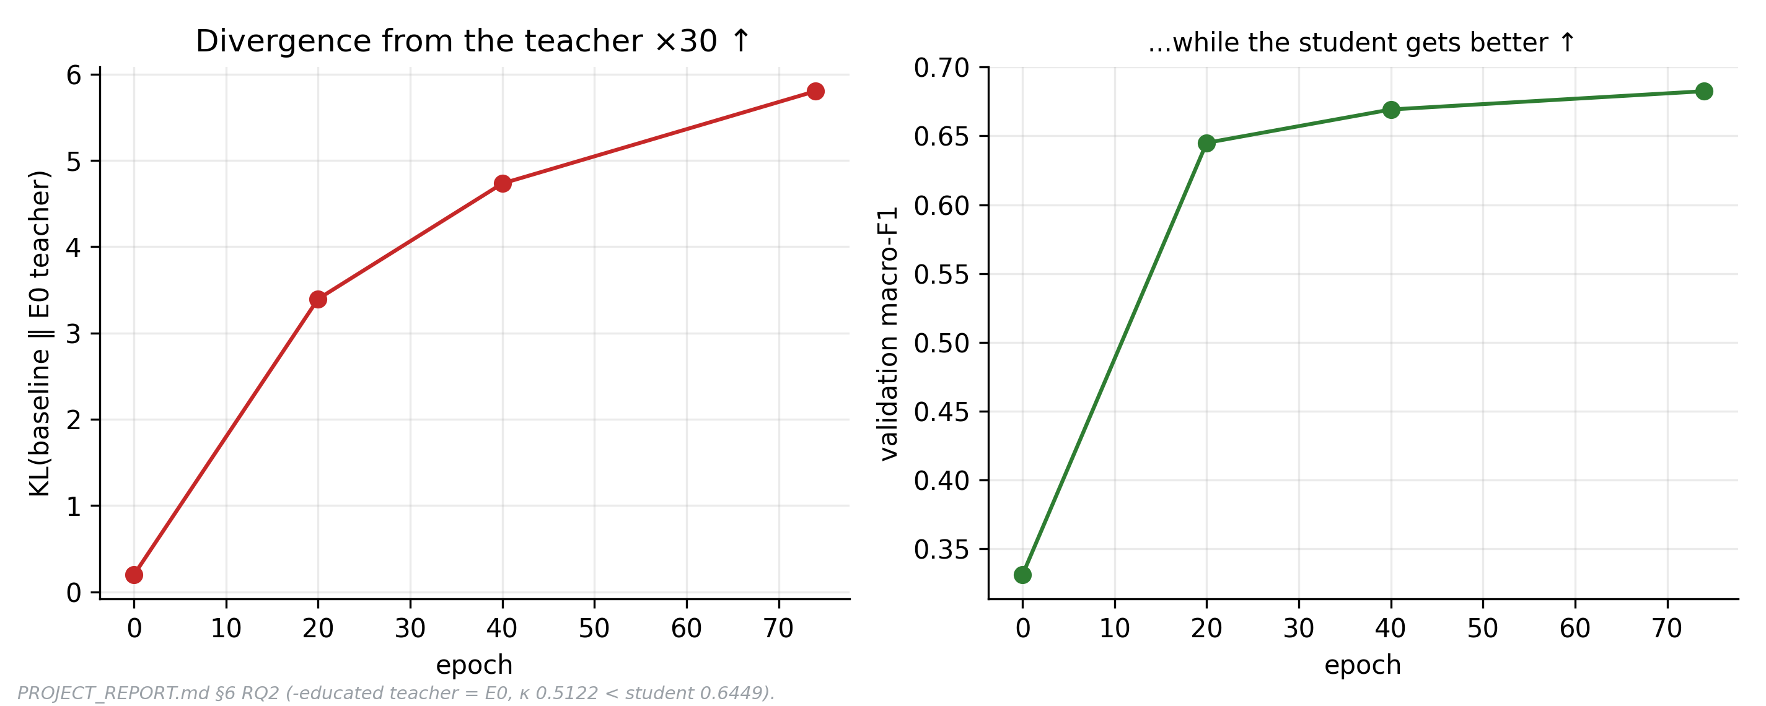
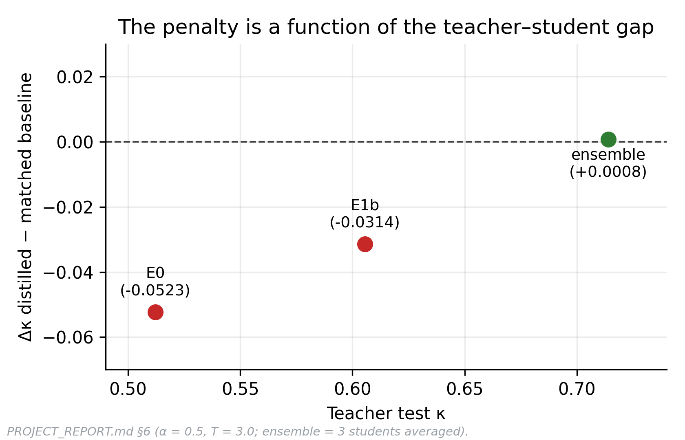
Why Single-Teacher Distillation Failed
Stage 1 Mechanism (Figs. 4.3–4.4) · v1 Experiments on Stored Labels, Not Comparable with v2 Numbers
The rule we found
A teacher must exceed the student's own undistilled performance before its soft targets help.
Evidence: students distilled from E0 and E1b (κ 0.5925, 0.6134) scored below the same student without KD (κ 0.6449).
Mechanism: the student outgrew its teacher, so half of every gradient pulled it towards a worse model. No α or T can fix that.
Fix: an ensemble of 3 comparable, diverse students (412K) exceeds each member; distilling it removed the penalty and improved calibration.
Fig. 4.3 — KL to the teacher rises while the student improves
Fig. 4.4 — the KD penalty shrinks as the teacher improves
17
Verified On-Device Sleep Reporting: KD, Evidence Packets, Fine-Tuned SLM & Edge Agent

Slide 18
Evaluation Metrics
Multi-Stage Quantitative Criteria Across Staging, Calibration, Report Verification & Edge Execution
1. Sleep Staging Metrics
  Cohen's Kappa (κ — Primary): Chance-corrected agreement across W, N1, N2, N3, REM; robust to class imbalance.
  Accuracy & Macro/Class F1: Unweighted 5-class Macro-F1 plus stage-specific F1 (tracking N1 and REM gains).
  Statistical Inference: Subject-resampled bootstrap 95% CIs and paired per-subject Wilcoxon signed-rank tests.
2. Calibration & Epistemic Trust
  Expected Calibration Error (ECE): 15-bin confidence-to-accuracy gap before and after validation scaling (Tc = 1.0021).
  Night-Confidence Correlation: Pearson r, Spearman ρ, and partial r between mean night entropy and expert κ.
  Derived-Metric Reliability: Validation error thresholds partitioning 24 metrics into 3 robust, 13 fragile, 8 unreliable.
3. SLM Report Quality & Safety
  Verified & 5/5 Completeness: Reports passing all 30 L1/L2 rules and covering all 5 mandatory tier items.
  Numeric Fidelity: Exact match ratio between numbers in claims and Evidence Packet fields (492/493 test).
  Flawed Release Rate & CI Bound: Flawed reports released (target = 0) + 95% two-sided Clopper–Pearson lower bound.
4. Agentic & Edge System Metrics
  Fault Matrix & Safety Invariants: Pass rate across 14 real-EDF/injected fault scenarios (S01–S14) and invariants I1–I8.
  Byte-Identical Reproducibility: Bitwise SHA-256 identity of generated HTML report pages across reruns (31/31).
  Edge Latency & Memory Budget: Tokens/s, wall-clock seconds/night (78 s x86; 6–9 min Pi 5), and peak RAM (4,719 MiB).
18
Verified On-Device Sleep Reporting: KD, Evidence Packets, Fine-Tuned SLM & Edge Agent

Slide 19
Result Analysis
Experimental Findings Across Stages 1–5: Staging (Table 4.2, B1), Packet (Table 4.5), SLM (Table 4.6) & Agent
Protocol / Split | Model | Params | Acc % | Cohen's κ | Macro-F1 | N1 / REM F1
Stage 1 Unseen Subj | Inherited (leaked 0.666) · v1 stored labels | 649,229 | — | 0.5066 | 41.07 | 0.0 (N3) / 18.4
Stage 1 Single KD | E1b KD vs hard control · v1 stored labels | 121,099 | — | 0.613 vs 0.645 | 67.1 vs 69.2 | KD Penalty
Held-Out Test (v2) | ENSmc Teacher (EEG) | 412,311 | 80.02% | 0.732 | 76.91 | 48.7 / 81.8
Held-Out Test (v2) | v1 Student N4kd (EEG) | 139,606 | 79.00% | 0.718 | 75.23 | 45.5 / 78.2
B1 EDF-78 (10-Fold) | v2 Arch (From Scratch) | 175,599 | 83.0–83.5 | 0.769 / 0.775 | 78.4–79.0 | 53.1 / 85.9
Held-Out Test (v2) | v2 N6adv (EEG+EOG) | 175,599 | 81.96% | 0.756 (vs v1: p=9e-4) | 78.20 | 50.7 / 83.7
Stage 3 & 4 — Evidence Packet & Verified SLM
  Calibration & Tiers: Test ECE = 0.0134; Night entropy predicts expert κ (r = −0.637, p = 2e-4): High 0.788 > Med 0.731 > Low 0.689.
  Llama-Student v2: 31/31 dev and 28/29 test verified at 5/5; 0/29 flawed released (1 invented REM latency blocked; base 3B released 31/31 flawed).
Stage 5 & Baselines — Agentic Workflow & YASA
  Same-Night vs YASA 0.8.1: Accuracy 79.0% vs 74.4%, κ = 0.701 vs 0.635, N1 F1 54.5 vs 30.2 (better on 21/31 dev nights).
  Agent Robustness: 14/14 fault scenarios passed (I1–I8 hold); Path B EDFs reached κ = 0.701 (30 verified, 1 review), 31/31 byte-identical, median 78 s x86.
19
Verified On-Device Sleep Reporting: KD, Evidence Packets, Fine-Tuned SLM & Edge Agent

Slide 20
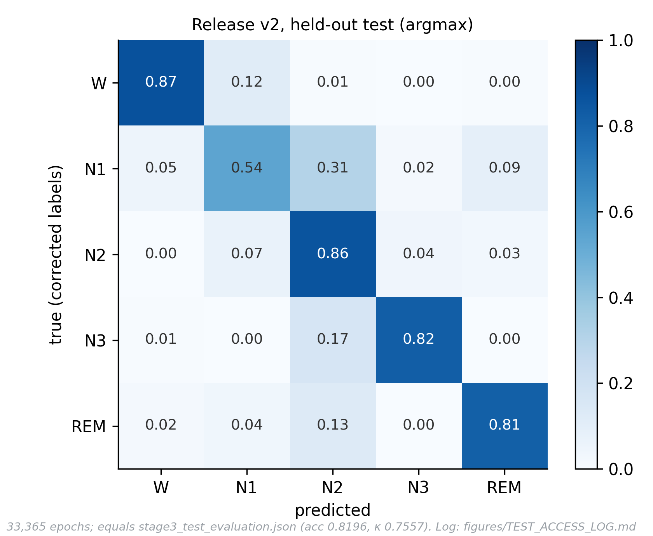
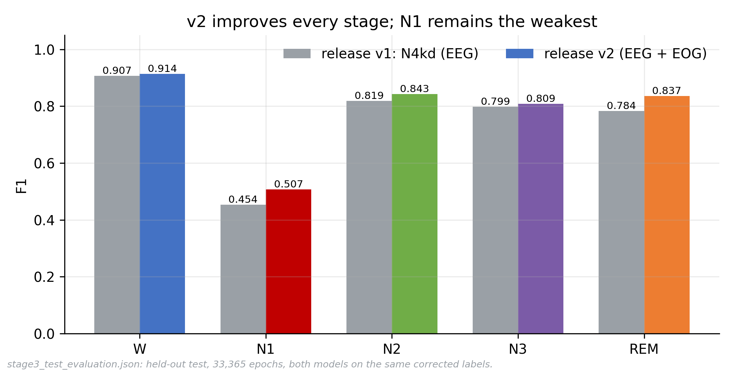
Results — Staging on the Held-Out Test
Release v2 (N6adv, EEG + EOG) on 15 Unseen Subjects, 29 Nights, 33,365 Epochs, Corrected Labels
Fig. 4.8 — confusion matrix, release v2
Fig. 4.9 — per-class F1, v2 vs v1 on the same labels
0.756
Cohen's κ (v1 0.718)
81.96%
accuracy
78.2
macro-F1
13 / 15
subjects improved, p = 0.0009
20
Verified On-Device Sleep Reporting: KD, Evidence Packets, Fine-Tuned SLM & Edge Agent

Slide 21
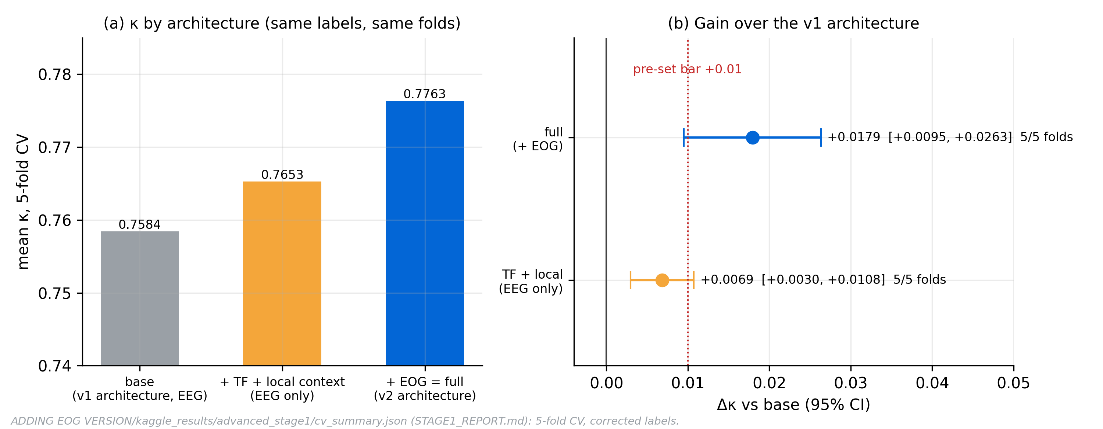
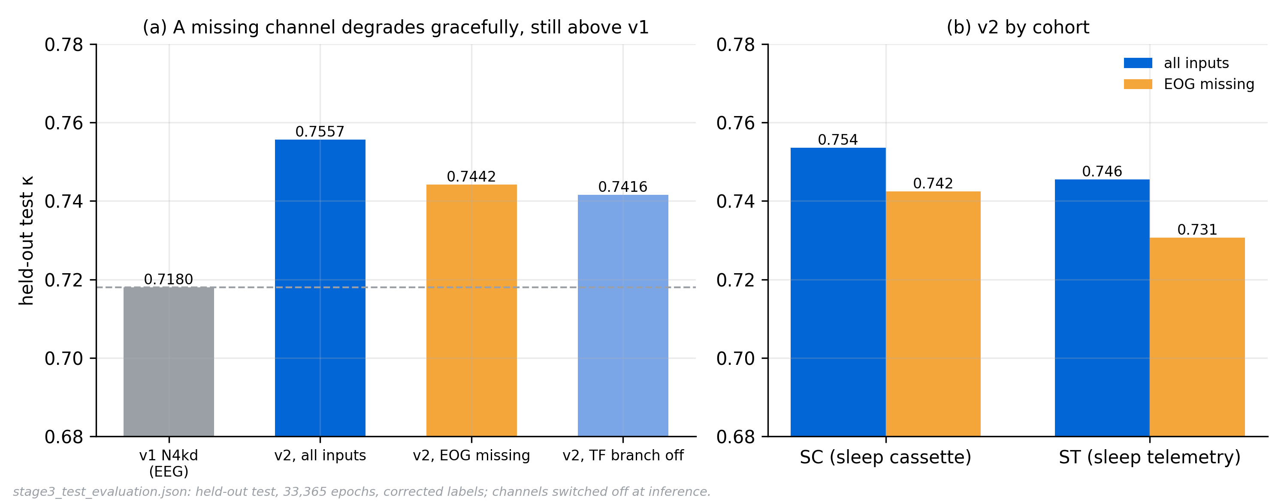
Results — Ablation & Robustness
Like-for-Like 5-Fold CV Ablation (Fig. 4.7) and Behaviour When the EOG Channel Is Missing (Fig. 4.10)
What each part adds
TF + local context + recipe: κ 0.7584 → 0.7653 (+0.0069, CI +0.003 to +0.011).
+ EOG (v2): κ 0.7763, +0.0179 over base (CI +0.0095 to +0.026), better on 5/5 folds.
EOG missing: test κ 0.756 → 0.744, still above the EEG-only v1 (0.718). SC 0.754, ST 0.746.
Read with care: the test gain over v1 combines label correction, EOG and recipe; the CV ablation is the like-for-like attribution.
Fig. 4.7 — base → TF + local context → full (EOG), same labels and teacher
Fig. 4.10 — test κ with EOG removed, by cohort
21
Verified On-Device Sleep Reporting: KD, Evidence Packets, Fine-Tuned SLM & Edge Agent

Slide 22
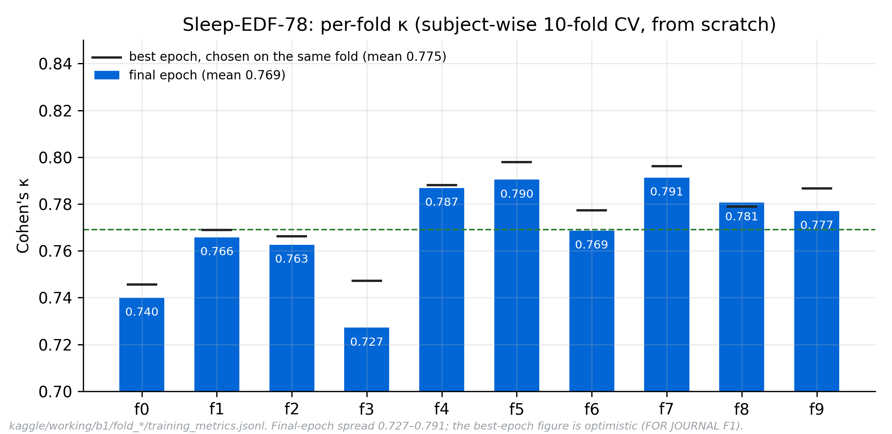
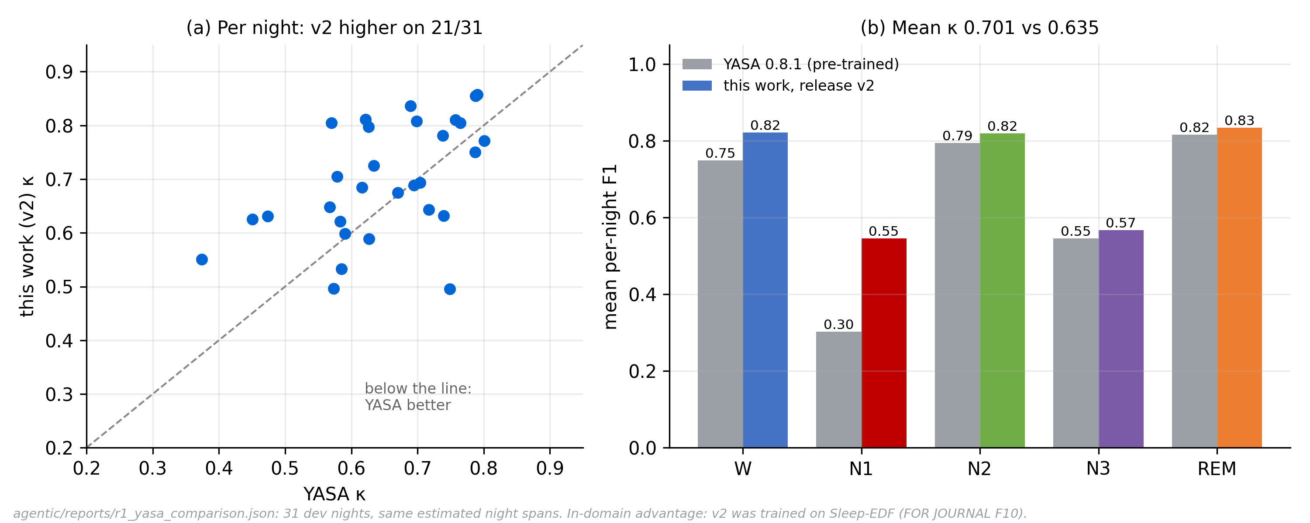
Results — Standard Benchmark & Same-Night Baseline
Sleep-EDF-78 10-Fold Subject-Wise CV From Scratch (Fig. 4.11) and YASA on Identical Nights (Fig. 4.19)
B1 (78 subjects, 153 nights)
Acc 83.0–83.5%, κ 0.769–0.775, macro-F1 78.4–79.0 · N1 51.6–53.1, REM 85.7–85.9.
The lower values (final epoch) are the conservative headline; the selected epoch is optimistic.
Project 5-fold CV agrees: κ 0.776, within 0.001.
Same nights as YASA
κ 0.701 vs 0.635 · acc 79.0% vs 74.4% · N1 F1 54.5 vs 30.2 · better on 21/31 nights (in-domain advantage).
Fig. 4.11 — B1 per-fold κ: bars final epoch, markers selected epoch
Fig. 4.19 — v2 vs YASA 0.8.1 on 31 dev nights
22
Verified On-Device Sleep Reporting: KD, Evidence Packets, Fine-Tuned SLM & Edge Agent

Slide 23
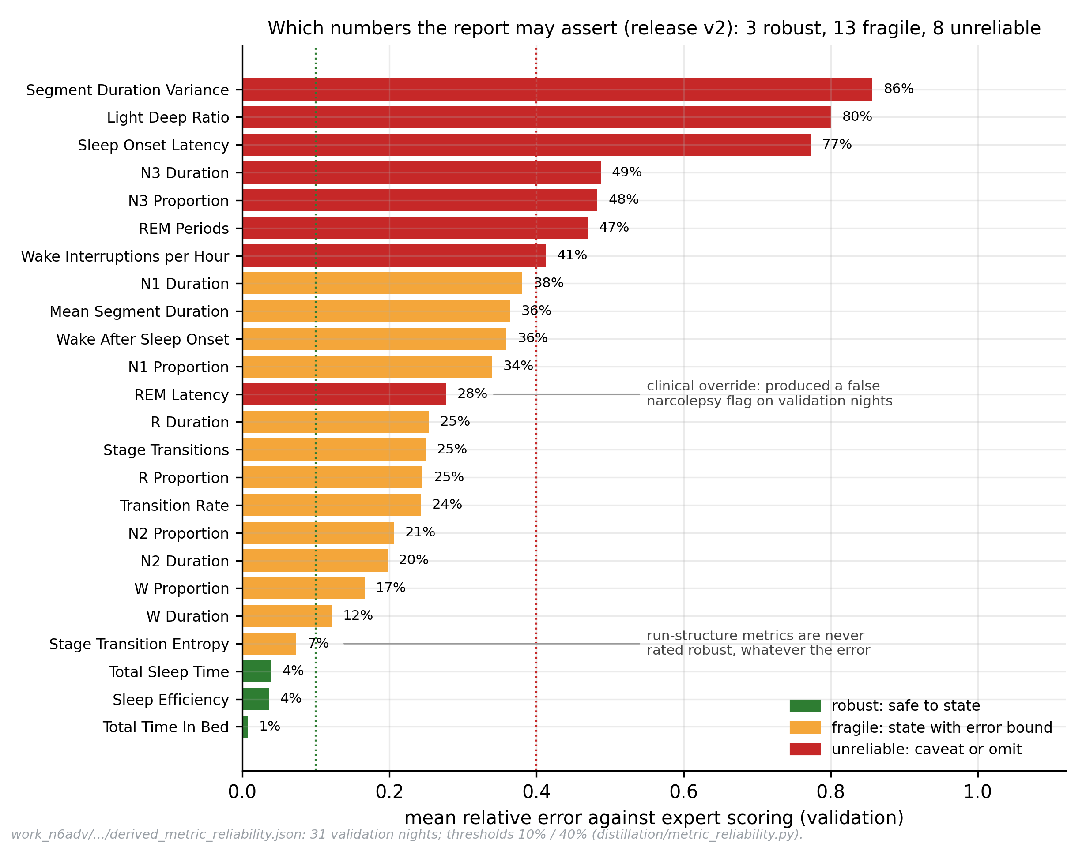
Results — Evidence Packet
Calibration, Night Confidence and the Measured Reliability of Every Derived Metric (Table 4.5, Fig. 4.13)
3 / 13 / 8
robust / fragile / unreliable
r = −0.637
night entropy vs expert κ
Calibration: T = 1.0021 fitted on validation; test ECE 0.0133 → 0.0134, so v2 is already calibrated.
Night tiers (test, not fitted there): high 0.788 > medium 0.731 > low 0.689 mean κ.
Triage: flagging the 10 lowest-confidence nights catches 5 of the 10 worst.
Per stage (test F1): W 0.914, N2 0.844, REM 0.837, N3 0.809 high; N1 0.507 low.
Contract: schema 1.3, 19 citable evidence items; consumers refuse a version mismatch.
Fig. 4.13 — which of 24 derived metrics a report may state
23
Verified On-Device Sleep Reporting: KD, Evidence Packets, Fine-Tuned SLM & Edge Agent

Slide 24
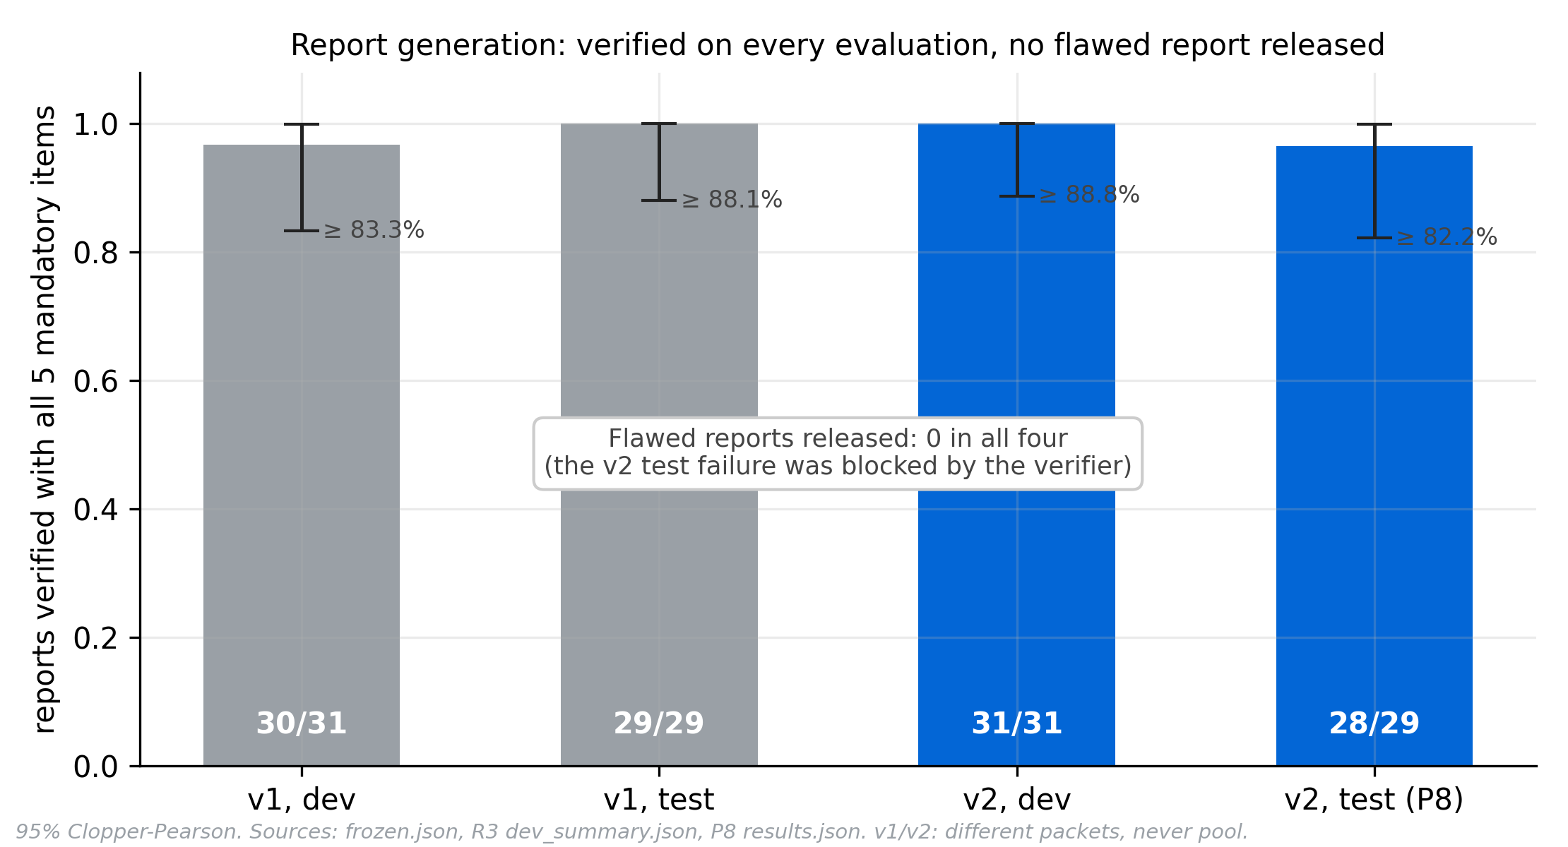
Results — Report Model Selection & Verification
Fine-Tuned Llama-3.2-3B-Student Under a Grammar and a Frozen 30-Rule Verifier (Table 4.6, Fig. 4.14)
Report model | Dev 5/5 | Test 5/5 | Flawed released
Llama-3.2-3B base (untrained) | 2/31 | — | 31/31 ungated
Qwen-Student 1.5B (LoRA) | 10/31 | 12/29 | 0
Llama-Student v1 (v1 packets) | 30/31 | 29/29 | 0
Llama-Student v2 (current) | 31/31 | 28/29 | 0
How the report model was chosen
Selection bar (pre-registered): ≥ 25/31 at 5/5 on dev; the locked test run once per model.
v2 on test: 28/29 verified, fidelity 492/493, 95% lower bound 82.2%. v1 and v2 used different packets: report side by side, never pooled.
Training: LoRA r16/α32, 3 epochs, 123 nights of verifier-passing reference claims; Q4_K_M, 2.02 GB.
Grammar alone is not enough: with the GBNF grammar, untrained 1.5–3.8B models reached 0–2/31.
Determinism: temperature 0, seed 0, pinned chat template; llama-server did not reproduce outputs, so llama-completion is used.
Fig. 4.14 — verified reports by release and split, 95% Clopper–Pearson bars
24
Verified On-Device Sleep Reporting: KD, Evidence Packets, Fine-Tuned SLM & Edge Agent

Slide 25
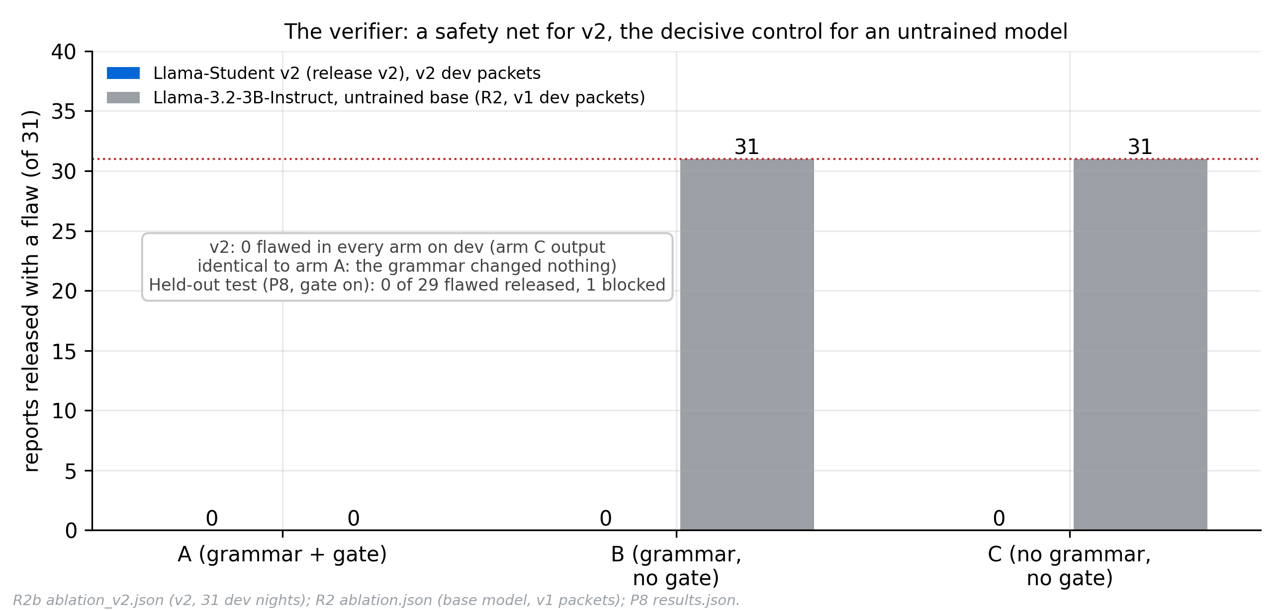
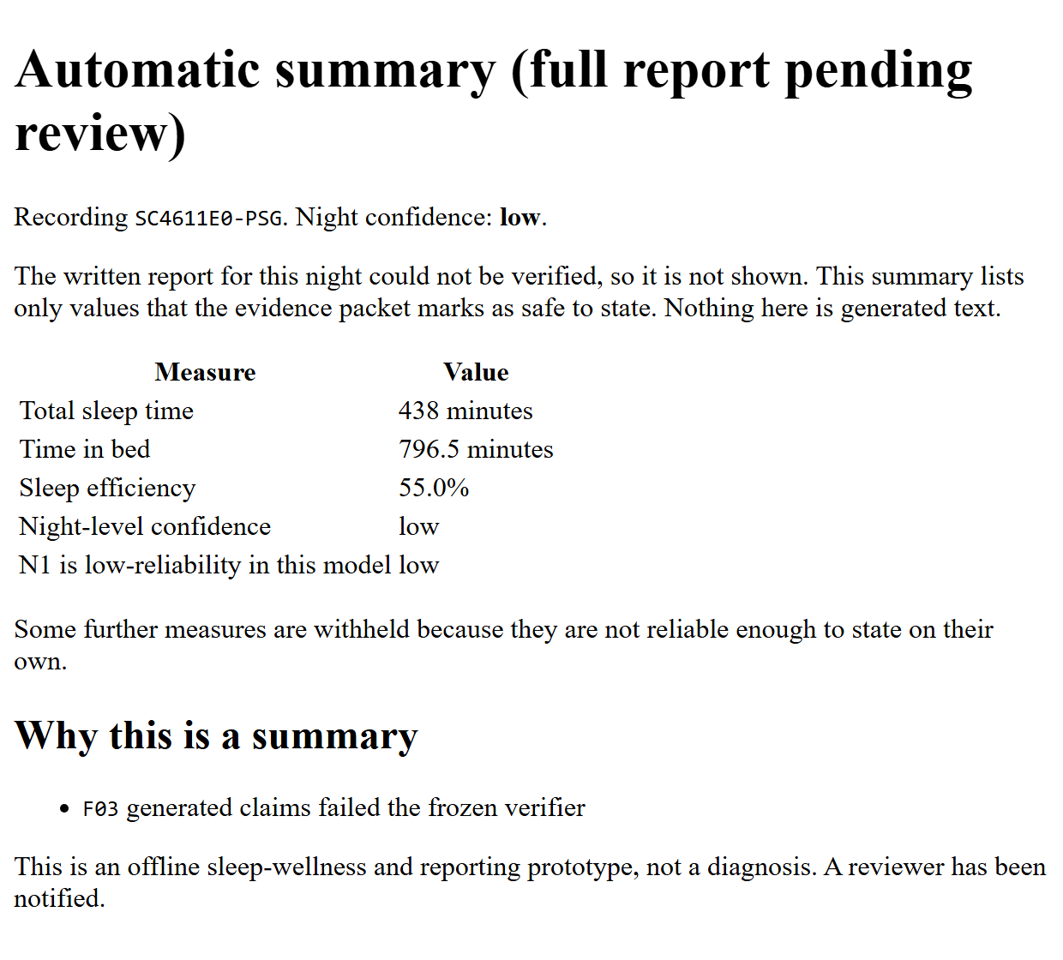
Results — Verifier Ablation & the Blocked Night
The Gate Is a Safety Net for the Fine-Tuned Model and Decisive for an Untrained One (Table 4.7, Fig. 4.15)
Test night SC4611E0
REM was 0.12% of the night, so the packet's REM latency is empty. The model wrote −1.0 instead of omitting the claim.
The verifier flagged L2.value_mismatch and L2.uncited_quantity; the text was never rendered and the reader got this fallback summary:
Fig. 4.15 — reports released with a flaw: gate on / gate off / gate and grammar off
31 dev nights | Gate on | Gate off | Gate + grammar off
v2 student | 0/31 | 0/31 | 0/31
v1 student | 0/31 | 1/31 | 2/31
Base 3B | 0/31 (fallback) | 31/31 | 31/31
25
Verified On-Device Sleep Reporting: KD, Evidence Packets, Fine-Tuned SLM & Edge Agent

Slide 26
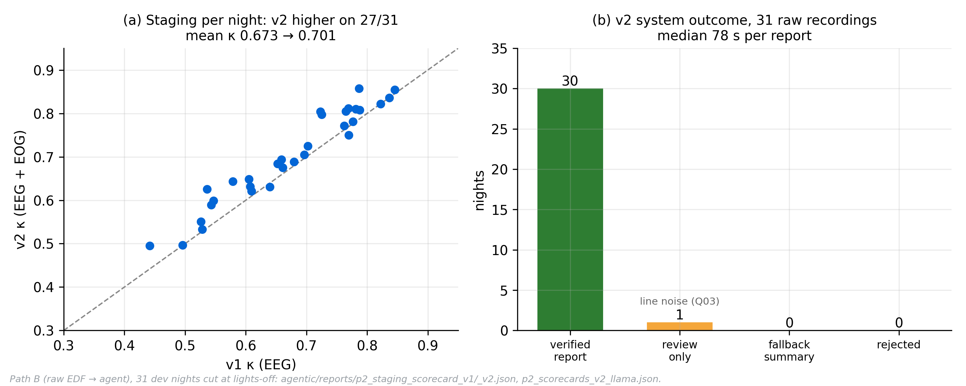
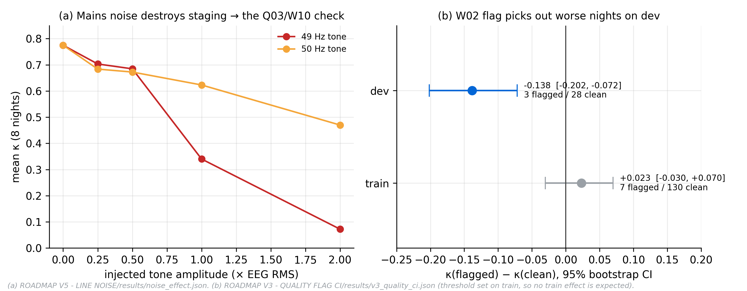
Results — Agentic Workflow on Real Recordings
Raw EDF → One Delivered Page: Path B Scorecard (Fig. 4.16) and Signal-Quality Gates (Fig. 4.17)
Path B (v2): mean κ 0.701 (v1 0.673); 30 verified + 1 review (line noise); median 78 s per report.
Fault matrix: 14/14 scenarios reach their expected outcome; invariants I1–I8 hold; crash at 8 boundaries → exactly one delivery.
Reproducible: 31/31 byte-identical pages across two real-model runs.
Sampling rates: 128/256 Hz → 18/18 outcomes match 100 Hz.
Night boundaries: start p90 2 epochs; end p90 41 (bar 30, accepted deviation).
Line noise: 49 Hz at 1× RMS drops κ 0.775 → 0.340, so Q03/W10 input checks were added.
Fig. 4.16 — Path B on 31 dev nights, v2 vs v1
Fig. 4.17 — line noise damages staging; the W02 flag marks worse nights
26
Verified On-Device Sleep Reporting: KD, Evidence Packets, Fine-Tuned SLM & Edge Agent

Slide 27
Results — Edge Simulation
Simulation Ladder L0–L3 Run on x86 and Under ARM64 Emulation (3 Nov); the Raspberry Pi 5 Itself Is Phase II
31 / 31
reports byte-identical in an offline container
151 s
per report, 4 CPUs (x86)
5.16 GB
peak RAM (bar ≤ 10 GB)
Level | Result | Status
L0 analytical | 3.06–4.37 tok/s on Pi 5 → ≈ 6–9 min/night | Estimate
L1 x86 container, no network | 31/31 verified, identical to PC | Done 3 Nov
L2 ARM64 (QEMU) | Staging parity on 8 SC nights | Partly done
L3 fault scenarios | 14/14 pass, I1–I8 hold | Done (x86)
L5 real Pi 5 | Speed, heat, power, 7-night soak | Phase II
Pi 5 budget (estimates)
Report generation 266–380 s, prefill 40–80 s, everything else < 2 min.
Peak ≈ 6–8 GB of 16 GB; memory bandwidth, not size, sets speed.
Pre-registered bars
|Δp| ≤ 1e-4 · dev 5/5 ≥ x86 · P95 ≤ 15 min · RAM ≤ 10 GB · no throttling · 7-night soak, 0 crashes.
27
Verified On-Device Sleep Reporting: KD, Evidence Packets, Fine-Tuned SLM & Edge Agent

Slide 28
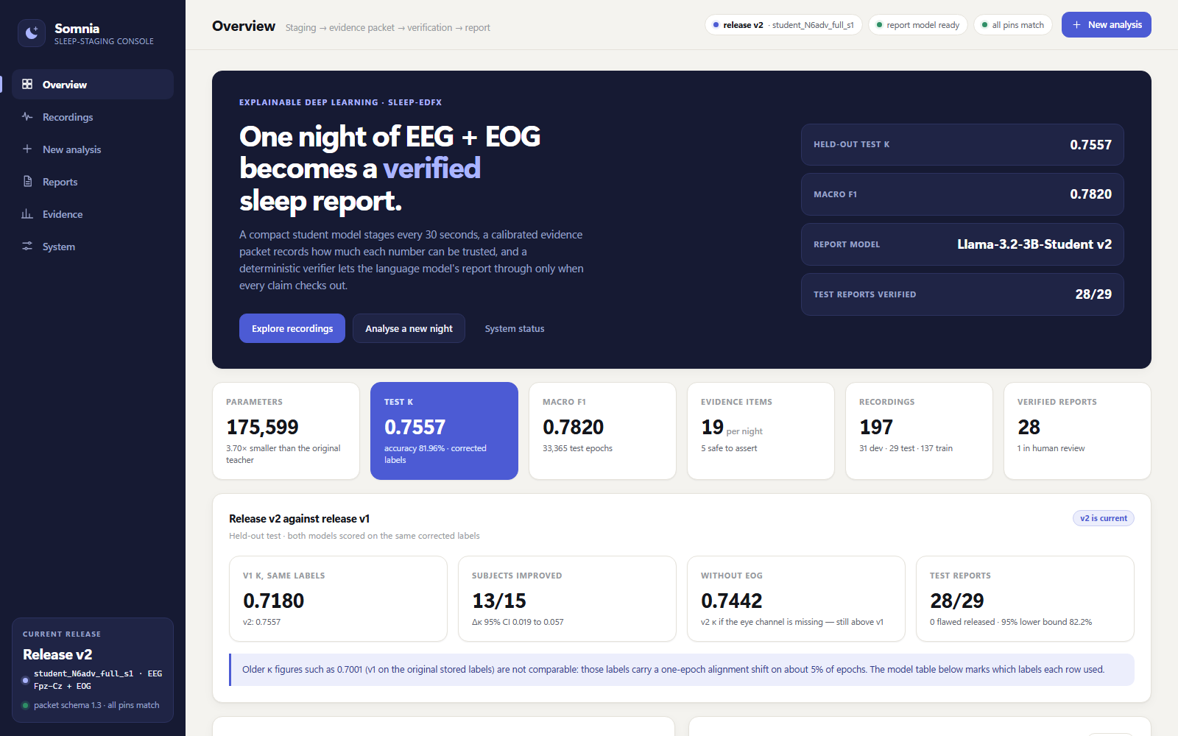
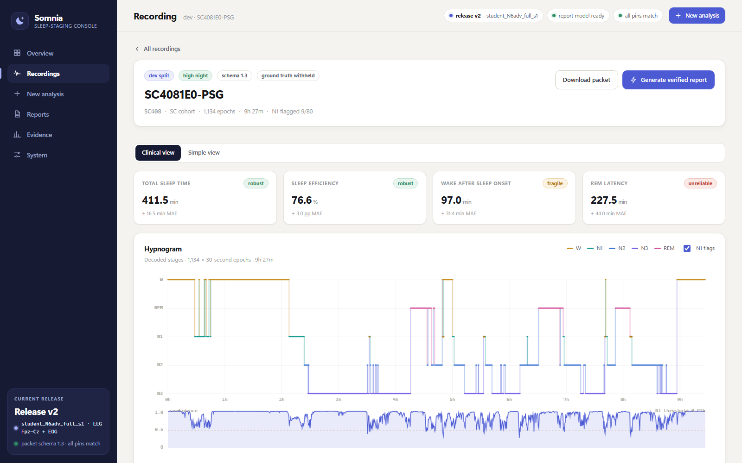
Demo — Somnia Console
Release v2 Running Locally: python -m agentic run-edf <night.edf> --release v2 · python -m ui
Overview: headline results read live from the result files
Recording SC4081E0: reliability tags on every metric, hypnogram and confidence
What the reader sees: each metric carries its tag (robust / fragile / unreliable) and its validation error; "Generate verified report" runs the agent, and only a verifier-passing report is shown.
28
Verified On-Device Sleep Reporting: KD, Evidence Packets, Fine-Tuned SLM & Edge Agent

Slide 29
Limitations
Honest Appraisal of Current Dataset, Clinical, Methodological & Edge Hardware Constraints (Section 3.2.8)
1. Dataset & Statistical Scope
  Single-Dataset Dependency: All results rest on Sleep-EDFx (100 subjects). Crossing from SC to ST cost 0.187 κ in v1 cross-cohort tests.
  Small Locked Test Set: 29 test nights (15 subjects) give a 95% lower bound of 82.2% on 28/29 and ±0.05 CI width on κ.
  Test Split Retirement: Logged 7 times across project milestones; retired from evaluating future architectures.
  Label Pipeline Scope: Rebuilt aligned labels fix a real bug (5–7% epochs) but may differ from other papers.
2. Clinical & Methodological
  Packet vs. Clinical Truth: 'Verified' means consistent with the packet, not clinically validated; no clinician rating yet.
  Wellness Prototype Scope: Excludes apnea, EEG arousals, and limb movements; holds no FDA 510(k) or AASM clearance.
  Path B Wake-Tail Error: Start error is median 0 (p90 = 2 epochs), but wake-tail end p90 is 41–49 epochs vs 30-epoch bar.
  N1 Stage Ceiling: Test N1 F1 is 50.7% (B1 53.1%) due to human inter-scorer noise (25–45%); flagged low-reliability.
3. Edge Hardware & Footprint
  Analytical Pi 5 Numbers: Raspberry Pi 5 time (6–9 min/night) and RAM (6–8 GB) are bandwidth estimates; board run is Phase II.
  Docker & ARM64 (run 3 Nov): Offline 4-CPU/16 GB container: 31/31 reports byte-identical (151 s, 5.16 GB peak); ARM64 staging parity met under emulation on 8 SC nights. ARM report model and ST nights still open.
  Asymmetric Footprint: Staging student is 0.70 MB (175.6K params), but the Q4_K_M SLM (2.02 GB) is 99.9% of system size.
  Multi-Night Trend Deferred: Fault scenario S15 (two-night trend note) awaits the persistent history store in Phase II.
29
Verified On-Device Sleep Reporting: KD, Evidence Packets, Fine-Tuned SLM & Edge Agent

Slide 30
Conclusion
Six Stages, Each Gated by a Measured Result, and the Headline Claim the Evidence Supports
1 · Knowledge distillation
Worked only once evaluation was leak-free and the teacher (a 3-student ensemble) beat the student; its clearest gain was calibration.
2 · Student model
175,599-param EEG + EOG student: κ 0.756 held-out, 0.769–0.775 on Sleep-EDF-78; κ 0.744 without EOG.
3 · Evidence packet
Measured trust: night tiers predict expert agreement (r = −0.637); 3 of 24 metrics safe to state plainly.
4 · Small language model
Fine-tuned 3B behind a frozen verifier: 28/29 verified on the locked test, 0 flawed released.
5 · Agentic workflow
14/14 fault scenarios, invariants I1–I8, 31/31 byte-identical reruns, one truthful page per night.
6 · Edge simulation
Offline container and ARM64 staging parity met; Pi 5 budgeted at ≈ 6–9 min and 6–8 GB per night.
Headline: a 0.18M-parameter staging model competitive with models 5–74× larger, joined to a local 3B report model whose output is released only after a deterministic check — with no flawed report released on held-out data.
"Verified" means consistent with the evidence packet; clinical usefulness still needs the Phase II clinician study and an external cohort.
30
Verified On-Device Sleep Reporting: KD, Evidence Packets, Fine-Tuned SLM & Edge Agent

Slide 31
Phase II Plan
Prioritized Seven-Milestone Roadmap & Pre-Registered Raspberry Pi 5 Acceptance Bars (Chapter 5)
Priority | Phase II Milestone | Concrete Deliverables & Pre-Registered Acceptance Bars
P1 (Edge) | Raspberry Pi 5 (16 GB) Deployment (L1–L5) | Containers built and x86 parity met (3 Nov). Next: ARM64 parity on ST nights + report model, history store (S15), real Pi 5 and 7-night soak (P95 ≤ 15 min, RAM ≤ 10 GB).
P2 (Data) | External Multi-Cohort Generalization | Evaluate zero-shot and fine-tuned staging + packet calibration on external polysomnography cohorts (MESA and CFS) for cross-population validity.
P3 (Clinical) | Blinded Clinician Report Evaluation | Conduct a blinded study with 2–3 sleep specialists scoring 20+ generated reports on clinical accuracy, appropriate hedging, and clarity.
P4 (Hygiene) | Benchmark & Teacher Hygiene | Re-run B1 Sleep-EDF-78 10-fold CV with an inner early-stopping split and pooled confusion matrix; retrain ENSmc teacher on corrected labels.
P5 (Labels) | Multi-Scorer Soft-Label Distillation | Distil on multi-scorer datasets (DOD-H / DOD-O, 5 expert scorers per epoch) so soft targets capture true human inter-scorer ambiguity.
P6 (SLM) | 1B–1.5B Report Student & Fast Decoding | Train a 1–1.5B SLM to pass the 5/5 completeness bar and add prompt-prefix caching + speculative decoding to halve Pi 5 latency.
P7 (Eval) | New Locked Evaluation Cohort | Construct a fresh, untouched locked test set before evaluating any post-v2 staging or reporting architecture.
31
Verified On-Device Sleep Reporting: KD, Evidence Packets, Fine-Tuned SLM & Edge Agent

Slide 32
Publication Plan
Two-Track Academic Publication Strategy for Biomedical Journals & Edge-AI Conferences
Track 1 — Primary Archival Journal Paper
  Target Journals: IEEE Journal of Biomedical and Health Informatics (JBHI), IEEE TBME, or Artificial Intelligence in Medicine (Elsevier).
  Proposed Title: 'Verified On-Device Sleep Reporting: Bridging Compact Multi-Modal Knowledge Distillation and Grammar-Constrained SLMs.'
  Core Contributions: Full 6-stage pipeline, Schema 1.3 uncertainty contract, 30-rule pre-release verifier (28/29 verified, 0 flawed released), and 5–7% label audit.
Track 2 — Conference / Workshop Paper
  Target Conferences: IEEE EMBC (Engineering in Medicine & Biology Conference), IEEE ICASSP, or ACM/IEEE CHIL / Edge-AI Workshops.
  Proposed Title: 'Why Single-Teacher Distillation Fails in Leak-Free Sleep Staging: Ensemble Calibration Transfer and Gated EOG Fusion.'
  Core Contributions: Exposure-gradient audit (0.806 → 0.507 κ), teacher-student capacity mechanism, 175.6K N6adv student (B1 κ = 0.769–0.775), and 14/14 fault matrix.
Manuscript Readiness & Reproducibility Assets (Prepared in Repository `FOR JOURNAL/`)
  Reproducible Artifact Package: All 21 publication-grade v2 figures (`figures/output_v2/`), exact SHA-256 release manifests (`v2.yaml`), unit-tested KD loss & split scripts, and pre-submission hygiene checklist are archived and reproducible.
32
Verified On-Device Sleep Reporting: KD, Evidence Packets, Fine-Tuned SLM & Edge Agent

Slide 33
Reference (APA Style)
Key Academic Literature Cited
  Berry, R. B., et al. (2017). The AASM manual for the scoring of sleep and associated events. American Academy of Sleep Medicine.
  Eldele, E., et al. (2021). AttnSleep: Attention-based deep learning for sleep stage classification. IEEE TNSRE, 29, 809–818.
  Goldberger, A. L., et al. (2000). PhysioBank, PhysioToolkit, and PhysioNet. Circulation, 101(23), e215–e220.
  Guo, C., Pleiss, G., Sun, Y., & Weinberger, K. Q. (2017). On calibration of modern neural networks. Proc. ICML (pp. 1321–1330).
  Hinton, G., Vinyals, O., & Dean, J. (2015). Distilling the knowledge in a neural network. arXiv:1503.02531.
  Hu, E. J., et al. (2022). LoRA: Low-rank adaptation of large language models. Proc. ICLR.
  Kemp, B., et al. (2000). Analysis of a sleep-dependent neuronal feedback loop (Sleep-EDFx). IEEE TBME, 47(9), 1185–1194.
  Perslev, M., et al. (2019). U-Time: Fully convolutional network for sleep staging. Advances in NeurIPS (Vol. 32).
  Phan, H., et al. (2019). SeqSleepNet: Hierarchical RNN for sequence-to-sequence sleep staging. IEEE TNSRE, 27(3), 400–410.
  Phan, H., et al. (2022). SleepTransformer: Sleep staging with interpretability and uncertainty. IEEE TBME, 69(8), 2456–2467.
  Seifen, C., et al. (2025). Evaluation of locally run LLMs for obstructive sleep apnea decision support. PMC12257169.
  Sundararajan, M., Taly, A., & Yan, Q. (2017). Axiomatic attribution for deep networks (Integrated Gradients). Proc. ICML.
  Supratak, A., Dong, H., Wu, C., & Guo, Y. (2017). DeepSleepNet: Automatic sleep stage scoring from raw EEG. IEEE TNSRE, 25(11).
  Supratak, A., & Guo, Y. (2020). TinySleepNet. Proc. IEEE EMBC (pp. 641–644). Vallat, R., & Walker, M. P. (2021). YASA. eLife, 10.
33
Verified On-Device Sleep Reporting: KD, Evidence Packets, Fine-Tuned SLM & Edge Agent

Slide 34
Reference (APA Style) — continued
Systems Compared on Slides 7–8 and the Runtime Stack
LMCSleepNet (2025). Lightweight multi-channel sleep staging. PMC12527093.
LightSleepX (2026). Lightweight EEG+EOG sleep staging. arXiv:2609.19062.
MultiChannelSleepNet. Transformer-based multi-channel sleep staging (2 EEG + EOG).
SalientSleepNet. Multimodal salient-wave detection for sleep staging.
SleepSatelightFTC (2024). bioRxiv 10.1101/2024.08.02.606301.
Micro SleepNet (2023). On-phone sleep staging. PMC10416229.
SleepVLM (2026). Vision-language sleep staging with rationales. arXiv:2603.26738.
SleepLM (2026). Sleep-language foundation model. arXiv:2602.23605. ICML.
ChatGPT-4o on PSG reports (2025). PMC11890353.
NeuraDock (2026). Boundary-aware EEG agent. arXiv:2606.26519.
Meta AI (2024). Llama 3.2 model card.
Gerganov, G., et al. llama.cpp (GGUF, GBNF grammars). github.com/ggml-org/llama.cpp.
Entries on this slide are from the project's related-work survey; complete author lists and venues must be checked against the originals before submission.
34
Verified On-Device Sleep Reporting: KD, Evidence Packets, Fine-Tuned SLM & Edge Agent

