Slide 1



22AIE498
PROJECT PHASE 1
REVIEW - 1

Slide 2
Project Title: Explainable, User-Centric Clinical AI Platform for Personalized and Actionable Elderly Care.
Team Number : 48
Team Members :
Name | Roll Number
Harishankar Binu Nair | AM.EN.U4AIE22023
Girish Sundararajan | AM.EN.U4AIE22044
Project Guide: Dr. Simi Surendran Project Coordinator: Dr. Veena G
Date: 19 - 09 - 2025 Branch: S7 CSE-AI (Batch: A)

Slide 3
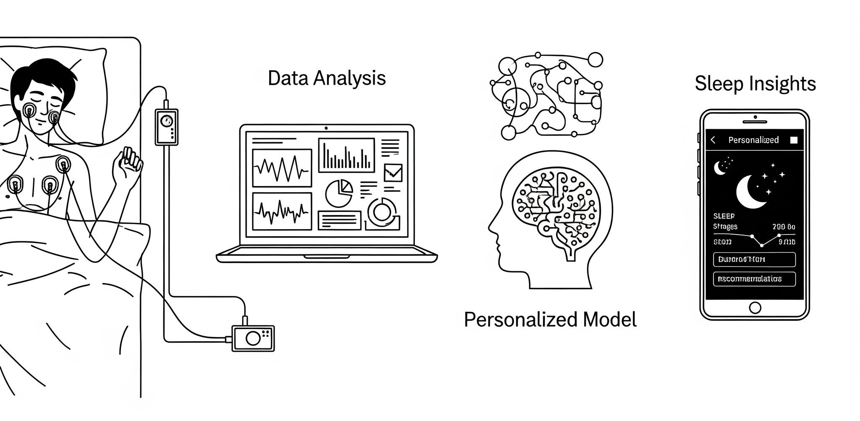
Introduction
Chronic disease prevalence is rising among older populations, leading to greater vulnerability and long-term health challenges.
Most works done in sleep health domain provides no clinical impact due to its black-box nature.
Availability of an open source software or framework still remains lacking mainly for old age homes and recreational centres

Slide 4
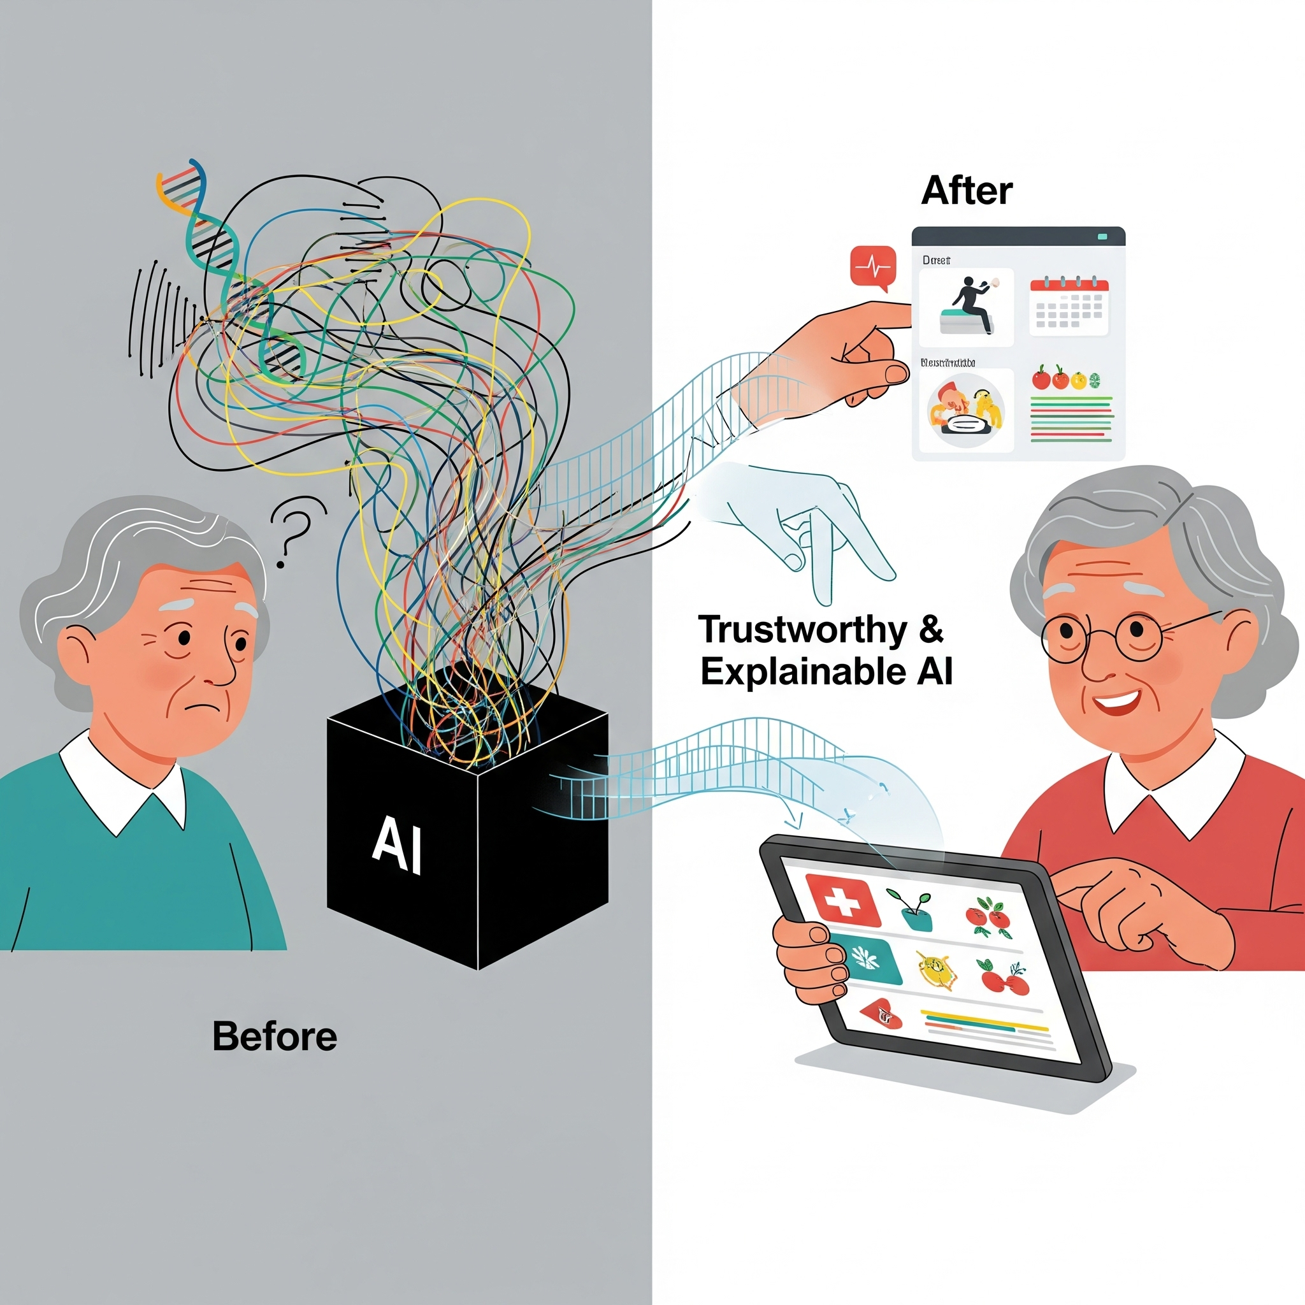
Motivation
PSG signals are strongly associated with health risks and diseases. but manual interpretation is not always feasible.
Elderly cohorts have higher risks of diseases and other health risks, thus requiring a robust intervention method.
Clinical impact of most AI studies and frameworks are very low due to its black-box nature leads to development of a trustworthy system.
The elderly population frequently require higher technical assistance leading to the need for user-friendly and personalized plan with more layman-level explanation.

Slide 5
Problem Statement
We aim to develop a personalized and explainable multimodal learning framework that leverages unlabeled polysomnography (PSG) data to predict long-term disease risks in elderly populations, like cardiovascular diseases (heart failure, stroke), neurological disorders (dementia, Parkinson's), metabolic conditions (diabetes), and mortality outcomes.
Predict long-term heart disease risks from multimodal sleep-related biomarkers.
Provide transparent explanations for clinicians and simplified insights for elderly users.
Personalize predictions based on individual physiology, lifestyle, and comorbidities.
Enable agentic LLMs to orchestrate multimodal reasoning and clinical decision support.
Design conversational AI for empathetic, accessible, and personalized interactions.

Slide 6
Literature Review Overview
Classical Statistical & Regression Models
Magnison-Benoit et al. (2025): ORP (Odds Ratio Product) with regression models for age-related sleep architecture.
Traditional Machine Learning Approaches
Wallace et al. (2021): Random forests with permutation-based variable importance for mortality prediction.Ramesh & Arachchige (2023): Review of dopamine depletion, genetics, pathology, and therapeutic options.
Deep Learning Architectures for Sleep Signal Representation
Lee et al. (2025): SleepXViT, dual Vision Transformer with explainability via attention heatmaps.
Phan et al. (2022): SleepTransformer, sequence-to-sequence transformer for uncertainty quantification.
Dutt et al. (2022): SleepXAI, CNN-CRF with Grad-CAM for explainable sleep staging.
Thapa et al. (2025): Multimodal foundation model trained on 585K hours of PSG data.
Clinical Decision Support & Multimodal Integration
Hwang et al. (2022): CNN-based CDSS with user-centered AI explanations, validated by technicians.
de Chazal et al. (2020): Multisensor approaches (EEG, HRV, oximetry) for OSA phenotyping.

Slide 7
Key Insights from Literature Review
Shift Toward Explainable AI for Clinical Impact
Vision Transformers (e.g., SleepXViT [2]) and attention mechanisms are now widely used to make sleep staging more interpretable for clinicians, improving trust and diagnostic performance.
Explainable clinical decision support systems boost technician staging accuracy, especially among novices, by providing pattern-based explanations and uncertainty estimates
Integration of Multimodal Data
Combining EEG, EOG, EMG, clinical, and demographic data improves robustness.
Sensor fusion challenges remain for interpretation and consistency.
Explainability: Clinical Impact & Limits
Heatmaps and relevance propagation guide clinicians but lack standardized evaluation.
Explanations save time in ambiguous cases, but risk of over-reliance persists.
Personalization & Gaps
Patient-specific models (transfer/continual learning, phenotyping) enable tailored care.
Large, diverse datasets are essential for generalizable personalization.

Slide 8
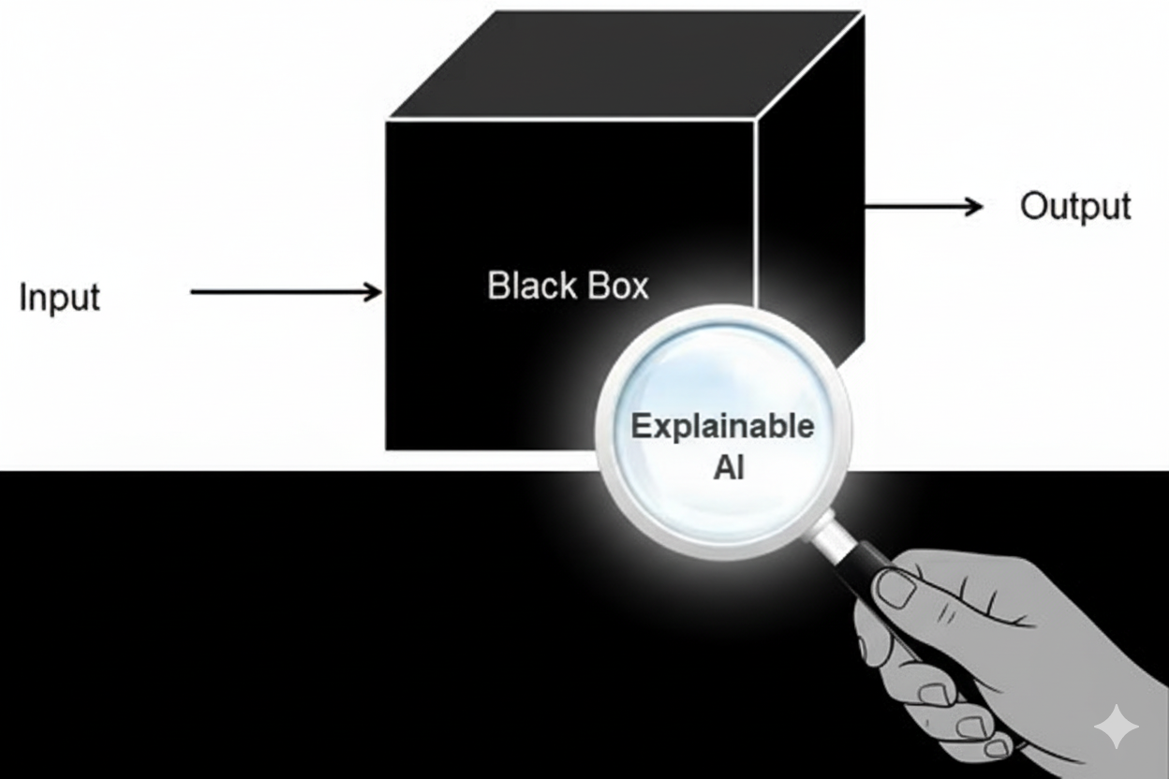
Research Gaps
Existing studies rarely unify PSG signals with clinical, demographic, and lifestyle data for cardiovascular risk prediction.
Current models lack personalization and fail to adapt to individual variations and long-term health trajectories in elderly populations.
Most AI approaches act as black boxes, offering limited interpretability for clinicians and accessibility for elderly users.
Agentic systems for multimodal reasoning and clinical decision support in elderly care is underexplored.

Slide 9
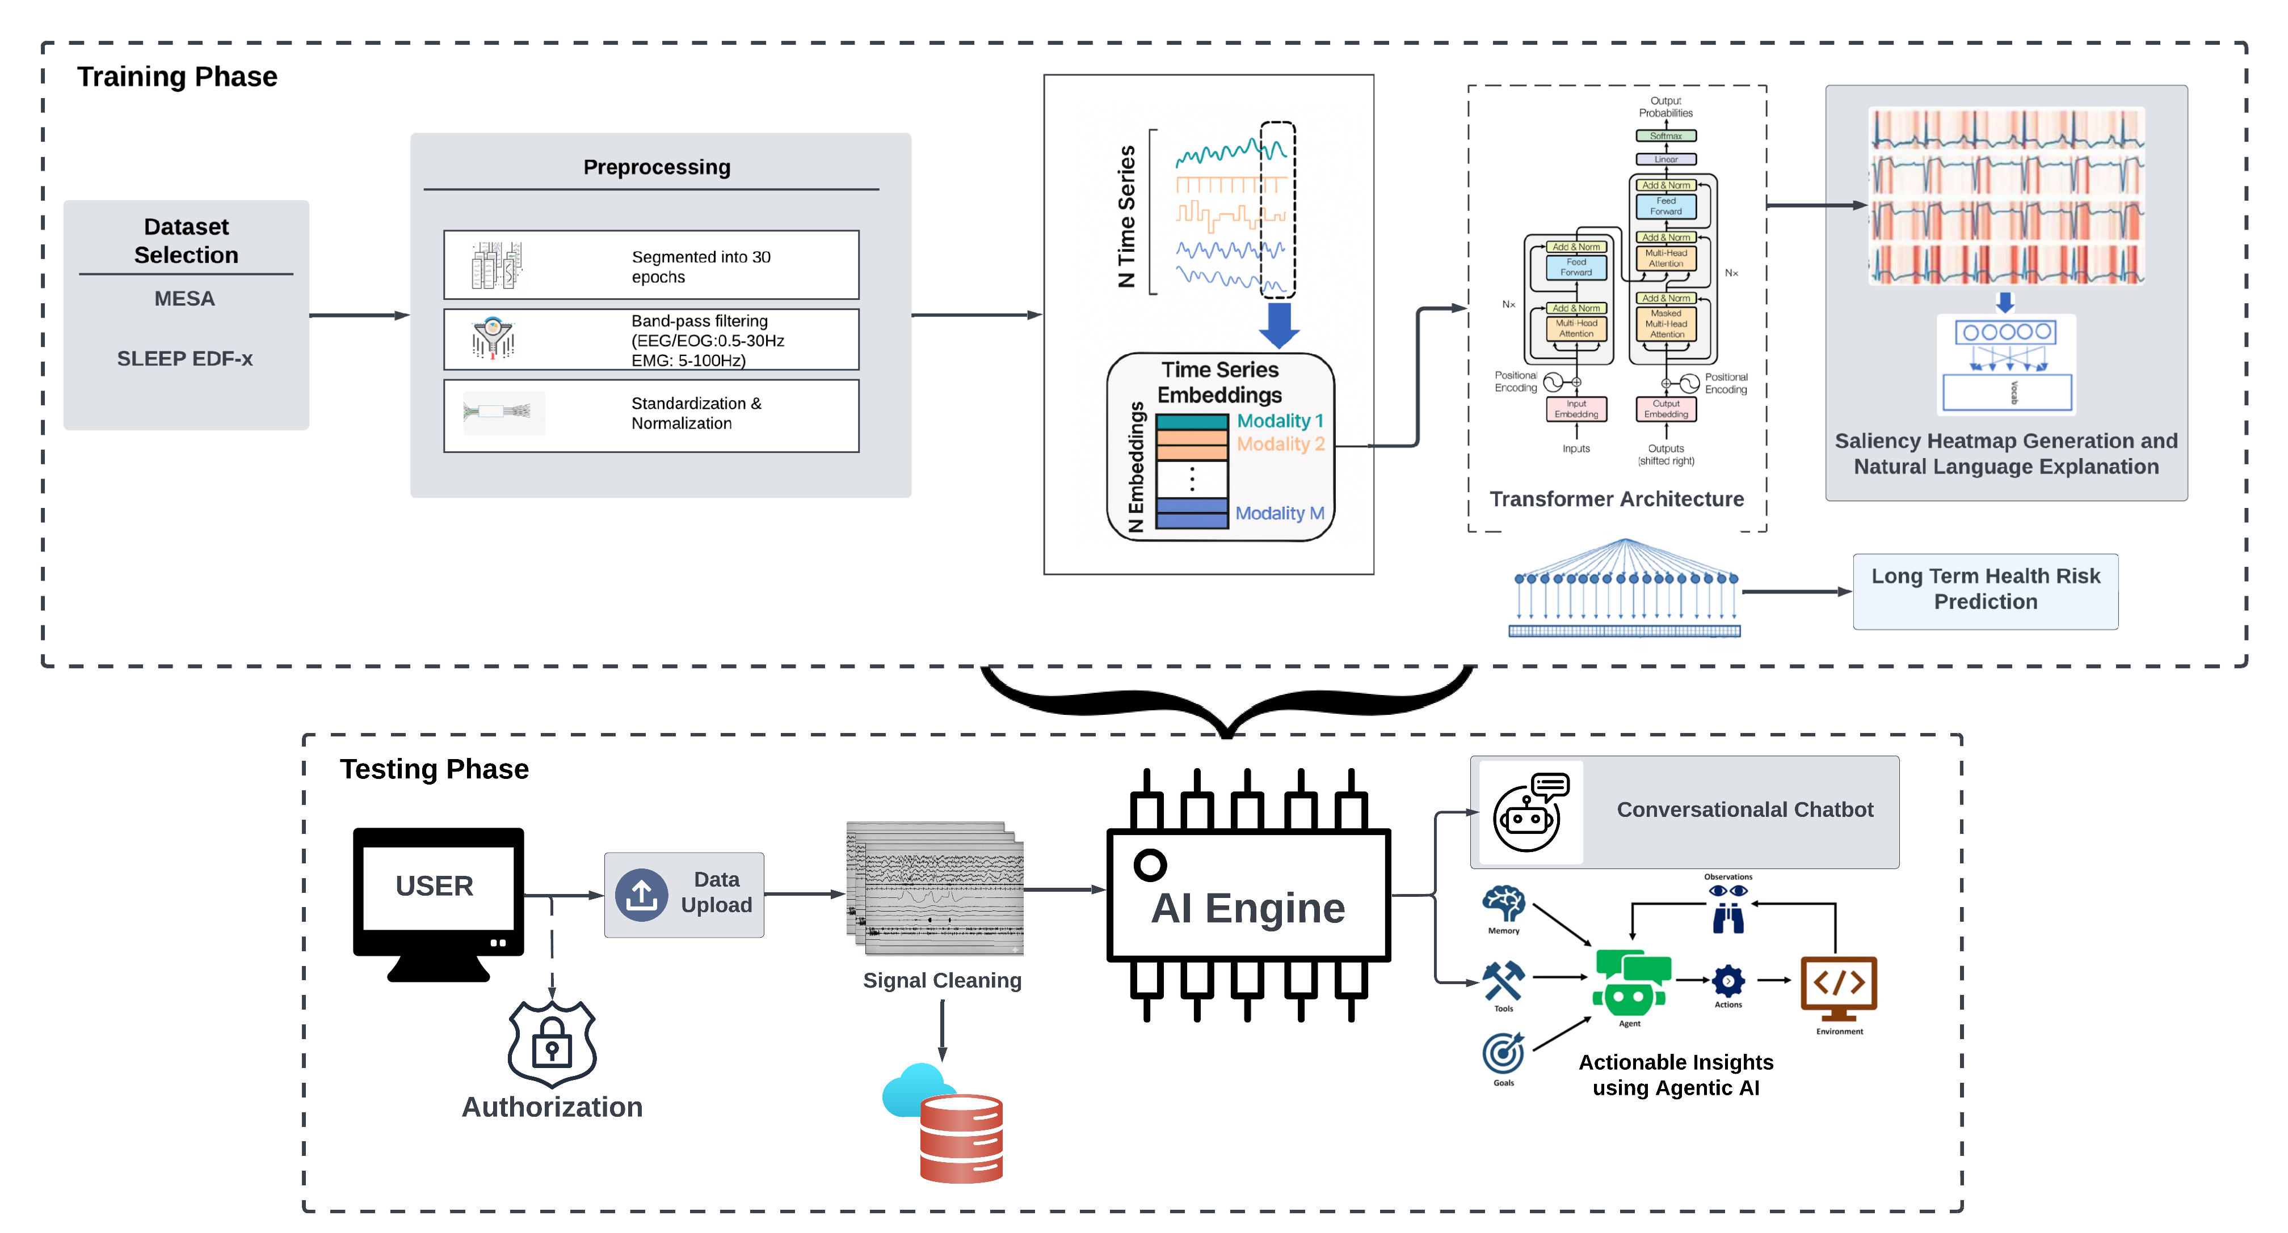
System Architecture (Methodology)

Slide 10
Methodology – Phase 1 (Part A : Modules)
Interface
Intuitive dashboards for clinicians, caregivers, and patients.
Role-based views and explainable AI visualizations.
Access previous predictions and analysis.
view personalized data and insights
AI Engine
Joint Spatial-Temporal Modeling Captures complex interactions across sensors/modalities and time, essential for multimodal health signals.
Dynamic Attention Weights Learns importance of specific nodes and time points, enabling precise focus on critical features for risk prediction.
Transformer temporal attention models extended sequences, detecting subtle trends and events over time.
Dual attention maps provide clear explanations of which modalities and time segments drive predictions, aiding clinical trust.
Gradient based saliency heatmaps
Saliency heatmaps uses the model’s gradients to show which input values most influenced the model’s output
Produces concept-level attributions so clinicians see medically meaningful causes.
Presents model’s confidence and uncertainty of its output.

Slide 11
Methodology – Phase 1 (Part A : Modules)
Narrative Generation
Provides a caregiver view of XAI in plain language
Synthesizes explanations from the model’s output, saliency maps and patient history to give a layman level understandings.
Agentic AI architecture uses RAG model to extract remedies and information about medical conditions.
Actionable Insights
Ranks urgency and suggests next steps, such as follow-up tests, interventions, or referrals.
Provides transparent reasoning for each recommendation using model attention and explanation maps.
Tailored insights to patient history, current data, and care protocol context.
Conversational Chatbot
An AI chatbot that helps mainly caretakers and elder people with technical help and tool-tips.
Can provide insights and explanations on basic medical queries in the field.
Voice interface for chances that the elder user is hard of hearing.
Multi-lingual support for local languages.

Slide 12
Methodology – Phase 1 Pipeline
Dataset Selection We collect multimodal polysomnography (PSG) data from diverse sources including Sleep EDFx, SHHS, MROS, MESA, CinC, WSC, and DREEM, ensuring broad coverage of demographics and recording conditions.
Generalization To harmonize heterogeneous datasets, we standardize channel orderings, variable naming conventions, and align recording timelines for consistency across studies.
Preprocessing The raw signals are segmented into 30-second epochs, passed through band-pass filters to isolate relevant frequency bands, resampled to a common 100 Hz rate, and cleaned by excluding corrupted segments. Finally, normalization and standardization are applied to maintain uniform signal scaling.
Architecture Design and experimentation Pretraining on pretext subtasks such as sleep staging, event detection, signal reconstruction and cross modality predictions. Generalizing on different dataset and finetuning towards main task – health risk prediction.
XAI module Integration Basic SHAP or LIME visualizations and advanced GRAD-CAM tests for concept-level attributions.

Slide 13
Methodology - (Phase 2)
Interface Development A highly User-friendly UI is required, thus extensive work is needed while designing the application. All features need to understandable by both caretakers and clinicians, providing both advanced insights and simple access.
Model Compression and Latency tests To further enable deployment, we apply knowledge distillation techniques to transfer knowledge from large models to compact versions, and use Neural Architecture Search (NAS) to automatically discover efficient structures. Mostly NAS is computationally heavy thus might lean towards simpler solutions like pruning and quatization.
Evaluation and Benchmarking The trained models are rigorously evaluated against standard benchmarks to assess performance, generalizability, and efficiency. Unit testing is done across all modules to ensure proper workflow and efficient data movements.
Cloud Deployment Finally, the models are deployed on Cloud Environment, with load-balancing, scaling capabilities suitable for large scale deployment.

Slide 14
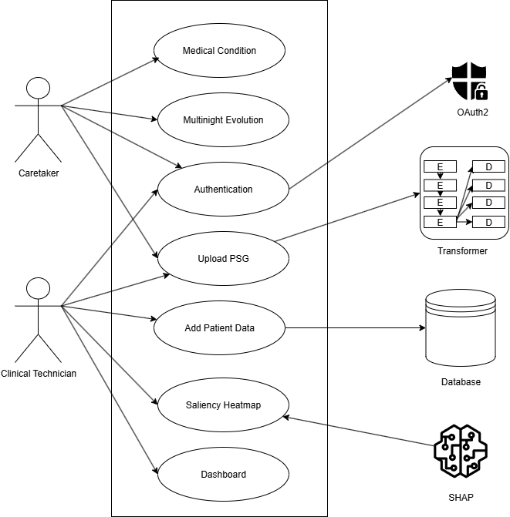
Use Case Diagram

Slide 15
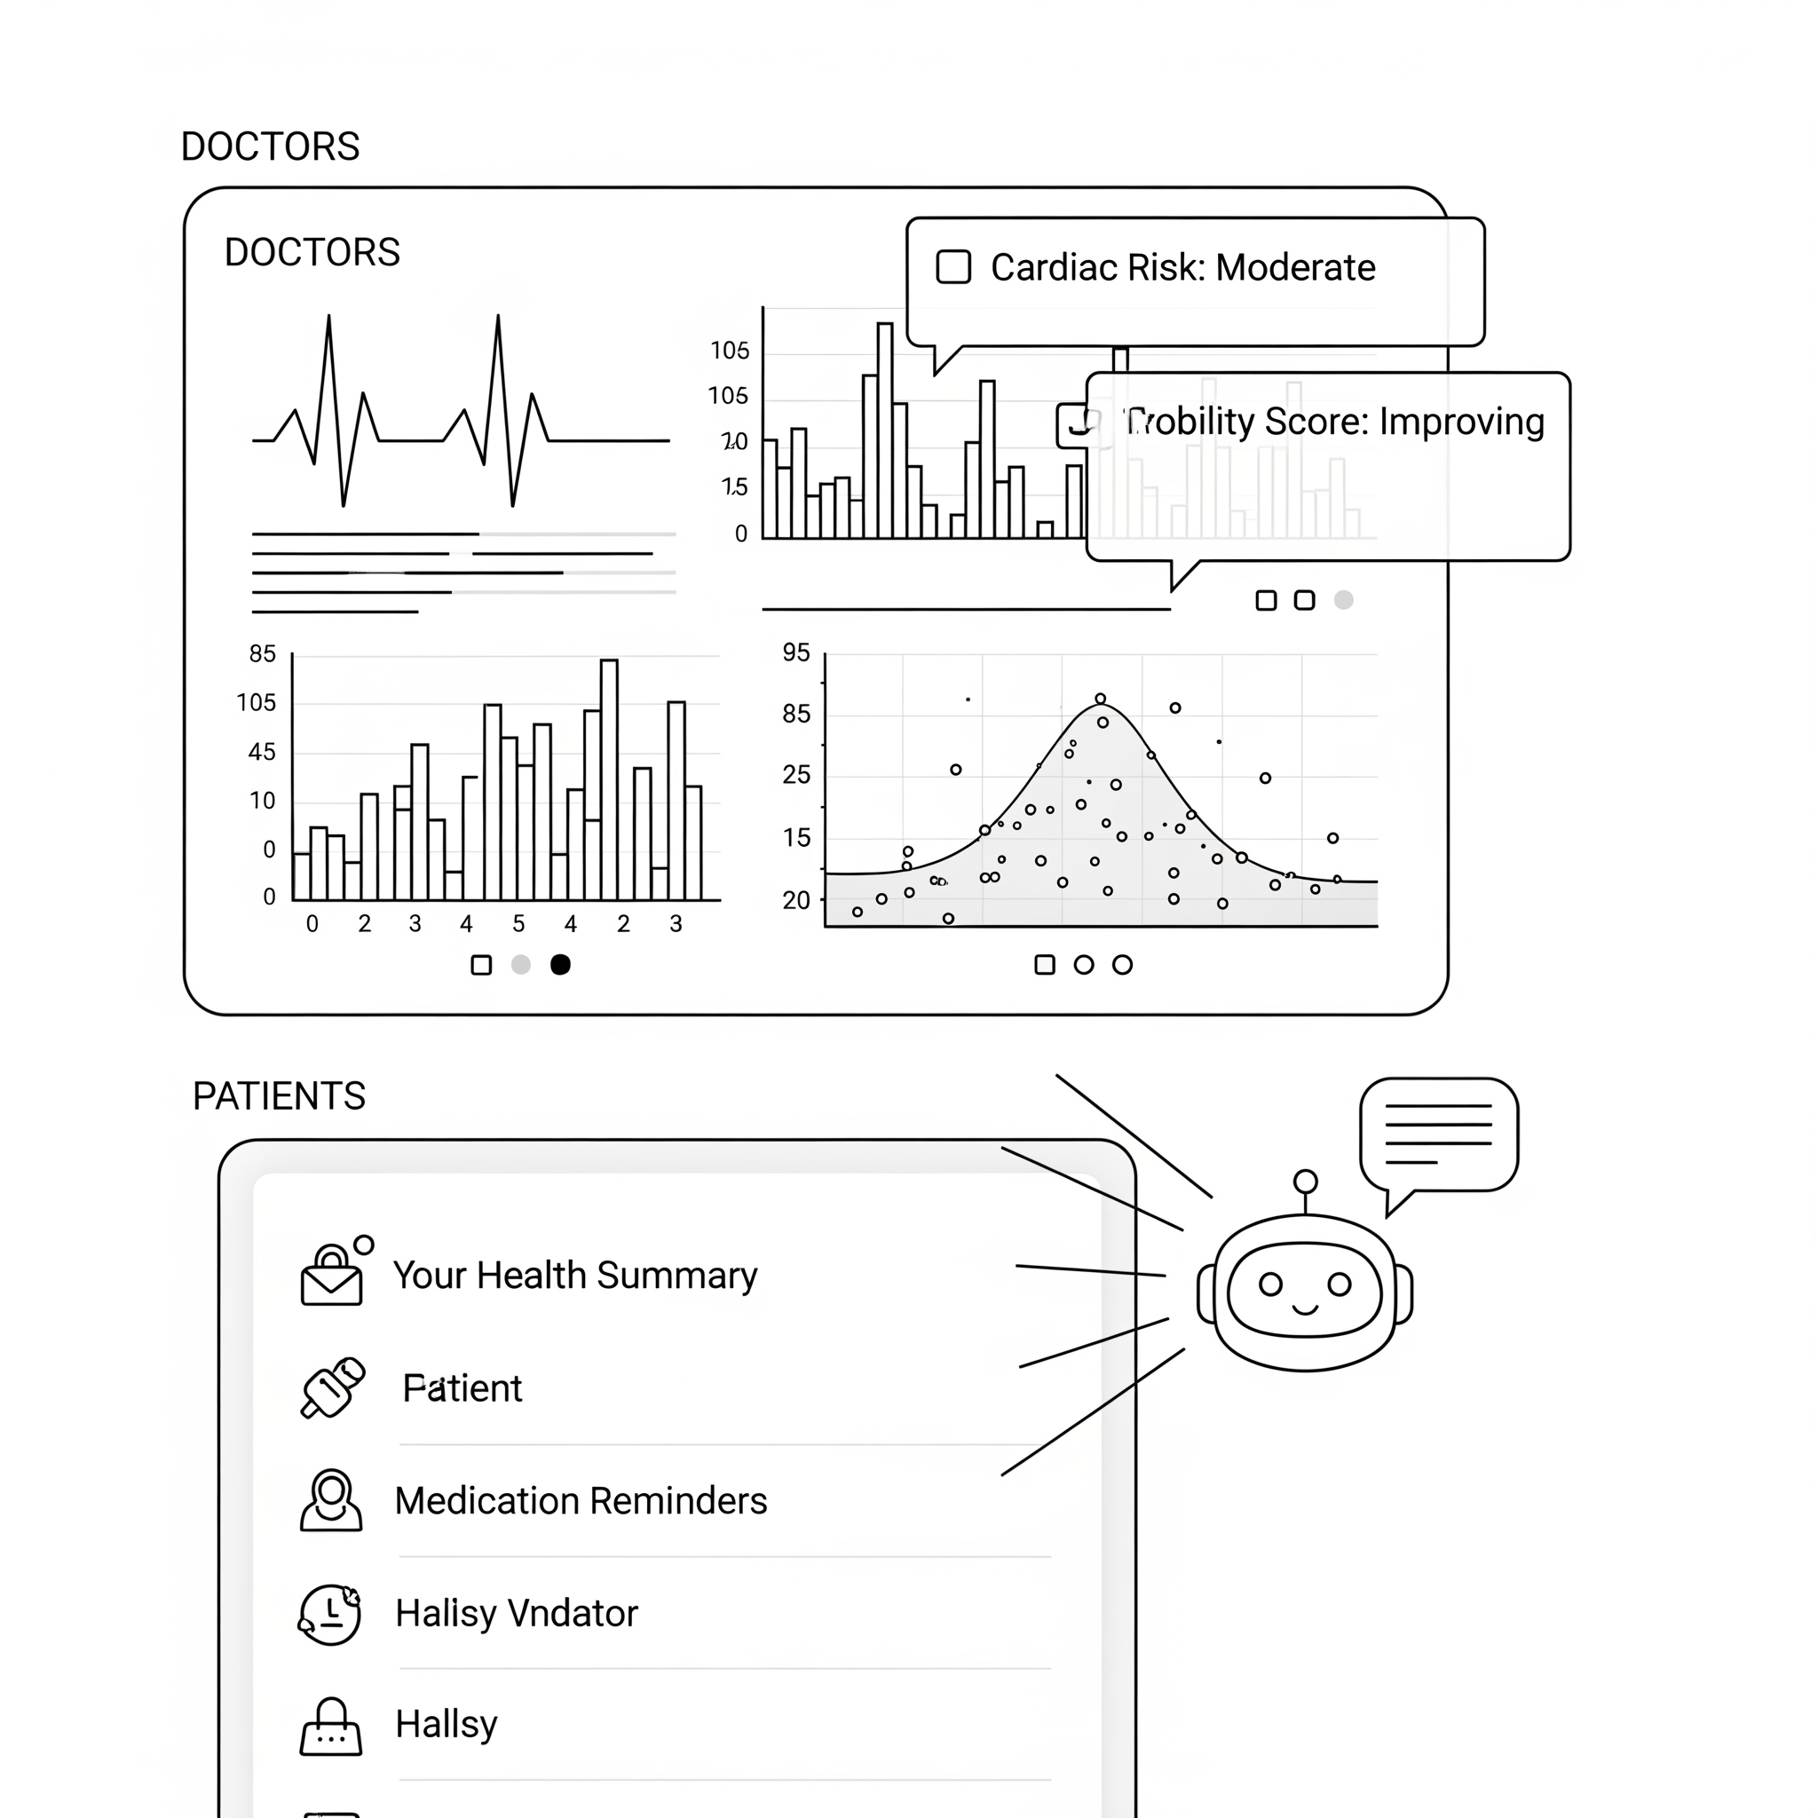
Novelty of the Proposed Work
Elderly cohorts, who face disproportionately higher risks of diseases, remain underrepresented as the primary focus of PSG-based sleep studies and predictive modeling.
Most existing frameworks deliver low clinical impact because their black-box nature undermines clinician trust, creating a clear need for interpretable, clinically trustworthy systems.
There is a lack of general, user-friendly software for caregivers in old-age homes that translates PSG-derived insights into layperson-understandable, actionable guidance.

Slide 16
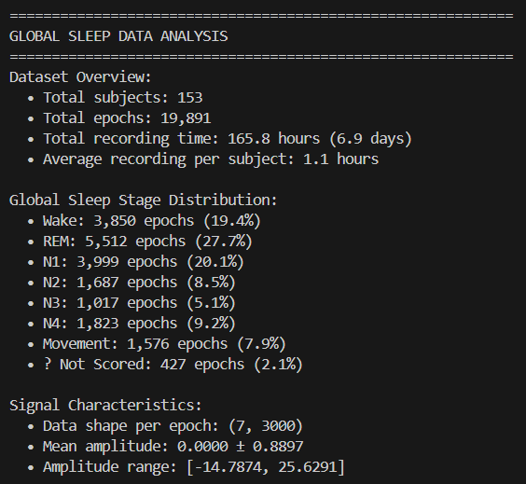
Progress
Sleep – EDF Expanded
Dataset selected: - MESA (342 GB)
- Sleep-EDF Expanded (8.1GB)
Explorative Data Analysis - EDA
• Sleep-EDFx provides 153 patient records out of which only 74 are above age 60 years. • Mesa provides 2237 patient records out of which 1805 records are eligible of the criteria (age>=60) with the mean age being 72.45 years old.
Preprocessing
• Segmented into 30 seconds epoch. • Bandpass filter each channel.
• Resample all to 100Hz.
• Artifact/Bad segment exclusion.
• Normalization/Standardization.
• Map annotation files respectively (W, N1, N2, N3, REM, Movement, ?(Not scored))

Slide 17
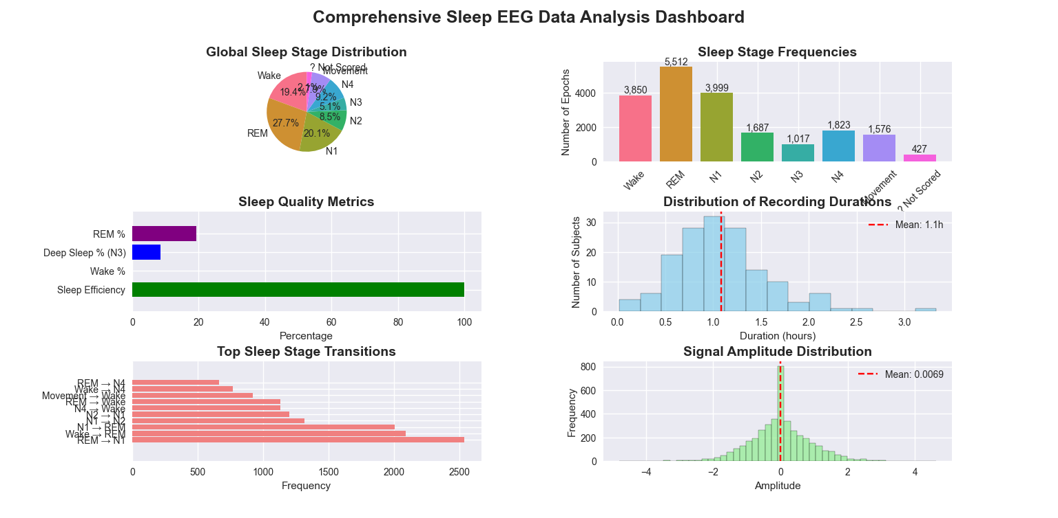

Slide 18

Conclusion
PSG-based biomarkers enable earlier, personalized prediction of major health risks in the elderly.
Clinician-grade reports and plain-language caregiver summaries bridge expert and lay needs.
Planned evaluation includes robust metrics, clinician studies, and reproducible artifacts.
Multi-level XAI (saliency, concept attributions, uncertainty) makes decisions auditable and interpretable.
Models are tuned for age-related physiology, comorbidities, and longitudinal change.

Slide 19
REFERENCES
[1] Magnison-Benoit, S., Snow, C., Pun, M., Gauba, H., Berghmans, S., Clarke, A., Hansen, B., Donald, A. M. H., Gerardy, B., Hogan, D. B., Hill, M. D., Holodinsky, J., Tsai, W. H., Longman, R. S., Rawling, J. M., Younes, M., & Poulin, M. J. (2025). Age-related changes in sleep architecture: Effects of body mass index, sex, and mental health in community-dwelling adults using at-home polysomnography. Sleep Medicine, 133, 106629. https://doi.org/10.1016/j.sleep.2025.106629
[2] Lee, H., Choi, Y. R., Lee, H. K., Jeong, J., Hong, J., Shin, H. W., & Kim, H. S. (2025). Explainable vision transformer for automatic visual sleep staging on multimodal PSG signals. npj Digital Medicine, 8, 55. https://doi.org/10.1038/s41746-024-01378-0
[3] Phan, H., Mikkelsen, K., Chen, O. Y., Koch, P., Mertins, A., & De Vos, M. (2022). SleepTransformer: Automatic sleep staging with interpretability and uncertainty quantification. IEEE Transactions on Biomedical Engineering, 69(8), 2456–2467. https://doi.org/10.1109/TBME.2022.3147187
[4] Thapa, R., Kjær, M. R., He, B., Covert, I., Moore, H., Hanif, U., Ganjoo, G., Westover, M. B., Jennum, P., Brink-Kjær, A., Mignot, E., & Zou, J. (2025). A multimodal sleep foundation model developed with 500K hours of sleep recordings for disease predictions. medRxiv (preprint). https://doi.org/10.1101/2025.02.04.25321675
[5] Wallace, M. L., Coleman, T. S., Mentch, L. K., Gerardy, J. L., Patel, S. R., Gottlieb, D. J., Punjabi, N. M., Redline, S., Stone, K. L., Ensrud, K. E., Peppard, P. E., & Hall, M. H. (2021). Physiological sleep measures predict time to 15-year mortality in community adults: Application of a novel machine learning framework. Journal of Sleep Research, 30(6), e13386. https://doi.org/10.1111/jsr.13386
[6] Hwang, J., Lee, T., Lee, H., & Byun, S. (2022). A clinical decision support system for sleep staging tasks with explanations from artificial intelligence: User-centered design and evaluation study. Journal of Medical Internet Research, 24(1), e28659. https://doi.org/10.2196/28659
[7] de Chazal, P., Sutherland, K., & Cistulli, P. A. (2020). Advanced polysomnographic analysis for OSA: A pathway to personalized management? Respirology, 25(3), 251–258. https://doi.org/10.1111/resp.13564
[8] Dutt, N., et al. (2022). SleepXAI: Explainable artificial intelligence for sleep staging using polysomnography data. [Conference/Journal details if available]. [SleepXAI-1.pdf]

Slide 20
THANK YOU !

