Slide 1
Instruction Set

Slide 2
Instruction Set of 8086
Data copy/ Transfer instructions
Arithmetic and logical instructions
Branch instructions
Loop instructions
Machine control instructions
Flag manipulation instructions
Shift and rotate instructions
String instructions

Slide 3
Data copy/ Transfer instructions
MOV: Move - transfers data from one register/memory location to another register/memory location.
Source - one of the segment registers or other general or special purpose registers or a memory location
Destination - another register or memory location
For immediate addressing mode - segment register cannot be a destination register
Direct loading of the segment registers with immediate date is not permitted
To do so, load any general purpose register with the data and move it to segment register

Slide 4
Load DS with 5000H
MOV DS, 5000H (Not permitted)
MOV AX, 5000H
MOV DS, AX
Source and destination registers cannot be memory location
MOV AX, 5000H ;immediate
MOV AX, BX ;Register
MOV AX, [SI] ;Indirect
MOV AX, [2000H] ;Direct
MOV AX, 50H[BX] ;Based relative, 50H displacement

Slide 5
PUSH: push to stack
Push the content of the specified register/ memory location on to the stack
Stack pointer is decremented by 2 after each instruction execution of PUSH
Stack-top is always occupied by the recently pushed data
Decrement SP by 2 & store 2 byte operand onto the stack
Higher byte is pushed first and then the lower byte
Higher byte occupies the higher address and lower byte occupies the lower addess

Slide 6
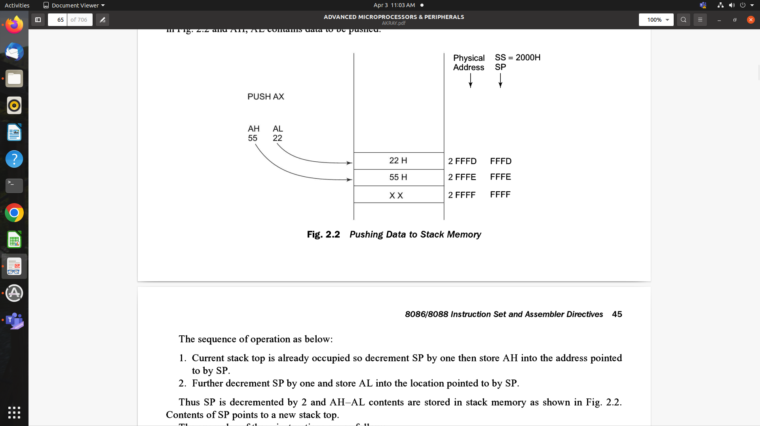

Slide 7
POP
Pop from stack
Loads the specified register/ memory location with the contents of the memory location of which the address is formed using the current stack segment and stack pointer
Stack pointer is incremented by 2
Contents of stack top memory location is stored in AL & SP is incremented by one
Contents of stack top memory location is stored in AH & SP is again incremented by one

Slide 8
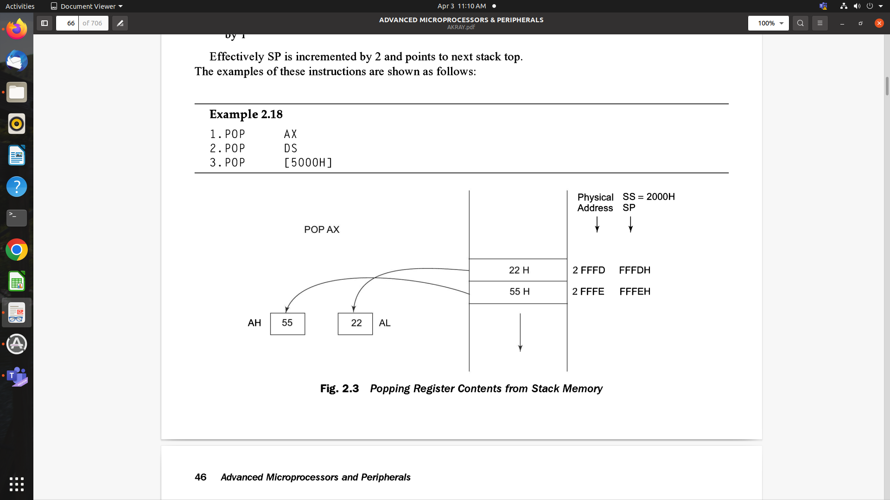

Slide 9
XCHG: Exchange
Exchanges the contents of the specified source and destination operands
Operands may be registers or one of them may be a memory location
Exchange of contents of 2 memory locations is not permitted
Immediate data is also not allowed in this instruction
XCHG [5000], AX - exchanges data between AX and a memory location [5000H] in the data segment
XCHG BX, AX - exchanges data between AX and BX

Slide 10
IN
Input the port - reading from an input port
Address of the input port may be specified in the instruction directly or indirectly
AL & AX - allowed 8-bit or 16-bit input operations
DX - only register allowed to carry the 16-bit port address
IN AL, 03H - reads data from an 8-bit port whose address is 03H and stores it in AL
IN AX, DX - reads data from a 16-bit port whose address is in DX and stores it in AX
MOV DX, 0800H - Port address 0800H is stored in DX
IN AX, DX - Read the content of the port in AX

Slide 11
OUT
Output to the port - writing to an output port
Output port address is specified directly or implicitly in DX
Contents of AX or AL are transferred to a directly or indirectly addressed port
Data transfer to an odd addressed port is through D8 to D15
Data transfer to an even addressed port is through D0 to D7
Source operand registers can be AL or AX
OUT 03H, AL ;sends data available in AL to the port address 03H
OUT DX, AX ;sends data available in AX to a port address specified in DX
MOV DX, 0300H ;copy the port address in DX
OUT DX, AX ;content of AX is written to a port address in DX

Slide 12
XLAT: Translate
Using a lookup table technique, find out the codes for code conversion problems

Slide 13
LEA: Load effective address
Loads the effective address formed by destination operand into the specified source register
LEA BX, ADR ; Effective address of label ADR; ie offset of ADR will be transferred to Reg; BX
LEA SI, ADR[BX] ; offset of label ADR will be added to content of BX to form effective address and it will be loaded in SI

Slide 14
LDS/ LES: Load pointer to DS/ES
Loads the DS or ES register and the specified destination register in the instruction with the content of memory location specified as source in the instruction

Slide 15
LAHF - Load AH from lower byte of Flag
Observe the status of all the condition code flags at a time
SAHF - Store AH to lower byte of flag
Sets or resets the condition code flags (except overflow) in the lower byte of the flag register depending on the corresponding bit positions in AH
PUSHF - Push flags to Stack; first the upper byte and then the lower byte; sp=sp-2
POPF - Pop flags from Stack; SP = SP + 2

Slide 16
Arithmetic Instructions
Add, Sub, Mul, Div, ASCII and Decimal adjust instructions, INC, DEC
The Arithmetic Instructions affect all the condition code flags.
The operands are either the registers or memory locations or immediate data depending on the addressing mode.

Slide 17
ADD = adds an immediate data or contents of a memory location specified in the instruction or a register (source) to the contents of another register (destination) or memory location.
The result is in the destination operand.
Both the source and destination operands cannot be a memory location.
Memory to memory addition is not possible.
Contents of segment registers cannot be added using this instruction
All the condition code flags are affected based on the result

Slide 18
Write the meaning of this instruction and its corresponding addressing modes
ADD AX, 0100H
ADD AX, BX
ADD AX, [SI]
ADD AX, [5000H]
ADD [5000H], 0100H
ADD 0100H

Slide 19
ADC : Add with carry
Same as add, but it adds carry flag bit to the result
All the condition code flags are affected by this instruction
ADC 0100H
ADC AX, BX
ADC AX, [SI]
ADC AX, [5000H]
ADC [5000H], 0100H

Slide 20
INC
INC: increment
Adds the content of the specified register or memory location by 1
All the condition code flags are affected except the carry flag CF
Add 1 to the content of the operand
Immediate data cannot be operand
INC AX
INC [BX]
INC [5000H]

Slide 21
DEC
Decrement :
Subtract 1 from the content of the register or memory location
All condition code flags except the carry flag are affected depending on the result
Immediate data cannot be an operand
DEC AX
DEC [5000H]

Slide 22
SUB
Subtracts the source operand from the destination operand
Result is present in the destination operand
Source operand may be a register, memory location or immediate data
Destination operand may be a register or a memory location
Source and destination operands both must not be memory operands
Destination operand cannot be an immediate data
All the condition code flags are affected by this instruction

Slide 23
SUB AX, 0100H
SUB AX, BX
SUB AX, [5000H]
SUB [5000H], 0100

Slide 24
SBB
Subtract with borrow
Subtracts the source operand and the borrow flag(carry flag) from the destination operand
Subtracting 1 from the result of SUB; if carry(borrow) flag is set
Result is stored in the destination operand
All the condition code flags are affected
SBB AX, 0100H
SBB AX, BX
SBB AX, [5000H]
SBB [5000H], 0100

Slide 25
CMP: Compare
Source operand - register, immediate data, memory location
Destination operand - register, memory location
Compares the source operand with the destination operand - subtracts the source operand from the destination operand upon the result of subtraction.
If both the operands are equal, zero flag is set
If the source operand is greater than the destination operand, carry flag is set
Else carry flag is reset

Slide 26
CMP BX, 0100H
CMP AX, 0100H
CMP [5000H], 0100H
CMP BX, [SI]
CMP BX, CX

Slide 27
AAA : ASCII Adjust after Addition
All the ASCII adjust are also called as unpacked BCD arithmetic instructions.
ADD 2 ASCII coded operands and its result is in AL
AAA converts the contents of AL to unpacked decimal digits
AAA - examines the lower 4 bits of AL to check whether it contains a valid BCD number in the range 0 to 9
If it is between 0 to 9 & AF = 0, then AAA sets the higher 4 bits of AL to 0
AH should be cleared before addition
If the lower digit of AL is between 0 to 9 & AF is set, AL = AL + 6. AH = AH + 1. The upper 4 bits of AL are cleared
If the lower digit of AL is > 9 & AF is set, AL = AL + 6. AH = AH + 1. AF = CF = 1. The upper 4 bits of AL are cleared
AH is modified as sum of previous contents and the carry from the adjustment
It does not give the exact ASCII codes of the sum but they can be obtained by adding 3030H to AX.

Slide 28
AAS : ASCII adjust AL after Subtraction
Subtract 2 unpacked ASCII operands
Correct the result in AL
If the lower 4 bits of AL > 9, or if AF = 1, then AL = AL - 6, AH = AH -1, CF and AF = 1
If CF and AF = 0, the result needs no correction
The upper nibble of AL is 00 and the lower nibble may be from 0 to 9.

Slide 29
AAM : ASCII adjust after multiplication
Multiplication of 2 unpacked BCD operands ( higher nibbles of the operands = 0)
Convert the product in AL to unpacked BCD format
AAM replaces the content of AH by tens of the decimal multiplication and AL singles of the decimal multiplication.

Slide 30
AAD : ASCII adjust before division
Converts two unpacked BCD digits in AH and AL to the equivalent binary number in AL.
Adjustment is made before division.
PF, SF, ZF are modified.
AF, CF, OF are undefined.
AX = 05 08
AAD => AL - 00 3A
58D = 3A H in AL
DH = 02 H
DIV DH

Slide 31
Packed BCD Arithmetic
DAA : Decimal adjust Accumulator
Convert the result of the addition of 2 packed BCD numbers to a valid BCD number.
The result has to be only in AL.
If lower nibble > 9 after addition or if AF is set, it will add 06 to the lower nibble in AL.
After adding 06 in the lower nibble of AL, if the upper nibble of AL > 9 or CF = 1, DAA adds 60H to AL.
DAA affects AF, CF, PF and ZF
OF is undefined

Slide 32
DAA
IF ((AL AND 0FH) > 9) OR (AF = 1)
THEN
AL := AL + 6;
AF := 1;
ELSE
AF := 0;
FI;
IF (AL > 9FH) OR (CF = 1)
THEN
AL := AL + 60H;
CF := 1;
ELSE CF := 0;
FI;

Slide 33
DAS: Decimal adjust after subtraction
Subtraction of 2 packed BCD numbers to a valid BCD number.
Convert the result to a valid BCD number.
The subtraction has to be in AL only.
If the lower nibble of AL > 9, it will subtract 06 from lower nibble of AL.
If the result of subtraction sets the carry flag or if upper nibble >9, it subtracts 60H from AL.
This instruction modifies the AF, CF, PF, and Zf flags.
OF is undefined.

Slide 34
NEG: Negate
2’s complement of the destination in the instruction
Destination may be register or memory
If OF = 1 then the operation cannot be performed.
This affects all the condition code flags.

Slide 35
MUL : unsigned multiplication byte or word
Multiplies an unsigned byte or word by the contents of AL.
Unsigned byte or word may be in one of the general purpose registers or memory locations
MSW of the result is stored in DX
LSW of the result is stored in AX
Flags are modified based on the result
No immediate operand is allowed
If MSB or MSW of the result is ‘0’, CF and OF both will be set.

Slide 36
MUL BH ; AX = AL X BH
MUL CX ; DX AX = AX X CX

Slide 37
IMUL : Signed Multiplication
Multiplies a signed byte in source operand by a signed byte in AL or a
Signed word in source operand by a signed word in AX
Source - general purpose register, memory location, index register or base register,
Source cannot be an immediate operand
Higher order word is stored in DX and lower order word is stored in AX - result is 32 bits
AF, PF, SF and ZF are undefined after IMUL
AL, AX are implicit operands in case of 8-bits and 16 bit multiplication respectively.
Unused higher order bits are filled by sign bit and CF, AF are cleared.
IMUL BH
IMUL CX
IMUL [SI]

Slide 38
CBW: Convert signed byte to word
Convert the signed byte to word
It copies the sign bit of a byte to be converted to all bits in the higher byte of the result word
Byte to be converted should be there in AL
Result is there in AX
It does not affect any flag.

Slide 39
CWD: Convert signed word to double word
Copies the sign bit of AX to all the bits of the DX register.
This operation is to be done before signed division.
It does not affect any flag.

Slide 40
DIV : Unsigned division
Divides an unsigned word or double word by a 16-bit or 8-bit operand.
The dividend must be in AX for 16-bit operation and divisor may be specified using any one of the addressing modes except immediate.
Quotient in AL, Remainder in AH
If the result is too big to fit in AL, type 0 and an interrupt is generated.
Double word division (32-bit) - higher word should be in DX, lower word in AX
Quotient in AX, Remainder in DX
This instruction does not affect any flag.

Slide 41
IDIV: Signed division
Performs the same operation as the DIV instruction but with signed operands
The result will also be signed numbers
Divide by zero interrupt is generated, if the result is too big to fit in AX or Ax & DX
All the flags are undefined after IDIV.

