Slide 1
Microprocessors

Slide 2
Microprocessor - a programmable device
Programming Model
Addressing of Memory Space
Architecture of Intel MP
Addressing Modes - Real, Protected, Flat mode

Slide 3
Objectives
Describe the function and purpose of each program-visible register in the 8086–Core2 microprocessors, including the 64-bit extensions.
Detail the flag register and the purpose of each flag bit.
Describe how memory is accessed using real mode memory-addressing techniques.
Describe how memory is accessed using protected mode memory-addressing techniques.
Describe how memory is accessed using the 64-bit flat memory model.
Describe the program-invisible registers found within the 80286 through Core2 microprocessors.
Detail the operation of the memory-paging mechanism.

Slide 4
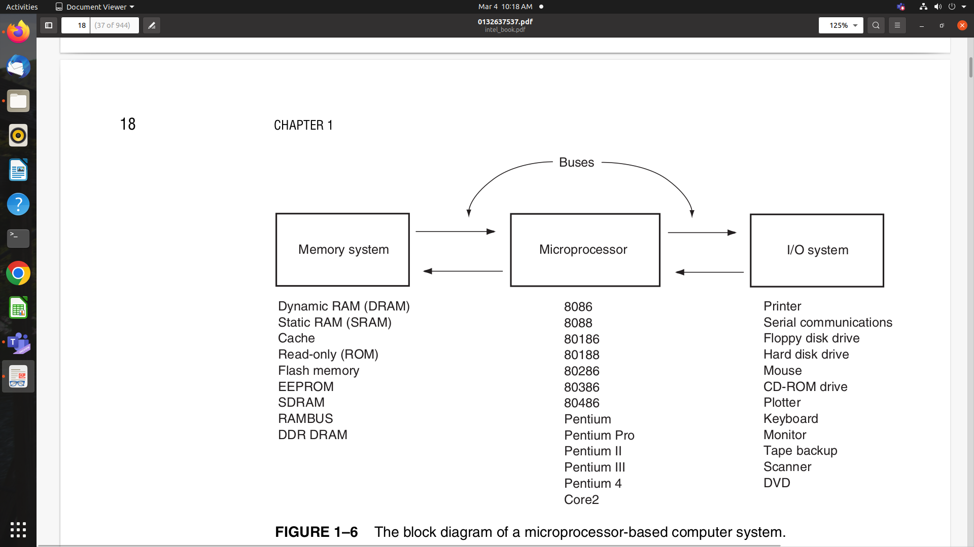
MP based Personal Computer System
Three blocks interconnected by bus.
A bus is the set of common connections that carry the same type of information. For example, the address bus, which contains 20 or more connections, conveys the memory address to the memory.

Slide 5
Memory map of PC System
The memory system is divided into three main parts: TPA (transient program area), system area, and XMS (extended memory system).
The type of microprocessor in your computer determines whether an extended memory system exists.
If the computer is based upon a really old 8086 or 8088 (a PC or XT), the TPA and systems area exist, but there is no extended memory area.

Slide 6
The PC and XT computers contain 640K bytes of TPA and 384K bytes of system memory, for a total memory size of 1M bytes. We often call the first 1M byte of memory the real or conventional memory system because each Intel microprocessor is designed to function in this area by using its real mode of operation.
Computer systems based on the 80286 through the Core2 not only contain the TPA (640K bytes) and system area (384K bytes), they also contain extended memory.

Slide 7
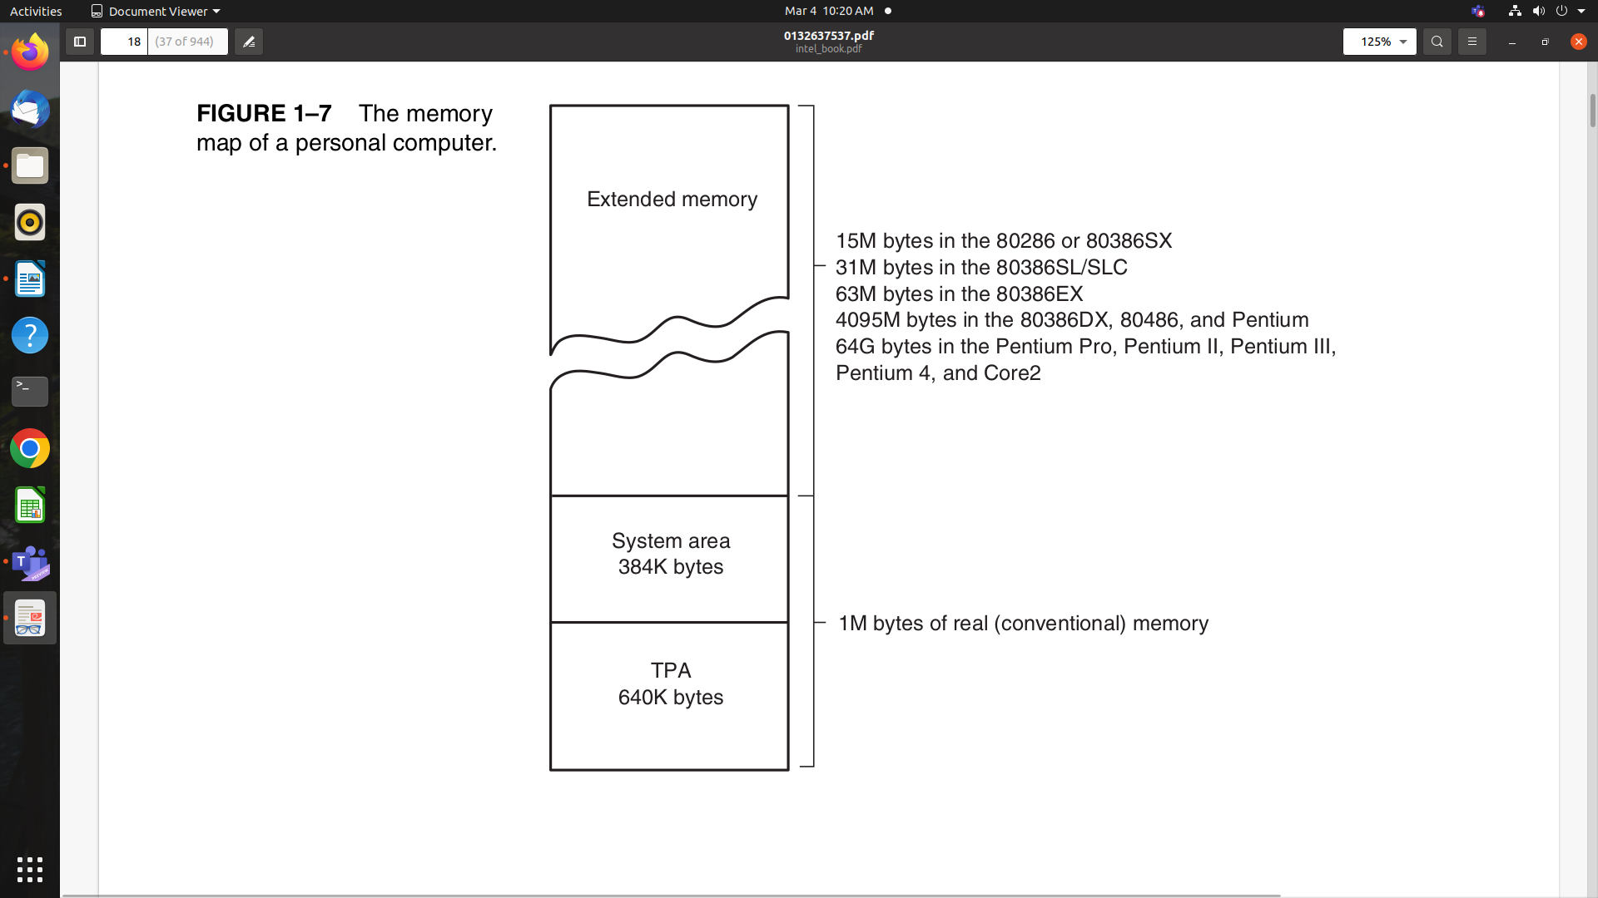

Slide 8
Peripheral Bus -
8 bit PB 8086
16 bit PB 80286
32 bit PB 80386, 80486
VESA Local Bus - interfaces disk and video to MP
PCI Bus
ATX class systems - USB
The universal serial bus is intended to connect peripheral devices such as keyboards, a mouse, modems, and sound cards to the microprocessor through a serial data path and a twisted pair of wires.
USB - reduce system cost by reducing the number of wires
Current Data Transfer Rate of USB - !!!
AGP (advanced graphics port) for video cards - transfers data between the video card and the microprocessor at higher speeds
serial ATA interface (SATA) for hard disk drives and the PCI Express bus for the video card - transfers data from the PC to the hard disk drive at rates of 150M bytes per second or 300M bytes for SATA-2

Slide 9
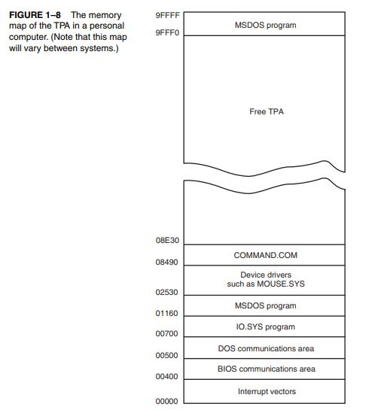

Slide 10
The Transient Program Area
The transient program area (TPA) holds the DOS (disk operating system) operating system and other programs that control the computer system.
The TPA is a DOS concept and not really applicable in Windows.
The TPA also stores any currently active or inactive DOS application programs.
The length of the TPA is 640K bytes, this area of memory holds the DOS operating system.

Slide 11
TPA
The system BIOS is a collection of programs stored in either a read-only (ROM) or flash memory that operates many of the I/O devices connected to your computer system.
The system BIOS and DOS communications areas contain transient data used by programs to access I/O devices and the internal features of the computer system.
The IO.SYS is a program that loads into the TPA from the disk whenever an MSDOS system is started.
The IO.SYS contains programs that allow DOS to use the keyboard, video display, printer, and other I/O devices often found in the computer system.
The IO.SYS program links DOS to the programs stored on the system BIOS ROM.

Slide 12
TPA
The size of the driver area and number of drivers changes from one computer to another.
Drivers are programs that control installable I/O devices such as a mouse, disk cache, hand scanner, CD-ROM memory (Compact Disk Read-Only Memory), DVD (Digital Versatile Disk), or installable devices, as well as programs.
Installable drivers are programs that control or drive devices or programs that are added to the computer system.
DOS drivers are normally files that have an extension of .SYS, such as MOUSE.SYS; in DOS version 3.2 and later, the files have an extension of .EXE, such as EMM386.EXE.

Slide 13
TPA
Windows uses a file called SYSTEM.INI to load drivers used by Windows.
In newer versions of Windows such as Windows XP, a registry is added to contain information about the system and the drivers used by the system.
You can view the registry with the REGEDIT program.
The COMMAND.COM program (command processor) controls the operation of the computer from the keyboard when operated in the DOS mode.
The COMMAND.COM program processes the DOS commands as they are typed from the keyboard.
Never erase COMMAND.COM, IO.SYS, or MSDOS.SYS.

Slide 14
System Area
The system area contains programs on either a read-only memory (ROM) or flash memory, and areas of read/write (RAM) memory for data storage.

Slide 15
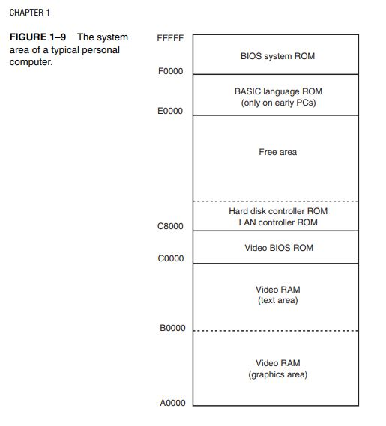

Slide 16
Windows Systems.
The Windows memory map appears in Figure 1–10 and has two main areas, a TPA and a system area.
The difference between it and the DOS memory map are the sizes and locations of these areas.
The Windows TPA is the first 2G bytes of the memory system from locations 00000000H to 7FFFFFFFH.
The Windows system area is the last 2G bytes of memory from locations 80000000H to FFFFFFFFH
The system area is where the system BIOS is located and also the video memory. Also located in the system area is the actual Windows program and drivers.

Slide 17
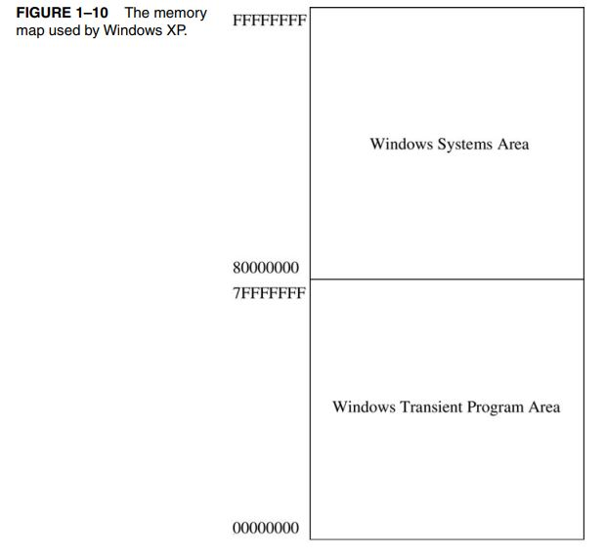

Slide 18
IO Space
An I/O port address is similar to a memory address, except that instead of addressing memory, it addresses an I/O device.
The I/O devices allow the microprocessor to communicate between itself and the outside world.
The I/O space allows the computer to access up to 64K different 8-bit I/O devices, 32K different 16-bit devices, or 16K different 32-bit devices.

Slide 19
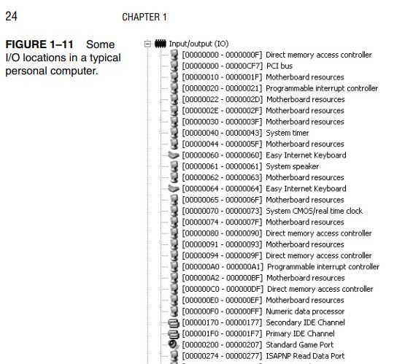
IO Space

Slide 20
The Microprocessor
The microprocessor, (CPU central processing unit), is the controlling element in a computer system.
The microprocessor controls memory and I/O through a series of connections called buses.
The buses select an I/O or memory device, transfer data between an I/O device or memory and the microprocessor, and control the I/O and memory system.
Memory and I/O are controlled through instructions that are stored in the memory and executed by the microprocessor.

Slide 21
The microprocessor performs three main tasks for the computer system:
(1) data transfer between itself and the memory or I/O systems
(2) simple arithmetic and logic operations
(3) program flow via simple decisions.
Although these are simple tasks, it is through them that the microprocessor performs virtually any series of operations or tasks.

Slide 22
The power of the microprocessor is in its capability to execute billions of millions of instructions per second from a program or software (group of instructions) stored in the memory system.
This stored program concept has made the microprocessor and computer system very powerful devices.

Slide 23
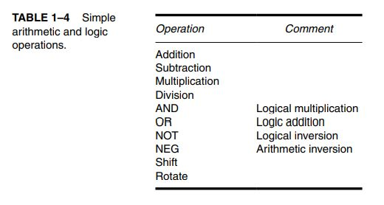
Arithmetic and Logic Operations
These operations are very basic, but through them, very complex problems are solved.
Data are operated upon from the memory system or internal registers.
Data widths are variable and include a byte (8 bits), word (16 bits), and doubleword (32 bits).

Slide 24
The numeric coprocessor is also capable of performing integer operations on quadwords (64 bits).
The MMX and SIMD units inside the Pentium through Core2 function with integers and floatingpoint number in parallel. The SIMD unit requires numbers stored as octalwords (128 bits).

Slide 25
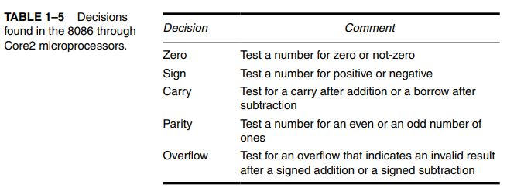
Decisions

Slide 26
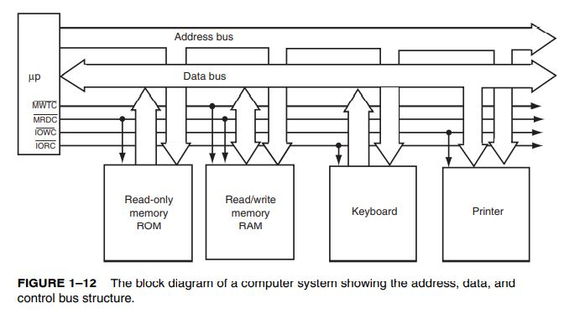
Buses

Slide 27
Buses
A bus is a common group of wires that interconnect components in a computer system.
The buses that interconnect the sections of a computer system transfer address, data, and control information between the microprocessor and its memory and I/O systems.
In the microprocessor based computer system, three buses exist for this transfer of information: address, data, and control bus.

Slide 28
The address bus requests a memory location from the memory or an I/O location from the I/O devices.
If I/O is addressed, the address bus contains a 16-bit I/O address from 0000H through FFFFH.
The 16-bit I/O address, or port number, selects one of 64K different I/O devices.
If memory is addressed, the address bus contains a memory address, which varies in width with the different versions of the microprocessor.
The 8086 and 8088 address 1M byte of memory, using a 20-bit address that selects locations 00000H–FFFFFH.
The 80286 and 80386SX address 16M bytes of memory using a 24-bit address that selects locations 000000H–FFFFFFH.
The 80386SL, 80386SLC, and 80386EX address 32M bytes of memory, using 25-bit address that selects locations 0000000H–1FFFFFFH.
The 80386DX, 80486SX, and 80486DX address G bytes of memory, using a 32-bit address that selects locations 00000000H–FFFFFFFFH.
The Pentium also addresses 4G bytes of memory, but it uses a 64-bit data bus to access up to 8 bytes of memory at a time.
The Pentium Pro through Core2 microprocessors have a 64-bit data bus and a 32-bit address bus that address 4G of memory from location 00000000H–FFFFFFFFH, or a 36-bit address bus that addresses 64G of memory at locations 000000000H–FFFFFFFFFH, depending on their configuration.

Slide 29
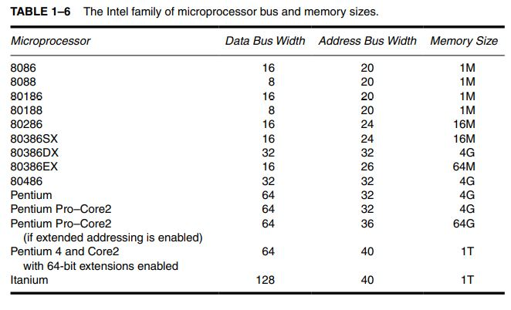

Slide 30
The 64-bit extensions to the Pentium family provide 40 address pins in its current version that allow up to 1T byte of memory to be accessed through its 10 digit hexadecimal address.
Note that 240 is 1 terra.
In future editions of the 64-bit microprocessors Intel plans to expand the number of address bits to 52, and ultimately to 64 bits.
A 52-bit address bus allows 4P (Peta) bytes of memory to be accessed and a 64-bit address bus allows 16E (Exa) bytes of memory.

Slide 31
The data bus transfers information between the microprocessor and its memory and I/O address space.
Data transfers vary in size, from 8 bits wide to 64 bits wide in various members of the Intel microprocessor family.
For example, the 8088 has an 8-bit data bus that transfers 8 bits of data at a time.
The 8086, 80286, 80386SL, 80386SX, and 80386EX transfer 16 bits of data through their data buses; the 80386DX, 80486SX, and 80486DX transfer 32 bits of data; and the Pentium through Core2 microprocessors transfer 64 bits of data.
The advantage of a wider data bus is speed in applications that use wide data.
For example, if a 32-bit number is stored in memory, it takes the 8088 microprocessor four transfer operations to complete because its data bus is only 8 bits wide. The 80486 accomplishes the same task with one transfer because its data bus is 32 bits wide.

Slide 32
The control bus contains lines that select the memory or I/O and cause them to perform a read or write operation.
In most computer systems, there are four control bus connections: (memory read control), (memory write control), (I/O read control), and (I/O write control).
The overbar indicates that the control signal is active-low (it is active when a logic zero appears on the control line).
For example, if IOWC = 0, the microprocessor is writing data from the data bus to an I/O device whose address appears on the address bus.
Note that these control signal names are slightly different in various versions of the microprocessor.

Slide 33
The microprocessor reads the contents of a memory location by sending the memory an address through the address bus.
Next, it sends the memory read control signal ( ) to cause the memory to read data.
Finally, the data read from the memory are passed to the microprocessor through the data bus.
Whenever a memory write, I/O write, or I/O read occurs, the same sequence ensues, except that different control signals are issued and the data flow out of the microprocessor through its data bus for a write operation.

