Slide 1
Lex Yacc tutorial
Kun-Yuan Hsieh
kyshieh@pllab.cs.nthu.edu.tw
Programming Language Lab., NTHU
PLLab, NTHU,Cs2403 Programming Languages

Slide 2
Overview
take a glance at Lex!
PLLab, NTHU,Cs2403 Programming Languages

Slide 3
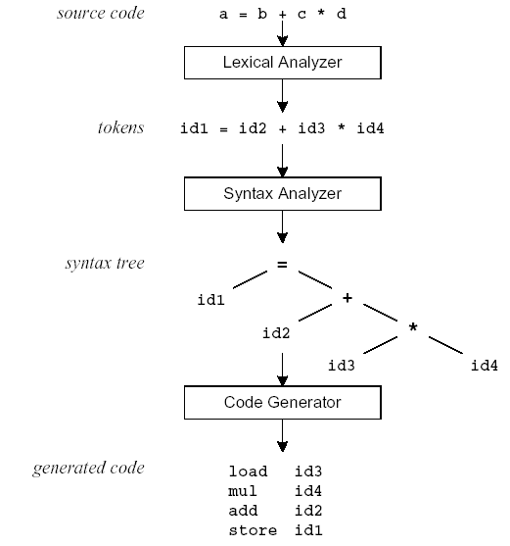
Compilation Sequence
PLLab, NTHU,Cs2403 Programming Languages

Slide 4
What is Lex?
The main job of a lexical analyzer (scanner) is to break up an input stream into more usable elements (tokens)
  a = b + c * d;
  ID ASSIGN ID PLUS ID MULT ID SEMI
Lex is an utility to help you rapidly generate your scanners
PLLab, NTHU,Cs2403 Programming Languages

Slide 5
Lex – Lexical Analyzer
Lexical analyzers tokenize input streams
Tokens are the terminals of a language
  English
    words, punctuation marks, …
  Programming language
    Identifiers, operators, keywords, …
Regular expressions define terminals/tokens
PLLab, NTHU,Cs2403 Programming Languages

Slide 6
Lex Source Program
Lex source is a table of
  regular expressions and
  corresponding program fragments
digit [0-9]
letter [a-zA-Z]
%%
{letter}({letter}|{digit})* printf(“id: %s\n”, yytext);
\n printf(“new line\n”);
%%
main() {
yylex();
}
PLLab, NTHU,Cs2403 Programming Languages

Slide 7
Lex Source to C Program
The table is translated to a C program (lex.yy.c) which
  reads an input stream
  partitioning the input into strings which match the given expressions and
  copying it to an output stream if necessary
PLLab, NTHU,Cs2403 Programming Languages

Slide 8
An Overview of Lex
Lex source program
Lex
lex.yy.c
lex.yy.c
C compiler
a.out
input
a.out
tokens
PLLab, NTHU,Cs2403 Programming Languages

Slide 9
Lex Source
Lex source is separated into three sections by %% delimiters
The general format of Lex source is
The absolute minimum Lex program is thus
{definitions}
%%
{transition rules}
%%
{user subroutines}
(required)
(optional)
%%
PLLab, NTHU,Cs2403 Programming Languages

Slide 10
Lex v.s. Yacc
Lex
  Lex generates C code for a lexical analyzer, or scanner
  Lex uses patterns that match strings in the input and converts the strings to tokens
Yacc
  Yacc generates C code for syntax analyzer, or parser.
  Yacc uses grammar rules that allow it to analyze tokens from Lex and create a syntax tree.
PLLab, NTHU,Cs2403 Programming Languages

Slide 11
Lex with Yacc
Lex source
(Lexical Rules)
Yacc source
(Grammar Rules)
Lex
Yacc
lex.yy.c
y.tab.c
call
yylex()
yyparse()
Parsed
Input
Input
return token
PLLab, NTHU,Cs2403 Programming Languages

Slide 12
Regular Expressions
PLLab, NTHU,Cs2403 Programming Languages

Slide 13
Lex Regular Expressions (Extended Regular Expressions)
A regular expression matches a set of strings
Regular expression
  Operators
  Character classes
  Arbitrary character
  Optional expressions
  Alternation and grouping
  Context sensitivity
  Repetitions and definitions
PLLab, NTHU,Cs2403 Programming Languages

Slide 14
Operators
“ \ [ ] ^ - ? . * + | ( ) $ / { } % < >
If they are to be used as text characters, an escape should be used
\$ = “$”
\\ = “\”
Every character but blank, tab (\t), newline (\n) and the list above is always a text character
PLLab, NTHU,Cs2403 Programming Languages

Slide 15
Character Classes []
[abc] matches a single character, which may be a, b, or c
Every operator meaning is ignored except \ - and ^
e.g.
[ab] => a or b
[a-z] => a or b or c or … or z
[-+0-9] => all the digits and the two signs
[^a-zA-Z] => any character which is not a
letter
PLLab, NTHU,Cs2403 Programming Languages

Slide 16
Arbitrary Character .
To match almost character, the operator character . is the class of all characters except newline
[\40-\176] matches all printable characters in the ASCII character set, from octal 40 (blank) to octal 176 (tilde~)
PLLab, NTHU,Cs2403 Programming Languages

Slide 17
Optional & Repeated Expressions
a? => zero or one instance of a
a* => zero or more instances of a
a+ => one or more instances of a
E.g.
ab?c => ac or abc
[a-z]+ => all strings of lower case letters
[a-zA-Z][a-zA-Z0-9]* => all alphanumeric strings with a leading alphabetic character
PLLab, NTHU,Cs2403 Programming Languages

Slide 18
Precedence of Operators
Level of precedence
  Kleene closure (*), ?, +
  concatenation
  alternation (|)
All operators are left associative.
Ex: a*b|cd* = ((a*)b)|(c(d*))
PLLab, NTHU,Cs2403 Programming Languages

Slide 19
Pattern Matching Primitives
Metacharacter | Matches
. | any character except newline
\n | newline
* | zero or more copies of the preceding expression
+ | one or more copies of the preceding expression
? | zero or one copy of the preceding expression
^ | beginning of line / complement
$ | end of line
a|b | a or b
(ab)+ | one or more copies of ab (grouping)
[ab] | a or b
a{3} | 3 instances of a
“a+b” | literal “a+b” (C escapes still work)
PLLab, NTHU,Cs2403 Programming Languages

Slide 20
Recall: Lex Source
Lex source is a table of
  regular expressions and
  corresponding program fragments (actions)
a = b + c;
a operator: ASSIGNMENT b + c;
…
%%
<regexp> <action>
<regexp> <action>
…
%%
%%
“=“ printf(“operator: ASSIGNMENT”);
PLLab, NTHU,Cs2403 Programming Languages

Slide 21
Transition Rules
regexp <one or more blanks> action (C code);
regexp <one or more blanks> { actions (C code) }
A null statement ; will ignore the input (no actions)
[ \t\n] ;
  Causes the three spacing characters to be ignored
a = b + c;
d = b * c;
↓ ↓
a=b+c;d=b*c;
PLLab, NTHU,Cs2403 Programming Languages

Slide 22
Transition Rules (cont’d)
Four special options for actions:
|, ECHO;, BEGIN, and REJECT;
| indicates that the action for this rule is from the action for the next rule
  [ \t\n] ;
  “ “ |
“\t” |
“\n” ;
The unmatched token is using a default action that ECHO from the input to the output
PLLab, NTHU,Cs2403 Programming Languages

Slide 23
Transition Rules (cont’d)
REJECT
  Go do the next alternative
…
%%
pink {npink++; REJECT;}
ink {nink++; REJECT;}
pin {npin++; REJECT;}
. |
\n ;
%%
…
PLLab, NTHU,Cs2403 Programming Languages

Slide 24
Lex Predefined Variables
yytext -- a string containing the lexeme
yyleng -- the length of the lexeme
yyin -- the input stream pointer
  the default input of default main() is stdin
yyout -- the output stream pointer
  the default output of default main() is stdout.
cs20: %./a.out < inputfile > outfile
E.g.
  [a-z]+ printf(“%s”, yytext);
  [a-z]+ ECHO;
  [a-zA-Z]+ {words++; chars += yyleng;}
PLLab, NTHU,Cs2403 Programming Languages

Slide 25
Lex Library Routines
yylex()
  The default main() contains a call of yylex()
yymore()
  return the next token
yyless(n)
  retain the first n characters in yytext
yywarp()
  is called whenever Lex reaches an end-of-file
  The default yywarp() always returns 1
PLLab, NTHU,Cs2403 Programming Languages

Slide 26
Review of Lex Predefined Variables
Name | Function
char *yytext | pointer to matched string
int yyleng | length of matched string
FILE *yyin | input stream pointer
FILE *yyout | output stream pointer
int yylex(void) | call to invoke lexer, returns token
char* yymore(void) | return the next token
int yyless(int n) | retain the first n characters in yytext
int yywrap(void) | wrapup, return 1 if done, 0 if not done
ECHO | write matched string
REJECT | go to the next alternative rule
INITAL | initial start condition
BEGIN | condition switch start condition
PLLab, NTHU,Cs2403 Programming Languages

Slide 27
User Subroutines Section
You can use your Lex routines in the same ways you use routines in other programming languages.
%{
void foo();
%}
letter [a-zA-Z]
%%
{letter}+ foo();
%%
…
void foo() {
…
}
PLLab, NTHU,Cs2403 Programming Languages

Slide 28
User Subroutines Section (cont’d)
The section where main() is placed
%{
int counter = 0;
%}
letter [a-zA-Z]
%%
{letter}+ {printf(“a word\n”); counter++;}
%%
main() {
yylex();
printf(“There are total %d words\n”, counter);
}
PLLab, NTHU,Cs2403 Programming Languages

Slide 29
Usage
To run Lex on a source file, type
lex scanner.l
It produces a file named lex.yy.c which is a C program for the lexical analyzer.
To compile lex.yy.c, type
cc lex.yy.c –ll
To run the lexical analyzer program, type
./a.out < inputfile
PLLab, NTHU,Cs2403 Programming Languages

Slide 30
Versions of Lex
AT&T -- lex
http://www.combo.org/lex_yacc_page/lex.html
GNU -- flex
http://www.gnu.org/manual/flex-2.5.4/flex.html
a Win32 version of flex :
http://www.monmouth.com/~wstreett/lex-yacc/lex-yacc.html
or Cygwin :
http://sources.redhat.com/cygwin/
Lex on different machines is not created equal.
PLLab, NTHU,Cs2403 Programming Languages

Slide 31
Yacc - Yet Another Compiler-Compiler
PLLab, NTHU,Cs2403 Programming Languages

Slide 32
Introduction
What is YACC ?
  Tool which will produce a parser for a given grammar.
  YACC (Yet Another Compiler Compiler) is a program designed to compile a LALR(1) grammar and to produce the source code of the syntactic analyzer of the language produced by this grammar.
PLLab, NTHU,Cs2403 Programming Languages

Slide 33
How YACC Works
gram.y
File containing desired
grammar in yacc format
yacc
yacc program
y.tab.c
C source program created by yacc
cc
or gcc
C compiler
a.out
Executable program that will parse
grammar given in gram.y
PLLab, NTHU,Cs2403 Programming Languages

Slide 34
How YACC Works
y.tab.h
yacc
YACC source (*.y)
y.tab.c
y.output
(1) Parser generation time
C compiler/linker
y.tab.c
a.out
(2) Compile time
Abstract
Syntax
Tree
a.out
Token stream
(3) Run time
PLLab, NTHU,Cs2403 Programming Languages

Slide 35
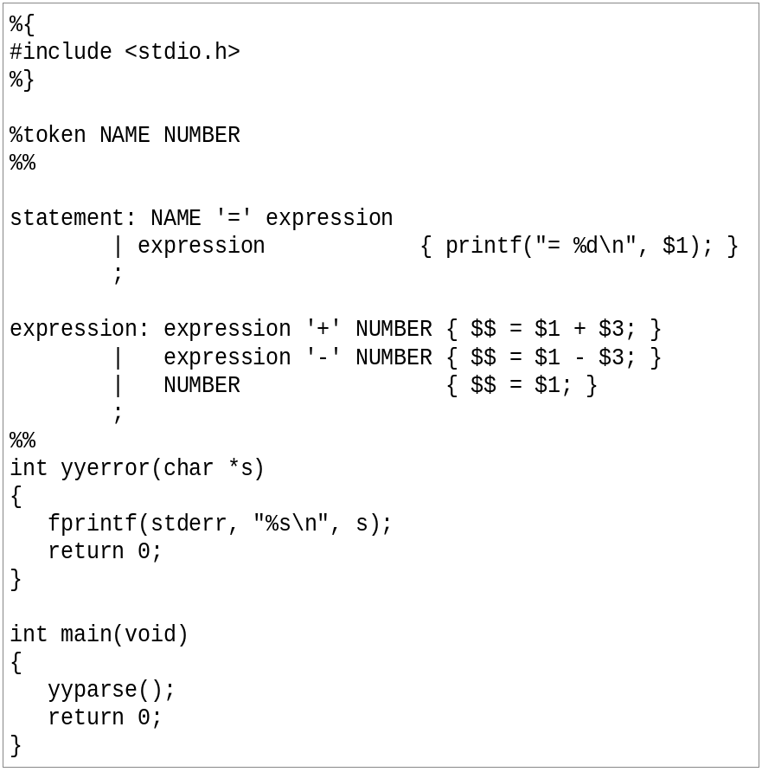
An YACC File Example
PLLab, NTHU,Cs2403 Programming Languages

Slide 36
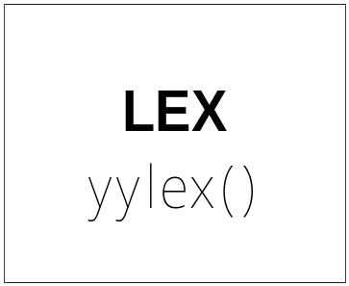
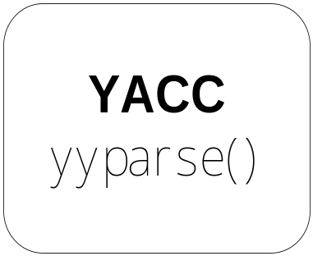
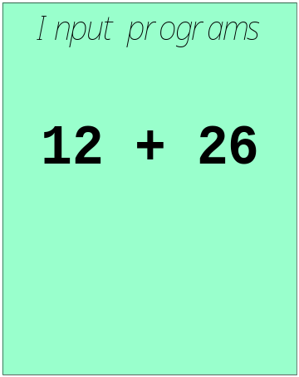

Works with Lex
How to work ?
PLLab, NTHU,Cs2403 Programming Languages

Slide 37
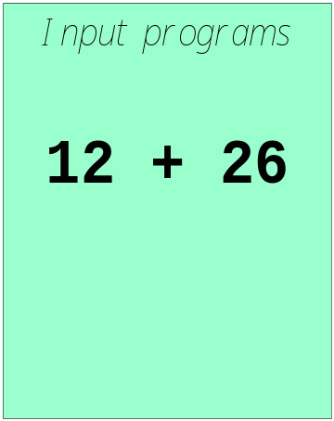
Works with Lex
[0-9]+
call yylex()
next token is NUM
NUM ‘+’ NUM
PLLab, NTHU,Cs2403 Programming Languages

Slide 38
YACC File Format
%{
  C declarations
  %}
  yacc declarations
  %%
  Grammar rules
  %%
  Additional C code
  Comments enclosed in /* ... */ may appear in any of the sections.
PLLab, NTHU,Cs2403 Programming Languages

Slide 39
Definitions Section
%{
#include <stdio.h>
#include <stdlib.h>
%}
%token ID NUM
%start expr
It is a terminal
由 expr 開始parse
PLLab, NTHU,Cs2403 Programming Languages

Slide 40
Start Symbol
The first non-terminal specified in the grammar specification section.
To overwrite it with %start declaraction.
%start non-terminal
PLLab, NTHU,Cs2403 Programming Languages

Slide 41
Rules Section
This section defines grammar
Example
expr : expr '+' term | term;
term : term '*' factor | factor;
factor : '(' expr ')' | ID | NUM;
PLLab, NTHU,Cs2403 Programming Languages

Slide 42

Rules Section
Normally written like this
Example:
expr : expr '+' term
| term
;
term : term '*' factor
| factor
;
factor : '(' expr ')'
| ID
| NUM
;
PLLab, NTHU,Cs2403 Programming Languages

Slide 43
The Position of Rules
expr : expr '+' term { $$ = $1 + $3; }
| term { $$ = $1; }
;
term : term '*' factor { $$ = $1 * $3; }
| factor { $$ = $1; }
;
factor : '(' expr ')' { $$ = $2; }
| ID
| NUM
;
PLLab, NTHU,Cs2403 Programming Languages

Slide 44
The Position of Rules
$1
expr : expr '+' term { $$ = $1 + $3; }
| term { $$ = $1; }
;
term : term '*' factor { $$ = $1 * $3; }
| factor { $$ = $1; }
;
factor : '(' expr ')' { $$ = $2; }
| ID
| NUM
;
PLLab, NTHU,Cs2403 Programming Languages

Slide 45
The Position of Rules
expr : expr '+' term { $$ = $1 + $3; }
| term { $$ = $1; }
;
term : term '*' factor { $$ = $1 * $3; }
| factor { $$ = $1; }
;
factor : '(' expr ')' { $$ = $2; }
| ID
| NUM
;
$2
PLLab, NTHU,Cs2403 Programming Languages

Slide 46
The Position of Rules
expr : expr '+' term { $$ = $1 + $3; }
| term { $$ = $1; }
;
term : term '*' factor { $$ = $1 * $3; }
| factor { $$ = $1; }
;
factor : '(' expr ')' { $$ = $2; }
| ID
| NUM
;
$3
Default: $$ = $1;
PLLab, NTHU,Cs2403 Programming Languages

Slide 47
Communication between LEX and YACC
[0-9]+
call yylex()
next token is NUM
NUM ‘+’ NUM
LEX and YACC需要一套方法確認token的身份
PLLab, NTHU,Cs2403 Programming Languages

Slide 48

Communication between LEX and YACC
Use enumeration ( 列舉 ) / define
由一方產生，另一方 include
  YACC 產生 y.tab.h
  LEX include y.tab.h
yacc -d gram.y
Will produce:
y.tab.h
PLLab, NTHU,Cs2403 Programming Languages

Slide 49
Communication between LEX and YACC
yacc -d xxx.y
Produced
y.tab.h:
# define CHAR 258
# define FLOAT 259
# define ID 260
# define INT 261
%{
#include <stdio.h>
#include "y.tab.h"
%}
id [_a-zA-Z][_a-zA-Z0-9]*
%%
int { return INT; }
char { return CHAR; }
float { return FLOAT; }
{id} { return ID;}
scanner.l
%{
#include <stdio.h>
#include <stdlib.h>
%}
%token CHAR, FLOAT, ID, INT
%%
parser.y
PLLab, NTHU,Cs2403 Programming Languages

Slide 50
YACC
Rules may be recursive
Rules may be ambiguous*
Uses bottom up Shift/Reduce parsing
  Get a token
  Push onto stack
  Can it reduced (How do we know?)
    If yes: Reduce using a rule
    If no: Get another token
Yacc cannot look ahead more than one token
Phrase -> cart_animal AND CART
| work_animal AND PLOW
…
PLLab, NTHU,Cs2403 Programming Languages

Slide 51
Yacc Example
Taken from Lex & Yacc
Simple calculator
  a = 4 + 6
  a
  a=10
  b = 7
  c = a + b
  c
  c = 17
  $
PLLab, NTHU,Cs2403 Programming Languages

Slide 52
Grammar
expression ::= expression '+' term |
expression '-' term |
term
term ::= term '*' factor |
term '/' factor |
factor
factor ::= '(' expression ')' |
'-' factor |
NUMBER |
NAME
PLLab, NTHU,Cs2403 Programming Languages

Slide 53
Parser (cont’d)
statement_list: statement '\n'
| statement_list statement '\n'
;
statement: NAME '=' expression { $1->value = $3; }
| expression { printf("= %g\n", $1); }
;
expression: expression '+' term { $$ = $1 + $3; }
| expression '-' term { $$ = $1 - $3; }
| term
;
PLLab, NTHU,Cs2403 Programming Languages
parser.y

Slide 54
Parser (cont’d)
term: term '*' factor { $$ = $1 * $3; }
| term '/' factor { if ($3 == 0.0)
yyerror("divide by zero");
else
$$ = $1 / $3;
}
| factor
;
factor: '(' expression ')' { $$ = $2; }
| '-' factor { $$ = -$2; }
| NUMBER { $$ = $1; }
| NAME { $$ = $1->value; }
;
%%
PLLab, NTHU,Cs2403 Programming Languages
parser.y

Slide 55
Scanner
%{
#include "y.tab.h"
#include "parser.h"
#include <math.h>
%}
%%
([0-9]+|([0-9]*\.[0-9]+)([eE][-+]?[0-9]+)?) {
yylval.dval = atof(yytext);
return NUMBER;
}
[ \t] ; /* ignore white space */
PLLab, NTHU,Cs2403 Programming Languages
scanner.l

Slide 56
Scanner (cont’d)
[A-Za-z][A-Za-z0-9]* { /* return symbol pointer */
yylval.symp = symlook(yytext);
return NAME;
}
"$" { return 0; /* end of input */ }
\n |”=“|”+”|”-”|”*”|”/” return yytext[0];
%%
PLLab, NTHU,Cs2403 Programming Languages
scanner.l

Slide 57
YACC Command
Yacc (AT&T)
  yacc –d xxx.y
Bison (GNU)
  bison –d –y xxx.y
產生y.tab.c, 與yacc相同
不然會產生xxx.tab.c
PLLab, NTHU,Cs2403 Programming Languages

Slide 58
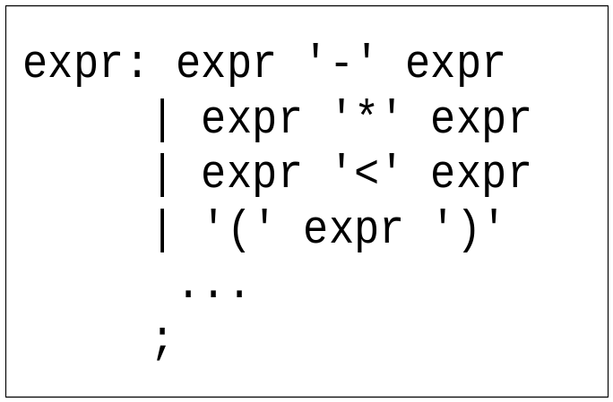
Precedence / Association
(1) 1 – 2 - 3
(2) 1 – 2 * 3
1-2-3 = (1-2)-3? or 1-(2-3)?
Define ‘-’ operator is left-association.
1-2*3 = 1-(2*3)
Define “*” operator is precedent to “-” operator
PLLab, NTHU,Cs2403 Programming Languages

Slide 59
Precedence / Association
%right ‘=‘
%left '<' '>' NE LE GE
%left '+' '-‘
%left '*' '/'
highest precedence
PLLab, NTHU,Cs2403 Programming Languages

Slide 60
Precedence / Association
%left '+' '-'
%left '*' '/'
%noassoc UMINUS
expr : expr ‘+’ expr { $$ = $1 + $3; }
| expr ‘-’ expr { $$ = $1 - $3; }
| expr ‘*’ expr { $$ = $1 * $3; }
| expr ‘/’ expr
{
if($3==0)
yyerror(“divide 0”);
else
$$ = $1 / $3;
}
| ‘-’ expr %prec UMINUS {$$ = -$2; }
PLLab, NTHU,Cs2403 Programming Languages

Slide 61
Shift/Reduce Conflicts
shift/reduce conflict
  occurs when a grammar is written in such a way that a decision between shifting and reducing can not be made.
  ex: IF-ELSE ambigious.
To resolve this conflict, yacc will choose to shift.
PLLab, NTHU,Cs2403 Programming Languages

Slide 62
YACC Declaration Summary
`%start'
Specify the grammar's start symbol
`%union'
Declare the collection of data types that semantic values may have
`%token'
Declare a terminal symbol (token type name) with no precedence or
associativity specified
`%type'
Declare the type of semantic values for a nonterminal symbol
PLLab, NTHU,Cs2403 Programming Languages

Slide 63
YACC Declaration Summary
`%right'
Declare a terminal symbol (token type name) that is
right-associative
`%left'
Declare a terminal symbol (token type name) that is left-associative
`%nonassoc'
Declare a terminal symbol (token type name) that is nonassociative
(using it in a way that would be associative is a syntax error,
ex: x op. y op. z is syntax error)
PLLab, NTHU,Cs2403 Programming Languages

Slide 64
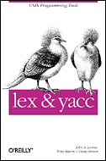
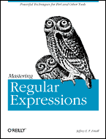
Reference Books
lex & yacc, 2nd Edition
  by John R.Levine, Tony Mason & Doug Brown
  O’Reilly
  ISBN: 1-56592-000-7
Mastering Regular Expressions
  by Jeffrey E.F. Friedl
  O’Reilly
  ISBN: 1-56592-257-3
PLLab, NTHU,Cs2403 Programming Languages

