Slide 1
UIT2502 – Data Analytics & Visualization
Hypothesis Testing

Slide 2
A Culinary Analogy Scenario: A chef notices that their customers seem to prefer dishes with a certain spice blend.
Customers will rate the new dishes with the spice blend higher than those without.
If I include this spice blend in my new dishes, then customers will enjoy them more.
A particular combination of spices can significantly enhance the flavor profile of a dish and increase customer satisfaction.

Slide 3
Hypothesis
Statement: "If I include this spice blend in my new dishes, then customers will enjoy them more."
Explanation: This is an educated guess based on the chef's observations. It suggests a possible relationship between the spice blend and customer preference.

Slide 4
Prediction
Statement: "Customers will rate the new dishes with the spice blend higher than those without.
Explanation: This is a specific, measurable outcome that can be tested to either support or refute the hypothesis.

Slide 5
Theory
Statement: "A particular combination of spices can significantly enhance the flavor profile of a dish and increase customer satisfaction.
Explanation: A theory is a well-substantiated explanation of some aspect of the natural world, based on a body of evidence. In this case, a theory might develop over time if numerous chefs and studies consistently find that certain spice blends are more popular with customers.

Slide 6
To summarize
Hypothesis: A testable statement that proposes a possible relationship between variables.
Prediction: A specific, measurable outcome expected from testing the hypothesis.
Theory: A well-supported explanation of a phenomenon, often based on multiple pieces of evidence.

Slide 7
To summarize
Hypothesis: A general statement proposing a relationship between variables.
Prediction: A specific, testable statement derived from a hypothesis.
In essence, a prediction is a more focused version of a hypothesis.
It outlines the expected outcome of an experiment or observation based on the hypothesis.

Slide 8
Hypothesis characteristics based on variables
A cause-effect relationship between variables:
One variable causes another one to change (or not change)
Testable nature:
Formulate a hypothesis that can be tested to support or refuse
Precise and accurate variables:
Independent and dependent variables need to be specific and clear

Slide 9
Hypothesis Definition
A hypothesis is a research statement based on predictions you can test to support or refuse through scientific methods like experiments, statistical data analysis, observations, etc.
Hypothesis is a tentative claim made by person or organization.
It needs to be testable so you could later support or refuse it through further experiments, observations, and any other scientific research methods.
The claim is about population parameter, and we seek evidence from sample.
A hypothesis always proposes a relationship between several variables – Independent and dependent variables

Slide 10
Hypothesis
A ________ statement for ________ claims exhibiting the relationship between ___________________ representing __________ of the ___________ derived from the samples.

Slide 11
Hypothesis
A testable statement for measurable claims exhibiting the relationship between dependent and independent variables representing predictions of the population derived from the samples.

Slide 12
Types of hypothesis
Type of hypothesis | Description
Simple | Predicting the direct relationship between two variables – Hypothesis could be presented in if-then format
Complex | Predicts the relationship between variables but has more than two dependent and independent variables
Null | Default position stating there’s no relationship between variables - no difference in the experiment’s results
Alternative | Directly contradicts a null hypothesis

Slide 13
Types of hypothesis
Type of hypothesis | Description
Logical | Use reasoning and logical connections instead of proven facts, statistics, or background research
Empirical | Those going through tests, trials, or errors via observation and experiments right now and can be changed later around the independent variables - opposite of a logical hypothesis.
Statistical | Can be tested and verified statistically based on data and quantitative research methods.

Slide 14
Types of hypothesis
Type of hypothesis | Example
 | Light color does not affect plant growth.
 | Light color affects plant growth.
 | 60% of people talking on the phone while driving have been in at least one car accident.
 | Overweight people who eat junk food have higher chances of getting excessive cholesterol and heart disease.
 | Everyday smoking leads to lung cancer.
 | Women taking vitamin E grow hair faster than those taking vitamin K
 | Dogs won’t survive without water.

Slide 15
Types of hypothesis
Type of hypothesis | Example
Null | Light color does not affect plant growth.
Alternative | Light color affects plant growth.
Statistical | 60% of people talking on the phone while driving have been in at least one car accident.
Complex | Overweight people who eat junk food have higher chances of getting excessive cholesterol and heart disease.
Simple | Everyday smoking leads to lung cancer.
Empirical | Women taking vitamin E grow hair faster than those taking vitamin K
Logical | Dogs won’t survive without water.

Slide 16
Example: Setting null and alternative hypotheses
Soft drink company filling 200 ml of soft drink in cans. The company hopes that the cans are averaging the quantity. A quality controller(QC) is worried that a machine is out of control and wants to conduct a hypothesis test to help determine whether that is true. The QC hopes the machine is functioning properly but is interested in finding whether machine is mal functioning and that result in different filling in bottles.
Null hypothesis:
Alternative hypothesis :

Slide 17
Example: Setting null and alternative hypotheses
Soft drink company filling 200 ml of soft drink in cans. The company hopes that the cans are averaging the quantity. A quality controller(QC) is worried that a machine is out of control and wants to conduct a hypothesis test to help determine whether that is true. The QC hopes the machine is functioning properly but is interested in finding whether machine is mal functioning and that result in different filling in bottles.
Null hypothesis (H0):
There is no problem in the machine and the mean value of the filled drink is 200 ml
Alternative hypothesis (H1) :
There is a problem in the machine and the mean value of the filled drink is not 200 ml

Slide 18
Example: Setting null and alternative hypotheses
Soft drink company filling 200 ml of soft drink in cans. The company hopes that the cans are averaging the quantity. A quality controller(QC) is worried that a machine is out of control and wants to conduct a hypothesis test to help determine whether that is true. The QC hopes the machine is functioning properly but is interested in finding whether machine is mal functioning and that result in different filling in bottles.
The equality point is by default assigned to the null hypotheses.
One of the two hypotheses must exactly match the research question.

Slide 19
Example: Setting null and alternative hypotheses
Soft drink company filling 200 ml of soft drink in cans. The company hopes that the cans are averaging the quantity. A quality controller(QC) is worried that a machine is out of control and wants to conduct a hypothesis test to help determine whether that is true. The QC hopes the machine is functioning properly but is interested in finding whether machine is mal functioning and that result in different filling in bottles.
Null hypothesis: μ = 200 ml
Alternative hypothesis : μ ≠ 200ml

Slide 20
Example: Setting null and alternative hypotheses
Soft drink company filling 200 ml of soft drink in cans. The company hopes that the cans are averaging the quantity. A quality controller(QC) is worried that a machine is out of control and wants to conduct a hypothesis test to help determine whether that is true. The QC hopes the machine is functioning properly but is interested in finding whether machine is mal functioning and that result in different filling in bottles.
Null hypothesis: μ = 200 ml
Alternative hypothesis : μ ≠ 200ml

Slide 21
Example: Setting null and alternative hypotheses
Soft drink company filling 200 ml of soft drink in cans. The company hopes that the cans are averaging the quantity. A quality controller(QC) is worried that a machine is out of control and wants to conduct a hypothesis test to help determine whether that is true. The QC hopes the machine is functioning properly but is interested in finding whether machine is mal functioning and that is result in filling more capacity in bottles.
Null hypothesis: μ = 200 ml
Alternative hypothesis : μ > 200ml

Slide 22
Inference after statistical experiments
 | Decision(from sample)
 | Status of hypotheses | Accept Null Hypothesis | Reject Null Hypothesis
Actual result | Null Hypothesis (True)
 | Null Hypothesis (False)

Slide 23
Inference after statistical experiments
 | Decision(from sample)
 | Status of hypotheses | Accept Null Hypothesis | Reject Null Hypothesis
Actual result | Null Hypothesis (True) | CORRECT DECISION
 | Null Hypothesis (False) |  | CORRECT DECISION

Slide 24
Inference after statistical experiments
 | Decision(from sample)
 | Status of hypotheses | Accept Null Hypothesis | Reject Null Hypothesis
Actual result | Null Hypothesis (True) | CORRECT DECISION | ERROR
 | Null Hypothesis (False) | ERROR | CORRECT DECISION

Slide 25
Inference after statistical experiments
 | Decision(from sample)
 | Status of hypotheses | Accept Null Hypothesis | Reject Null Hypothesis
Actual result | Null Hypothesis (True) | CORRECT DECISION | TYPE I ERROR (α)
 | Null Hypothesis (False) | TYPE II ERROR (β) | CORRECT DECISION

Slide 26
Choosing a better hypothesis
 | Decision(from sample)
 | Status of hypotheses | Accept Null Hypothesis | Reject Null Hypothesis
Actual result | Null Hypothesis (True) | CORRECT DECISION (1-α) | TYPE I ERROR (α) Level of Significance
 | Null Hypothesis (False) | TYPE II ERROR (β) | CORRECT DECISION (1- β) - Power of a Test

Slide 27
Hypothesis Testing
A statistical mechanism for decision making
Checks validity of a claim
Initially null hypothesis is assumed to be TRUE
It certain cases, it begins by making a tentative assumption about a population parameter based on rejecting the null hypothesis or accepting the alternate hypothesis

Slide 28
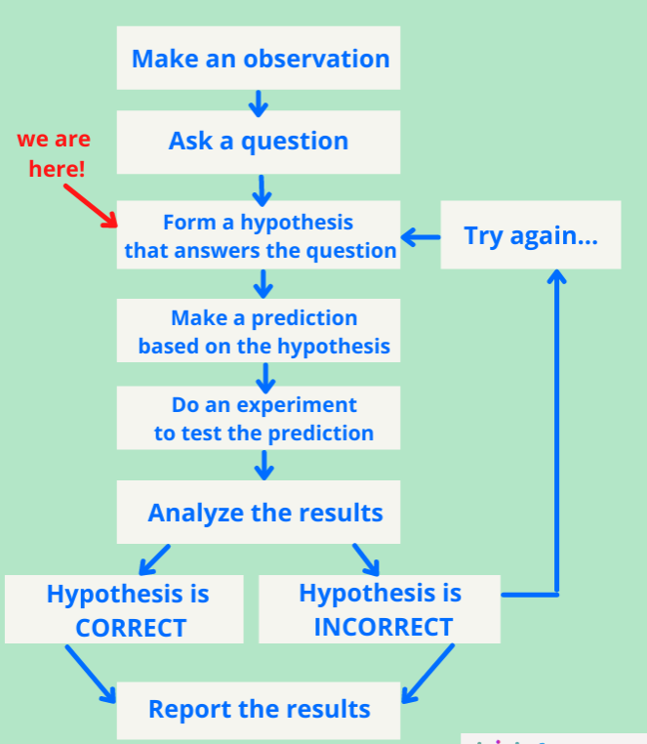
Process of Hypothesis Testing

Slide 29
Choosing a better hypothesis
Level of significance is the probability of making a Type I error when the null hypothesis is true as an equality
Power of a test: Good test should reject null hypothesis when it is false
Good hypothesis test should reduce α and β
or
should have a high value of (1-β) or (1-α)

Slide 30
Decision Tests – Dependent on H1
A one-tailed test results from an alternative hypothesis which specifies a direction.
i.e. when the alternative hypothesis states that the parameter is in fact either bigger or smaller than the value specified in the null hypothesis.
A two-tailed test results from an alternative hypothesis which does not specify a direction.
i.e. when the alternative hypothesis states that the null hypothesis is wrong.

Slide 31
One-tailed test
A one-tailed test may be either left-tailed or right-tailed.
A left-tailed test is used when the alternative hypothesis states that the true value of the parameter specified in the null hypothesis is less than the null hypothesis claims.
A right-tailed test is used when the alternative hypothesis states that the true value of the parameter specified in the null hypothesis is greater than the null hypothesis claims

Slide 32
Keywords related to two-tailed tests
Confidence interval:
also known as the acceptance region,
It is a set of values for the test statistic for which the null hypothesis is accepted.
i.e. if the observed test statistic is in the confidence interval then we accept the null hypothesis and reject the alternative hypothesis.

Slide 33
Keywords related to two-tailed tests
Critical Region
Also known as the rejection region
It is a set of values for the test statistic for which the null hypothesis is rejected.
i.e. if the observed test statistic is in the critical region then we reject the null hypothesis and accept the alternative hypothesis.

Slide 34
Keywords related to two-tailed tests
Significance Levels:
Confidence intervals can be calculated at different significance levels.
We use α to denote the level of significance and perform a hypothesis test with a [100(1−α)]% confidence interval.
Confidence intervals are usually calculated at 5% or 1% significance levels, where α=0.05 and α=0.01 respectively.

Slide 35
Keywords related to two-tailed tests
Significance Levels:
Note that a 95% confidence interval does not mean there is a 95% chance that the true value being estimated is in the calculated interval. (It is not wrt the value)
Rather, given a population, there is a 95% chance that choosing a random sample from this population results in a confidence interval which contains the true value being estimated. (But, wrt the sample chosen)

Slide 36
Keywords related to two-tailed tests
Critical Values
It is a cut-off point
If a test statistic on one side of the critical value results in accepting the null hypothesis, a test statistic on the other side will result in rejecting the null hypothesis.

Slide 37
Keywords
z_{critical}
Rejection Region
Acceptance Region
α
z₂
z₁
μ₀
Reject H₀
Cannot Reject H₀

Slide 38
Two-tailed test
The main difference between one-tailed and two-tailed tests is that one-tailed tests will only have one critical region whereas two-tailed tests will have two critical regions.
If we require a 100(1−α)% confidence interval we have to make some adjustments when using a two-tailed test.

Slide 39
Two-tailed test
The confidence interval must remain a constant size, so if we are performing a two-tailed test, as there are twice as many critical regions then these critical regions must be half the size.
This means that when we read the tables, when performing a two-tailed test, we need to consider α/2 rather than α.

Slide 40
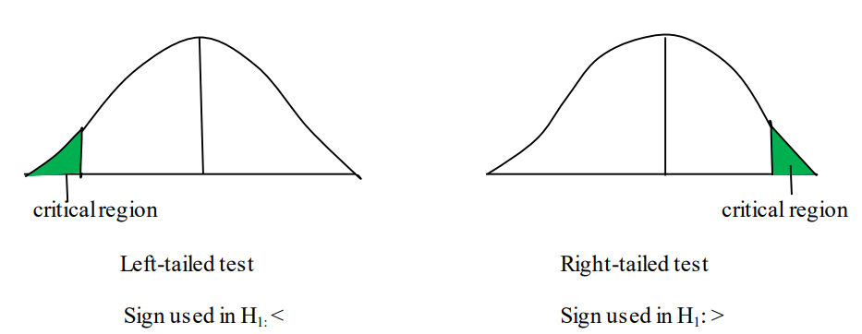
Decision rule – Depends on alternative hypothesis
If alternative hypothesis is directional then it is _______ test.

Slide 41
Decision rule – Depends on alternative hypothesis
If alternative hypothesis is directional then it is one tailed test

Slide 42
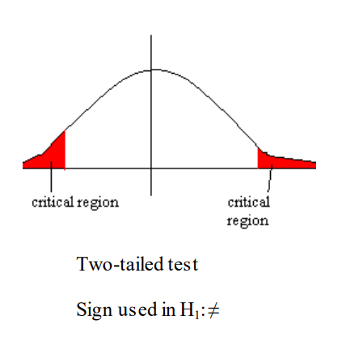
Decision rule – Depends on alternative hypothesis
If alternative hypothesis is non-directional then it is ________ test.

Slide 43
Decision rule – Depends on alternative hypothesis
If alternative hypothesis is non-directional then it is two tailed test

Slide 44
Example
Find the critical values of the normal distribution using a 5% significance level for both a one-tailed and a two-tailed test.

Slide 45
Steps in Hypothesis Testing
State the Null Hypothesis
State the Alternative Hypothesis
Set α
Collect Data
Calculate a test statistic
Construct Acceptance / Rejection regions
Based on steps 5 and 6, draw a conclusion about H0

Slide 46
Understanding P value
P value indicates the maximum level of significance at which the null hypothesis is not rejected
Case 1:
if P >= α then H0 is not rejected or accepted
Case 2:
if P < α then H0 is rejected

Slide 47
Example
P value | α value | Status of H0
0.05 | <= 0.05
0.06 | <= 0.05
0.02 | = 0.05

Slide 48
Example
P value | α value | Status of H0
0.05 | <= 0.05 | Not rejected
0.06 | <= 0.05 | Not rejected
0.02 | = 0.05 | Rejected
If P≥α then H0 is not rejected

Slide 49
Z- Test
Z-test is a parametric statistical method for comparing the means of the two populations (two-sample independent and paired Z-test) and for comparing the mean of a sample to a specific value (one sample Z-test).
Z-test requires a large sample size (n ≥ 30) and known population variance (or deviation). If the population variance is not known, use a t-test, which uses sample standard deviation (s).

Slide 50
Z- Test
In Z-test, the test statistic follows the standard normal distribution (Z-distribution) (type of continuous probability distribution) under the null hypothesis.
Z-test has three main types: One Sample Z-test, two sample Z-test (unpaired or independent), and paired Z-test.

Slide 51
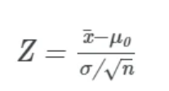
One-Sample Test
One Sample Z-test (single sample Z-test) is used to compare the sample mean with some specific or hypothesized value (known mean of the population). One Sample Z-test checks whether the sample comes from a known population where population mean and standard deviation (σ) should be known.

Slide 52
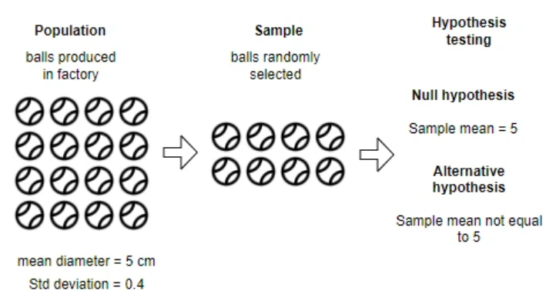
One-Sample Test

Slide 53
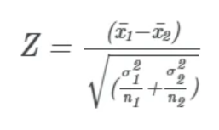
Two sample Z-test (unpaired or independent Z-test)
The two-sample (unpaired or independent) Z-test calculates if the means of two independent groups are equal or significantly different from each other. Unlike the t-test, Z-test is performed when the population means and standard deviation are known.

Slide 54
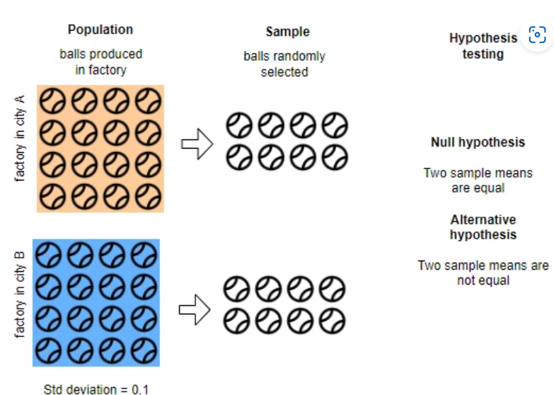
Two-Sample Test

Slide 55
Paired Z-test (dependent Z-test)
Paired Z-test is used for checking whether there is difference between the two paired samples or not. For example, we have plant variety A and would like to compare the yield of variety A before and after the application of fertilizer.

Slide 56
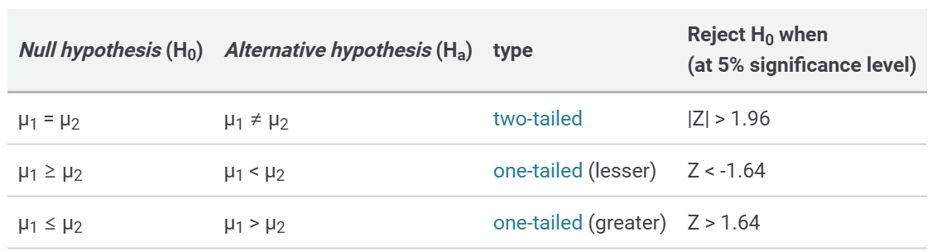
Summary

Slide 57
Summary

Slide 58
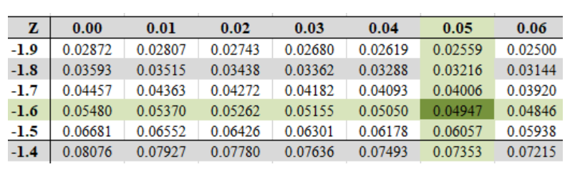
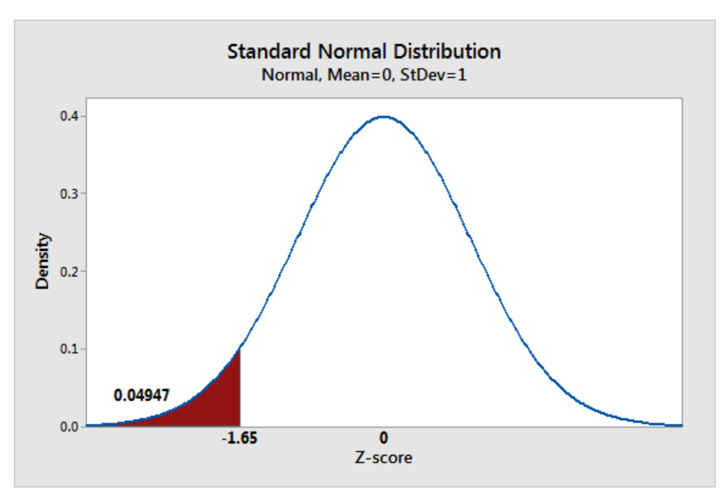
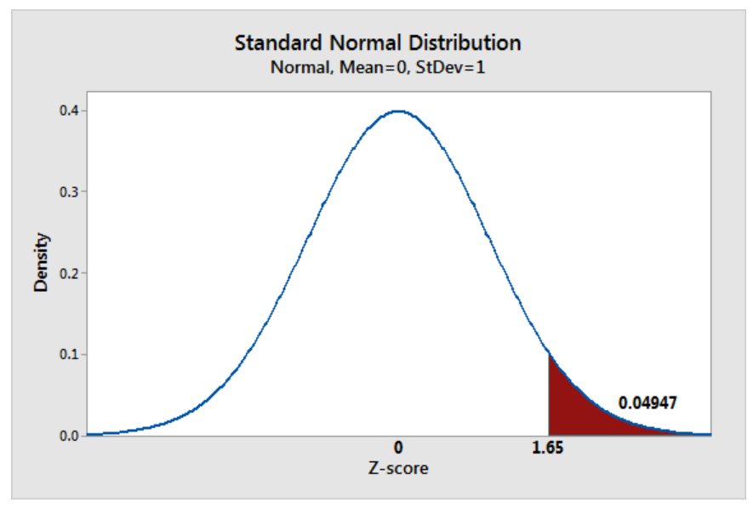
Understanding Z- Stats

Slide 59
Understanding Z- Stats
We can conclude that 4.947% of observations will fall more than ± 1.65 standard deviations away from the mean in a normally distributed population. If less than 0.05 then the outcome is not the expected or unusual pattern.

Slide 60
Understanding p-value
P-value is a probability value which is set as threshold that should be satisfied by the sample taken so that it supports the null hypothesis giving sufficient evidence (sample) to accept the null hypothesis.
Example: if p-value is 0.1123, it means that the sample chosen acts as the evidence that supports the null hypothesis for about approx. 11% which is much higher than the set threshold of 5%.

Slide 61
Understanding p-value
Objective is not to reject or accept null hypothesis but is to check that if we assume null hypothesis is true then what is the probability that we get for the sample chosen.

Slide 62
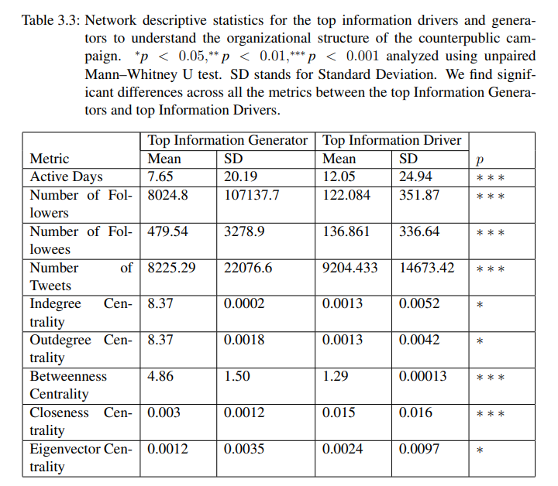
Example

Slide 63
Books
TEXTBOOKS:
David Cielen, Arno D. B. Meysman, and Mohamed Ali, “Introducing Data Science”, Manning Publications, 2016. (first two chapters for Unit I).
Robert S. Witte and John S. Witte, “Statistics”, Eleventh Edition, Wiley Publications, 2017.
Jake VanderPlas, “Python Data Science Handbook”, O’Reilly, 2016.
REFERENCES:
Allen B. Downey, “Think Stats: Exploratory Data Analysis in Python”, Green Tea Press, 2014.

