Slide 1
UIT2502 – Data Analytics & Visualization
Chi- Square Test

Slide 2
Introduction
It is a non-parametric test
All chi-square values are greater than 0
AUC for chi-square is positively right skewed
Chi-square distribution is different for each DoF
It is a statistical test for categorical values of independent and dependent variables

Slide 3
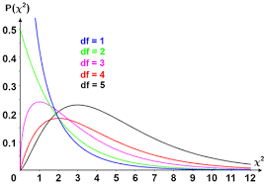
Chi-Square distribution

Slide 4
Types of chi-square test
Chi square test for single sample standard deviation/ Variance
Chi-square tests for independence of attributes
Chi square test for goodness of fit

Slide 5
Chi square test for single sample standard deviation
Weight of 10 students is given below . Can we say that the variance of the distribution of weight of all students from which the below sample of 10 students was drawn is equal to 20kgs?
Samples | 1 | 2 | 3 | 4 | 5 | 6 | 7 | 8 | 9 | 10
Weight (kg) | 38 | 40 | 45 | 53 | 47 | 43 | 55 | 48 | 52 | 49

Slide 6
S.No | Xi | (Xi-mean) | (Xi-mean)²
1 | 38 | -9 | 81
2 | 40 | -7 | 49
3 | 45 | -2 | 4
4 | 53 | 6 | 36
5 | 47 | 0 | 0
6 | 43 | -4 | 16
7 | 55 | 8 | 64
8 | 48 | 1 | 1
9 | 52 | 5 | 25
10 | 49 | 2 | 4
 | 470 | 0 | 280
 | Mean=47

Slide 7
X= (∑Xi)/n = 470/10=47
S ²= [∑(Xi- X )² /(n-1)]
S ² = [280/(10-1)] = 31.11
S ²= 31.11
Step 1: Let Null hypothesis
H₀➔ (σ_{s} ²)=(σ ²_{p})
Alternative hypothesis
H∞ ➔ (σ_{s} ²)≠(σ ²_{p})
Step 2: To test this hypothesis Chi-square test can be used
Step 3: Level of significance is 5% and 1%
Step 4: Degree of freedom is (n-1) that is (10-1)
d.f→ 9 d.f
Step 5: Calculated value
[(S ²)/(σ ²_{p})](d.f.)= [31.11/20](9)= 13.99
The table value of Chi-square
9 d.f at 5% is →16.92
9 d.f at 1% is →21.67

Slide 8
Interpretation:
At 5% level of significance the calculated value 13.99 less than the table value 16.92 hence the null hypothesis is accepted.
That is the variance of the given distribution can be taken as 20kgs at 5 percent level of significance
At 1% level of significance the calculated value 13.99 less than the table value 21.67 hence the null hypothesis is accepted.
That is the variance of the given distribution can be taken as 20kgs at 1 percent level of significance

Slide 9
Chi square test for independent factor
Degree of freedom: (r-1)*(c-1) where k is number of classes
Test statistics:
Oi= Observed value or Observed frequency
e_{i =} Expected value or Expected Frequency
Null hypothesis:
There is no association (or In dependence )of one factor on the other.
Alternative hypothesis:
There is association (or dependence) between one factor on another

Slide 10
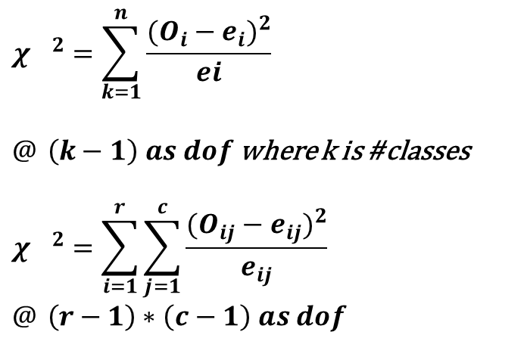
Chi square test for goodness of fit
How well does assumed theoretical distribution fit to the observed data
$${χ_{}}^{2}=\sum_{k=1}^{n}{\frac{(O_{i}−e_{i})^{2}}{ei}}$$
$@ \left(k−1\right) as dof$ where k is #classes
$${χ_{}}^{2}=\sum_{i=1}^{r}{\sum_{j=1}^{c}{\frac{(O_{ij}−e_{ij})^{2}}{e_{ij}}}} \\ @ \left(r−1\right)∗\left(c−1\right) as dof$$

Slide 11
Example
Genetic theory states that children having one parent of blood type A and the other of blood type B will always be of one of three types A, AB, B and that the proportion of three types will on an average be as 1:2:1.
A report states that out of 300 children having one A parent and B parent 30 percent were found to be type A, 45 percent type AB and remaining type B. Test the hypothesis by Chi square test.

Slide 12
Example
About population:
Genetic theory states that children having one parent of blood type A and the other of blood type B will always be of one of three types A, AB, B and that the proportion of three types will on an average be as 1:2:1.
About sample:
A report states that out of 300 children having one A parent and B parent 30 percent were found to be type A, 45 percent type AB and remaining type B. Test the hypothesis by Chi square test.

Slide 13
Example
Type | O_{i} | E_{i} | (O_{i}-E_{i}) | (O_{i}-E_{i})² | (O_{i}-E_{i})²/E_{i}
A | 90 | 75 | 15 | 225 | 3
AB | 135 | 150 | -15 | 225 | 1.5
B | 75 | 75 | 0 | 0 | 0
 |  |  |  | Total | 4.5

Slide 14
Null Hypothesis :
There is no significance difference in the observed proposition to that of genetic theory
i.e the observed value fit into the genetic theory
Alternative hypothesis:
There is significance difference in the observed proposition to that of genetic theory
Degree of freedom:
(k-1)= 3-1 = 2
Level of significance at 5%
The calculated value is 4.5
The table value is 5.991
Inference :
The table value is greater than the calculated value, so the null hypothesis is accepted. The observed value fit into the theory.

Slide 15
Books
TEXTBOOKS:
David Cielen, Arno D. B. Meysman, and Mohamed Ali, “Introducing Data Science”, Manning Publications, 2016. (first two chapters for Unit I).
Robert S. Witte and John S. Witte, “Statistics”, Eleventh Edition, Wiley Publications, 2017.
Jake VanderPlas, “Python Data Science Handbook”, O’Reilly, 2016.
REFERENCES:
Allen B. Downey, “Think Stats: Exploratory Data Analysis in Python”, Green Tea Press, 2014.

