Slide 1
Chapter 2
The Software Process
Software engineering defined
A layered technology
Process, methods, and tools
Generic process framework
Umbrella activities
Capability Maturity Model (SW-CMM)
(Source: Pressman, R. Software Engineering: A Practitioner’s Approach. McGraw-Hill, 2005)

Slide 2
Software Engineering - Defined
(1969) Software engineering is the establishment and use of sound engineering principles in order to obtain economically software that is reliable and works efficiently on real machines
(IEEE) The application of a systematic, disciplined, quantifiable approach to the development, operation, and maintenance of software; that is, the application of engineering to software

Slide 3
Software Engineering is a Layered Technology
Tools
Methods
Processes
Quality Focus

Slide 4
Process, Methods, and Tools
Process
  Provides the glue that holds the layers together; enables rational and timely development; provides a framework for effective delivery of technology; forms the basis for management; provides the context for technical methods, work products, milestones, quality measures, and change management
Methods
  Provide the technical "how to" for building software; rely on a set of basic principles; encompass a broad array of tasks; include modeling activities
Tools
  Provide automated or semi-automated support for the process and methods (i.e., CASE tools)

Slide 5
Generic Process Framework
Communication
  Involves communication among the customer and other stake holders; encompasses requirements gathering
Planning
  Establishes a plan for software engineering work; addresses technical tasks, resources, work products, and work schedule
Modeling (Analyze, Design)
  Encompasses the creation of models to better understand the requirements and the design
Construction (Code, Test)
  Combines code generation and testing to uncover errors
Deployment
  Involves delivery of software to the customer for evaluation and feedback

Slide 6
Umbrella Activities
Software requirements management
Software project planning
Software project tracking and oversight
Software quality assurance
Software configuration management
Software subcontract management
Formal technical reviews
Risk management
Measurement – process, project, product
Reusability management (component reuse)
Work product preparation and production

Slide 7
What is a Process?
(Webster) A system of operations in producing something; a series of actions, changes, or functions that achieve an end or a result
(IEEE) A sequence of steps performed for a given purpose

Slide 8
What is a Software Process?
(SEI) A set of activities, methods, practices, and transformations that people use to develop and maintain software and the associated products (e.g., project plans, design documents, code, test cases, and user manuals)
As an organization matures, the software process becomes better defined and more consistently implemented throughout the organization
Software process maturity is the extent to which a specific process is explicitly defined, managed, measured, controlled, and effective

Slide 9
Capability Maturity Model
(SW-CMM)
Developed in 1987 by the Software Engineering Institute (SEI) at Carnegie-Mellon University under the sponsorship of DARPA
Described in the book Managing the Software Process in 1989 by Watts Humphrey
Published as a separate document: Capability Maturity Model for Software in 1991

Slide 10
Immature Software Organizations
Software processes are generally improvised
If a process is specified, it is not rigorously followed or enforced
The software organization is reactionary
Managers only focus on solving immediate (crisis) problems
Schedules and budgets are routinely exceeded because they are not based on realistic estimates
When hard deadlines are imposed, product functionality and quality are often compromised
There is no basis for judging process quality or for solving product or process problems
Activities such as reviews and testing are curtailed or eliminated when projects fall behind schedule

Slide 11
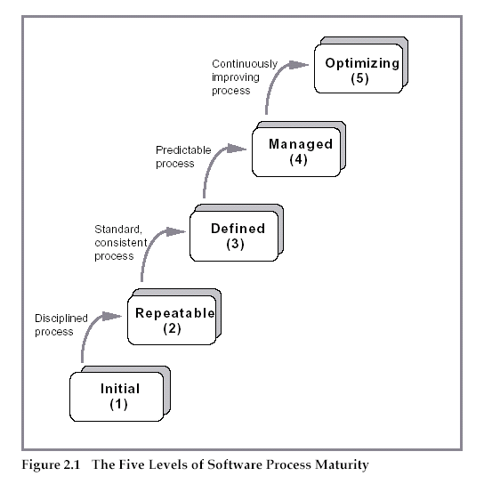
Five Levels of Software Process Maturity

Slide 12
Characteristics of Each Level
Initial Level (Level 1)
  Characterized as ad hoc, and occasionally even chaotic
  Few processes are defined, and success depends on individual effort
Repeatable (Level 2)
  Basic project management processes are established to track cost, schedule, and functionality
  The necessary process discipline is in place to repeat earlier successes on projects with similar applications

Slide 13
Characteristics of Each Level (continued)
Defined (Level 3)
  The software process for both management and engineering activities is documented, standardized, and integrated into a standard software process for the organization
  All projects use an approved, tailored version of the organization's standard software process for developing and maintaining software
Managed (Level 4)
  Detailed measures of the software process and product quality are collected
  Both the software process and products are quantitatively understood and controlled

Slide 14
Characteristics of Each Level (continued)
Optimized (Level 5)
  Continuous process improvement is enabled by quantitative feedback from the process and from piloting innovative ideas and technologies

Slide 15
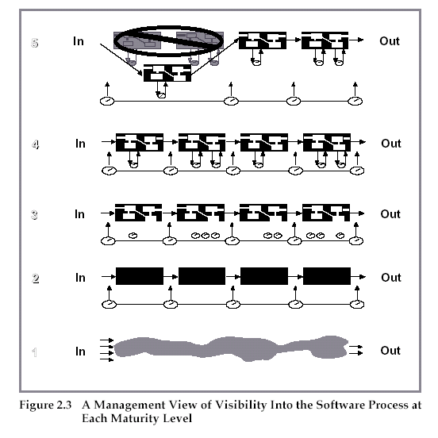
Visibility into the Software Process

Slide 16
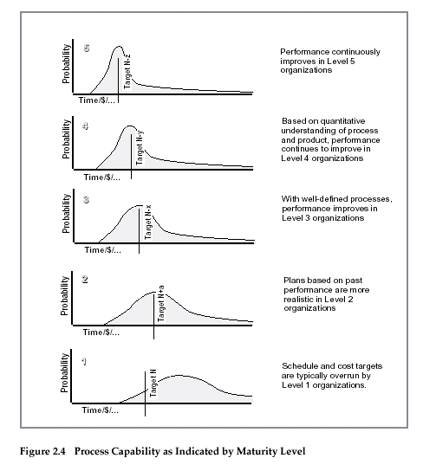
Probability of Schedule and Budget

Slide 17
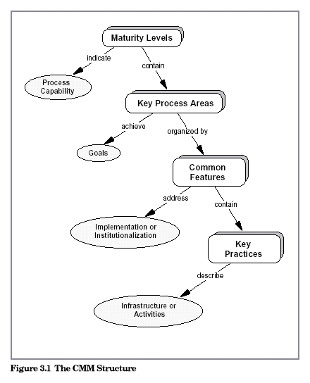
The CMM Structure

Slide 18
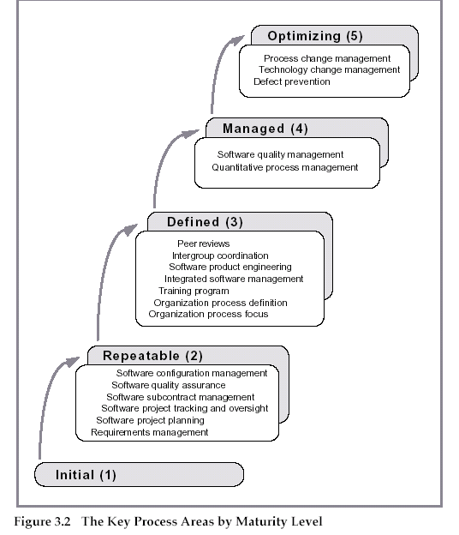
Key Process Areas

Slide 19
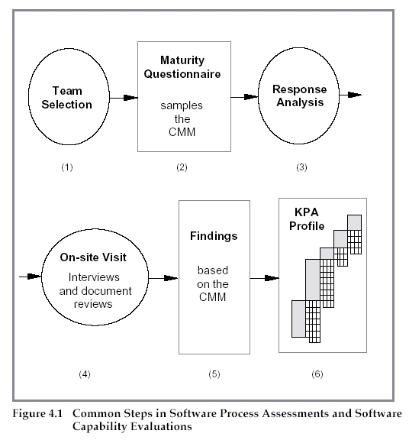
Software Process Assessments
☺

