Slide 1

Basic Details of the Team and Problem Statement
Ministry/Organization Name/Student Innovation:
Ministry of Law and Justice
PS Code: Problem Statement ID:1282
PS Number:SIH1282
Problem Statement Title: Tech-driven solutions for undertrial prisoners in India
Team Name: VIRTUAL GAOLORS
Team Leader Name: P.S Sudharshan
Institute Code (AISHE): C-16604
Institute Name: Sri Sivasubramaniya Nadar College of Engineering, Kalavakkam.
Theme Name: Miscellaneous

Slide 2
PROBLEM STATEMENT
Key features:
1. A mobile app that provides legal aid to undertrial prisoners, including legal representation, access to court proceedings, and legal resources.
2. A platform that connects undertrial prisoners with pro bono lawyers, legal clinics, and legal aid organizations including UTRCs for bail process.
3. A rehabilitation program that uses technology to provide education, vocational training, and mental health support to undertrial prisoners
. 4. A dashboard that tracks and monitors the status and progress of undertrial prisoners, providing real-time information to lawyers, judges, and prison authorities.
5. A virtual platform that allows undertrial prisoners and the support-persons to access the awareness of rights and various provisions of UTPs and thereby improving access to justice.

Slide 3
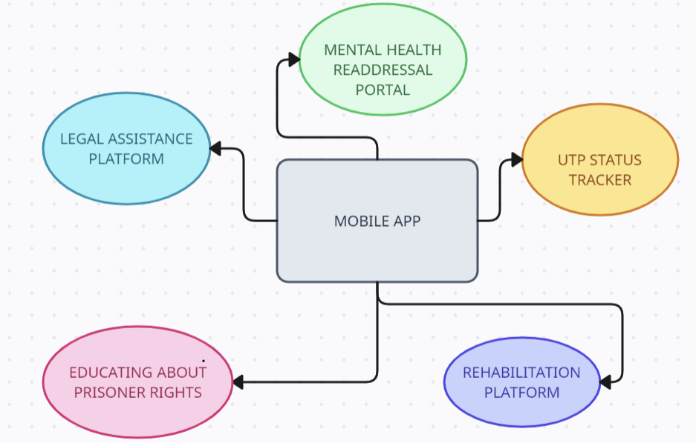



Idea/Approach Details
Idea/Solution/Prototype:
The intended solution is a mobile application that provides a means of connecting undertrial prisoners(UTPs) serving in various prisons across the country.
The proposed solution mainly focuses on :
Complete Upliftment of the lives of Undertrial Prisoners(UTPs).
Provides them with the required legal assistance and awareness and facilitates prisoner rehabilitation.
Provides police and judiciary bodies the ability to check the status of prisoners (such as modal conduct and prisoner activities) hence merging technology within judicial systems in India.
FLOW DIAGRAM OF THE MAJOR FUNCTIONAL MODULES
Technology Stack:
Front-End: Flutter
Back-end: Django
Database: MongoDB

Slide 4
Idea/Approach Details
Use Cases:
Dependencies/Show Stoppers:
A fully-functioning multi-lingual Android-based App with the following major functionalities:
Legal Assistance Platform- to connect prisoners with pro-bono lawyer agencies and firms and providing them access legal proceedings.
Legal Resources and Guides– to create awareness and educate prisoners regarding their rights and laws that have been guaranteed for them.
Mental Health and Rehabilitation Portal: A specific platform to address mental health issues and offer help in securing education and vocational training.
UTP Status Tracker- A specialized platform for the prison authorities and other institutions to monitor Under-trial Prisoners and their current status.
Dependencies:
Data Access and Privacy: Access to relevant data, such as criminal records, case files, and prisoner information and ensuring to have necessary permissions.
Infrastructure and Connectivity: The success of technology-driven solutions relies on reliable infrastructure and internet connectivity which is essential for the widespread adoption of these solutions.
Other external factors such as Government Funding ,Government support and stakeholder engagement also plays an pivotal role.
Showstoppers:
Security Concerns: Handling sensitive legal and personal data necessitates robust security measures.
Cultural and Linguistic Diversity: India is a diverse country with multiple languages and cultural nuances. Ensuring that technology solutions are culturally sensitive and support multiple languages can be a significant hurdle.

Slide 5
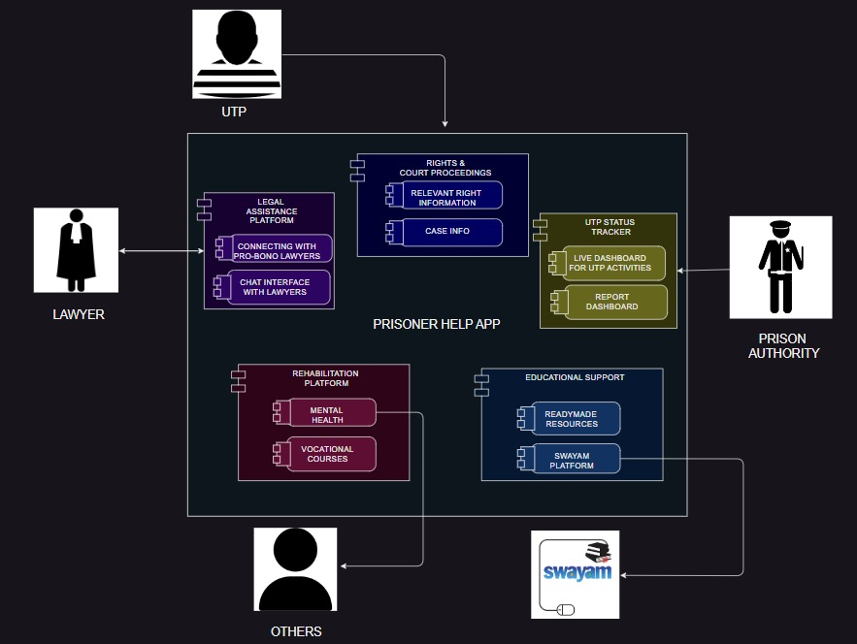
Overview of the System Design
Business Plan and Layout Diagram
The Government of India has allocated a sum of Rs.7916 crores for the Department of Prison and Prisoner welfare, and three-fourths of India's prisoners are under trial for the 2023-24 FY.
The successful implementation of the app within prison complexes would hence contribute in bringing down the funds that go towards the facilitation of food, sanitation and other basic needs by bringing legal services to under-trial prisoners who mostly suffer due to lack of economic resources.
The roll-out involves the installation of encrypted bio-metric booths with devices containing the functional app wherein prisoners can access the app services under the constant monitoring/surveillance of the prison authorities.
The number of devices given to a particular prison would depend upon the prison size ,under-trial prisoner count and the demand.
DETAILED UML DIAGRAM OF THE APP FUNCTIONING

Slide 6
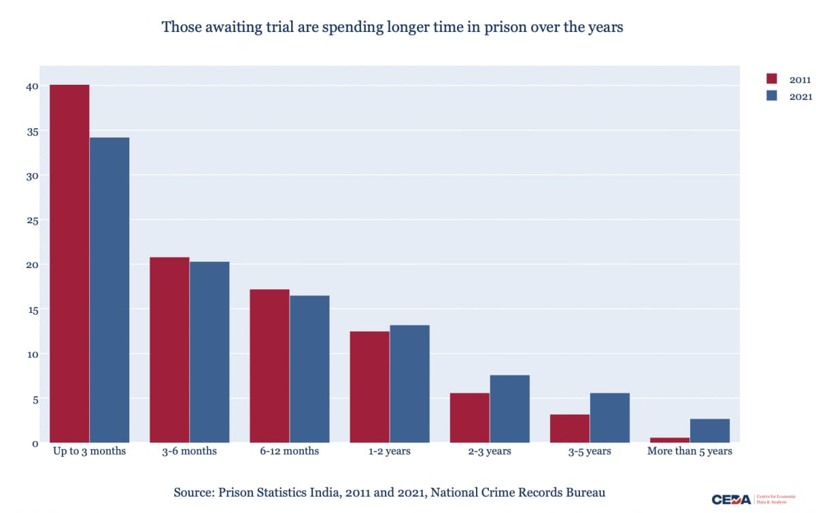
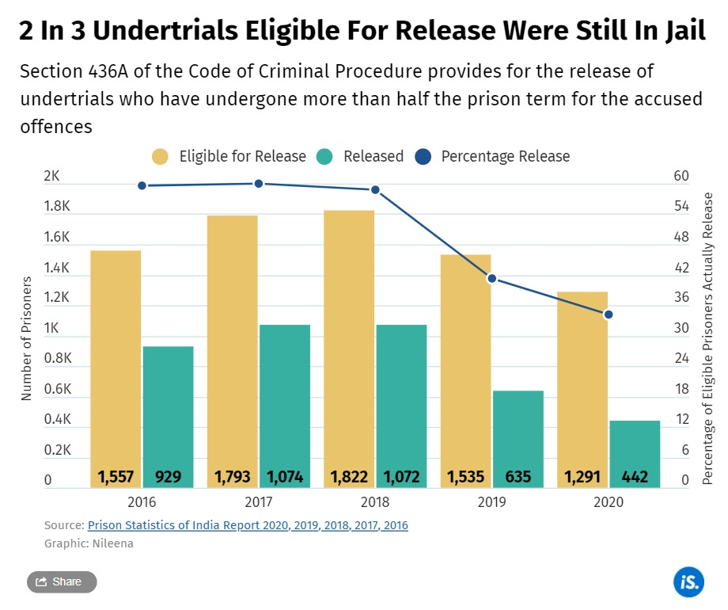
Studies and Impact
Studies show that 76% of the prisoners are undertrials in India(4,73,000 approx.). Many are still in custody. Recently American Government has allowed mobile phones inside prisons. So, with the technological growth and updates, it is time to bring facilities but with high protection. Also, lawyers need to know what's actually happening among cases. The app aims to:
1. Reduce undertrials.
2. Assist innocent undertrial prisoners.
3. Support pro bono lawyers with cases and history.
4. Lower government expenses for undertrials.

Slide 7
Team Member Details
Team Leader Name: P.S.SUDHARSHAN
Branch : B.Tech Stream : IT Year : II
Team Member 1 Name: KEERTHICK V
Branch : B.Tech Stream : IT Year : II
Team Member 2 Name: NITHYASRI R
Branch : B.Tech Stream : IT Year : II
Team Member 3 Name: SHOBITH KUMAR R
Branch : B.E Stream : CSE Year : II
Team Member 4 Name: SHUDHESH V
Branch : B.E. Stream : CSE Year : II
Team Member 5 Name: AATHI SANKAR
Branch : B.E Stream : ECE Year : II

