Slide 1

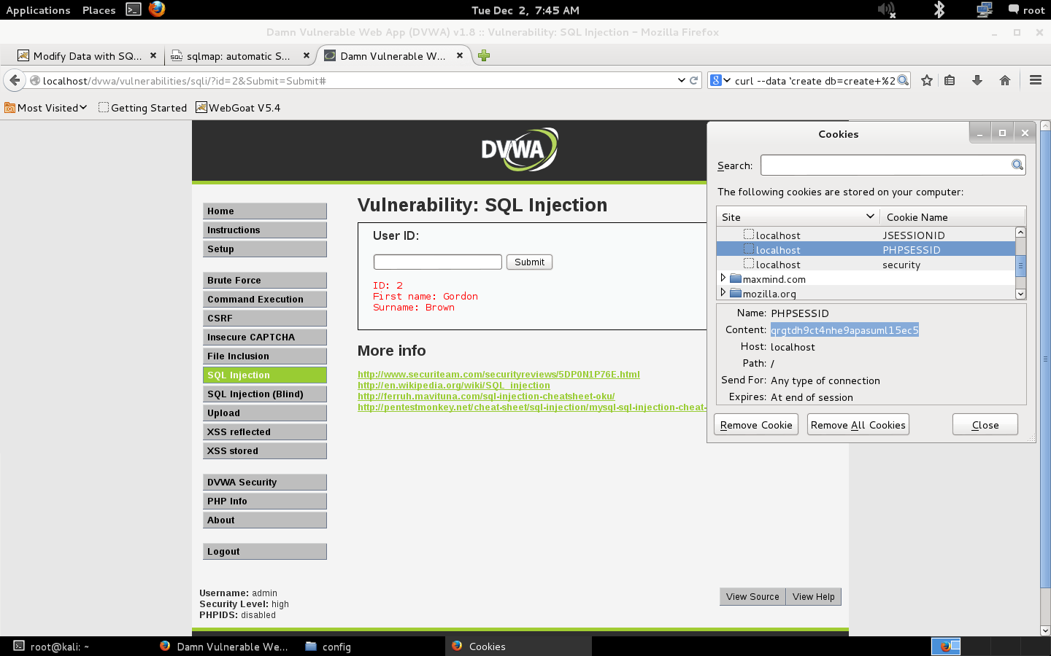

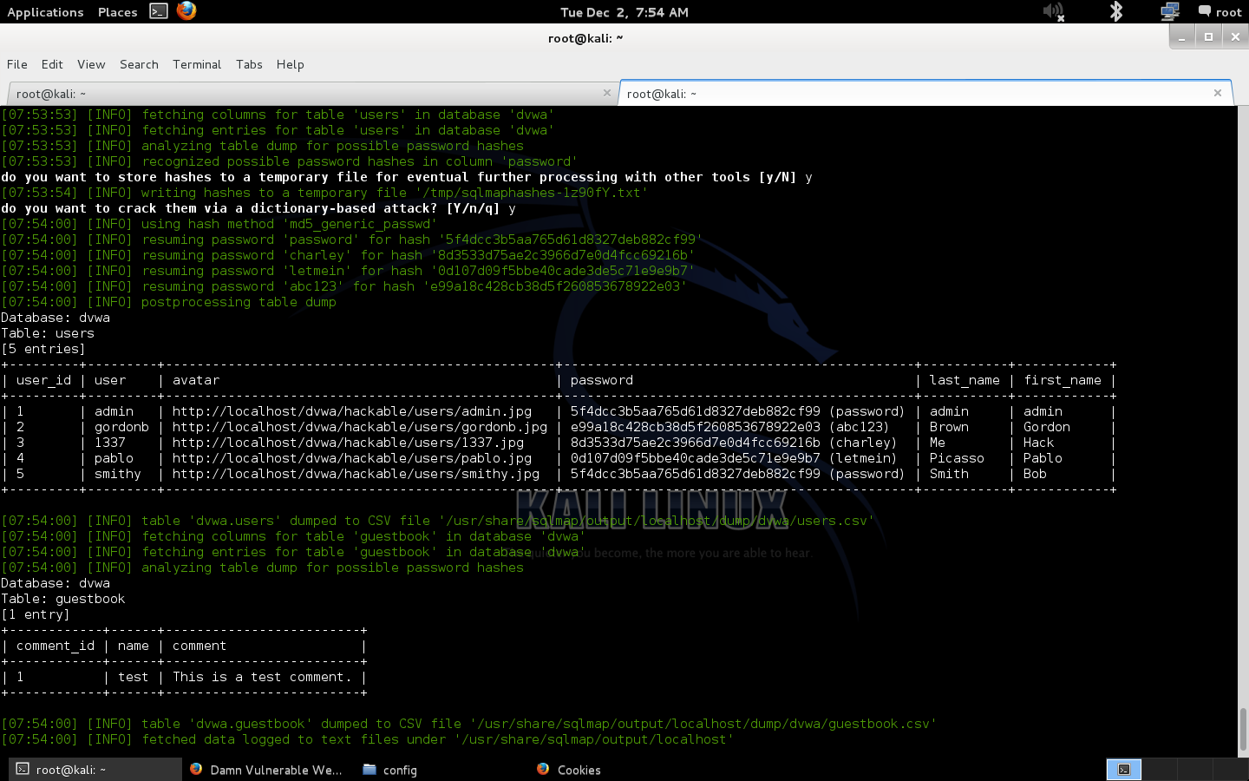
SQL Injection Attack (SQLIA)
Nolan Hu & Professor Fangyang Shen
New York City College of Technology, Computer Systems Technology
Abstract
Method
Conclusion
SQL Injection is one of the top ten web application vulnerabilities according to OWASP. The prime objective of an attacker using this exploit is to steal data from an organization. Once an attacker becomes aware that your system is vulnerable to SQL Injection, he has the ability to alter or delete the database. The impact of this vulnerability is critical to an organization and it must be dealt with the highest priority.
The aim of this project is to demonstrate how simple this attack can be executed. We use RandomStorm’s Damn Vulnerable Web Application to setup a vulnerable web application on the localhost. We also use sqlmap to automate detecting and exploiting SQL Injection. After exploitation, the audience will be presented with ways to defend and prevent the vulnerability.
Setup a virtual pentesting lab for the demonstration. The only hardware equipment being used is a MacBook Air (2014) with OS X Mavericks. We used Vmware Fusion to setup the virtual lab environment.
Download and install the Kali Linux 1.0.9 ISO on a virtual machine. We move over to work on the new operating system.
Download and extract the Damn Vulnerable Web Application (DVWA) V1.0.8 into the root directory. Start apache2 and MySQL and create a dvwa database. On the browser navigate to “http://locahost/dvwa” and login.
Obtain the cookie from the browser. Launch the sqlmap script with the syntax “sqlmap -u "http://localhost/dvwa/vulnerabilities/sqli/?id=2&Submit=Submit#" --cookie="PHPSESSID=qrgtdh9ct4nhe9apasuml15ec5; security=low;" --current-user --current-db –dump”. Follow through the prompts and the end result will be all the database contents including the cracked password hashes.
The demonstration shows just how easy a SQL Injection attack can be. There is even software that will help automate the exploit and allow anyone with minimal technical skills to exploit the vulnerability. Although SQL Injection first became public in a 1998 article in Phrack Magazine, the vulnerability is still prevalent in today’s web applications. Many big organizations have been compromised from this vulnerability showing that SQL Injection is still a viable attack vector.
It is important for developers to write code that will mitigate the exploit or else organizations may face serious consequences. Big banks and tech companies deal with millions of user’s sensitive data which would be horrendous if it fell into the wrong hands. Companies must take preventative measures outlined by distinguished industry leaders in cyber security or else there will be dire consequences. As mentioned before, SQL Injection is one of the top web application vulnerabilities and we cannot stress how important that the public should be aware of it.
Materials
Laptop (MacBook Air OS X Mavericks)
Damn Vulnerable Web Application (DVWA) V1.0.8
Kali Linux (1.0.9)
VMware Fusion
sqlmap
References
Discussion
OWASP, “SQL Injection,” Aug. 2014; www.owasp.org/index.php/SQL_Injection
OWASP, “SQL Injection Prevention Cheat Sheet,” Jun.. 2014; www.owasp.org/index.php/SQL_Injection_Prevention_Cheat_ Sheet
Salesforce, “Secure Coding SQL Injection”; https://developer. salesforce.com/page/Secure_Coding_SQL_Injection
V. Chapela, “Advanced SQL Injection,” Apr. 2005; www.one-esecurity.com/docs/Victor_Chapela-Advanced_SQL_ Injection.pdf
M. Kumar and L. Indu, “Detection and Prevention of SQL Injection Attack,” 2014; www.ijcsit.com/docs/Volume%205/vol5issue01/ijcsit2014050178.pdf
S. Kost, “An Introduction to SQL Injection Attacks for Oracle Developers,” Jan 2004; http://www.net-security.org/dl/articles/IntegrigyIntrotoSQLInjectionAttacks.pdf
Acunetix, “SQL Injection: What is it?”;www.acunetix.com/websitesecurity/sql-injection/
SQL Injection is one of the most common vulnerabilities to date. The flaw comes from web application development and is not a problem from the database or web server. SQL injection errors occur when data enters a program from an untrusted source or the data is used to dynamically construct a SQL query. Here is sample of vulnerable source code:
Using an input of “administrator’ –”, the attacker can login as admin without having to provide a password. The query string will look like this:
According to OWASP SQL Injection Prevention Cheatsheet, there are a couple ways to prevent this vulnerability:
Use of prepared statements (parameterized queries)
Use of stored procedures
Escaping all user supplied input
Enforce using least privelage accounts
White list input validation
Acknowledgments
I would like to acknowledge that a major resource used in this project was by OWASP and they deserve recognition for providing free and open source material for everyone in the community.

