Slide 1
Xiphos(Java Game)
Collision Check
HUD
Saving and Loading
Exp, Gold and Item drops
Equipment
Sound effects(not final)
Auto battle(not final)

Slide 2
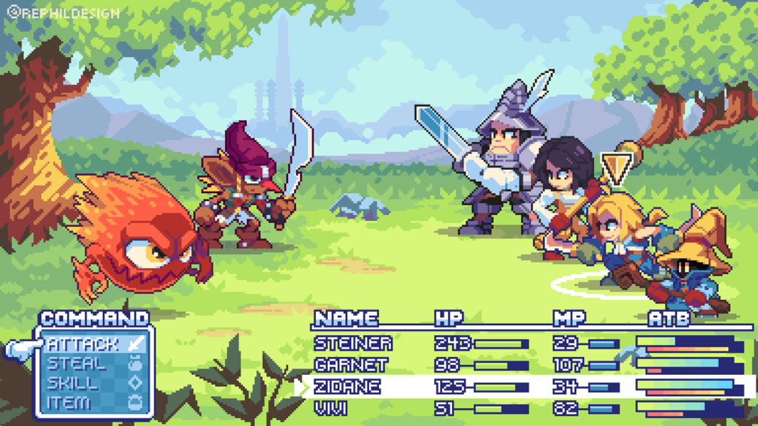
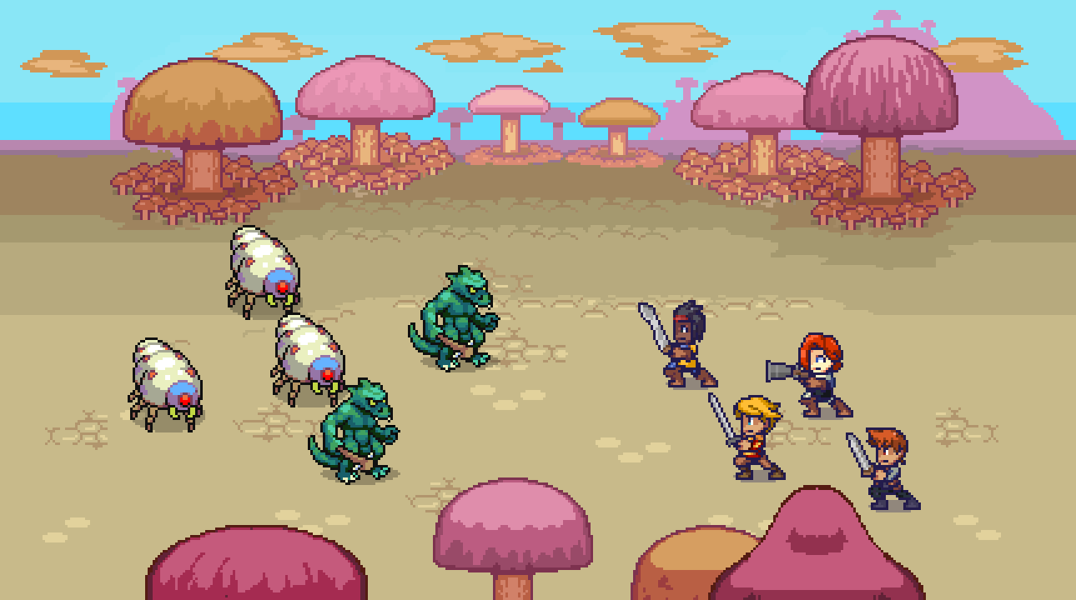
Concept

