Slide 1



Hash Tabele
AiSP
Notes:
This lecture illustrates hash tables, using open addressing.
Before this lecture, students should have seen other forms of a Dictionary, where a collection of data is stored, and each data item has a key associated with it.

Slide 2
Šta je Hash tabela ?
Najednostavnija vrsta hash tabele je niz zapisa.
Ovaj primjer ima 701 zapis.
[ 0 ]
[ 1 ]
[ 2 ]
[ 3 ]
[ 4 ]
[ 5 ]
[ 700]
. . .
Niz zapisa
Notes:
This lecture introduces hash tables, which are an array-based method for implementing a Dictionary. You should recall that we have seen dictionaries implemented in other ways, for example with a binary search tree. The abstract properties of a dictionary remain the same: We can insert items in the dictionary, and each item has a key associated with it. When we want to retrieve an item, we specify only the key, and the retrieval process finds the associated data.
What we do now is use an array to implement the dictionary. The array is an array of records. In this example, we could store up to 701 records in the array.

Slide 3
Šta je Hash tabela ?
[ 4 ]
Number 506643548
Svaki zapis ima specijalno polje nazvano ključ (key).
U primjeru, ključ je long integer polje nazvano Number.
[ 0 ]
[ 1 ]
[ 2 ]
[ 3 ]
[ 4 ]
[ 5 ]
[ 700]
. . .
Notes:
Each record in the array contains two parts. The first part is a number that we'll use for the key of the item. We could use something else for the keys, such as a string. But for a hash table, numbers make the most convenient keys.

Slide 4

Šta je Hash tabela?
[ 4 ]
Number 506643548
To može biti ID osobe i ostatak zapisa ima info o osobi.
[ 0 ]
[ 1 ]
[ 2 ]
[ 3 ]
[ 4 ]
[ 5 ]
[ 700]
. . .
Notes:
The numbers might be identification numbers of some sort, and the rest of the record contains information about a person. So the pattern that you see here is the same pattern that you've seen in other dictionaries: Each entry in the dictionary has a key (in this case an identifying number) and some associated data.

Slide 5



Šta je Hash tabela?
Kada se hash tabela koristi neka mjesta mogu sadržavati validne zapise a neka mogu biti prazna.
[ 0 ]
[ 1 ]
[ 2 ]
[ 3 ]
[ 4 ]
[ 5 ]
[ 700]
Number 281942902
Number 233667136
Number 506643548
. . .
Number 155778322
Notes:
When a hash table is being used as a dictionary, some of the array locations are in use, and other spots are "empty", waiting for a new entry to come along.
Oftentimes, the empty spots are identified by a special key. For example, if all our identification numbers are positive, then we could use 0 as the Number that indicates an empty spot.
With this drawing, locations [0], [4], [6], and maybe some others would all have Number=0.

Slide 6
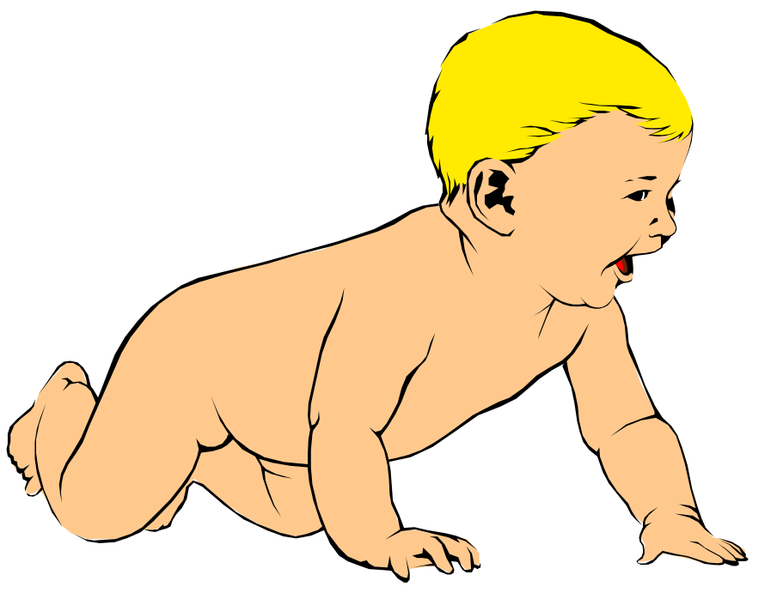
Umetanje novog zapisa
Number 580625685
Da bismo ubacili novi zapis, ključ se mora nekako pretvoriti u indeks niza.
Index se zove hash vrijednost ključa.
[ 0 ]
[ 1 ]
[ 2 ]
[ 3 ]
[ 4 ]
[ 5 ]
[ 700]
Number 281942902
Number 233667136
Number 506643548
. . .
Number 155778322
Notes:
In order to insert a new entry, the key of the entry must somehow be converted to an index in the array. For our example, we must convert the key number into an index between 0 and 700. The conversion process is called hashing and the index is called the hash value of the key.

Slide 7
Umetanje novog zapisa
Number 580625685
Tipičan način kreiranja hash vrijednosti:
(Number mod 701)
Koliko je (580625685 mod 701) ?
[ 0 ]
[ 1 ]
[ 2 ]
[ 3 ]
[ 4 ]
[ 5 ]
[ 700]
Number 281942902
Number 233667136
Number 506643548
. . .
Number 155778322
Notes:
There are many ways to create hash values. Here is a typical approach.
a. Take the key mod 701 (which could be anywhere from 0 to 700).
So, quick, what is (580,625,685 mod 701) ?

Slide 8
Umetanje novog zapisa
Number 580625685
Tipičan način kreiranja hash vrijednosti:
(Number mod 701)
3
Koliko je (580625685 mod 701) ?
[ 0 ]
[ 1 ]
[ 2 ]
[ 3 ]
[ 4 ]
[ 5 ]
[ 700]
Number 281942902
Number 233667136
Number 506643548
. . .
Number 155778322
Notes:
Three.

Slide 9
Umetanje novog zapisa
Number 580625685
Ova hash vrijednost se koristi za lociranje novog zapisa.
[3]
[ 0 ]
[ 1 ]
[ 2 ]
[ 3 ]
[ 4 ]
[ 5 ]
[ 700]
Number 281942902
Number 233667136
Number 506643548
. . .
Number 155778322
Notes:
So, this new item will be placed at location [3] of the array.

Slide 10
Umetanje novog zapisa
Ova hash vrijednost se koristi za lociranje novog zapisa.
[ 0 ]
[ 1 ]
[ 2 ]
[ 3 ]
[ 4 ]
[ 5 ]
[ 700]
Number 281942902
Number 233667136
Number 580625685
Number 506643548
. . .
Number 155778322
Notes:
The hash value is always used to find the location for the record.

Slide 11

Kolizije
Number 701466868
Ovdje je novi zapis za umetanje čija hash vrijednost je 2.
Moja hash
vrijednost je [2].
[ 0 ]
[ 1 ]
[ 2 ]
[ 3 ]
[ 4 ]
[ 5 ]
[ 700]
Number 281942902
Number 233667136
Number 580625685
Number 506643548
. . .
Number 155778322
Notes:
Sometimes, two different records might end up with the same hash value.

Slide 12

Kolizije
Number 701466868
Ovo se zove kolizija, jer već postoji drugi ispravan zapis na lokaciji [2].
Kada se desi kolizija,
ide se dalje sve dok se ne nađe prazno mjesto.
[ 0 ]
[ 1 ]
[ 2 ]
[ 3 ]
[ 4 ]
[ 5 ]
[ 700]
Number 281942902
Number 233667136
Number 580625685
Number 506643548
. . .
Number 155778322
Notes:
This is called a collision.
When a collision occurs, the insertion process will move forward through the array until an empty spot is found. Sometimes you will have a second collision...

Slide 13
Kolizije
Number 701466868
Ovo se zove kolizija, jer već postoji drugi ispravan zapis na lokaciji [2].
Kada se desi kolizija,
ide se dalje sve dok se ne nađe prazno mjesto.
[ 0 ]
[ 1 ]
[ 2 ]
[ 3 ]
[ 4 ]
[ 5 ]
[ 700]
Number 281942902
Number 233667136
Number 580625685
Number 506643548
. . .
Number 155778322
Notes:
...and a third collision...

Slide 14
Kolizije
Number 701466868
Ovo se zove kolizija, jer već postoji drugi ispravan zapis na lokaciji [2].
Kada se desi kolizija,
ide se dalje sve dok se ne nađe prazno mjesto.
[ 0 ]
[ 1 ]
[ 2 ]
[ 3 ]
[ 4 ]
[ 5 ]
[ 700]
Number 281942902
Number 233667136
Number 580625685
Number 506643548
. . .
Number 155778322
Notes:
But if there are any empty spots, eventually you will reach an empty spot, and the new item is inserted here.

Slide 15
Kolizije
Ovo se zove kolizija, jer već postoji drugi ispravan zapis na lokaciji [2].
Novi zapis dolazi na prazno mjesto.
[ 0 ]
[ 1 ]
[ 2 ]
[ 3 ]
[ 4 ]
[ 5 ]
[ 700]
Number 281942902
Number 233667136
Number 580625685
Number 506643548
Number 701466868
. . .
Number 155778322
Notes:
The new record is always placed in the first available empty spot, after the hash value.

Slide 16
Pretraga po ključu
Number 701466868
Podaci koji su povezani sa ključem mogu se naći prilično brzo.
[ 0 ]
[ 1 ]
[ 2 ]
[ 3 ]
[ 4 ]
[ 5 ]
[ 700]
Number 281942902
Number 233667136
Number 580625685
Number 506643548
Number 701466868
. . .
Number 155778322
Notes:
It is fairly easy to search for a particular item based on its key.

Slide 17
Pretraga po ključu
Number 701466868
Izračunati hash vrijednost.
Provjeriti lokaciju u nizu za taj ključ.
Moja hash
vrijed je [2].
Nisam ja.
[ 0 ]
[ 1 ]
[ 2 ]
[ 3 ]
[ 4 ]
[ 5 ]
[ 700]
Number 281942902
Number 233667136
Number 580625685
Number 506643548
Number 701466868
. . .
Number 155778322
Notes:
Start by computing the hash value, which is 2 in this case. Then check location 2. If location 2 has a different key than the one you are looking for, then move forward...

Slide 18
Pretraga po ključu
Number 701466868
Nastaviti kretanje naprijed dok ne nađete ključ ili stignete na prazno mjesto.
Moja hash
vrijed je [2].
Nisam ja.
[ 0 ]
[ 1 ]
[ 2 ]
[ 3 ]
[ 4 ]
[ 5 ]
[ 700]
Number 281942902
Number 233667136
Number 580625685
Number 506643548
Number 701466868
. . .
Number 155778322
Notes:
...if the next location is not the one we are looking for, then keep moving forward...

Slide 19
Pretraga po ključu
Number 701466868
Nastaviti kretanje naprijed dok ne nađete ključ ili stignete na prazno mjesto.
Moja hash
vrijed je [2].
Nisam ja.
[ 0 ]
[ 1 ]
[ 2 ]
[ 3 ]
[ 4 ]
[ 5 ]
[ 700]
Number 281942902
Number 233667136
Number 580625685
Number 506643548
Number 701466868
. . .
Number 155778322
Notes:
Keep moving forward until you find the sought-after key...

Slide 20
Pretraga po ključu
Number 701466868
Nastaviti kretanje naprijed dok ne nađete ključ ili stignete na prazno mjesto.
Moja hash
vrijed je [2].
DA!
[ 0 ]
[ 1 ]
[ 2 ]
[ 3 ]
[ 4 ]
[ 5 ]
[ 700]
Number 281942902
Number 233667136
Number 580625685
Number 506643548
Number 701466868
. . .
Number 155778322
Notes:
In this case we find the key at location [5].

Slide 21
Pretraga po ključu
Number 701466868
Kada je zapis nađen, informacija može biti kopirana u željenu lokaciju.
Moja hash
vrijed je [2].
DA!
[ 0 ]
[ 1 ]
[ 2 ]
[ 3 ]
[ 4 ]
[ 5 ]
[ 700]
Number 281942902
Number 233667136
Number 580625685
Number 506643548
Number 701466868
. . .
Number 155778322
Notes:
The data from location [5] can then be copied to to provide the result of the search function.
What happens if a search reaches an empty spot? In that case, it can
halt and indicate that the key was not in the hash table.

Slide 22
Brisanje zapisa
Zapisi se mogu uklanjati iz hash tabele.
Obriši
me!
[ 0 ]
[ 1 ]
[ 2 ]
[ 3 ]
[ 4 ]
[ 5 ]
[ 700]
Number 281942902
Number 233667136
Number 580625685
Number 506643548
Number 701466868
. . .
Number 155778322
Notes:
Records can be deleted from a hash table...

Slide 23
Brisanje zapisa
Zapisi se mogu uklanjati iz hash tabele.
Ali lokacija se ne smije ostaviti kao obična "prazna tačka", jer bi to moglo da ometa pretraživanje.
[ 0 ]
[ 1 ]
[ 2 ]
[ 3 ]
[ 4 ]
[ 5 ]
[ 700]
Number 281942902
Number 233667136
Number 580625685
Number 701466868
. . .
Number 155778322
Notes:
But the spot of the deleted record cannot be left as an ordinary empty spot, since that would interfere with searches. (Remember that a search can stop when it reaches an empty spot.)

Slide 24
Brisanje zapisa
Zapisi se mogu uklanjati iz hash tabele.
Ali lokacija se ne smije ostaviti kao obična "prazna tačka", jer bi to moglo da ometa pretraživanje.
Lokacija mora biti označena na neki poseban način tako da pretraga može reći da je mjesto nekada imalo nešto u sebi.
[ 0 ]
[ 1 ]
[ 2 ]
[ 3 ]
[ 4 ]
[ 5 ]
[ 700]
Number 281942902
Number 233667136
Number 580625685
Number 701466868
. . .
Number 155778322
Notes:
Instead we must somehow mark the location as "a location that used to have something here, but no longer does."
We might do this by using some other special value for the Number field of the record.
In any case, a search can not stop when it reaches "a location that used to have something here". A search can only stop when it reaches a true empty spot.

Slide 25
Zaključak
Hash tabele čuvaju zbirku zapisa sa ključevima.
Lokacija zapisa zavisi od hash vrijednosti ključa zapisa.
Kada dođe do kolizije, koristi se sljedeća raspoloživa lokacija.
Pretraživanje određenog ključa je generalno brzo.
Kada se jedna stavka obriše, lokacija mora biti označena na poseban način, tako da buduće pretrage znaju da se to mjesto koristilo.
Notes:
A quick summary . . .

Slide 26
Primjer
Problem ubacivanja; 89, 18, 49, 58, 69
riješiti upotrebom:
    ulančavanja,
    otvorenog adresiranja
    Veličina hash tabele je 10.
Notes:
A quick summary . . .

Slide 27
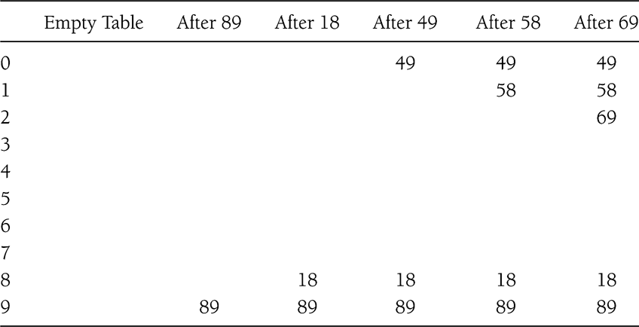
Primjer: linearno ispipavanje
Problem ubacivanja; 89, 18, 49, 58, 69
Notes:
A quick summary . . .

Slide 28
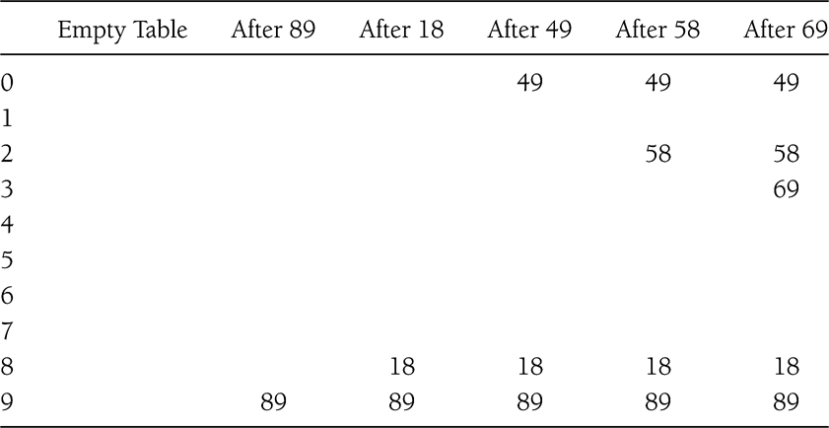
Primjer: kvadratno ispipavanje
f(i) = i²
Problem ubacivanja; 89, 18, 49, 58, 69
Notes:
A quick summary . . .

Slide 29
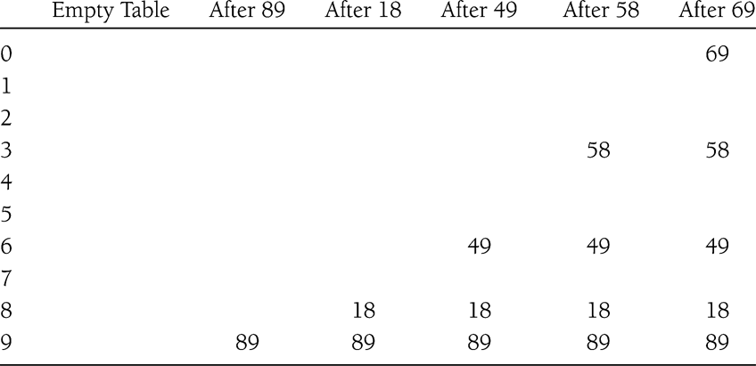
Primjer: dvostruko heširanje
Problem ubacivanja; 89, 18, 49, 58, 69
f(i) = i*hash₂(x)
E.g.: hash₂(x) = 7 – (x % 7)
Notes:
A quick summary . . .

Slide 30
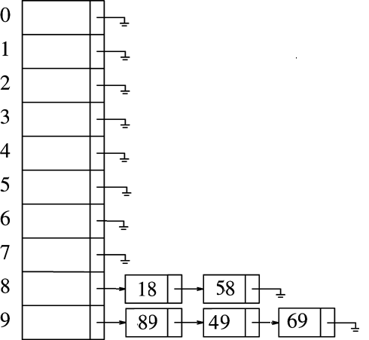
Primjer: ulančavanje
Notes:
A quick summary . . .

