Slide 1
Ada Boosting Regression

Slide 2
Adaboost Regression Algorithm
Adaptive Boosting
An ensemble machine learning algorithm
It is used to classify data by combining multiple weak or base learners (e.g., decision trees) into a strong learner
AdaBoost works by weighting the instances in the training dataset based on the accuracy of previous classifications.

Slide 3
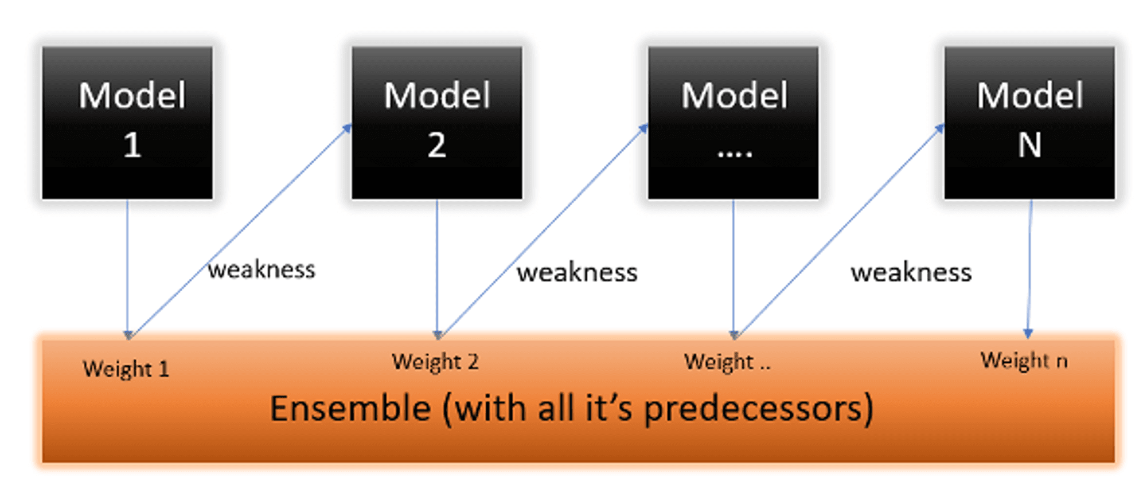
Adaboost Regression Algorithm

Slide 4
Adaboost Regression Algorithm
Initially, Adaboost selects a training subset randomly.
It iteratively trains the AdaBoost machine learning model by selecting the training set based on the accurate prediction of the last training.
It assigns the higher weight to wrong classified observations so that in the next iteration these observations will get the high probability for classification.
Also, It assigns the weight to the trained classifier in each iteration according to the accuracy of the classifier. The more accurate classifier will get high weight.
This process iterate until the complete training data fits without any error or until reached to the specified maximum number of estimators.

Slide 5
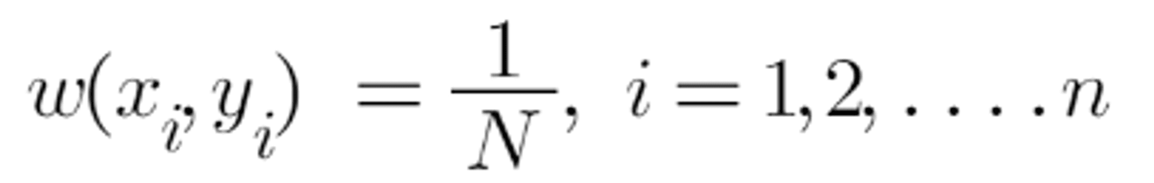
Adaboost Regression Algorithm
The sample weights are calculated using the following formula.
N denotes the total number of data points.

Slide 6
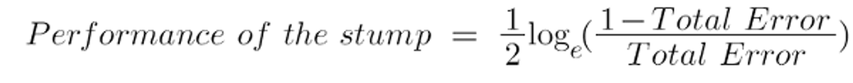
Adaboost Regression Algorithm
Formula to determine the "Amount of Say" or "Importance" or "Influence" for this classifier in categorizing the data points:
Total error is just the sum of all misclassified data points' sample weights. Fotar example, If we have 2 incorrect output for 10 testdata, Total Error=2/10

Slide 7
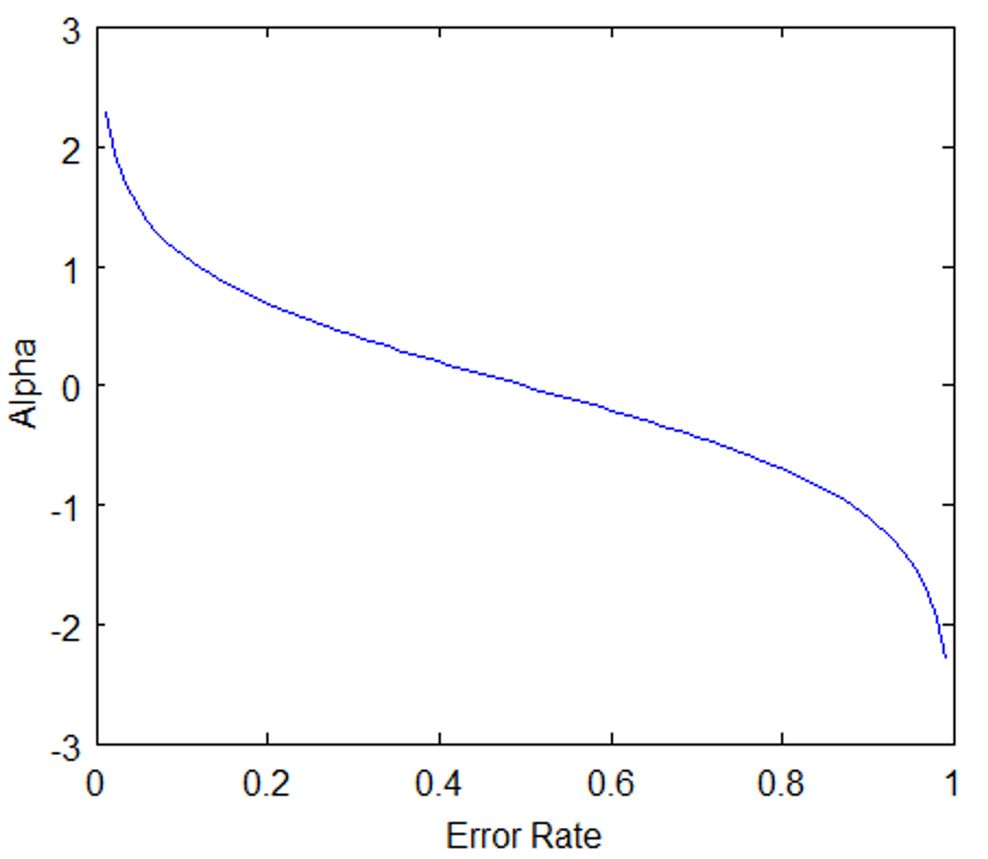
Adaboost Regression Algorithm
0 represents a flawless stump, while 1 represents a bad stump.
According to the graph above, when there is no misclassification, there is no error (Total Error = 0), hence the "amount of say (alpha)" will be a huge value.
When the classifier predicts half correctly and half incorrect, the Total Error equals 0.5, and the classifier's significance (amount of say) equals 0.
If all of the samples were improperly categorised, the error will be quite large (about to 1), and our alpha value will be a negative integer.

Slide 8
Adaboost Regression Algorithm
After determining the classifier's significance and total error, we must update the weights using the following formula:

Slide 9
Adaboost Regression Algorithm
Pros
AdaBoost is easy to implement.
It iteratively corrects the mistakes of the weak classifier and improves accuracy by combining weak learners.
You can use many base classifiers with AdaBoost.

Slide 10
Adaboost Regression Algorithm
Cons
AdaBoost is sensitive to noise data.
It is highly affected by outliers because it tries to fit each point perfectly.
Require multiple iteration of training

Slide 11
Adaboost Regression Algorithm
Applications
AdaBoost is widely used in applications such as face detection, object recognition, and text classification.
It is particularly effective when the data is noisy or when there are many irrelevant features

