Slide 1
Ada Boosting Regression

Slide 2
Adaboost Regression Algorithm
Adaptive Boosting
An ensemble machine learning algorithm
It is used to classify data by combining multiple weak or base learners (e.g., decision trees) into a strong learner
AdaBoost works by weighting the instances in the training dataset based on the accuracy of previous classifications.

Slide 3
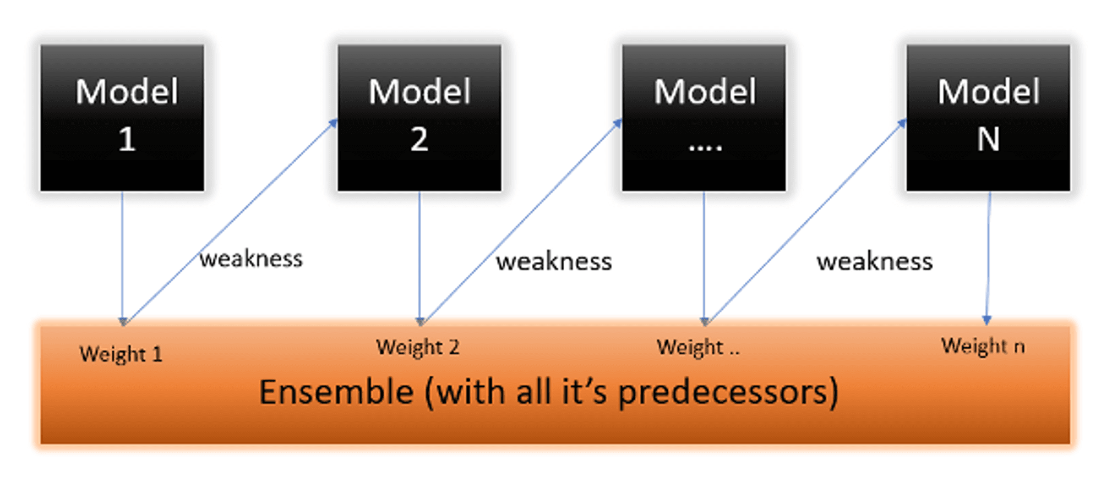
Adaboost Regression Algorithm

Slide 4
Adaboost Regression Algorithm
Initially, Adaboost selects a training subset randomly.
It iteratively trains the AdaBoost machine learning model by selecting the training set based on the accurate prediction of the last training.
It assigns the higher weight to wrong classified observations so that in the next iteration these observations will get the high probability for classification.
Also, It assigns the weight to the trained classifier in each iteration according to the accuracy of the classifier. The more accurate classifier will get high weight.
This process iterate until the complete training data fits without any error or until reached to the specified maximum number of estimators.
To classify, perform a "vote" across all of the learning algorithms you built.

Slide 5
Adaboost Regression Algorithm
Pros
AdaBoost is easy to implement.
It iteratively corrects the mistakes of the weak classifier and improves accuracy by combining weak learners.
You can use many base classifiers with AdaBoost.

Slide 6
Adaboost Regression Algorithm
Cons
AdaBoost is sensitive to noise data.
It is highly affected by outliers because it tries to fit each point perfectly.
Require multiple iteration of training

