Slide 1
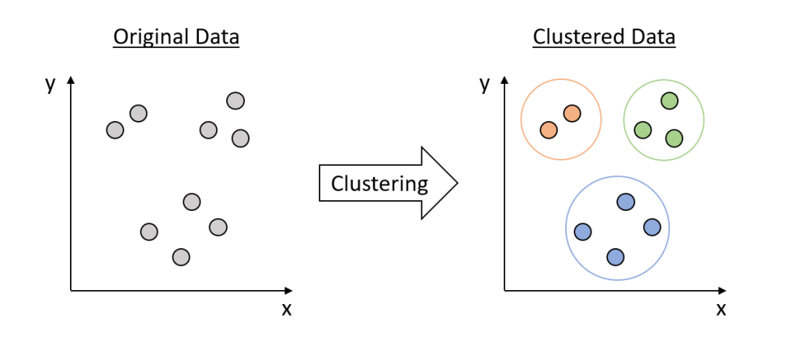

Slide 7
Machine Learning Clustering Algorithms

Slide 8
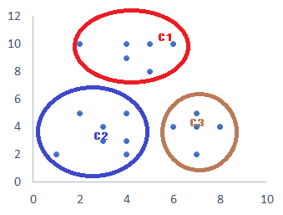
Clustering
Clustering is an unsupervised machine learning technique designed to group unlabeled examples based on their similarity to each other.
Original Data
Clustered Data
Clustering

Slide 9
Different Types of Clustering
BisectingKMeansClustering
AgglomerativeClustering
BirchClustering
MeanShiftClustering
AffinityPropagationClustering
DBScanClustering
KMeansClustering
HDBScanClustering
OpticsClustering
SpectralClustering

Slide 10
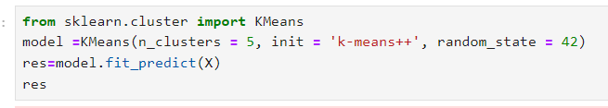
Kmeans Clustering
A partition-based clustering algorithm
Divides data into K clusters
Each cluster represented by centroid
Iterative refinement of centroids
Algorithm Steps
Initialize K centroids randomly
Assign each data point to nearest centroid
Update centroids as mean of assigned points
Repeat steps 2-3 until convergence

Slide 11
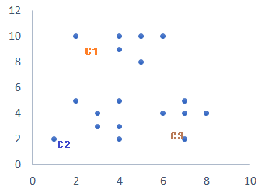
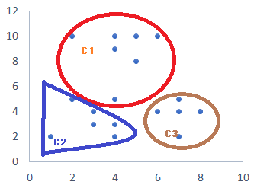
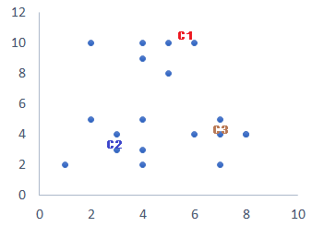
Kmeans Clustering
Add each datapoints to nearest centroid. It will create a 3 cluster.
Original Data set
Assign a centroids. K=3
Add each datapoints to nearest centroid. It will create a 3 cluster.
Assign new centroids

Slide 12
Kmeans Clustering
Advantages
Efficient and scalable
Easy to implement and interpret
Fast convergence
Disadvantages
Sensitive to initial centroid placement
Sensitivity to outliers
Scalability issues
Applications
Customer segmentation
Image compression
Gene expression analysis
Text clustering
Recommendation systems

Slide 13
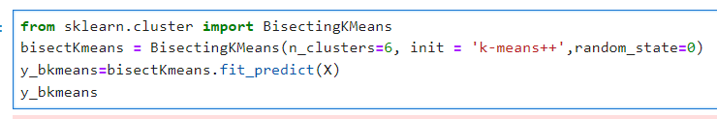
Bisecting Kmeans Clustering
A hybrid clustering approach
Combines K-Means and hierarchical clustering
Divides data into two clusters at each step
Suitable for large datasets
Algorithm Steps
Initialize K (number of clusters)
Select a cluster to bisect
Apply K-Means on the selected cluster with K=2
Split the cluster into two new clusters
Repeat steps 2-4 until K clusters are obtained

Slide 14
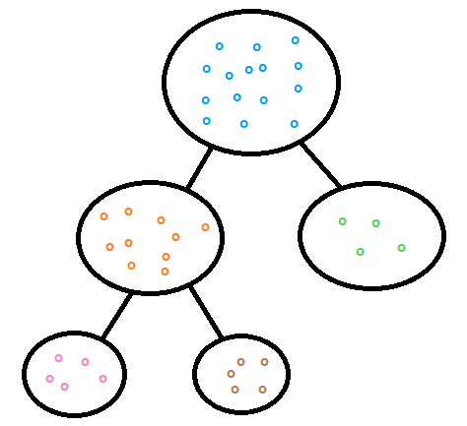
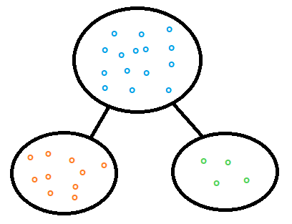
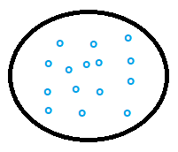
Bisecting Kmeans Clustering
Splitting the cluster with highest SSE into 2 (K=2). Now we reached the required number of cluster(3). No further split needed
Original Dataset will be split into 2 (K=2)
Original Dataset
Number of Cluster Needed=3
Original Data set
Final Cluster 3
Final Cluster 1
Final Cluster 2

Slide 15
Bisecting Kmeans Clustering
Advantages
Handles large datasets efficiently
Reduces computational complexity compared to K-Means
Can handle varying densities
Disadvantages
May not always find optimal clusters
Sensitive to initial cluster selection
Can be slow for very large datasets
Applications
Customer segmentation
Image segmentation
Gene expression analysis
Text clustering

Slide 16
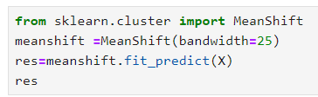
Mean Shift Clustering
A sliding-window based clustering algorithm
Non-parametric, non-hierarchical clustering
No fixed number of clusters
Robust to noise and outliers
Algorithm Steps
Initialize kernel bandwidth (h)
For each data point:
Calculate mean shift vector (direction of maximum density)
Update data point to new location (mean shift)
Repeat step 2 until convergence
Group points into clusters based on convergence points

Slide 17
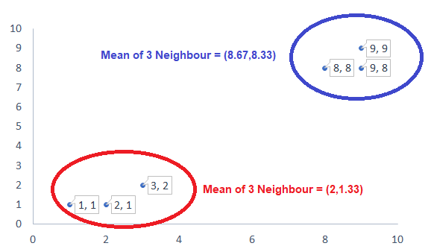
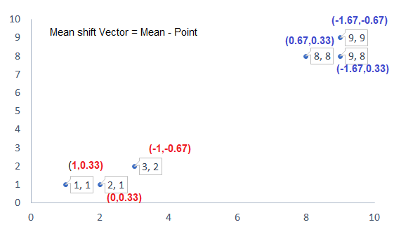
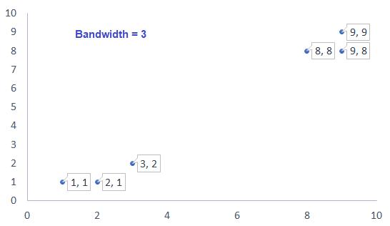
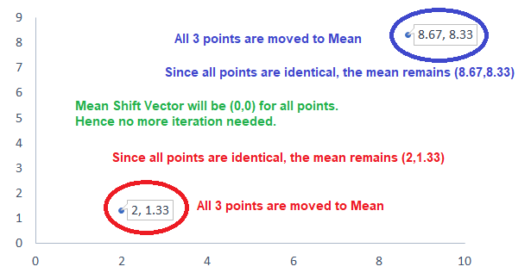
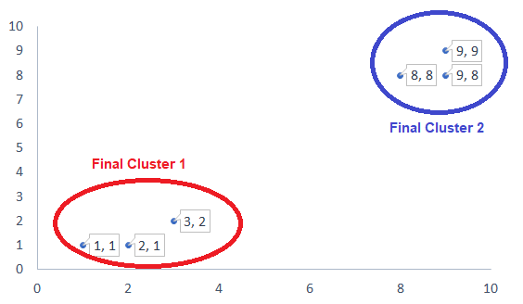
Mean Shift Clustering

Slide 18
Mean Shift Clustering
Advantages
No need to specify number of clusters
Robust to noise and outliers
Handles varying densities
Disadvantages
Computationally expensive (O(n^2) complexity)
Sensitive to bandwidth parameter
Can be slow for large datasets
Applications
Image segmentation
Object tracking
Customer segmentation
Gene expression analysis
Text clustering

Slide 19

Agglomerative Clustering
A bottom-up hierarchical clustering approach
Starts with individual data points as clusters
Merges closest clusters iteratively
Forms a tree-like structure (dendrogram)
Algorithm Steps
Initialize each data point as a separate cluster
Calculate pairwise distances between clusters
Merge the closest two clusters
Update distances between merged cluster and other clusters
Repeat steps 3-4 until desired number of clusters is reached

Slide 20
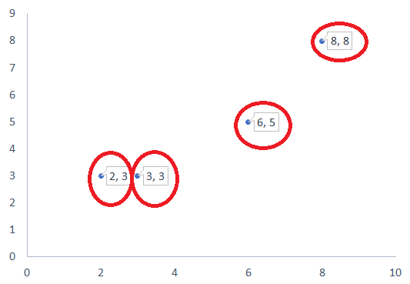
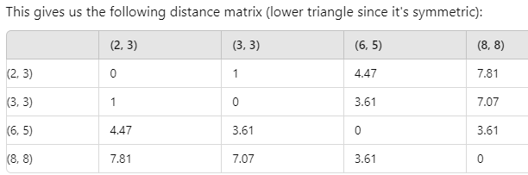
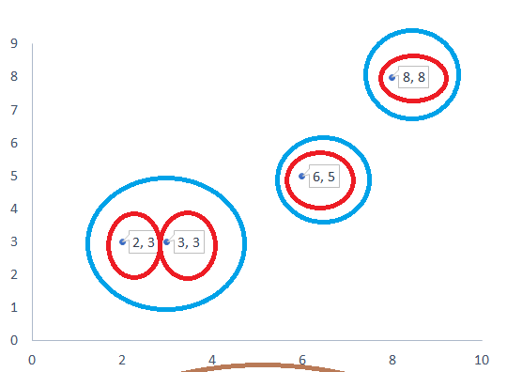
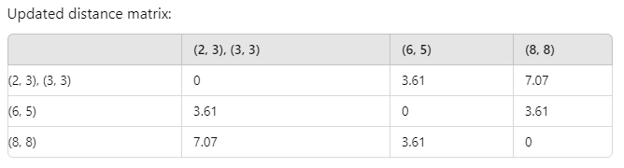
Agglomerative Clustering

Slide 21
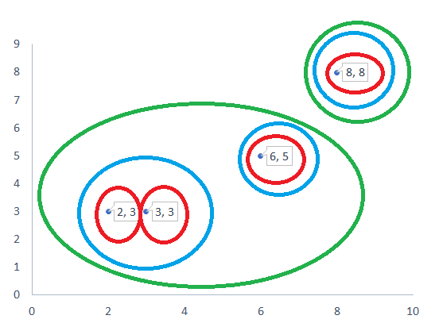
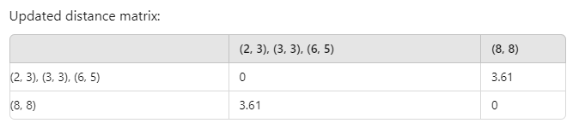
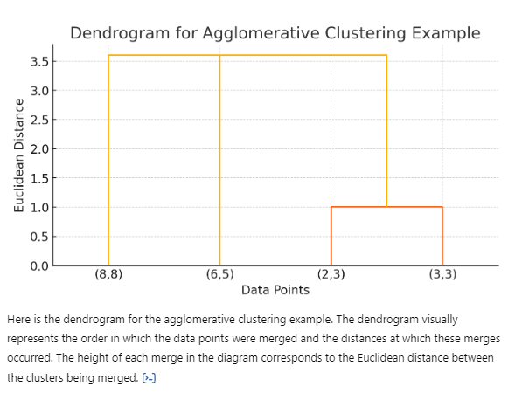
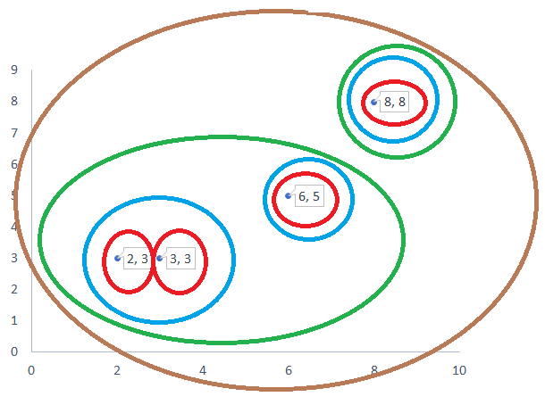
Agglomerative Clustering

Slide 22
Agglomerative Clustering
Advantages
Handles varying densities and outliers
Provides a hierarchical structure (dendrogram)
Easy to visualize and interpret
Disadvantages
Computationally expensive (O(n^2) complexity)
Difficult to choose optimal number of clusters- Sensitive to noise and outliers
Applications
Customer segmentation
Gene expression analysis
Image segmentation
Text clustering
Social network analysis

Slide 23
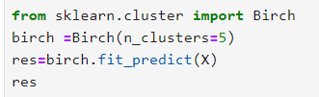
BIRCH Clustering
A hierarchical clustering algorithm for large datasets
Balanced Iterative Reducing and Clustering using Hierarchies
Balances computational efficiency and clustering quality
Uses a tree-like data structure (Clustering Feature (CF)-Tree)
Handles large datasets and noise
Algorithm Steps
Initialize CF-Tree with a single leaf node
Scan data points and insert into CF-Tree
If leaf node is full, split and create new leaf nodes
If tree height exceeds threshold, merge nodes
Repeat steps 2-4 until all data points are inserted
Perform clustering on leaf nodes

Slide 24
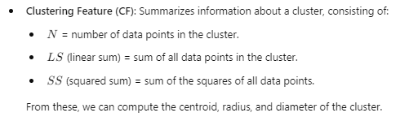
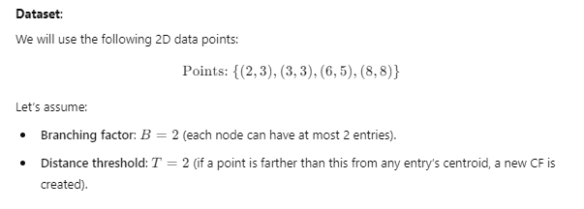
BIRCH Clustering

Slide 25
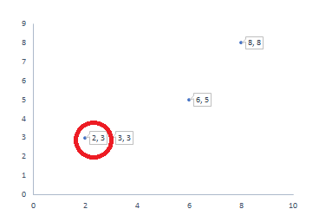

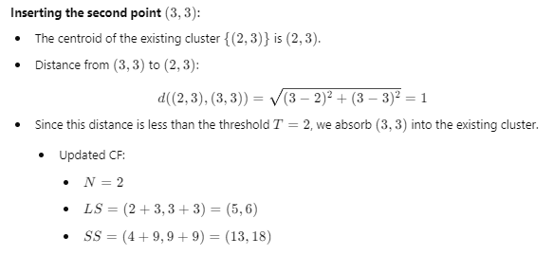
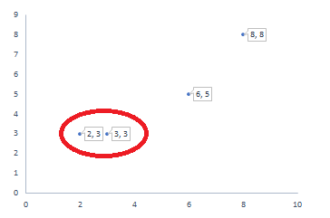
BIRCH Clustering
Root
CF1: (2,3)
N=1, LS=(2,3), SS=(4,9)
Root
CF1: (2,3) , (3,3)
N=2, LS=(5,6), SS=(13,18)

Slide 26
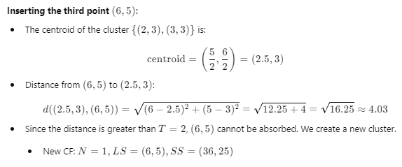
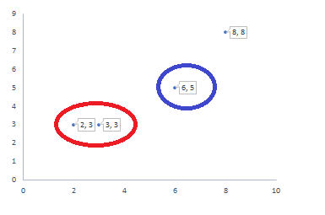
BIRCH Clustering
Root
CF1: (2,3) , (3,3)
N=2, LS=(5,6), SS=(13,18)
CF2: (6,5)
N=1, LS=(6,5), SS=(36,25)

Slide 27
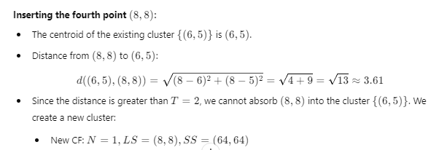
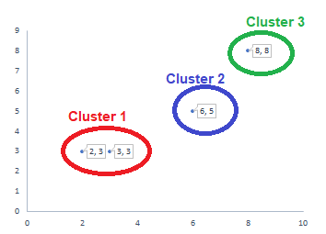
BIRCH Clustering
Root
CF1: (2,3) , (3,3)
N=2, LS=(5,6), SS=(13,18)
CF2: (6,5)
N=1, LS=(6,5), SS=(36,25)
CF3: (8,8)
N=1, LS=(8,8), SS=(64,64)

Slide 28
BIRCH Clustering
Advantages
Efficient for large datasets (O(n) complexity)
Handles noise and outliers
Robust to varying densities
Disadvantages
May not always find optimal clusters
Sensitive to threshold parameters
Can be slow for very high-dimensional data
Applications
Data mining
Customer segmentation
Image segmentation
Text clustering
Network analysis

Slide 29
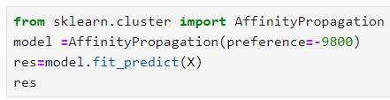
Affinity Propagation Clustering
A clustering algorithm based on message passing
Identifies exemplars (representative data points)
Clusters data points around exemplars
No need to specify number of clusters
Algorithm Steps
Initialize similarity matrix (S)
Calculate responsibility matrix (R)
Calculate availability matrix (A)
Update R and A matrices iteratively
Identify exemplars and clusters

Slide 30
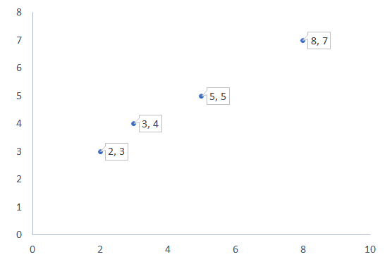

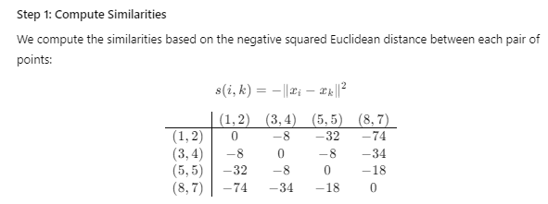
Affinity Propagation Clustering

Slide 31
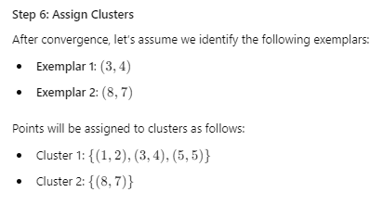
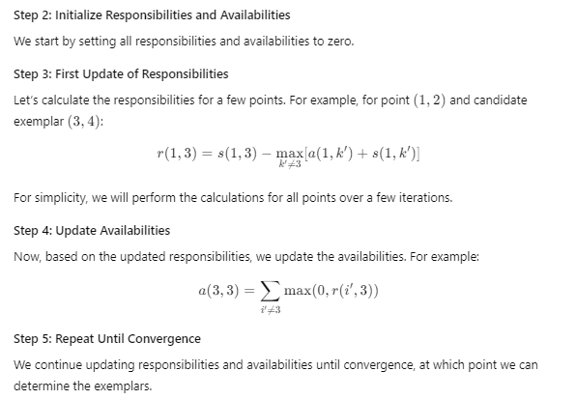
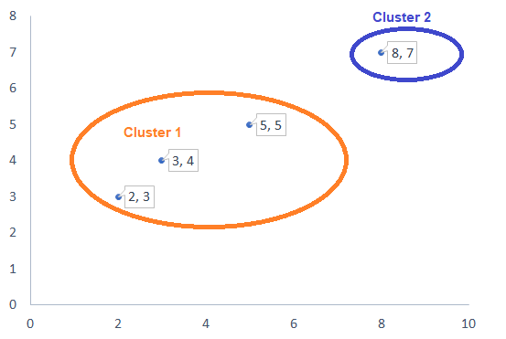
Affinity Propagation Clustering

Slide 32
Affinity Propagation Clustering
Advantages
No need to specify number of clusters
Robust to noise and outliers
Handles varying densities
Disadvantages
Computationally expensive (O(n^2) complexity)
Sensitive to damping factor parameter
Can be slow for large datasets
Applications
Image segmentation
Gene expression analysis
Customer segmentation
Text clustering
Recommendation systems

