Slide 1
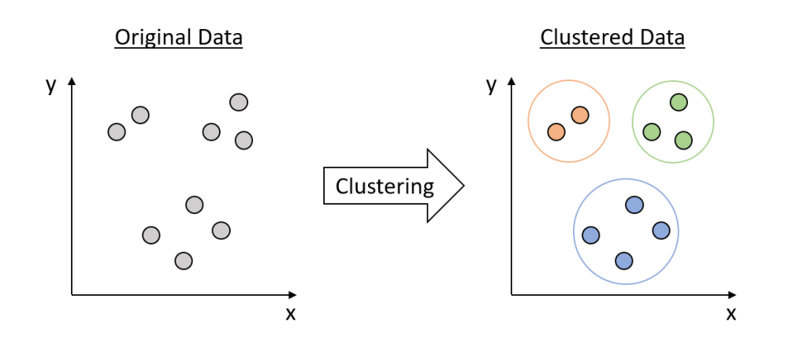

Slide 3
Machine Learning Clustering Algorithms

