Slide 1
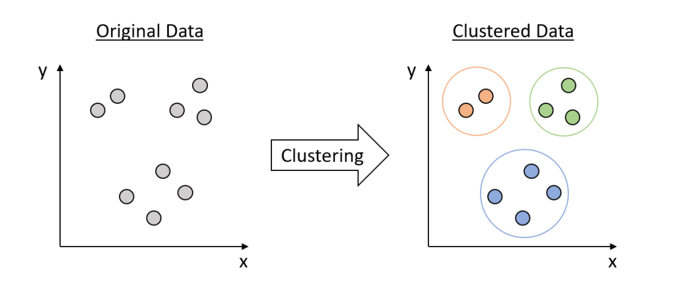

Slide 5
Machine Learning Clustering Algorithms

Slide 6
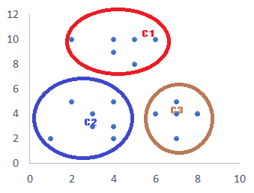
Clustering
Clustering is an unsupervised machine learning technique designed to group unlabeled examples based on their similarity to each other.
Original Data
Clustered Data
Clustering

Slide 7
Different Types of Clustering
BisectingKMeansClustering
AgglomerativeClustering
BirchClustering
MeanShiftClustering
AffinityPropagationClustering
DBScanClustering
KMeansClustering
HDBScanClustering
OpticsClustering
SpectralClustering

Slide 8
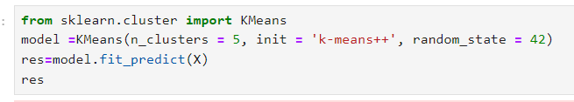
Kmeans Clustering
A partition-based clustering algorithm
Divides data into K clusters
Each cluster represented by centroid
Iterative refinement of centroids
Algorithm Steps
Initialize K centroids randomly
Assign each data point to nearest centroid
Update centroids as mean of assigned points
Repeat steps 2-3 until convergence

Slide 9
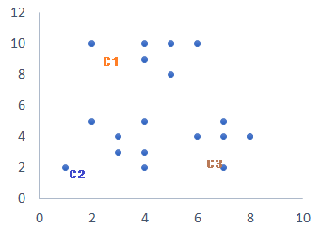
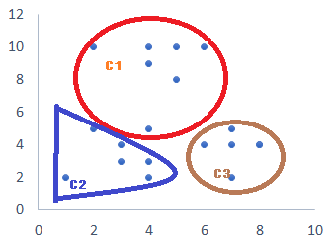
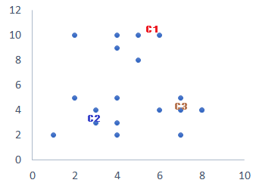
Kmeans Clustering
Add each datapoints to nearest centroid. It will create a 3 cluster.
Original Data set
Assign a centroids. K=3
Add each datapoints to nearest centroid. It will create a 3 cluster.
Assign new centroids

Slide 10
Kmeans Clustering
Advantages
Efficient and scalable
Easy to implement and interpret
Fast convergence
Disadvantages
Sensitive to initial centroid placement
Sensitivity to outliers
Scalability issues
Applications
Customer segmentation
Image compression
Gene expression analysis
Text clustering
Recommendation systems

Slide 11
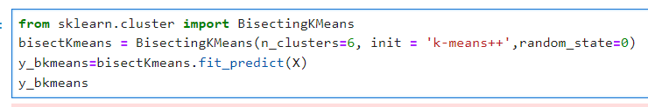
Bisecting Kmeans Clustering
A hybrid clustering approach
Combines K-Means and hierarchical clustering
Divides data into two clusters at each step
Suitable for large datasets
Algorithm Steps
Initialize K (number of clusters)
Select a cluster to bisect
Apply K-Means on the selected cluster with K=2
Split the cluster into two new clusters
Repeat steps 2-4 until K clusters are obtained

Slide 12
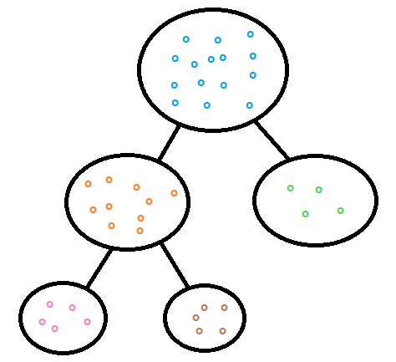
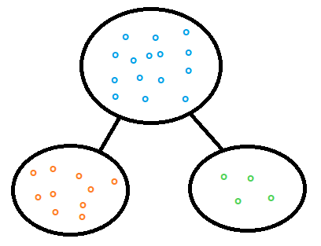
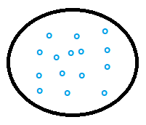
Bisecting Kmeans Clustering
Splitting the cluster with highest SSE into 2 (K=2). Now we reached the required number of cluster(3). No further split needed
Original Dataset will be split into 2 (K=2)
Original Dataset
Number of Cluster Needed=3
Original Data set
Final Cluster 3
Final Cluster 1
Final Cluster 2

Slide 13
Bisecting Kmeans Clustering
Advantages
Handles large datasets efficiently
Reduces computational complexity compared to K-Means
Can handle varying densities
Disadvantages
May not always find optimal clusters
Sensitive to initial cluster selection
Can be slow for very large datasets
Applications
Customer segmentation
Image segmentation
Gene expression analysis
Text clustering

