Slide 1
Machine Learning Clustering Algorithms

Slide 2
Brief Introduction of
10 Machine Learning Clustering Algorithms
In Tamil
Kmeans Clustering Algorithm
Bisecting Kmeans Clustering Algorithm
MeanShift Clustering Algorithm
Agglomerative Clustering Algorithm
BIRCH Clustering Algorithm
Affinity Propagation Clustering Algorithm
DBSCAN Clustering Algorithm
HDBSCAN Clustering Algorithm
Optics Clustering Algorithm
Spectral Clustering Algorithm

Slide 3
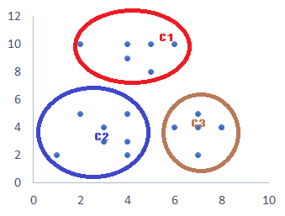
Clustering
Clustering is an unsupervised machine learning technique designed to group unlabeled examples based on their similarity to each other.
Original Data
Clustered Data
Clustering

Slide 4
Different Types of Clustering
KMeansClustering
BisectingKMeansClustering
MeanShiftClustering
AgglomerativeClustering
BirchClustering
AffinityPropagationClustering
DBScanClustering
HDBScanClustering
OpticsClustering
SpectralClustering

Slide 5
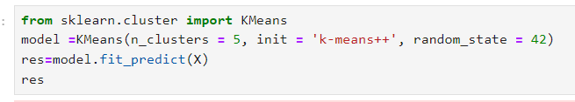
Kmeans Clustering
A partition-based clustering algorithm
Divides data into K clusters
Each cluster represented by centroid
Iterative refinement of centroids
Algorithm Steps
Initialize K centroids randomly
Assign each data point to nearest centroid
Update centroids as mean of assigned points
Repeat steps 2-3 until convergence

Slide 6
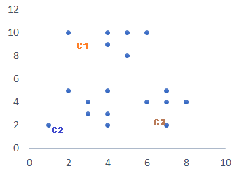
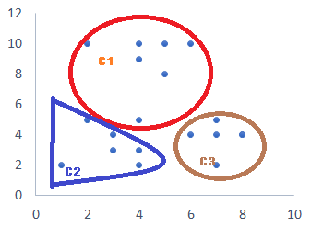
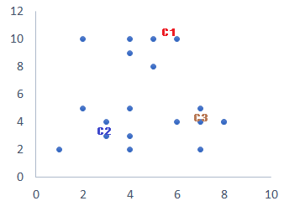
Kmeans Clustering
Add each datapoints to nearest centroid. It will create a 3 cluster.
Original Data set
Assign a centroids. K=3
Add each datapoints to nearest centroid. It will create a 3 cluster.
Assign new centroids

Slide 7
Kmeans Clustering
Advantages
Efficient and scalable
Easy to implement and interpret
Fast convergence
Disadvantages
Sensitive to initial centroid placement
Sensitivity to outliers
Scalability issues
Applications
Customer segmentation
Image compression
Gene expression analysis
Text clustering
Recommendation systems

Slide 8
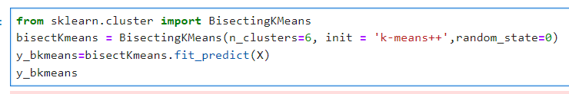
Bisecting Kmeans Clustering
A hybrid clustering approach
Combines K-Means and hierarchical clustering
Divides data into two clusters at each step
Suitable for large datasets
Algorithm Steps
Initialize K (number of clusters)
Select a cluster to bisect
Apply K-Means on the selected cluster with K=2
Split the cluster into two new clusters
Repeat steps 2-4 until K clusters are obtained

Slide 9
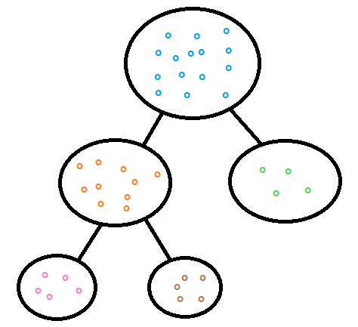
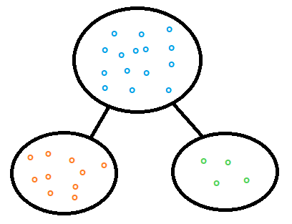
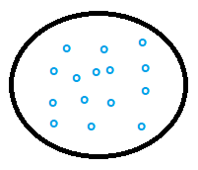
Bisecting Kmeans Clustering
Splitting the cluster with highest SSE into 2 (K=2). Now we reached the required number of cluster(3). No further split needed
Original Dataset will be split into 2 (K=2)
Original Dataset
Number of Cluster Needed=3
Original Data set
Final Cluster 3
Final Cluster 1
Final Cluster 2

Slide 10
Bisecting Kmeans Clustering
Advantages
Handles large datasets efficiently
Reduces computational complexity compared to K-Means
Can handle varying densities
Disadvantages
May not always find optimal clusters
Sensitive to initial cluster selection
Can be slow for very large datasets
Applications
Customer segmentation
Image segmentation
Gene expression analysis
Text clustering

Slide 11
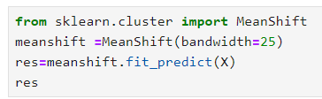
Mean Shift Clustering
A sliding-window based clustering algorithm
Non-parametric, non-hierarchical clustering
No fixed number of clusters
Robust to noise and outliers
Algorithm Steps
Initialize kernel bandwidth (h)
For each data point:
Calculate mean shift vector (direction of maximum density)
Update data point to new location (mean shift)
Repeat step 2 until convergence
Group points into clusters based on convergence points

Slide 12
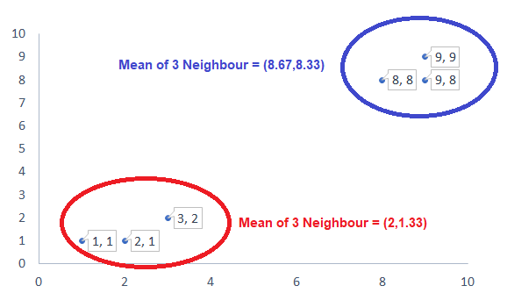
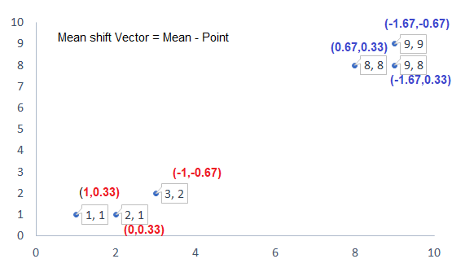
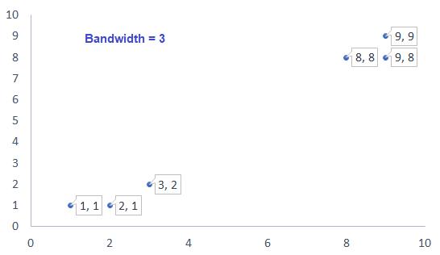
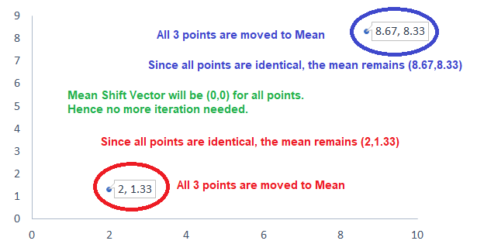
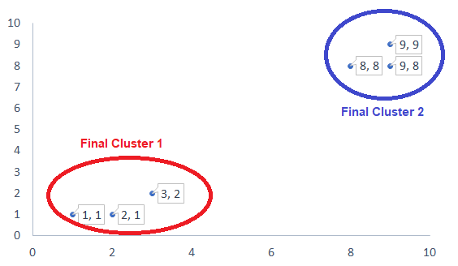
Mean Shift Clustering

Slide 13
Mean Shift Clustering
Advantages
No need to specify number of clusters
Robust to noise and outliers
Handles varying densities
Disadvantages
Computationally expensive (O(n^2) complexity)
Sensitive to bandwidth parameter
Can be slow for large datasets
Applications
Image segmentation
Object tracking
Customer segmentation
Gene expression analysis
Text clustering

Slide 14

Agglomerative Clustering
A bottom-up hierarchical clustering approach
Starts with individual data points as clusters
Merges closest clusters iteratively
Forms a tree-like structure (dendrogram)
Algorithm Steps
Initialize each data point as a separate cluster
Calculate pairwise distances between clusters
Merge the closest two clusters
Update distances between merged cluster and other clusters
Repeat steps 3-4 until desired number of clusters is reached

Slide 15
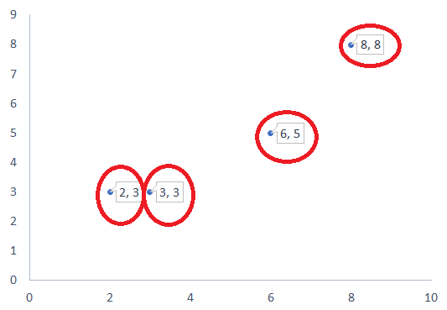
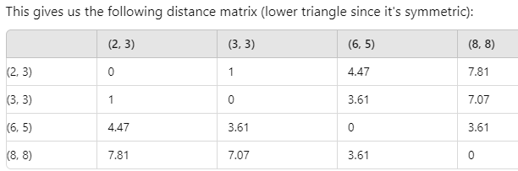
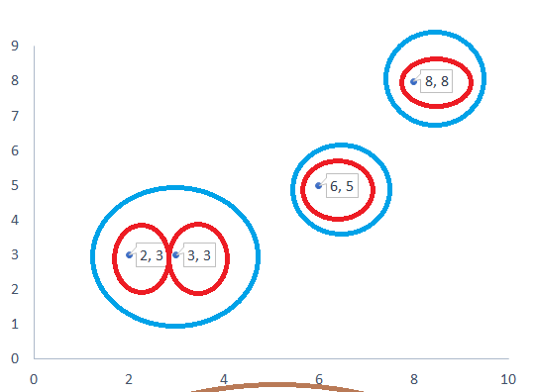
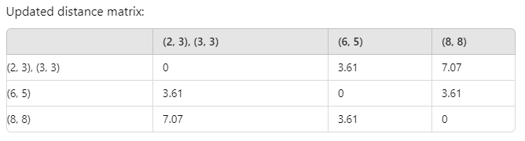
Agglomerative Clustering

Slide 16
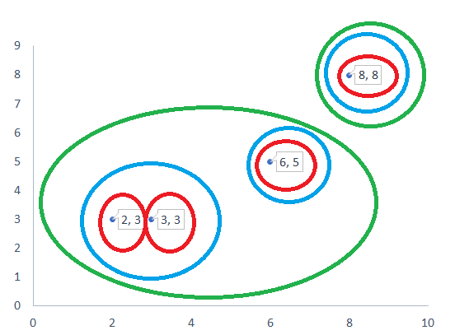
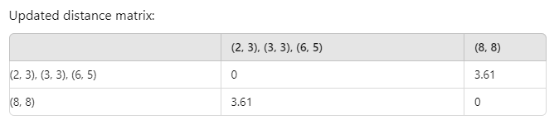
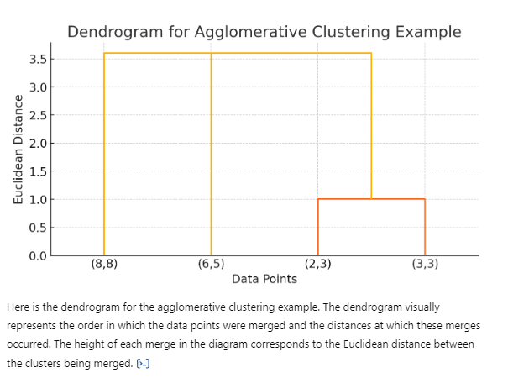
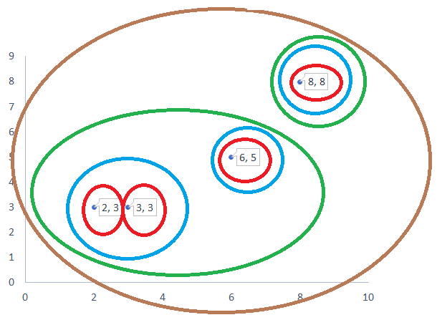
Agglomerative Clustering

Slide 17
Agglomerative Clustering
Advantages
Handles varying densities and outliers
Provides a hierarchical structure (dendrogram)
Easy to visualize and interpret
Disadvantages
Computationally expensive (O(n^2) complexity)
Difficult to choose optimal number of clusters- Sensitive to noise and outliers
Applications
Customer segmentation
Gene expression analysis
Image segmentation
Text clustering
Social network analysis

Slide 18
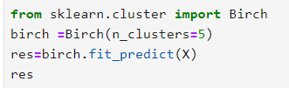
BIRCH Clustering
A hierarchical clustering algorithm for large datasets
Balanced Iterative Reducing and Clustering using Hierarchies
Balances computational efficiency and clustering quality
Uses a tree-like data structure (Clustering Feature (CF)-Tree)
Handles large datasets and noise
Algorithm Steps
Initialize CF-Tree with a single leaf node
Scan data points and insert into CF-Tree
If leaf node is full, split and create new leaf nodes
If tree height exceeds threshold, merge nodes
Repeat steps 2-4 until all data points are inserted
Perform clustering on leaf nodes

Slide 19
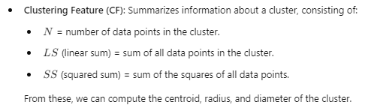
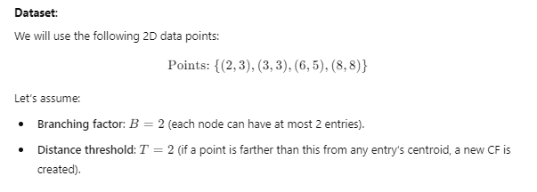
BIRCH Clustering

Slide 20
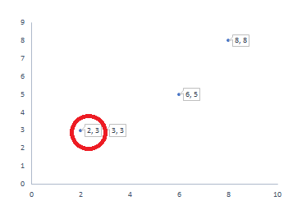

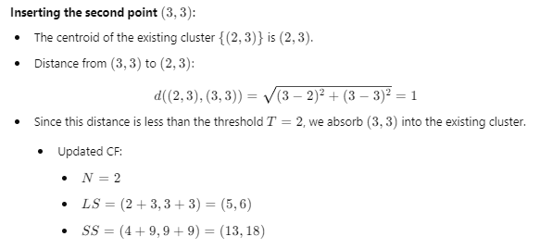
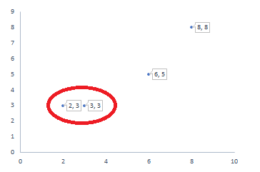
BIRCH Clustering
Root
CF1: (2,3)
N=1, LS=(2,3), SS=(4,9)
Root
CF1: (2,3) , (3,3)
N=2, LS=(5,6), SS=(13,18)

Slide 21
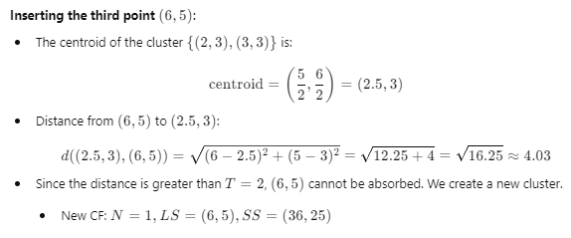
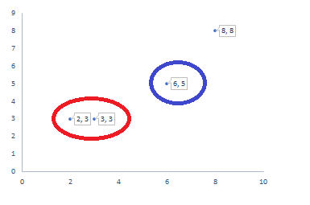
BIRCH Clustering
Root
CF1: (2,3) , (3,3)
N=2, LS=(5,6), SS=(13,18)
CF2: (6,5)
N=1, LS=(6,5), SS=(36,25)

Slide 22
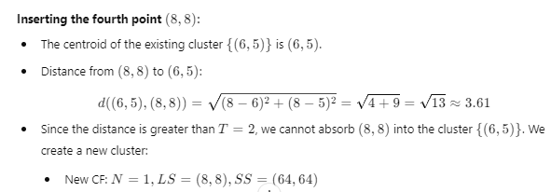
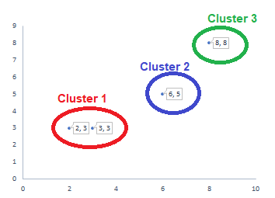
BIRCH Clustering
Root
CF1: (2,3) , (3,3)
N=2, LS=(5,6), SS=(13,18)
CF2: (6,5)
N=1, LS=(6,5), SS=(36,25)
CF3: (8,8)
N=1, LS=(8,8), SS=(64,64)

Slide 23
BIRCH Clustering
Advantages
Efficient for large datasets (O(n) complexity)
Handles noise and outliers
Robust to varying densities
Disadvantages
May not always find optimal clusters
Sensitive to threshold parameters
Can be slow for very high-dimensional data
Applications
Data mining
Customer segmentation
Image segmentation
Text clustering
Network analysis

Slide 24
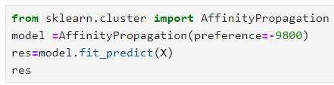
Affinity Propagation Clustering
A clustering algorithm based on message passing
Identifies exemplars (representative data points)
Clusters data points around exemplars
No need to specify number of clusters
Algorithm Steps
Initialize similarity matrix (S)
Calculate responsibility matrix (R)
Calculate availability matrix (A)
Update R and A matrices iteratively
Identify exemplars and clusters

Slide 25
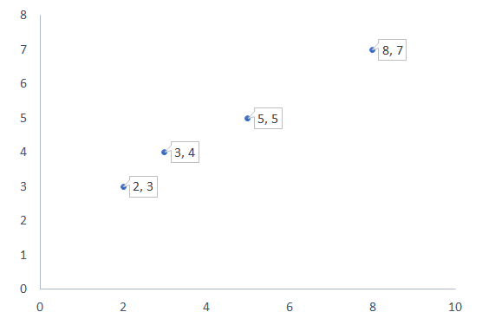

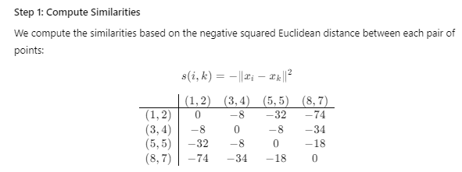
Affinity Propagation Clustering

Slide 26
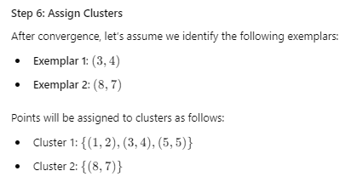
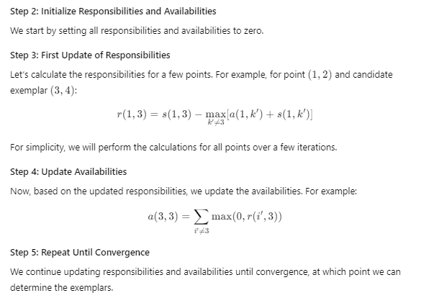
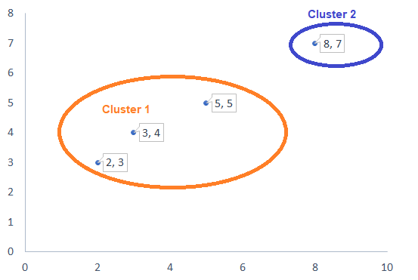
Affinity Propagation Clustering

Slide 27
Affinity Propagation Clustering
Advantages
No need to specify number of clusters
Robust to noise and outliers
Handles varying densities
Disadvantages
Computationally expensive (O(n^2) complexity)
Sensitive to damping factor parameter
Can be slow for large datasets
Applications
Image segmentation
Gene expression analysis
Customer segmentation
Text clustering
Recommendation systems

Slide 28
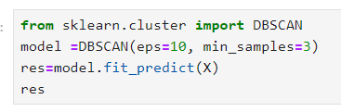
DBSCAN Clustering
A density-based clustering algorithm
Groups data points into clusters based on density
Identifies noise points
No need to specify number of clusters
Algorithm Steps
Initialize epsilon (ε) and minimum points (MinPts)
For each data point:
Find neighboring points within ε
If ≥ MinPts, mark as core point
Group core points into clusters
Assign non-core points to nearest cluster
Identify noise points

Slide 29
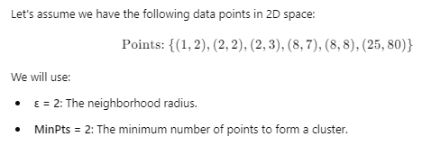
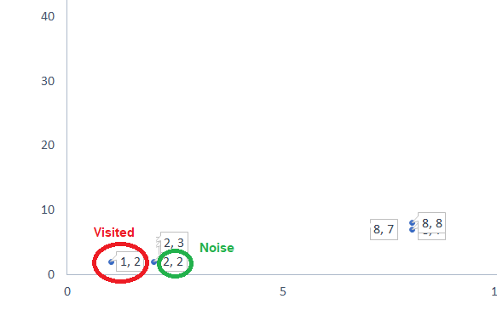
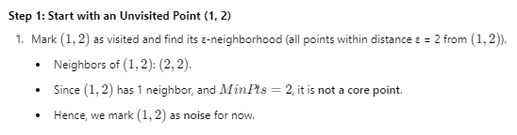
DBSCAN Clustering

Slide 30
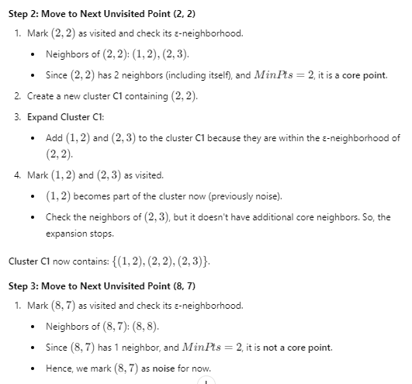
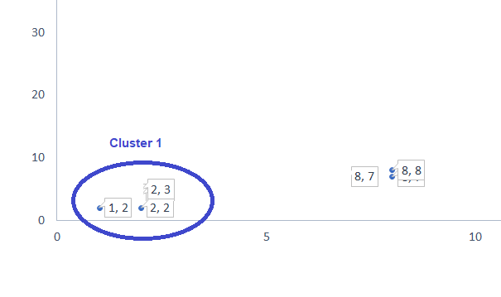
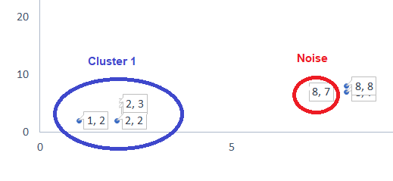
DBSCAN Clustering

Slide 31
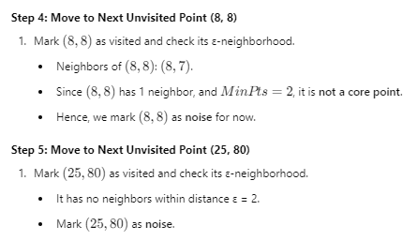
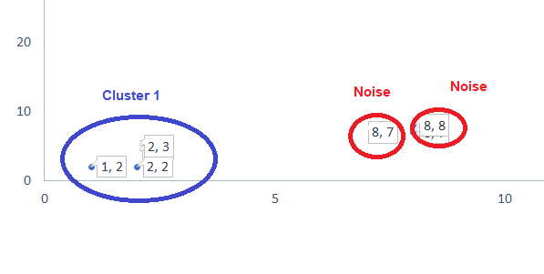
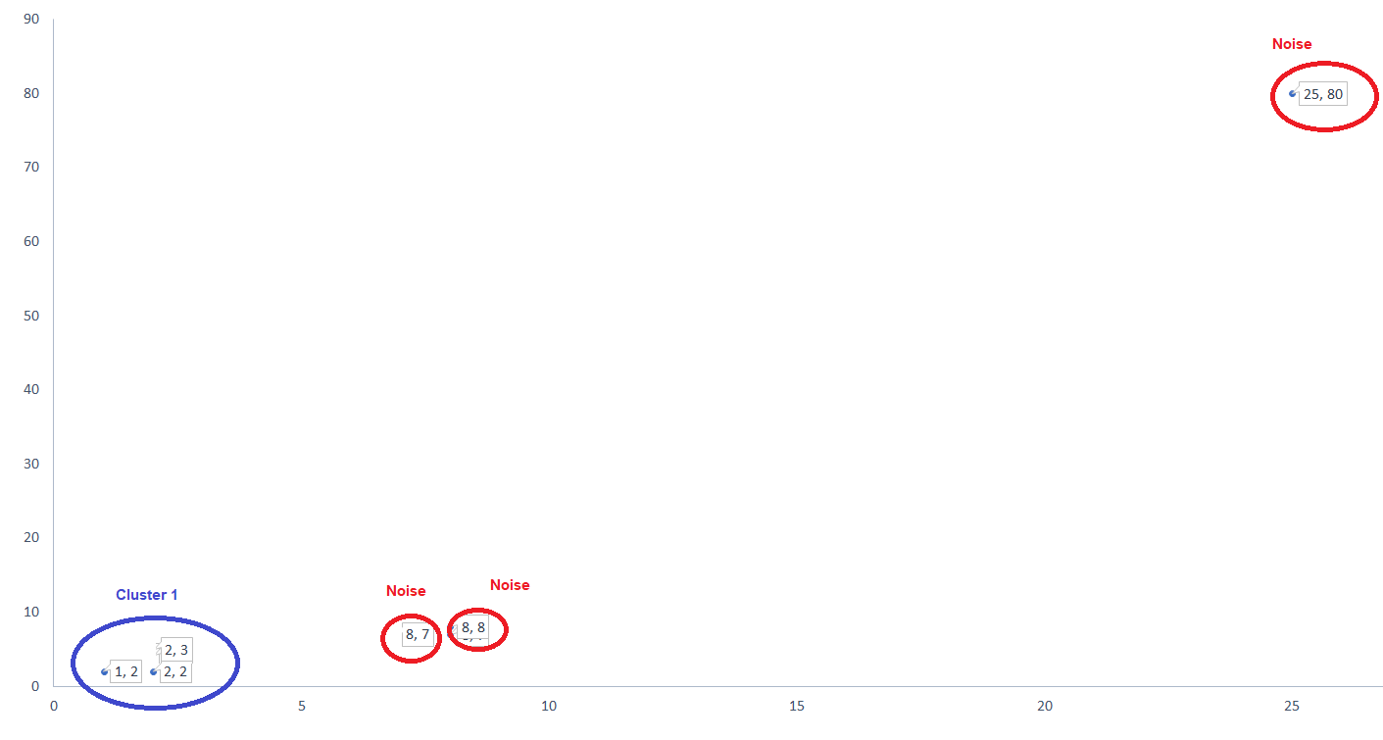

DBSCAN Clustering

Slide 32
DBSCAN Clustering
Advantages
Robust to noise and outliers
Handles varying densities
No need to specify number of clusters
Disadvantages
Sensitive to ε and MinPts parameters
Can be slow for large datasets
Difficulty in handling high-dimensional data
Applications
Spatial data analysis
Image segmentation
Gene expression analysis
Customer segmentation
Anomaly detection

Slide 33
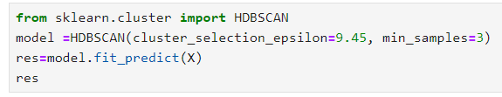
HDBSCAN Clustering
A hierarchical density-based clustering algorithm
Extends DBSCAN with hierarchical approach
Robust to varying densities and noise
No need to specify number of clusters
Algorithm Steps
Initialize minimum cluster size (min_cluster_size)
Calculate mutual reachability distance (mutual_reachability_distance)
Build minimum spanning tree (MST)
Identify clusters from MST
Refine clusters using hierarchical approach

Slide 34



HDBSCAN Clustering

Slide 35



HDBSCAN Clustering

Slide 36



HDBSCAN Clustering

Slide 37



HDBSCAN Clustering

Slide 38
HDBSCAN Clustering
Advantages
Robust to noise and outliers
Handles varying densities
No need to specify number of clusters
Provides hierarchical clustering
Disadvantages
Computationally expensive
Sensitive to min_cluster_size parameter
Difficulty in handling high-dimensional data
Applications
Image segmentation
Gene expression analysis
Customer segmentation
Text clustering
Anomaly detection

Slide 39

OPTICS Clustering
A density-based clustering algorithm
Ordering Points To Identify the Clustering Structure
Orders points based on density
Identifies clusters of varying densities
No need to specify number of clusters
Algorithm Steps
Initialize epsilon (ε) and minimum points (MinPts)
Calculate core distances and reachability distances
Build reachability graph
Identify clusters from reachability graph
Extract density-based clusters

Slide 40


OPTICS Clustering
Points: {(1,2),(2,3),(3,4),(8,8),(8,9),(25,30)}

Slide 41



OPTICS Clustering

Slide 42

OPTICS Clustering

Slide 43


OPTICS Clustering

Slide 44


OPTICS Clustering

Slide 45
OPTICS Clustering
Advantages
Robust to noise and outliers
Handles varying densities
No need to specify number of clusters
Provides hierarchical clustering
Disadvantages
Computationally expensive
Sensitive to ε and MinPts parameters
Difficulty in handling high-dimensional data
Applications
Image segmentation
Gene expression analysis
Customer segmentation
Text clustering
Anomaly detection

Slide 46

Spectral Clustering
A graph-based clustering algorithm
Uses eigenvectors of graph Laplacian
Clusters data points based on graph structure
Robust to noise and outliers
Algorithm Steps
Construct similarity graph (e.g., K-NN graph)
Calculate graph Laplacian (L)
Compute eigenvectors of L (v1, v2, ..., vk)
Normalize eigenvectors (u1, u2, ..., uk)
Cluster points based on eigenvectors (k-means)

Slide 47

Spectral Clustering
Points: {(1,2),(2,3),(3,4),(8,8),(8,9),(25,30)}

Slide 48

Spectral Clustering

Slide 49



Spectral Clustering

Slide 50



Spectral Clustering

Slide 51
Spectral Clustering
Advantages
Robust to noise and outliers
Handles non-linear relationships
Can handle high-dimensional data
Disadvantages
Computationally expensive
Sensitive to graph construction
Difficulty in choosing number of clusters (k)
Applications
Image segmentation
Gene expression analysis
Customer segmentation
Text clustering
Social network analysis

Slide 52
Machine Learning Clustering Algorithms
Youtube Link
https://youtu.be/oh_ERcST7mc?si=lOkOBzUTSv0JLv19

