Slide 1
Xg Boosting Regression

Slide 2
XgBoost Regression Algorithm
XGBoost stands for eXtreme Gradient Boosting
Developed by Tianqi Chen in 2016
An implementation of gradient boosted decision trees designed for speed and performance
Ensemble method that combines the predictions of several base estimators to improve robustness
Sequentially adds new models that correct errors made by previous models

Slide 3
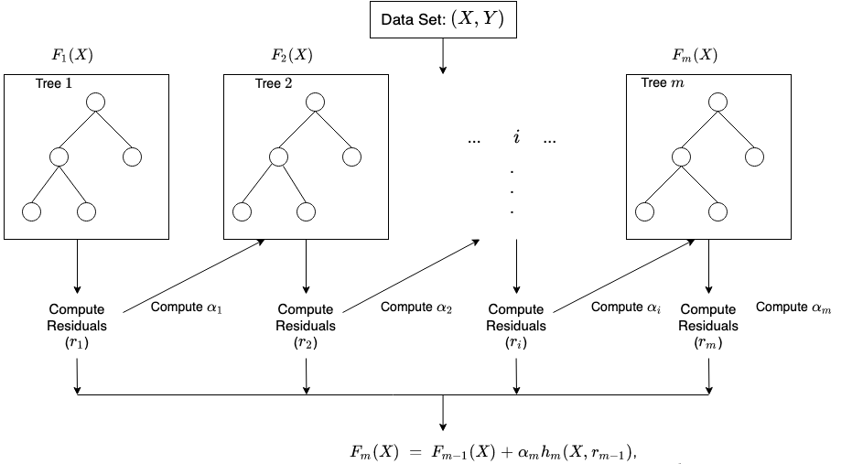
XgBoost Regression Algorithm

Slide 4
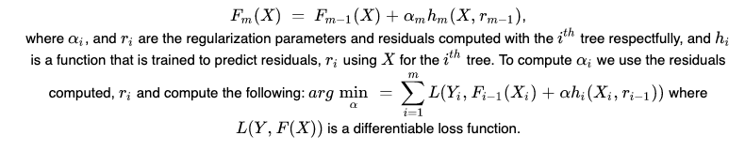
XgBosst Regression Algorithm

Slide 5

XgBoost Regression Algorithm
Create a single leaf tree.
For the first tree, compute the average of target variable as prediction and calculate the residuals using the desired loss function. For subsequent trees the residuals come from prediction made by previous tree.
Calculate the similarity score using the following formula: where, Hessian is equal to number of residuals; Gradient2 = squared sum of residuals; λ is a regularization hyperparameter.
Using similarity score we select the appropriate node. Higher the similarity score more the homogeneity.

Slide 6
XgBoost Regression Algorithm
Using similarity score we calculate Information gain. Information gain gives the difference between old similarity and new similarity and thus tells how much homogeneity is achieved by splitting the node at a given point. It is calculated using the following formula:
6. Create the tree of desired length using the above method. Pruning and regularization would be done by playing with the regularization hyperparameter.
7. Predict the residual values using the Decision Tree you constructed.
8. The new set of residuals is calculated using the following formula: where ρ is the learning rate.
9. Go back to step 1 and repeat the process for all the trees.

Slide 7
XGBoost Regression Algorithm
Pros
High Performance
Fast and efficient implementation
Parallel Processing
Efficiently handles missing data.
Flexibility.

Slide 8
XgBoost Regression Algorithm
Cons
complex algorithm and can be difficult to interpret
can be slow to train due to its many hyperparameters
can be memory intensive and is not suitable for low-end systems

Slide 9
XGBoost Regression Algorithm
Application
Used in Kaggle competitions for its superior performance
Applied in various domains such as finance (credit scoring, fraud detection), healthcare (disease prediction), marketing (customer segmentation), and more
Recognized for its accuracy and efficiency in both classification and regression tasks.

