Slide 1
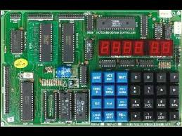
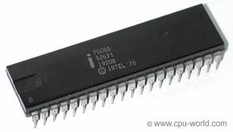
MICROPROCESSOR-8085 AND ITS WORKING
By Partha Pratim Dey

Slide 2
Content
Introduction
Features
Pin Configuration
Architecture 0f 8085
The 8085 Bus Structure
8085 Interrupts

Slide 3
Introduction
Microprocessor is a Central Processing Unit (CPU) etched on a single chip. A single Integrated Circuit (IC) has all the functional components of a CPU namely Arithmetic Logic Unit (ALU), Control Unit and registers. The 8085 microprocessor is an 8-bit processor that includes on its chip most of the logic circuitry for performing computing tasks and for communicating with peripherals.

Slide 4
Features
8 bit microprocessor(8085 microprocessor can read or write or perform arithmetic and logical operations on 8-bit data at time)
It has 8 data lines and 16 address lines hence capacity is 216 = 64 kB of memory
Cock frequency is 3 MHz
It requires +5V power supply.
It provides 5 hardware interrupt and 8 so ftware interrupts.

Slide 5
Pin Configuration
40 pins classified into
6 groups:
Data bus
Address bus
Control & status lines
Externally generated
Serial interface
Power supply & clock

Slide 6
Pin Configuration cont…
1) Address Bus (A15-A8 and AD7-AD0):
The microprocessor 8085 has 16 bit address lines from A15-A8 and AD7-AD0. These lines are used to transfer 16 bit address of memory as well as 8-bit address of I/O ports.
2) Data Bus:
The lower 8 lines (AD7-AD0) are often called as multiplexed data lines.

Slide 7
CONTROL LINES
RD : Read: This is active low signal which indicates that the selected I/O or memory device is to be read and also is available on the data bus.
WR : Write: This is active low signal which indicates that the data on data bus are to be written into a selected memory location.
IO/ M : (Input / Output / Memory): This is used to select either Input / Output devices or memory operation. When it is high it indicates an I/O operation and when it is low, it indicates a memory operation.
STATUS LINES
Status Pins (S1, S0): The microprocessor 8085 has two status pins as S1, S0 which is used to indicate the status of microprocessor or operation which is performed by microprocessor.

Slide 8
SPECIAL SIGNAL
ALE (Address Latch Enable): The ALE signal is used to enable or disable the external latch IC (74373/8212).
The external latch IC is used for the de-multiplexing of AD7-AD0 lines, i.e., it is used to separate the address and data from AD7-AD0 lines.
If ALE = 1/0 then external latch IC is enabled / disabled respectively.

Slide 9
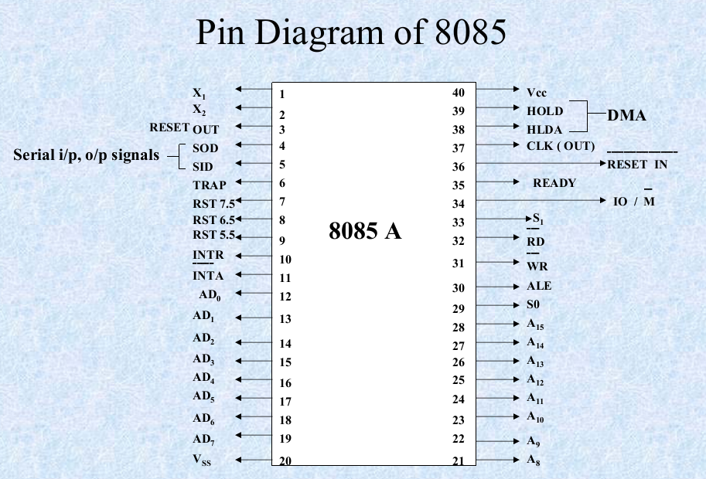

Slide 10
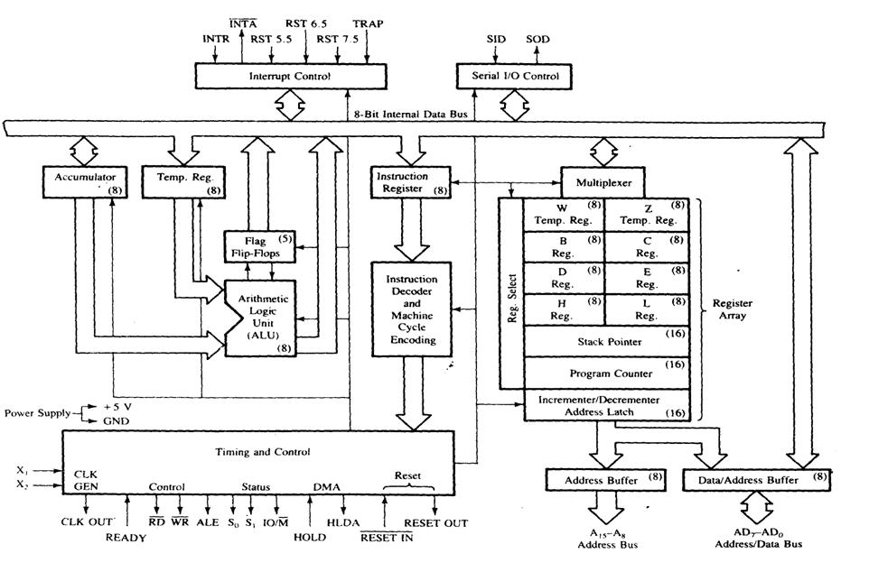

Slide 11
Architecture 0f 8085
8. Interrupt Control
9.Serial I/O Control
10.Address Bus
11. Data Bus
ALU
Timing and Control Unit
General Purpose Registers
Program Status word
Program Counter
Stack Pointer
Instruction Register and Decoder

Slide 12
REGISTERS
The Registers are of 8-bit & 16-bit size used for different purposes
A- Accumulator – This is an special purpose register. All the ALU operations are performed with reference to the contents of Accumulator.
B,C,D,E,H,L – General purpose registers. These registers can also used for 16-bit operations in pairs. The default pairs are BC, DE & HL.

Slide 13

F – Flag register – This register indicates the status of the ALU operation.
PC – Program Counter – This is a 16-bit register used to address the memory location from where an instruction is going to be executed.

Slide 14
SP – Stack pointer - This is a 16-bit register used to address the top of the stack memory location.
Temporary register, W & Z – These registers are only used by 8085 and are not available for the programmer.

Slide 15
ALU – Arithmetic & Logic Unit
ALU of 8085 performs 8-bit arithmetic & logical operations. The operations are generally performed with Accumulator as one of the operands. The result is saved in accumulator register.
Timing & Control Unit
This unit works as the brain of the CPU and generates all the timing and control signals to perform all the internal & external operations of the CPU.
Instruction Decoder & Machine Cycle Encoder Unit
This unit decodes the op-code stored in the Instruction Register (IR) and encodes it for the timing & control unit to perform the execution of the instruction.

Slide 16
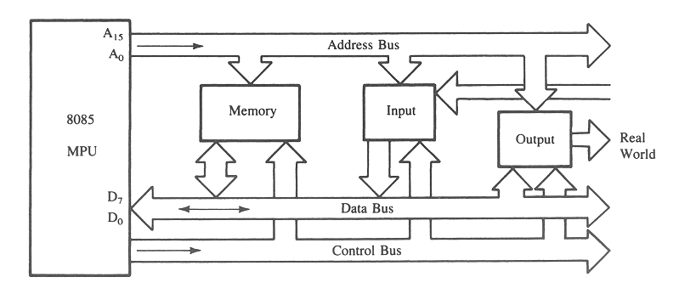
The 8085 Bus Structure
The 8-bit 8085 CPU (or MPU – Micro Processing Unit) communicates with the other units using a 16-bit address bus, an 8-bit data bus and a control bus.

Slide 17
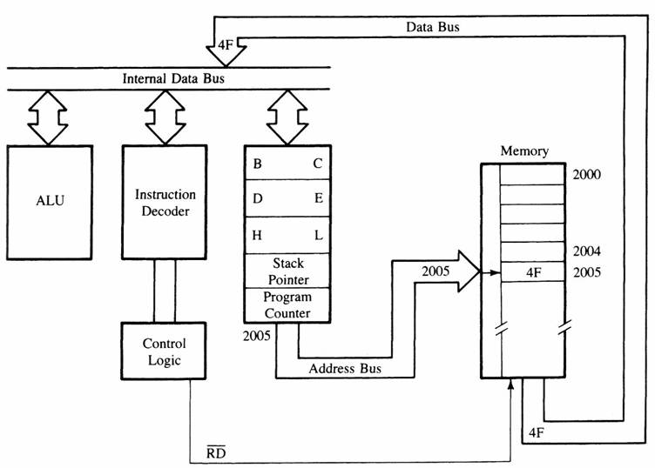
MPU Communication and Bus Timing

Slide 18
8085 Interrupts
Vector interrupt − In this type of interrupt, the interrupt address is known to the processor. For example: RST7.5, RST6.5, RST5.5, TRAP.
Non-Vector interrupt − In this type of interrupt, the interrupt address is not known to the processor so, the interrupt address needs to be sent externally by the device to perform interrupts. For example: INTR.
Maskable interrupt − In this type of interrupt, we can disable the interrupt by writing some instructions into the program. For example: RST7.5, RST6.5, RST5.5.
Non-Maskable interrupt − In this type of interrupt, we cannot disable the interrupt by writing some instructions into the program. For example: TRAP.
Software interrupt − In this type of interrupt, the programmer has to add the instructions into the program to execute the interrupt. There are 8 software interrupts in 8085, i.e. RST0, RST1, RST2, RST3, RST4, RST5, RST6, and RST7.
Hardware interrupt − There are 5 interrupt pins in 8085 used as hardware interrupts, i.e. TRAP, RST7.5, RST6.5, RST5.5, INTA.

Slide 19


