Slide 1
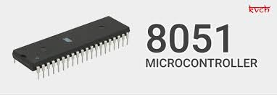
MICROCONTROLLER-8051AND ITS WORKING
By Partha Pratim Dey

Slide 2
CONTENT
INTRODUCTION
DIFFERENCE BETWEEN MC AND MP
TYPES OF MICROCONTROLLERS
ARCHITECTURE OF 8051
PIN DIAGRAM AND DETAILS
INTERRUPTS OF 8085
APPLICATON

Slide 3
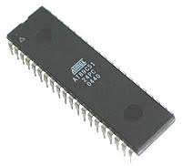
INTRODUCTION
A microcontroller is a small and low-cost microcomputer, which is designed to perform the specific tasks of embedded systems like displaying microwave’s information, receiving remote signals, etc.
The general microcontroller consists of the processor, the memory (RAM, ROM, EPROM), Serial ports, peripherals (timers, counters), etc.

Slide 4
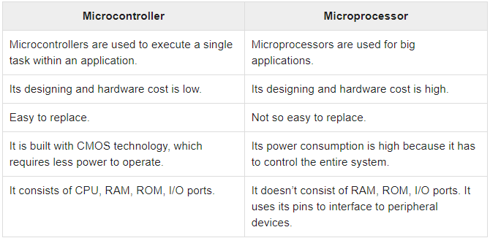
DIFFERENCE BETWEEN MP & MC

Slide 5
TYPES OF MICROCONTROLLERS
Microcontrollers are divided into various categories based on
Bits
Memory
Instruction Set

Slide 6
Based on Bits
8-bit microcontroller − This type of microcontroller is used to execute arithmetic and logical operations like addition, subtraction, multiplication division, etc. For example, Intel 8031 and 8051 are 8 bits microcontroller.
16-bit microcontroller − This type of microcontroller is used to perform arithmetic and logical operations where higher accuracy and performance is required. For example, Intel 8096 is a 16-bit microcontroller.
32-bit microcontroller − This type of microcontroller is generally used in automatically controlled appliances like automatic operational machines, medical appliances, etc.

Slide 7
Based on Memory
External memory microcontroller − This type of microcontroller is designed in such a way that they do not have a program memory on the chip. Hence, it is named as external memory microcontroller. For example: Intel 8031 microcontroller.
Embedded memory microcontroller − This type of microcontroller is designed in such a way that the microcontroller has all programs and data memory, counters and timers, interrupts, I/O ports are embedded on the chip. For example: Intel 8051 microcontroller.

Slide 8
Based on Instruction Set
CISC − CISC stands for complex instruction set computer. It allows the user to insert a single instruction as an alternative to many simple instructions.
RISC − RISC stands for Reduced Instruction Set Computers. It reduces the operational time by shortening the clock cycle per instruction.

Slide 9
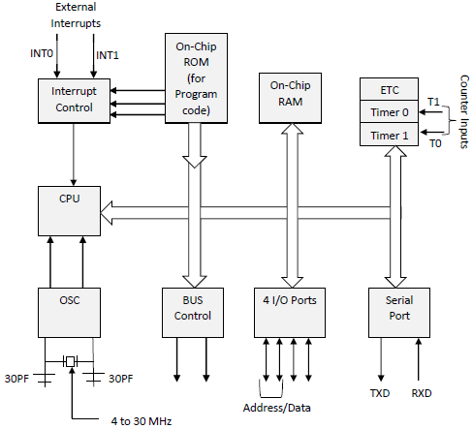
ARCHITECTURE OF 8051

Slide 10
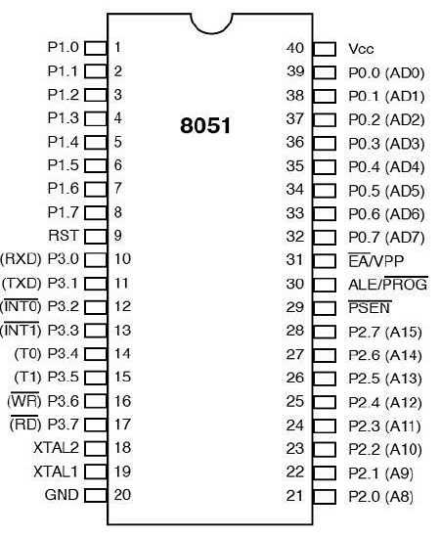
PIN DIAGRAM AND DETAILS

Slide 11
Pins 1 to 8 − These pins are known as Port 1. This port doesn’t serve any other functions. It is internally pulled up, bi-directional I/O port.
Pin 9 − It is a RESET pin, which is used to reset the microcontroller to its initial values.
Pins 10 to 17 − These pins are known as Port 3. This port serves some functions like interrupts, timer input, control signals, serial communication signals RxD and TxD, etc.
Pins 18 & 19 − These pins are used for interfacing an external crystal to get the system clock.
Pin 20 − This pin provides the power supply to the circuit.
Pins 21 to 28 − These pins are known as Port 2. It serves as I/O port. Higher order address bus signals are also multiplexed using this port.
Pin 29 − This is PSEN pin which stands for Program Store Enable. It is used to read a signal from the external program memory.
Pin 30 − This is EA pin which stands for External Access input. It is used to enable/disable the external memory interfacing.

Slide 12
Pin 31 − This is ALE pin which stands for Address Latch Enable. It is used to demultiplex the address-data signal of port.
Pins 32 to 39 − These pins are known as Port 0. It serves as I/O port. Lower order address and data bus signals are multiplexed using this port.
Pin 40 − This pin is used to provide power supply to the circuit.

Slide 13
INTERRUPTS OF 8085
Interrupts are the events that temporarily suspend the main program, pass the control to the external sources and execute their task. It then passes the control to the main program where it had left off.
8051 has 5 interrupt signals, i.e. INT0, TFO, INT1, TF1, RI/TI.

Slide 14
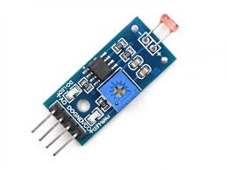
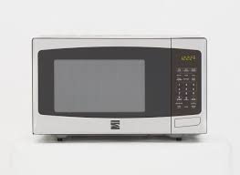
APPLICATION
Light sensing and controlling devices like LED.
Temperature sensing and controlling devices like microwave oven, chimneys.
Fire detection and safety devices like Fire alarm.
Measuring devices like Volt Meter.

Slide 15


