Slide 1
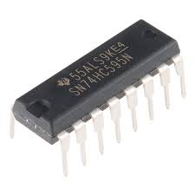
sequential CIRCUITS AND ITS APPLICATIONS IN INDUSTRY.
By Partha Pratim Dey

Slide 2
CONTENT
INTRODUCTION
TYPES OF SEQUENTIAL CIRCUIT
LATCH
SR LATCH
D LATCH
FLIP FLOP
SR FLIP FLOP
D FLIP FLOP
JK FLIP FLOP
T FLIP FLOP
APPLICATION OF SEQUENTIAL CIRCUIT
CONCLUSION

Slide 3
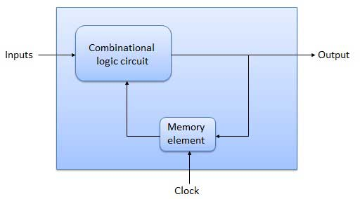
INTRODUCTION
The combinational circuit does not use any memory. Hence the previous state of input does not have any effect on the present state of the circuit.
But in sequential circuit has a memory element.
So, we can say a combinational circuit with memory element is known as “sequential circuit”.

Slide 4
TYPES OF SEQUENTIAL CIRCUIT
Synchronous – Output change at certain time, means depends on the clock.
Flip Flop
SR Flip Flop
JK Flip Flop
D Flip Flop
T Flip Flop
Asynchronous – Output change anytime
Latch
SR Latch
D Latch

Slide 5
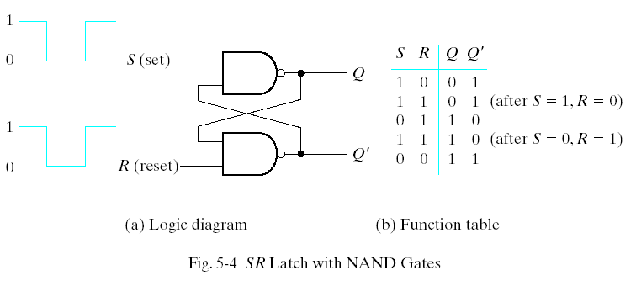
LATCH
Latches are basic storage elements that operate with signal levels.
SR Latch with NAND Gates:

Slide 6
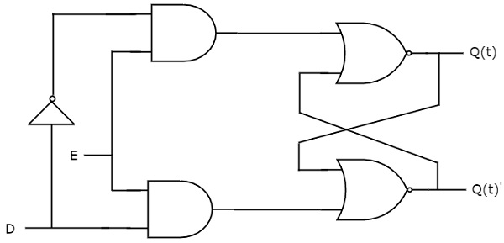
LATCH
D Latch:
S | Q(t+1)
0 | 0
1 | 1
State table
D | D` | Q | Q`
0 | 1 | 1 | 0
1 | 0 | 0 | 1
Circuit Diagram

Slide 7
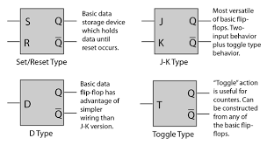
FLIP FLOP
Flip flop is a sequential circuit which generally samples its inputs and changes its outputs only at particular instants of time and not continuously. Flip flop is said to be edge sensitive or edge triggered.

Slide 8
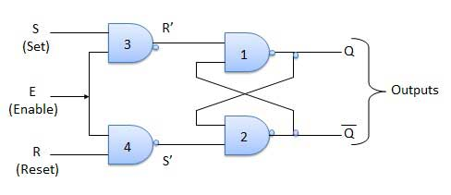
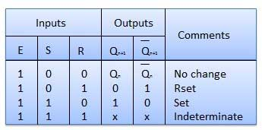
SR FLIP FLOP
It is basically S-R latch using NAND gates with an additional enable input. It is also called as level triggered SR-FF. For this, circuit in output will take place if and only if the enable input (E) is made active. In short this circuit will operate as an S-R latch if E = 1 but there is no change in the output if E = 0.
Truth Table
Circuit Diagram

Slide 9
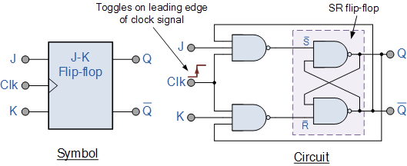
JK FLIP FLOP
In short to avoid the invalid state in SR flip flop JK flip flop is made.
Toggle – For simplicity “Toggle” means opposite of the previous sate.
Clk | J | K | Q | Q`
0 | X | X | Memory | Memory
1 | 0 | 0 | Memory | Memory
1 | 0 | 1 | 0 | 1
1 | 1 | 0 | 1 | 0
1 | 1 | 1 | Prv.st | Toggle
Circuit Diagram
Truth Table

Slide 10
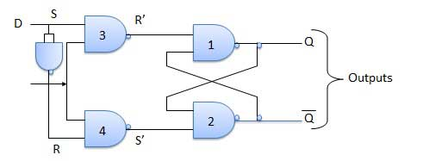
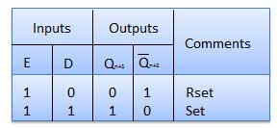
D FLIP FLOP
Delay Flip Flop or D Flip Flop is the simple gated S-R latch with a NAND inverter connected between S and R inputs. It has only one input. The input data is appearing at the output after some time. Due to this data delay between i/p and o/p, it is called delay flip flop.
Circuit Diagram
Truth Table

Slide 11
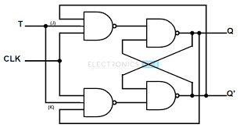
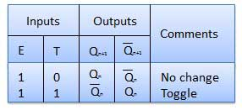
T FLIP FLOP
Toggle flip flop is basically a JK flip flop with J and K terminals permanently connected together.
Circuit Diagram
Truth Table

Slide 12
APPLICATION OF SEQUENTIAL CIRCUIT
Sequential Circuit (Combinational Circuit + Feedback ) "....I think without this , we can't imagine the DIGITAL WORLD.
Right from a simple mobile memory card to a bulky computer memory modules are the rock-solid example of Application of Seq. Circuit.
As a counter , shift register, flip-flops
As a memory unit.
As a programmable devices

Slide 13


