Slide 1
SOC DESIGN AND VERIFICATION
By Partha Pratim Dey

Slide 2
CONTENTS
INTRODUCTION
DIFFERENT FROM MICROCONTROLLER
AN SoC MADE UP OF
HOW SoC IS VERIFIED
CONCLUSION

Slide 3
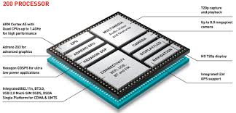
INTRODUCTION
A System on Chip(SoC) is an integrated circuit that integrates all components of computer or other electronics system. These components typically include a central processing unit, memory, input/output and secondary storage – all on a single microchip.

Slide 4
DIFFERENT FROM MICROCONTROLLER
A SoC integrates a microcontroller or microprocessor with advanced peripherals like graphics processing unit (GPU), Wi-Fi module, or one or more coprocessors. Similar to how a microcontroller integrates a microprocessor with peripheral circuits and memory.
On the other hand microcontrollers typically have under 100 kB of RAM (often just a few kilobytes) and often really are single-chip-systems, whereas the term SoC is typically used for more powerful processors, capable of running software such as the desktop versions of Windows and Linux, which need external memory chips (flash, RAM) to be useful, and which are used with various external peripherals.

Slide 5
AN SoC MADE UP OF
SoC
CPU
GPU
Northbridge
Southbridge
Other radios
(wifi, bluetooth etc)
Cellular radios
(4G lte)

Slide 6
HOW SoC IS VERIFIED ?
Verification of huge chips (> 80 mm2 in 28 nm!) with dozens of cores and hundreds of IP's is a mind-numbing task. So, you may wonder - how do these engineers do it ? Well, the answer is that no-one starts building from scratch. For instance, if some-one wanted to develop a C++ program, the best place to start would be from Qt, which is an application framework. In a similar way, SoC's are usually verified using legacy, flexible testbench structures that have been in use and improved upon over many years and have the ability to re-use a lot of the verification components. Such testbenches also have the flexibility to plug in Verification IP's (Intellectual Property) to aid in faster completion of projects. Such IP's are bought or licensed by these semiconductors firms and used in their testbench structures to verify specific design elements. An example would be Synopsys's AMBA VIPs, to verify AXI/AHB protocols used within the design.

Slide 7
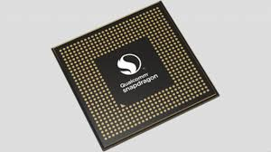
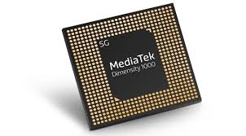
CONCLUSION
Because of SOC includes both the hardware and software, it uses less power, has better performance, requires less space and is more reliable than multi-chip systems. Most system-on-chips today come inside mobile devices like smartphones and tablets.

Slide 8


