Slide 1

Vlsi design flow
By Partha Pratim Dey

Slide 2
CONTENT
INTRODUCTION
DESIGN FLOW OF VLSI DESIGN
BRIEF DESCRIPTION OF EACH STAGES
System specification
Architectural Design
Functional Design
Logic design
Circuit Diagram
Physical Design
Fabrication
Packaging and Testing

Slide 3
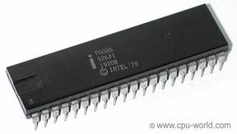
INTRODUCTION
Very-large-scale integration (VLSI) is the process of creating an integrated circuit (IC) by combining thousands of transistors into a single chip. VLSI began in the 1970s when complex semiconductor and communication technologies were being developed. The microprocessor is a VLSI device.

Slide 4
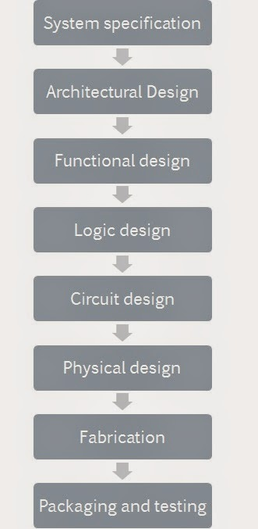
DESIGN FLOW OF VLSI DESIGN

Slide 5
SYSTEM SPECIFICATION
The first step of any design process is to lay down the specifications of the system. System specification is a high level representation of the system. The factors to be considered in this process include: performance, functionality, and physical dimensions (size of the die (chip)). The fabrication technology and design techniques are also considered.
The specification of a system is a compromise between market requirements, technology and economical viability. The end results are specifications for the size, speed, power, and functionality of the VLSI system.

Slide 6
ARCHITECTURAL design
The basic architecture of the system is designed in this step. This includes, such decisions as RISC (Reduced Instruction Set Computer) versus CISC (Complex Instruction Set Computer), number of ALUs, Floating Point units, number and structure of pipelines, and size of caches among others.
The outcome of architectural design is a Micro-Architectural Specification (MAS). While MAS is a textual (English like) description, architects can accurately predict the performance, power and die size of the design based on such a description.

Slide 7

Functional Design
In this step, main functional units of the system are identified. This also identifies the interconnect requirements between the units. The area, power, and other parameters of each unit are estimated.

Slide 8

Logic design
In this step the control flow, word widths, register allocation, arithmetic operations, and logic operations of the design that represent the functional design are derived and tested.

Slide 9

CIRCUIT DESIGN
The purpose of circuit design is to develop a circuit representation based on the logic design. The Boolean expressions are converted into a circuit representation by taking into consideration the speed and power requirements of the original design. Circuit Simulation is used to verify the correctness and timing of each component.

Slide 10

PHYSICAL DESIGN
In this step the circuit representation is converted into a geometric representation. As stated earlier, this geometric representation of a circuit is called a layout. Layout is created by converting each logic component (cells, macros, gates, transistors) into a geometric representation (specific shapes in multiple layers), which perform the intended logic function of the corresponding component. Connections between different components are also expressed as geometric patterns typically lines in multiple layers.

Slide 11
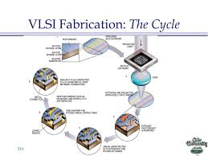
Fabrication
After layout and verification, the design is ready for fabrication. Since layout data is typically sent to fabrication on a tape, the event of release of data is called Tape Out. Layout data is converted (or fractured) into photo-lithographic masks, one for each layer. Masks identify spaces on the wafer, where certain materials need to be deposited, diffused or even removed. Silicon crystals are grown and sliced to produce wafers. Extremely small dimensions of VLSI devices require that the wafers be polished to near perfection. The fabrication process consists of several steps involving deposition, and diffusion of various materials on the wafer. During each step one mask is used. Several dozen masks may be used to complete the fabrication process.

Slide 12
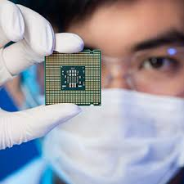
PACKAGING AND TESTING
Finally, the wafer is fabricated and diced into individual chips in a fabrication facility. Each chip is then packaged and tested to ensure that it meets all the design specifications and that it functions properly. Chips used in Printed Circuit Boards (PCBs) are packaged in Dual In-line Package (DIP), Pin Grid Array (PGA), Ball Grid Array (BGA), and Quad Flat Package (QFP). Chips used in Multi-Chip Modules (MCM) are not packaged, since MCMs use bare or naked chips.

Slide 13


