Slide 1
Java SIG
Introduction Java 8 with emphasis on lambda expressions and streams
Emiel Paasschens en Marcel Oldenkamp, 10 april 2014

Slide 2
Agenda
What's new in Java 8
Type annotations
Reflection
Compact profiles
New Date and Time API
Optional Class
Lambda expressies
Streams
Nashorn
Base64
No More Permanent Generation
Default methods on interfaces
Static methods on interfaces

Slide 3


What's New in JDK 8 Type annotations
Type Annotations are annotations that can be placed anywhere you use a type. This includes the new operator, type casts, implements clauses and throws clauses. Type Annotations allow improved analysis of Java code and can ensure even stronger type checking.
Java 8 only provides the ability to define these types of annotations. It is then up to framework and tool developers to actually make use of it.
Notes:
http://docs.oracle.com/javase/tutorial/java/annotations/type_annotations.html
http://java.dzone.com/articles/java-8-type-annotations

Slide 4
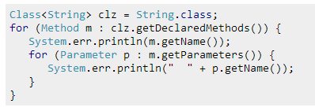
What's New in JDK 8 Method parameter reflection
Existing reflection methods
Get a reference to a Class
From the Class, get a reference to a Method by calling getDeclaredMethod() or getDeclaredMethods() which returns references to Method objects
New
From the Method object, call getParameters() which returns an array of Parameter objects
On the Parameter object, call getName()
Only works if code is compiled with -parameters compiler option
Notes:
http://stackoverflow.com/questions/21455403/how-to-get-method-parameter-names-in-java-8-using-reflection

Slide 5
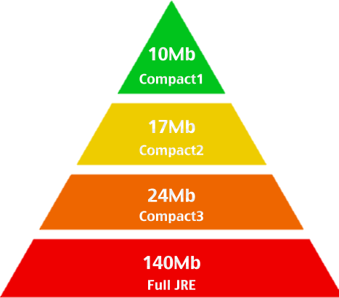
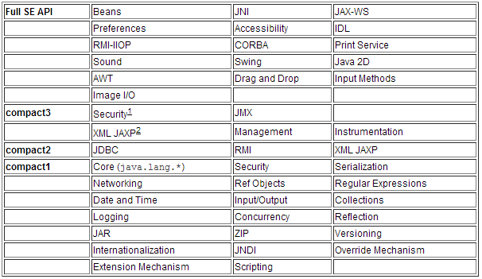
What's New in JDK 8 Compact profiles
Three Compact Profiles 1, 2, 3
contain predefined subsets of the Java SE platform
reduced memory footprint, allows applications to run on resource-constrained devices (mobile, wearable such as glass, watch )
compact profiles address API choices only; they are unrelated to the Java virtual machine (Jigsaw), the language, or tools.
Notes:
http://docs.oracle.com/javase/8/docs/technotes/guides/compactprofiles/compactprofiles.html
http://vitalflux.com/why-when-use-java-8-compact-profiles/

Slide 6
What's New in JDK 8 New Date and Time API
Java 8 introduces a new Date/Time API that is safer, easier to read, and more comprehensive than the previous API. Java’s Calendar implementation has not changed much since it was first introduced and Joda-Time is widely regarded as a better replacement. Java 8’s new Date/Time API is very similar to Joda-Time.
For example, define the time 8 hours from now:
Before Java 8:
Calendar cal = Calendar.getInstance(); cal.add(Calendar.HOUR, 8); cal.getTime(); // actually returns a Date
Java 8:
LocalTime now = LocalTime.now(); LocalTime later = now.plus(8, HOURS);
Notes:
https://leanpub.com/whatsnewinjava8/read#leanpub-auto-no-more-permanent-generation

Slide 7
What's New in JDK 8 Optional Class
Java 8 comes with the Optional class in the java.util package for avoiding null return values (and thus NullPointerException). It is very similar to Google Guava’s Optional and Scala’s Option class.
You can use Optional.of(x) to wrap a non-null value, Optional.empty() to represent a missing value, or Optional.ofNullable(x) to create an Optional from a reference that may or may not be null.
After creating an instance of Optional, you then use isPresent() to determine if there is a value and get() to get the value. Optional provides a few other helpful methods for dealing with missing values:
orElse(T) Returns the given default value if the Optional is empty.
orElseGet(Supplier<T>) Calls on the given Supplier to provide a value if the Optional is empty.
orElseThrow(Supplier<X extends Throwable>) Calls on the given Supplier for an exception to throw if the Optional is empty.
Notes:
https://leanpub.com/whatsnewinjava8/read#leanpub-auto-no-more-permanent-generation

Slide 8
What's New in JDK 8 Nashorn
Nashorn replaces Rhino as the default JavaScript engine for the Oracle JVM. Nashorn is much faster since it uses the invokedynamic feature of the JVM. It also includes a command line tool (jjs). You can run JavaScript files from the command line (java bin in your PATH):
$ jjs script.js
Running jjs with the -scripting option starts up an interactive shell: jjs> var date = new Date() jjs> print("${date}")
You can also run JavaScript dynamically from Java: ScriptEngineManager engineManager = new ScriptEngineManager(); ScriptEngine engine = engineManager.getEngineByName("nashorn"); engine.eval("function p(s) { print(s) }"); engine.eval("p('Hello Nashorn');"); engine.eval(new FileReader('library.js'));
Notes:
https://leanpub.com/whatsnewinjava8/read#leanpub-auto-no-more-permanent-generation

Slide 9
What's New in JDK 8 Base64
Until now, Java developers have had to rely on third-party libraries for encoding and decoding Base-64. Since it is such a frequent operation, a large project will typically contain several different implementations of Base64. For example: Apache commons-codec, Spring, and Guava all have separate implementations.
For this reason, Java 8 has java.util.Base64. It acts like a factory for Base64 encoders and decoders and has the following methods:
getEncoder()
getDecoder()
getUrlEncoder()
getUrlDecoder()
The URL Base-64 Encoder provides an encoding that is URL and Filename safe.
Notes:
https://leanpub.com/whatsnewinjava8/read#leanpub-auto-no-more-permanent-generation

Slide 10
What's New in JDK 8 No More Permanent Generation
Most allocations for the class metadata are now allocated out of native memory. This means that you won’t have to set the “XX:PermSize” options anymore (they don’t exist).
This also means that you will get a
java.lang.OutOfMemoryError: Metadata space
error message instead of
java.lang.OutOfMemoryError: Permgen space
when you run out of memory.
This is part of the convergence of the Oracle JRockit and HotSpot JVMs.
The proposed implementation will allocate class meta-data in native memory and move interned Strings and class statics to the Java heap. [http://openjdk.java.net/jeps/122]
Notes:
https://leanpub.com/whatsnewinjava8/read#leanpub-auto-no-more-permanent-generation

Slide 11
What's New in JDK 8 Default methods on interfaces
Default methods can be added to any interface. Like the name implies, any class that implements the interface but does not override the method will get the default implementation.
interface Bar { default void talk() { System.out.println("Bar!"); } }
class MyBar implements Bar { }
MyBar myBar = new MyBar(); myBar.talk();
Notes:
https://leanpub.com/whatsnewinjava8/read#leanpub-auto-no-more-permanent-generation

Slide 12
What's New in JDK 8 Default methods on interfaces
With a multiple inherited default method, you have to implement! interface Foo { default void talk() { System.out.println("Foo!"); } }
interface Bar { default void talk() { System.out.println("Bar!"); } }
class FooBar implements Foo, Bar { @Override void talk() { Foo.super.talk(); } }
Notes:
https://leanpub.com/whatsnewinjava8/read#leanpub-auto-no-more-permanent-generation

Slide 13
What's New in JDK 8 Static methods on interfaces
The ability to add static methods to interfaces is a similar change to the Java language:
This makes “helper” methods easier to find since they can be located directly on the interface, instead of a different class such as StreamUtil or Streams.
Here’s an example in the new Stream interface:
public static<T> Stream<T> of(T... values) {
return Arrays.stream(values);
}
Notes:
https://leanpub.com/whatsnewinjava8/read#leanpub-auto-no-more-permanent-generation

Slide 14
What's New in JDK 8 Others
JDK 8 includes Java DB 10.10 (Apache Derby open source database)
The Java SE 8 release contains Java API for XML Processing (JAXP) 1.6
http://www.oracle.com/technetwork/java/javase/8-whats-new-2157071.html
Notes:
http://www.oracle.com/technetwork/java/javase/8-whats-new-2157071.html

Slide 15
Lambda Expressions
Lambda Expressions
A new language feature.
Enable you to treat functionality as a method argument, or code as data.
Lambda expressions let you express instances of single-method interfaces (referred to as functional interfaces) more compactly.

Slide 16
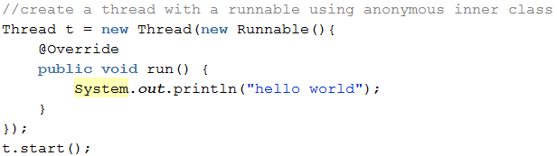
Lambda Expressions
What is a Lambda Expression?
A lambda expression is an anonymous function. See it as a method without a declaration. (no access modifier, return value declaration, and name)
‘functional expression treated as a variable’ .
Ability to pass “functionality” as an argument, previous only possible using inner class.
Notes:
http://viralpatel.net/blogs/lambda-expressions-java-tutorial/

Slide 17
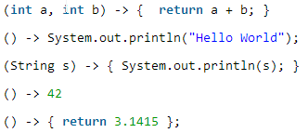
Lambda Expressions
What is a Lambda Expression?
A lambda expression is an anonymous function. See it as a method without a declaration. (no access modifier, return value declaration, and name)
‘functional expression treated as a variable’ .
Ability to pass “functionality” as an argument, previous only possible using inner class.
Why do we need lambda expressions?
Convenience. Write a method in the same place you are going to use it.
In the ‘old days’ Functions where not important for Java. On their own they cannot live in Java world. Lambda Expressions makes a Function a first class citizen, they exists on their own.
They make it easier to distribute processing of collections over multiple threads.
How do we define a lambda expression?
(Parameters) -> { Executed code }
Notes:
http://viralpatel.net/blogs/lambda-expressions-java-tutorial/

Slide 18
Structure of Lambda Expressions
A lambda expression can have zero, one or more parameters.
The type of the parameters can be explicitly declared or it can be inferred from the context. is same as just
Parameters are enclosed in parentheses and separated by commas.
When there is a single parameter, parentheses are not mandatory
The body of the lambda expressions can contain zero, one or more statements.
If body of lambda expression has single statement curly brackets are not mandatory and the return type of the anonymous function is the same as that of the body expression.
When there is more than one statement in body than these must be enclosed in curly brackets (a code block) and the return type of the anonymous function is the same as the type of the value returned within the code block, or void if nothing is returned.
or
or

Slide 19
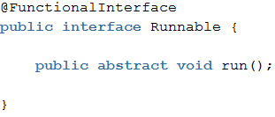
Functional Interface
Functional Interface is an interface with just one abstract method declared in it.
(so the interface may have other default and static methods)
Indicated by the informative annotation @FunctionalInterface
(the compiler will give an error if there are more abstract methods)
java.lang.Runnable is an example of a Functional Interface. There is only one method void run().
Other examples are Comparator and ActionListener.
Notes:
http://www.stoyanr.com/2012/12/devoxx-2012-java-8-lambda-and.html

Slide 20
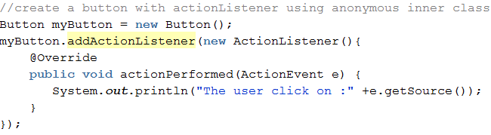
Functional Interface – ‘the old way’
Functional Interface is an interface with just one abstract method declared in it.
Example of assigning ‘on the fly’ functionality (the old way)
Notes:
http://www.stoyanr.com/2012/12/devoxx-2012-java-8-lambda-and.html

Slide 21
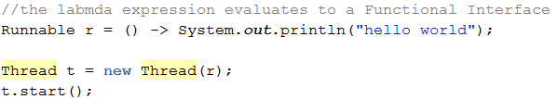
Functional Interface example Runnable using Lambda
Example of assigning ‘on the fly’ functionality (the new way)
A lambda expression evaluates to an instance of a functional interface
NEW:
OLD:

Slide 22
Functional Interface example Runnable using Lambda
Even shorter notation:

Slide 23
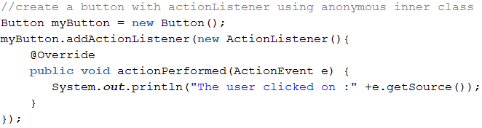
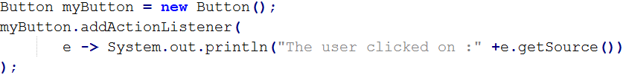
Functional Interface example ActionListener using Lambda
Example of a lambda expression with parameters
(functional interface actionlistener)
OLD:
NEW:

Slide 24
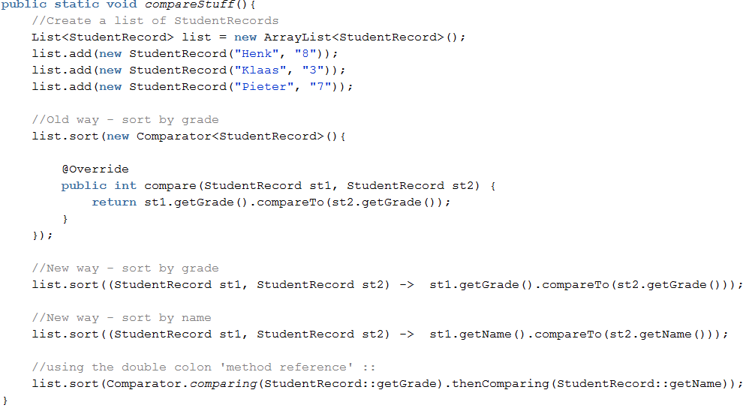
Comparable using Lambda

Slide 25
Predefined Functional Interfaces
Java 8 comes with several functional interfaces in package java.util.function:
Function<T,R> Takes an object of type T and returns R.
Supplier<T> Just returns an object of type T.
Predicate<T> Returns a boolean value based on input of type T.
Consumer<T> Performs an action with given object of type T.
BiFunction Like Function but with two parameters.
BiConsumer Like Consumer but with two parameters.
It also comes with several corresponding interfaces for primitive types, e.g:
IntFunction<R>
IntSupplier
IntPredicate
IntConsumer

Slide 26
Method References
Since a lambda expression is like a method without an object attached, wouldn’t it be nice if we could refer to existing methods instead of using a lamda expression? This is exactly what we can do with method references: public class FileFilters { public static boolean fileIsPdf(File file) {/*code*/} public static boolean fileIsTxt(File file) {/*code*/} public static boolean fileIsRtf(File file) {/*code*/} }
List<File> files = new LinkedList<>(getFiles()); files.stream().filter(FileFilters::fileIsRtf) .forEach(System.out::println);

Slide 27
Method References
Method references can point to:
Static methods (ie. previous slide).
Instance methods (ie. 2 below).
Methods on particular instances (ie. line 4 below).
Constructors (ie. TreeSet::new)
For example, using the new java.nio.file.Files.lines method:
1 Files.lines(Paths.get("Nio.java"))
2 .map(String::trim)
3 .filter(s -> !s.isEmpty())
4 .forEach(System.out::println);

Slide 28
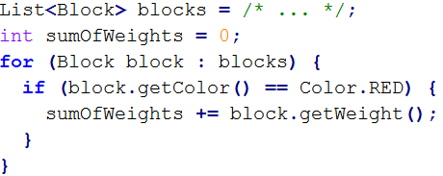
Collections - Streams
In Java <= 7 collections can only be manipulated through iterators
Verbose way of saying:
"the sum of the weights of the red blocks in a collection of blocks“
Programmer expresses how the computer should execute an algorithm
But, programmer is usually only interested in what the computer should calculate
To this end, other languages already provide what is sometimes called a pipes-and-filters-based API for collections.
Like linux: cat diagnostic.log | grep error | more
Notes:
http://blog.hartveld.com/2013/03/jdk-8-33-stream-api.html

Slide 29
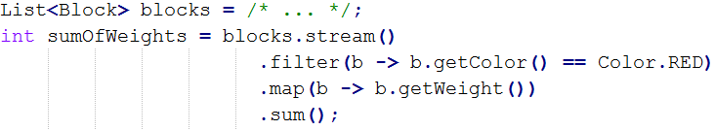
Collections - Streams
Java is extended with a similar API for its collections using filter and map, which take as argument a (lambda) expression.
Classes in the new java.util.stream package provide a Stream API to support functional-style operations on streams of elements.
The Stream API is integrated into the Collections API, which enables bulk operations on collections, such as sequential or parallel map-reduce transformations.
Notes:
http://blog.hartveld.com/2013/03/jdk-8-33-stream-api.html

Slide 30

Collections - Streams
Stream can be used only once!
Stream consists of:
One source
Zero or more intermediate operations (e.g. filter, map)
One terminal operation (forEach, reduce, sum)
Notes:
http://blog.hartveld.com/2013/03/jdk-8-33-stream-api.html

Slide 31
Collections - Streams
Some examples of sources:
From a Collection via the stream() and parallelStream() methods;
From an array via Arrays.stream(Object[]);
From static factory methods on the stream classes, such as Stream.of(Object[]), IntStream.range(int, int) or Stream.iterate(Object, UnaryOperator);
The lines of a file can be obtained from BufferedReader.lines();
Streams of file paths can be obtained from methods in Files;
Streams of random numbers can be obtained from Random.ints();
Numerous other stream-bearing methods in the JDK, including BitSet.stream(), Pattern.splitAsStream(java.lang.CharSequence), and JarFile.stream().
Notes:
http://blog.hartveld.com/2013/03/jdk-8-33-stream-api.html

Slide 32
Collections - Streams
Intermediate operations:
distinct() Remove all duplicate elements using equals method
filter(Predicate<T> predicate) Filters elements using predicate
limit(long maxSize) Truncates stream to first elements till maxSize (can be slow when parallel processing on ordered parallel pipelines)
map(Function<T,R> mapper) Map/convert object to other object
peek(Consumer<T> action) Apply given method on each element tip: useful for debugging: .peek(o -> System.out.println("o: " + o))
skip(long n) Remove first n element from Stream (can be slow when parallel processing on ordered parallel pipelines)
sorted(Comparator<T> comparator) Sort the stream with given Comparator
Notes:
http://blog.hartveld.com/2013/03/jdk-8-33-stream-api.html

Slide 33
Collections - Streams
Terminal operations:
boolean allMatch,anyMatch,noneMatch(Predicate<T> predicate)
long count() The count of all elements.
Optional<T> findAny() Return any element (or empty Optional)
Optional<T> findFirst() Return 1st element (or empty Optional)
Optional<T> min,max(Comparator<T> comparator) Return first or last element according to comparator
void forEach(Consumer<T> action) Performs action on each element
T reduce(T identity, BinaryOperator<T> accumulator)’Combine’ all elements T to one final result T. Sum, min, max, average, and string concatenation are all special cases of reduction, e.g. Integer sum = integers.reduce(0, (a, b) -> a+b); PS The methods sum() and average() are available on ‘specialized’ Streams IntStream, LongStream and DoubleStream
Notes:
http://blog.hartveld.com/2013/03/jdk-8-33-stream-api.html

Slide 34
Collections - Streams
Terminal operations:
collect(Supplier<R> supplier, BiConsumer<R,T> accumulator, BiConsumer<R,R> combiner) Performs operation accumulator on all elements of type T resulting into result R.
class Averager implements IntConsumer { private int total = 0; private int count = 0; public double average() { return count > 0 ? ((double) total)/count : 0; } public void accept(int i) { total += i; count++; } public void combine(Averager other) { total += other.total; count += other.count; } }
ages.collect(Averager::new, Averager::accept, Averager::combine);
Notes:
http://blog.hartveld.com/2013/03/jdk-8-33-stream-api.html

Slide 35
More information
More info
AMIS Blog:
http://technology.amis.nl/2013/10/03/java-8-the-road-to-lambda-expressions/
http://technology.amis.nl/2013/10/05/java-8-collection-enhancements-leveraging-lambda-expressions-or-how-java-emulates-sql/
Others:
https://leanpub.com/whatsnewinjava8/read#leanpub-auto-default-methods
http://docs.oracle.com/javase/tutorial/collections/streams/reduction.html
http://java.dzone.com/articles/why-we-need-lambda-expressions
http://viralpatel.net/blogs/lambda-expressions-java-tutorial/
http://www.angelikalanger.com/Lambdas/Lambdas.html
http://www.coreservlets.com/java-8-tutorial/#streams-2
http://java.dzone.com/articles/interface-default-methods-java

