Slide 1
IBM University Engagement Project Submission
“Exploring the Power of Agentic AI with IBM Watsonx”

Slide 2

Project Title – Eco Lifestyle Agent
Domain of Project – Environment & Sustainability
Student Name | Recent Passport Photo | Email ID | Mobile number [WhatsApp]
Sajina Sajimon
sajina.snsr@gmail.com
8848975334

Slide 3
Problem Statement -
Problem Statement : Eco Lifestyle Agent
The Challenge
Many people want to adopt sustainable lifestyles but lack access to reliable, practical, and personalized environmental guidance. Information on recycling, reducing plastic waste, eco-friendly products, sustainable travel, and government sustainability initiatives is often scattered across multiple sources.
Without easy-to-access guidance, individuals may struggle to make environmentally responsible decisions in their daily lives.
The Objective
Build an AI-powered Eco Lifestyle Agent that provides personalized sustainability recommendations and practical environmental guidance.
The solution should::
• Promote Eco-Friendly Habits — Encourage sustainable daily practices and environmentally conscious choices.
• Plastic Reduction Guidance – Help users reduce plastic consumption through practical alternatives.
• Water & Energy Conservation – Provide actionable recommendations for saving water and electricity.
• Sustainable Transportation – Suggest eco-friendly travel and transportation options.
• Eco-Friendly Product Recommendations – Recommend sustainable household and lifestyle products.
• Government Sustainability Schemes – Share information about sustainability-related initiatives and schemes.
• Knowledge-Based Sustainability Guidance – Retrieve and summarize information using a RAG-based knowledge base.

Slide 4
Technology Used
Tech Stack (Mandatory)
Use:
>IBM watsonx Orchestrate
>GPT-OSS 120B (via AWS Bedrock)
>IBM watsonx AI
>Retrieval-Augmented Generation (RAG)
>Exa MCP Tools
>Trafiklab OpenAPI
>Netlify
Deployment
I used IBM watsonx Orchestrate Agent + IBM watsonx AI + GPT-OSS 120B + RAG.

Slide 5
Proposed Solution -
Proposed Solution: AI-Powered Eco Lifestyle Agent
The proposed solution is an AI-powered Eco Lifestyle Agent built using IBM watsonx Orchestrate, IBM watsonx AI, GPT-OSS 120B, and Retrieval-Augmented Generation (RAG) to provide personalized sustainability guidance and environmentally responsible recommendations.
At its core, the solution uses a sustainability-focused knowledge base containing trusted environmental resources. The system retrieves relevant information and combines it with AI reasoning to generate accurate and actionable recommendations.
The system assists users with:
>Plastic Reduction Guidance – Provides practical alternatives to single-use plastics and encourages sustainable habits.
>Sustainable Travel Guidance – Suggests environmentally friendly transportation options and sustainable travel practices.
>Recycling & Waste Management – Helps users understand recycling methods, e-waste disposal, and waste segregation.
>Water & Energy Conservation – Recommends ways to reduce household water and electricity consumption.
>Eco-Friendly Product Suggestions – Recommends environmentally responsible products and alternatives.
>Government Sustainability Schemes – Shares information about sustainability-related initiatives when available.
The solution integrates Exa MCP tools for web information retrieval and Trafiklab APIs for transportation-related information. Overall, the system promotes sustainable living through practical recommendations, reliable information retrieval, and personalized environmental guidance.

Slide 6
Component Used -
IBM watsonx Orchestrate Components Used
1) Chat Interface – Interface where users enter sustainability-related questions and requests.
2) GPT-OSS 120B Model – Processes user input and generates personalized sustainability recommendations.
3) Knowledge Base – Stores and retrieves environmental knowledge from:
ECO_FRIENDLY.docx
Eco-Lifestyle.txt
4) Exa MCP Tools –
web_search_exa
web_fetch_exa
5) Trafiklab OpenAPI – Provides transportation-related information.
6) Agent Instructions – Controls sustainability-focused behavior and knowledge-base-first responses.
7) Web Deployment – Netlify-hosted user interface integrated with IBM watsonx Orchestrate.

Slide 7
Workflow -
Architecture blueprint
Workflow:
User Query
↓
IBM watsonx Orchestrate
↓
Knowledge Base Search
↓
Exa Web Search (if required)
↓
GPT-OSS 120B Processing
↓
Eco-Friendly Recommendation
↓
User Response
User
↓
Netlify Web Interface
↓
IBM watsonx Orchestrate
↓
GPT-OSS 120B
↓
Knowledge Base
↓
Exa MCP Tools
↓
Trafiklab API
↓
Personalized Sustainability Response

Slide 8
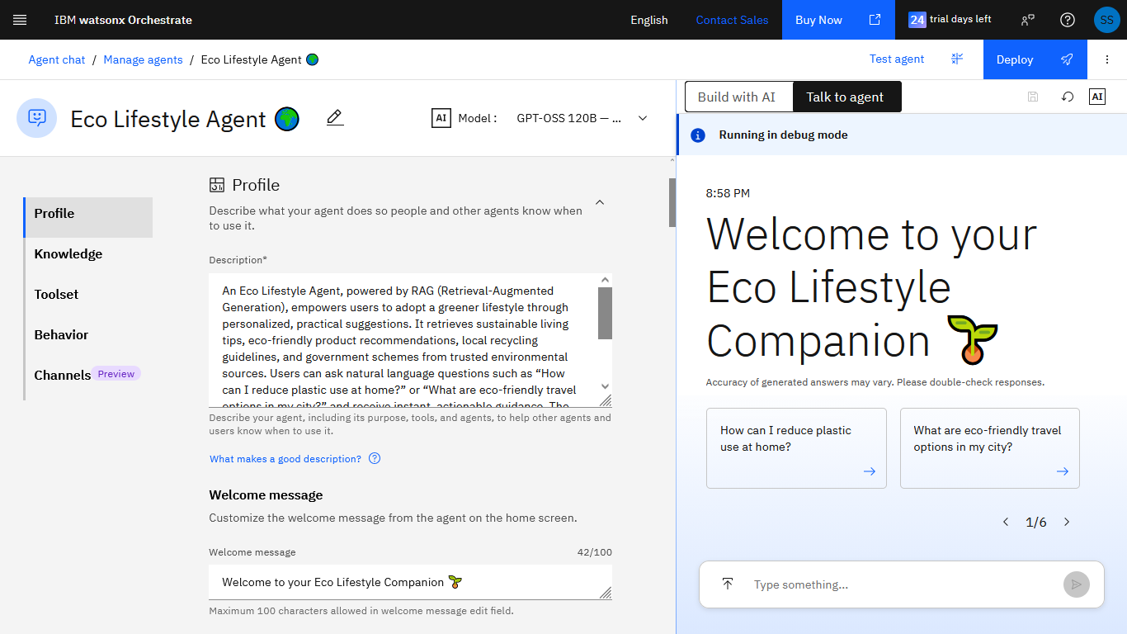
Screenshot of the Agent

Slide 9
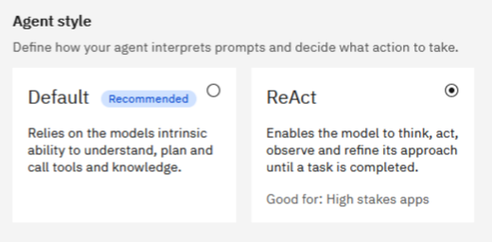
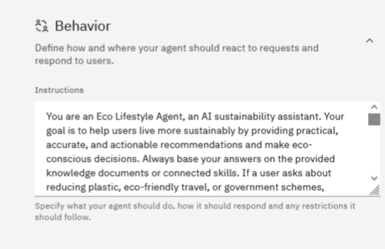
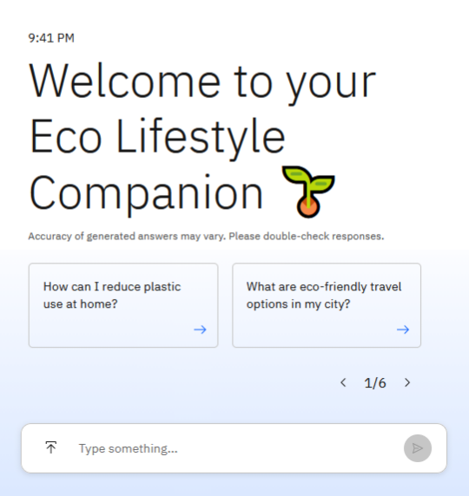
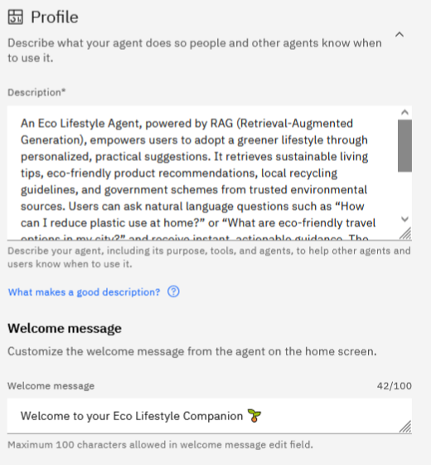
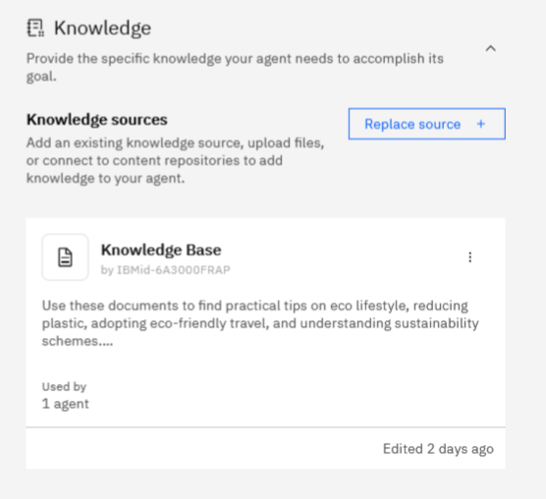
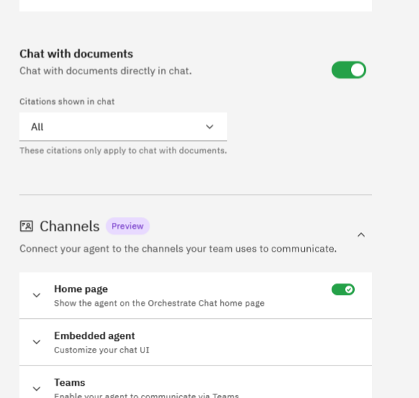
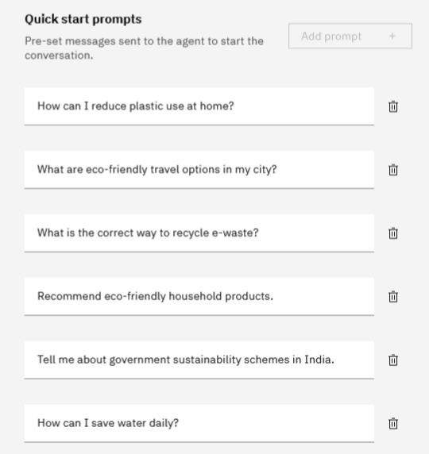
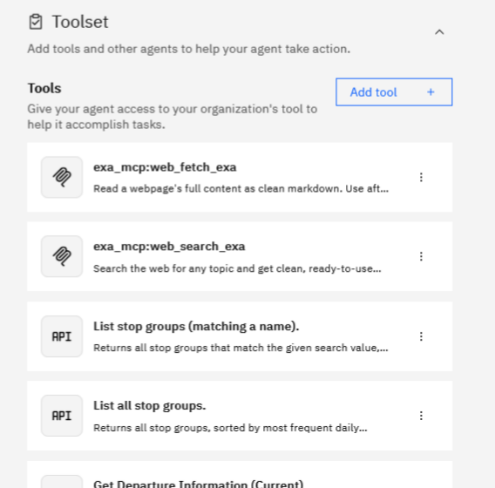
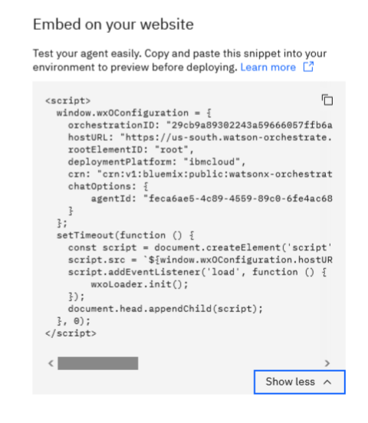
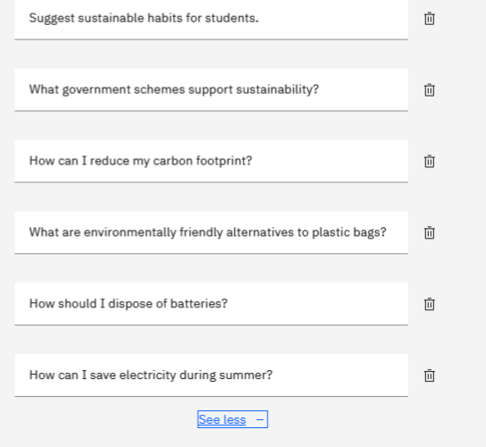
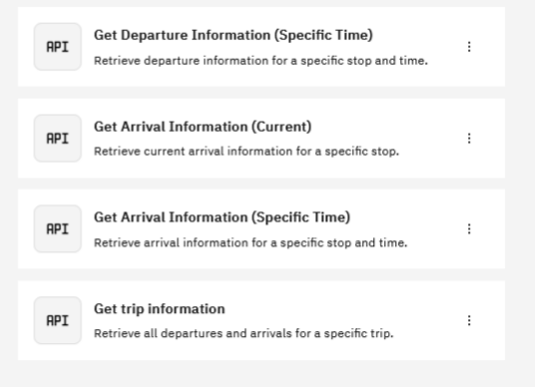

Slide 10

Role of Agentic AI in the solution
Role of Agentic AI in Eco Lifestyle Agent
Agentic AI enables the Eco Lifestyle Agent to function as an intelligent sustainability assistant rather than a traditional chatbot.
The agent can understand user intent, retrieve information from its environmental knowledge base, utilize connected tools when required, and generate personalized recommendations.
Agentic AI allows the system to:
>Understand sustainability-related questions
>Search the environmental knowledge base
>Retrieve relevant sustainability information
>Use external tools when necessary
>Generate personalized eco-friendly recommendations
>Adapt responses based on user context
This approach enables proactive, transparent, and reliable environmental guidance while encouraging sustainable decision-making and eco-conscious behavior.

Slide 11
Novelty and Uniqueness
The proposed Eco Lifestyle Agent combines Agentic AI, RAG, environmental knowledge retrieval, and personalized recommendations into a single intelligent sustainability platform.
>Knowledge-Grounded Sustainability Guidance – Uses RAG to provide accurate and reliable sustainability recommendations.
>Personalized Eco Recommendations – Tailors responses according to user needs and sustainability goals.
>Real-Time Information Retrieval – Uses Exa MCP tools to access current information when necessary.
>Transparent Information Usage – Clearly distinguishes retrieved knowledge from general sustainability advice.
>Practical Action-Oriented Responses – Encourages small daily actions that create meaningful environmental impact.
>Accessible Sustainability Education – Makes eco-friendly living easier through natural language interaction.
This makes the solution a practical, intelligent, and environmentally focused digital sustainability assistant.

Slide 12
Git Hub Link
Github URL
Repository URL:
https://github.com/iampixelbloom/Eco-Lifestyle-Agent
Live Demo
https://ecolifestyleagent.netlify.app/
·
·

Slide 13
Future Scope
Future Scope
1. Carbon Footprint Tracking
The system can estimate and monitor individual environmental impact, helping users understand how their daily choices affect sustainability goals.
2. Smart Home Integration
Integration with IoT devices can enable automated monitoring of energy and water consumption for more personalized sustainability recommendations.
3. Location-Based Sustainability Guidance
Provide local recycling information, environmental programs, and sustainability recommendations based on user location.
4. Personalized Sustainability Dashboard
Track eco-friendly habits, environmental impact, and sustainability progress over time.
5. Mobile Application
Develop a dedicated mobile application for easier accessibility and continuous engagement.
6. Multilingual Support
Support multiple languages to improve accessibility and reach a wider audience.
·
·
·

Slide 14


