Slide 1

Analyzing Food Delivery Data in R
BY- Piyush Doifode
Pathfinders
Isms

Slide 2
Overview of the project
The Problem
Food delivery platforms like Zomato, Swiggy, and Foodpanda generate massive amounts of operational data but struggle to answer key questions like:
Why are some deliveries rated poorly?
Does weather or traffic slow down deliveries?
Which cities or age groups of delivery personnel perform better?
When are peak ordering hours?
What the Project Does
It performs a full Exploratory Data Analysis (EDA) on a food delivery dataset covering variables like Delivery Person Age, Ratings, Order Date, Time Taken, and Weather Conditions. It goes through 5 stages — importing libraries, loading data, cleaning it, visualizing patterns, and drawing conclusions.
The project helps food delivery businesses optimize routes, manage delivery times, and improve customer satisfaction by understanding what operational factors actually drive performance — turning raw data into actionable decisions.

Slide 3
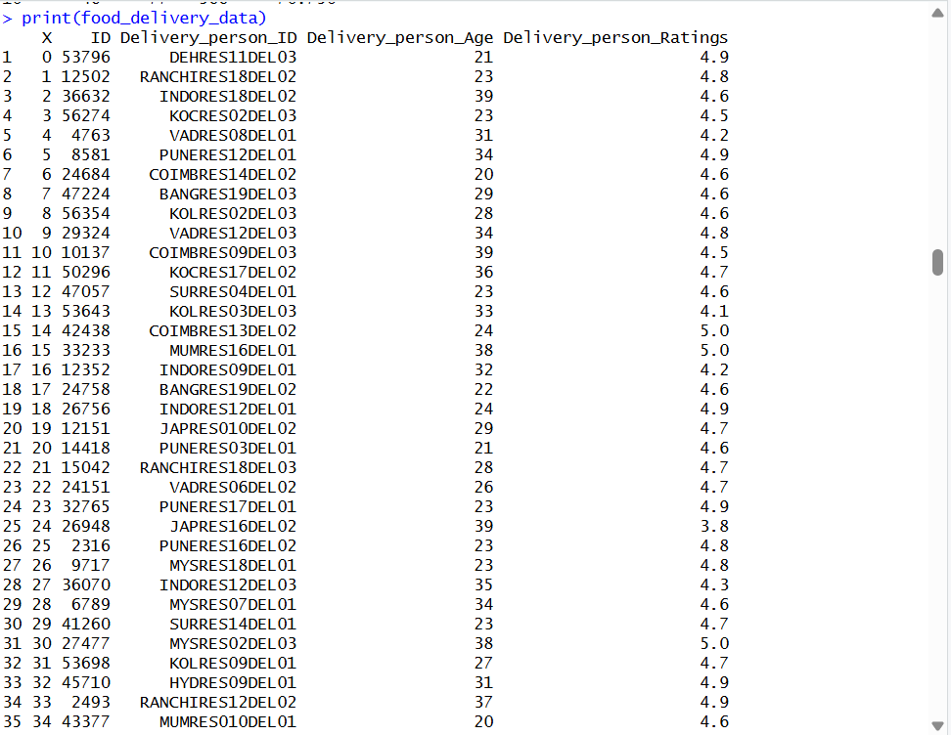
Step1 and 2- Importing Libraries and loading dataset
We will begin by loading the necessary libraries for data manipulation and visualization. We installed and loaded the libraries dplyr, ggplot2, forecast, and car to handle data processing, visualization, and time series analysis.
loading the food delivery dataset into R using the read.csv() function. We will display the first few rows to get an overview of the data structure.

Slide 4

Step-3 Cleaning the Dataset
We will clean the dataset to ensure its accuracy and prepare it for analysis.
We will remove any duplicate rows, handled missing values, and converted relevant columns (such as Order_Date and Time_Orderd) into appropriate formats.
We will extract the hour from Time_Orderd to analyze peak ordering hours.

Slide 5
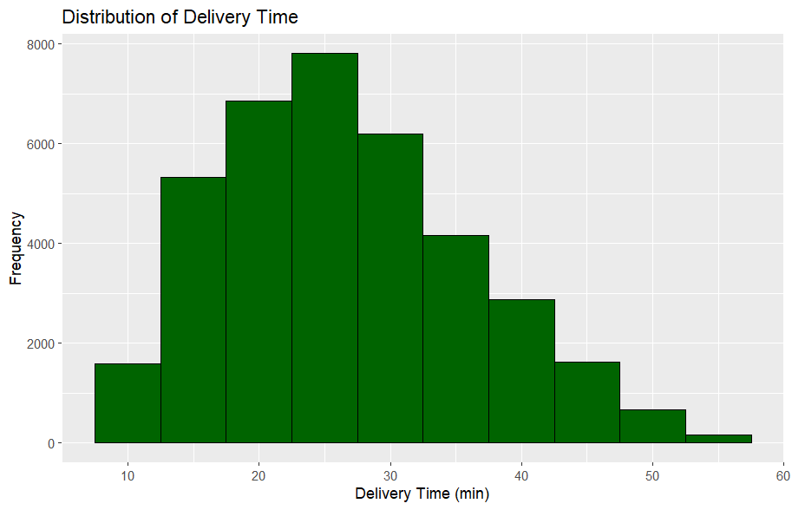
Step 4-Performing Exploratory Data Analysis (EDA)
We will create a histogram of delivery times, a bar plot of delivery person ratings, a pie chart for road traffic density, and more to gain insights into the food delivery process.
Insights-
The x-axis = Delivery time (in minutes)
The y-axis = Number of orders (frequency)
Key insight from the graph
Most deliveries happen between 20 to 30 minutes
Very few deliveries are too fast (below 10 min)
Very few are too slow (above 50 min

Slide 6
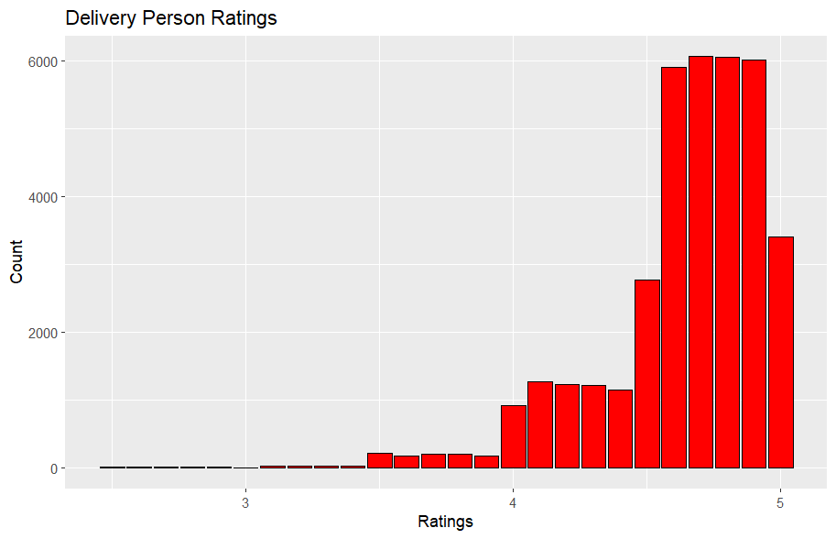
Step5- Delivery person Ratings Distribution
We will visualize the distribution of delivery person ratings to understand the feedback given to delivery personnel. We will create a bar plot to show the frequency of various delivery person ratings
Key insight from the graph
X-axis = Ratings (out of 5)
Y-axis = Number of ratings (count)
Most ratings are between 4.5 to 5
Very few ratings are below 4
almost no very low ratings
This means customers are highly
satisfied with delivery service

Slide 7
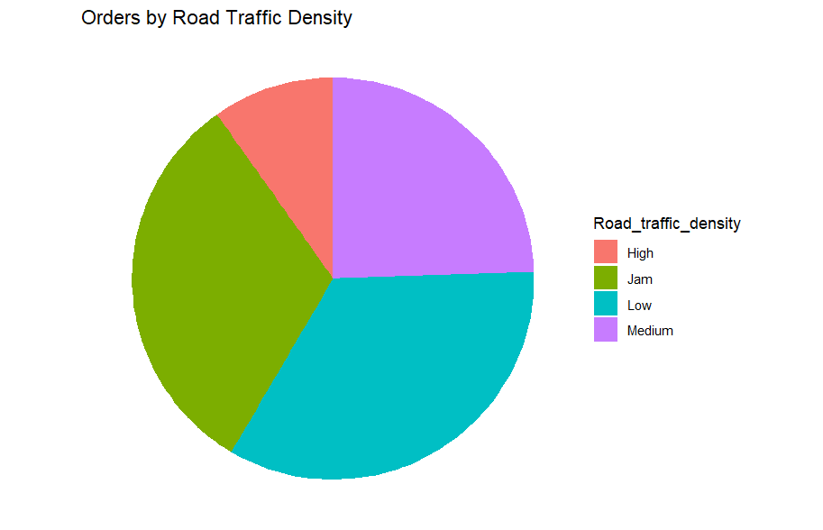
Step6- Orders by Road Traffic Density
Now we will visualize the Orders by Road Traffic Density by creating a a pie chart to show the proportion of orders under different road traffic conditions.
Key insight from the graph
This is a pie chart of orders by road traffic density.
It shows in what traffic conditions most orders are delivered
Categories: Low, Medium, Jam, High traffic
Most orders happen in Low and Jam traffic
A good number also happen in Medium traffic
Very few orders are in High traffic
So, deliveries mostly occur when traffic is manageable, not extreme

Slide 8
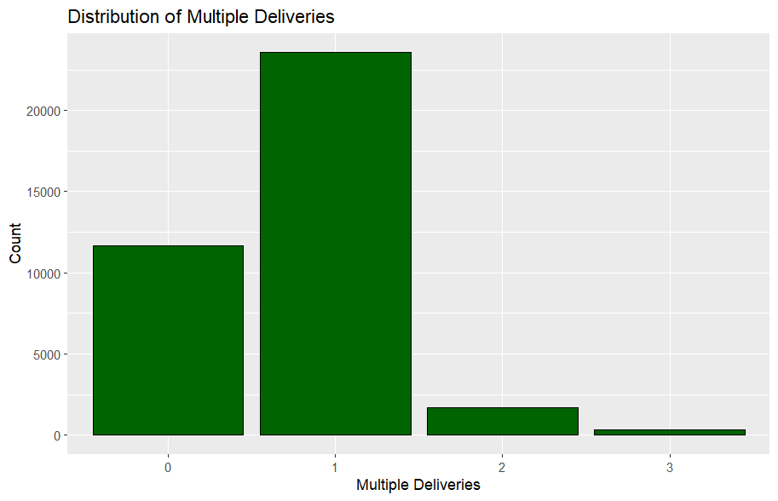
Step-7 Distribution of Multiple Deliveries
Now we will visualize the Distribution of Multiple Deliveries.
Key insight from the graph
This is a bar chart of multiple deliveries handled by delivery agents.
It shows how many orders a delivery person handles at a time
X-axis = Number of deliveries (0, 1, 2, 3)
Y-axis = Count (number of delivery agents/orders)
Most deliveries are single order (1 delivery at a time)
Some agents handle 0 deliveries (idle or no assignment)
Very few handle 2 or 3 deliveries together
So, majority of deliveries are handled one at a time

Slide 9
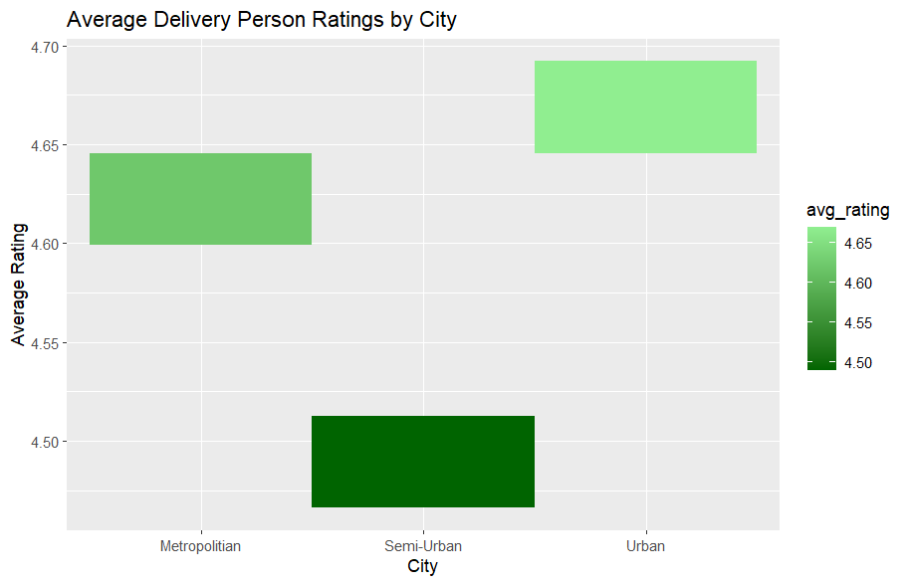
Step8-Average Delivery Person Ratings by City
Now we will visualize the Average Delivery Person Ratings by City.
Key insight from the graph
It shows how ratings differ in Metropolitan, Urban, and Semi-Urban areas
X-axis = City type
Y-axis = Average rating
Urban areas have the highest ratings
Metropolitan areas also have good ratings
Semi-Urban areas have slightly lower ratings
But overall, all ratings are above 4.5, which is very good

Slide 10
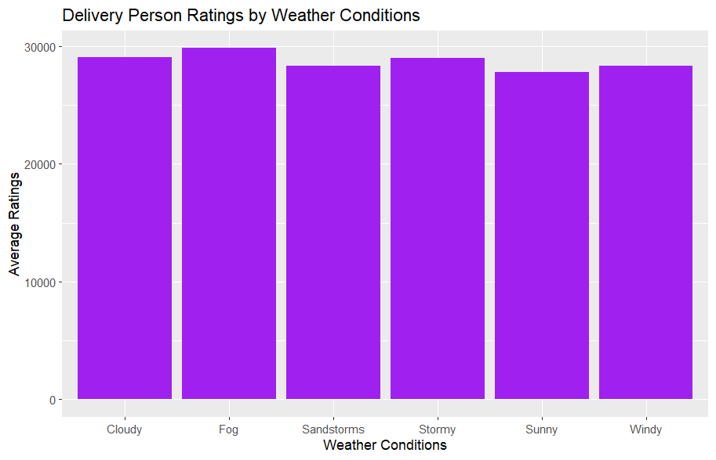
Step-9Delivery Person Ratings by Weather Conditions
Now we will visualize the Delivery Person Ratings by Weather Conditions.
All weather conditions show very similar rating totals (~28,000–30,000).
Fog has the highest bar (~30,000), while Sunny is the lowest (~28,000).
The differences are quite small, meaning weather doesn't drastically affect how
customers rate delivery personnel — they tend to rate similarly regardless of conditions

Slide 11
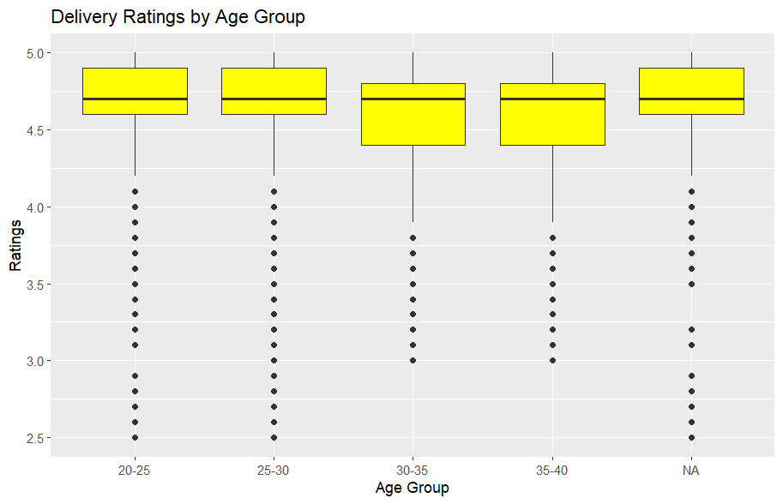
Step10- Delivery Ratings by Age Group
Now we will visualize the Delivery Ratings by Age Group.
The yellow box = middle 50% of ratings
(IQR — from 25th to 75th percentile)
The black line inside the box = median rating
The whiskers (lines extending out) = the overall
range (excluding outliers)
The dots below = outliers (unusually low ratings)
Age group has very little effect on delivery ratings —
performance is fairly consistent across
all age groups, which means factors
like weather, traffic, or time of day are likely more
impactful than the delivery person's age.

Slide 12
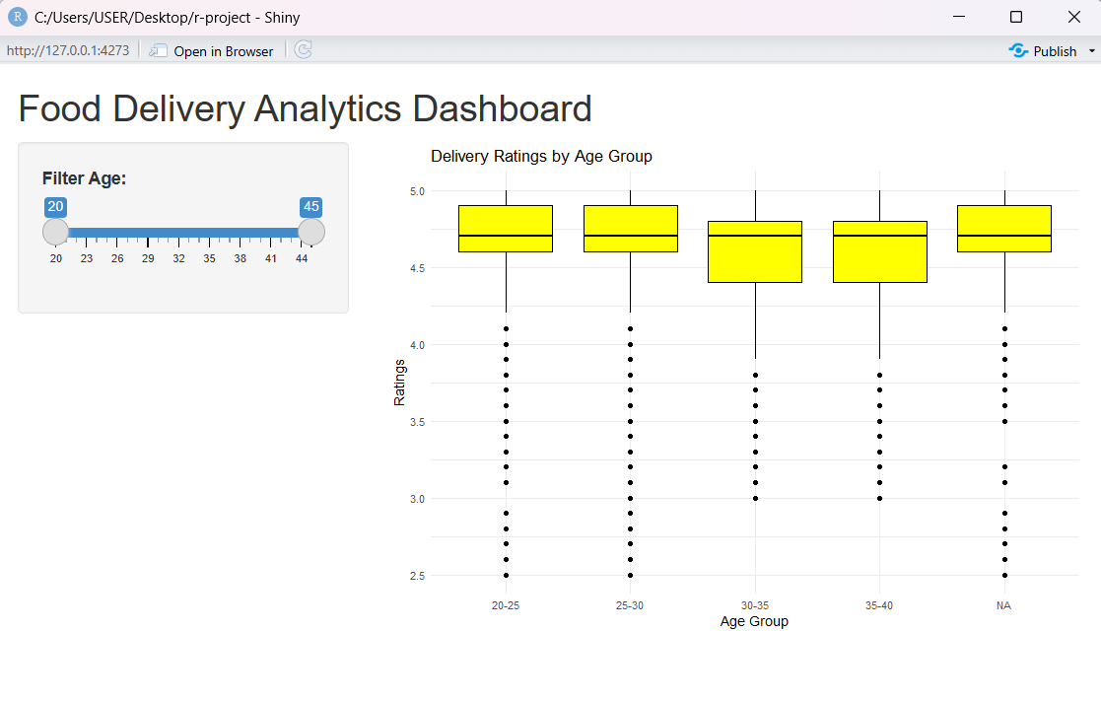
Dashboard
With the full age range selected (20–45), the plot looks
almost identical to the previous static one — same 5 groups
(20-25, 25-30, 30-35, 35-40, NA), same median ~4.7.
The boxes for 30-35 and 35-40 appear
slightly lower/bigger in this version.
In short, this is the same analysis but made interactive with Shiny —
the key value is that a user can now filter by age range and
see how ratings shift for a specific subset
of delivery personnel, making it a proper analytics
tool rather than just a static chart.

Slide 13
Conclusion
From our analysis, we:
Identified trends in delivery time, ratings, and traffic conditions.
Explored how weather conditions and multiple deliveries affect ratings.
Visualized regional and age-related differences in delivery performance.
We concluded that delivery times, weather, and traffic play a significant role in customer satisfaction. By understanding these patterns, businesses can optimize routes, manage delivery times more effectively, and improve service quality, ultimately enhancing customer retention.

