Slide 1
YAGO – A Core of Semantic Knowledge
Unifying WordNet and Wikipedia
Fabian M. Suchanek, Gjergji Kasneci, Gerhard Weikum
(Max-Planck Institute for Computer Science Saarbrücken/Germany)
吴雨婷 2016.11.11
Notes:
Talk a little slower
Add more background knowledge
Explain that 6E6 facts is the base
Explain the evaluation in detail (Wilson interval)

Slide 2
Overview
ر Motivation
ر The Yago ontology
ر Content
ر Model
ر Conclusion

Slide 3
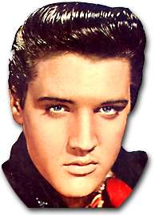
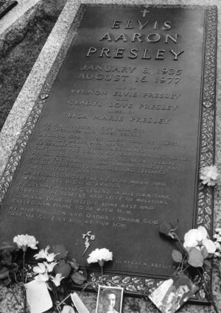
Motivation
☹
But: Maybe there are other Rock N'Roll geniuses in his generation?

Slide 4

Usual solution
Which other singers were born when Elvis was born?
Google Search
I'm Feeling Lucky
Elvis Presley - Wikipedia, the free encyclopedia
Elvis Presley was born on January 8, 1935 at around 4:35 a.m. in a two-room ... Other singers had been doing this for generations, but they were black. ...
en.wikipedia.org/wiki/Elvis_Presley Cached Similar pages

Slide 5
Usual solution
Which other singers were born in Elvis' year of birth?
Google Search
I'm Feeling Lucky
Elvis Presley - Wikipedia, the free encyclopedia
Elvis Presley was born on January 8, 1935 at around 4:35 a.m. in a two-room ... Other singers had been doing this for generations, but they were black. ...
en.wikipedia.org/wiki/Elvis_Presley Cached Similar pages

Slide 6
Usual solution
Will you please give me IMMEDIATELY all singers that wer
Google Search
I'm getting angry
Elvis Presley - Wikipedia, the free encyclopedia
Elvis Presley was born on January 8, 1935 at around 4:35 a.m. in a two-room ... Other singers had been doing this for generations, but they were black. ...
en.wikipedia.org/wiki/Elvis_Presley Cached Similar pages
Reason: Google does not search knowledge, but Web pages

Slide 7
Solution: An ontology
singer
is a
born
born
?
1935

Slide 8
Solution: An ontology
person
subclass
Classes
singer
Relations
is a
is a
born
born
?
Individuals
1935
means
means
Words
"Elvis Presley"
"The King"

Slide 9
Structure
ر AlbertEinstein hasWonPrize NobelPrize
ر AlbertEinstein bornInYear 1879
ر“Einstein” means AlbertEinstein
ر AlbertEinstein type physicist
ر physicist subClassOf scientist
ر subclassOf type transitiveRelation
ر fact (entity, relation, entity) has a fact identifier
fact(Albert Einstein, bornInYear, 1879) had the fact identifier #1 , then the following line
would say that this fact was found in Wikipedia:
#1 foundIn http : //www.wikipedia.org/Einstein
ر common entities (neither facts nor relations)
ر individuals (common entities that are not classes)
entity

Slide 10
Solution: An ontology
person
subclass
Classes
singer
Relations
is a
is a
BornInYear
BornInYear
?
Individuals
1935
means
means
Words
"Elvis Presley"
"The King"

Slide 11
Motivation
ر use only a single source of background knowledge
(mostly WordNet or Wikipedia) 本体知识来源单一
ر be extensible, easily reusable, and application-independent
具有良好的扩展性
ر OWL-Full:不具有计算完备性和可判定性；
OWL-Lite,OWL-DL: cannot express relations between facts ;
RDFS: provides only very primitive semantics(不能表示传递性)

Slide 12
Where do we get the ontology from?
Previous approaches:
ر Assemble the ontology manually
(WordNet, GeneOntology)
Problem: Usually low coverage
ر Extract the ontology from corpora
Problem: Usually low accuracy (50%-92%)

Slide 13
Where do we get the ontology from?
YAGO approach:
Assemble the ontology from Wikipedia (=> good coverage)
Use the category system of Wikipedia (=> good accuracy)
we obtain a complete hierarchy of classes, where the upper classes stem from WordNet and the leaves come from Wikipedia.

Slide 14
Exploiting the Wikipedia category system
Elvis Pr
born
1935
blah blah blub Elvis (don't read this! Better listen to the talk!) laber fasel suelz. Insbesondere, blub, texte zu, und so weiter blah blah blub Elvis laber fasel suelz. Blub, aber blah! Insbesondere, blub, texte zu, und so weiter blah blah blub Elvis laber fasel suelz. Insbesondere, blub, texte zu, und so weiter
Exploit relational categories
Categories:
1935_births

Slide 15
Exploiting the Wikipedia category system
Elvis Pr
American_singer
is a
born
1935
blah blah blub Elvis (don't read this! Better listen to the talk!) laber fasel suelz. Insbesondere, blub, texte zu, und so weiter blah blah blub Elvis laber fasel suelz. Blub, aber blah! Insbesondere, blub, texte zu, und so weiter blah blah blub Elvis laber fasel suelz. Insbesondere, blub, texte zu, und so weiter
Exploit relational categories
Exploit conceptual categories
Categories:
American_singers

Slide 16
Exploiting the Wikipedia category system
Disputed_article
Elvis Pr
American_singer
is a
is a
born
1935
blah blah blub Elvis (don't read this! Better listen to the talk!) laber fasel suelz. Insbesondere, blub, texte zu, und so weiter blah blah blub Elvis laber fasel suelz. Blub, aber blah! Insbesondere, blub, texte zu, und so weiter blah blah blub Elvis laber fasel suelz. Insbesondere, blub, texte zu, und so weiter
Exploit relational categories
Exploit conceptual categories
Categories:
Avoid administrational categories
Disputed_articles

Slide 17
Exploiting the Wikipedia category system
Rock'n_Roll_Music
Elvis Pr
American_singer
is a
is a
born
1935
blah blah blub Elvis (don't read this! Better listen to the talk!) laber fasel suelz. Insbesondere, blub, texte zu, und so weiter blah blah blub Elvis laber fasel suelz. Blub, aber blah! Insbesondere, blub, texte zu, und so weiter blah blah blub Elvis laber fasel suelz. Insbesondere, blub, texte zu, und so weiter
Exploit relational categories
Exploit conceptual categories
Categories:
Avoid administrational categories
Rock'n_Roll_Music
Avoid thematic categories

Slide 18
Thematic vs Conceptual Categories
☺ conceptual:
American singers of German origin
☹ thematic:
Rock N'Roll music in America
Shallow linguistic noun phrase parsing:
Premodifier Head Postmodifier
Heuristics: If the head is a plural word, the category is conceptual

Slide 19
The Upper Model
entity
?
person
American_singer
is a
born
1935

Slide 20
The Upper Model: From Wikipedia?
Social_group
Business
?
People_by_occupation
American_singer
is a
born
1935

Slide 21
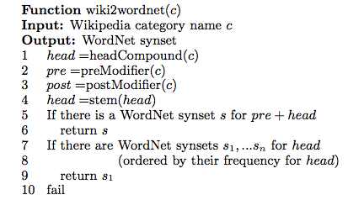
The Upper Model: From WordNet?
Person#3
Singer#1
...
Singer#17
?
American_singer
is a
born
1935

Slide 22
The Upper Model: From WordNet?
Person#3
Singer#1
...
Singer#17
!
American_singer
is a
born
1935

Slide 23
The YAGO ontology
Person#3
subclass
Singer#1
means
subclass
American_singer
"singer"
is a
born
1935
"Elvis Presley"
means

Slide 24
The YAGO ontology: Accuracy
Relation | Accuracy
subclass | 97.70% +/- 1.59%
is a | 94.54% +/- 2.36%
familyName | 97.81% +/- 1.75%
givenName | 97.62% +/- 2.08%
establishedIn | 90.84% +/- 4.28%
bornInYear | 93.14% +/- 3.71%
diedInYear | 98.70% +/- 1.30%
locatedIn | 98.41% +/- 1.52%
politicianOf | 92.43% +/- 3.93%
writtenInYear | 94.35% +/- 3.33%
hasWonPrize | 98.47% +/- 1.53%

Slide 25
The YAGO ontology: Number of Facts
6,000,000
Ontologies should not be judged purely by the number of facts! This is just an informational overview.
2,000,000
30,000 60,000 200,000 300,000
KnowItAll SUMO WordNet OpenCyc Cyc
Yago

Slide 26
The Yago Model: Why binary is not enough
singer
(Elvis, is_a, singer)
(But only from 1953 to 1977)
is a
(We know this from Wikipedia)

Slide 27
The Yago Model: Why binary is not enough
singer
#1 (Elvis, is_a, singer)
#2 (#1, time, 1953-1977)
#3 (#1, source, Wikipedia)
time
1953-1977
is a
source
Wikipedia

Slide 28
The Yago model formally
A YAGO ontology over
a set of relations R
a set of common entities C
a set of fact identifiers I
is a function
I → (I ∪ C ∪ R) × R × (I ∪ C ∪ R)
#1 (Elvis, is_a, singer)
#2 (#1, time, 1953-1977)
#3 (#1, source, Wikipedia)

Slide 29
The Yago model: Logical aspects
person
Axioms:
(x, is_a, y)
(y, subclass, z)
=> (x, is_a, z)
...
subclass
singer
is a
is a

Slide 30
The Yago model: Logical aspects
finite, unique
f1, f2, f3, f4, f5, f6, f7, f8, f9, f10
Axioms:
(x, is_a, y)
(y, subclass, z)
=> (x, is_a, z)
...
derive facts
f1, f2, f3, f4, f5
Eliminate facts
f1, f2, f3
finite, unique

Slide 31
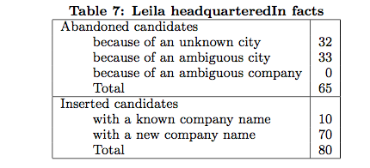
Enriching YAGO
YAGO is designed to be extendable by new facts
add the fact (x,r,y)
map x and y to existing entities in the YAGO ontology
be added as new entities
r has to be mapped to a relation in the YAGO ontology
(f, foundIn, w) with confidence c add the fact together with a new f
Y
N
Y
N

Slide 32
Thank you for listening!

Slide 33
Other singers of Elvis' generation
Which other singer was born in the same year as Elvis?
http://www.mpi-inf.mpg.de/yago
Enter your Yago Query:
"Elvis Presley" bornInYear $year
$other bornInYear $year
$other isa singer

Slide 34
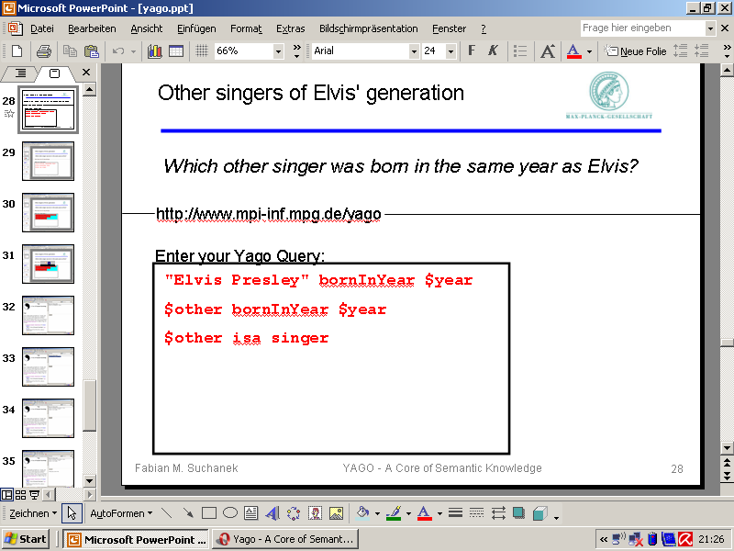

Slide 35
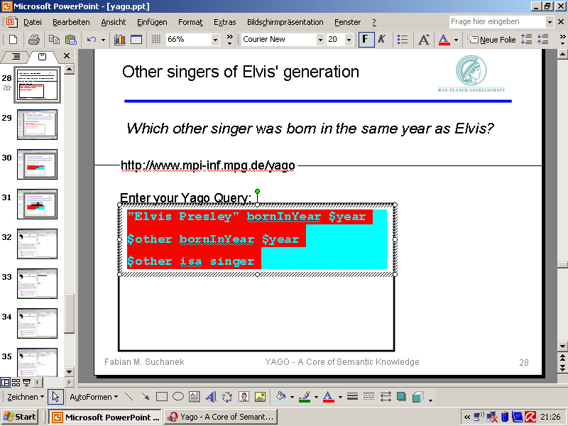

Slide 36


YAGO – A Core of Semantic Knowledge - Opera

Slide 37
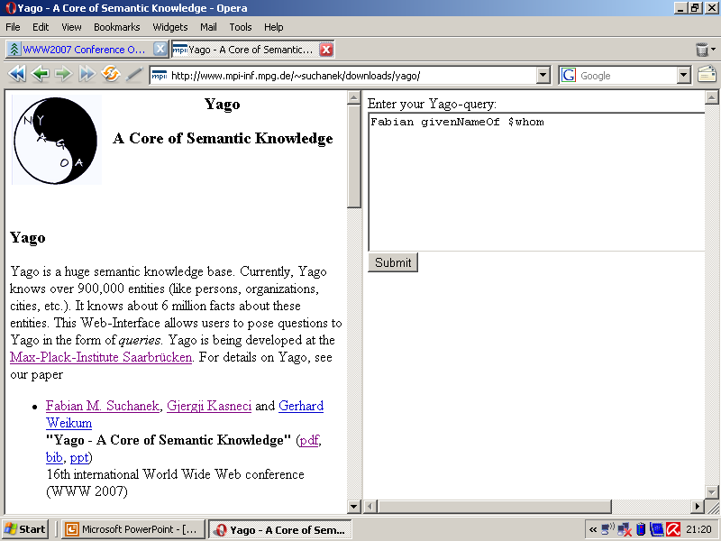

Slide 38
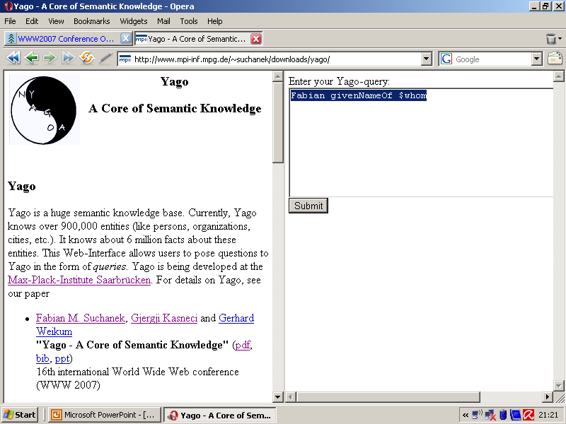

Slide 39
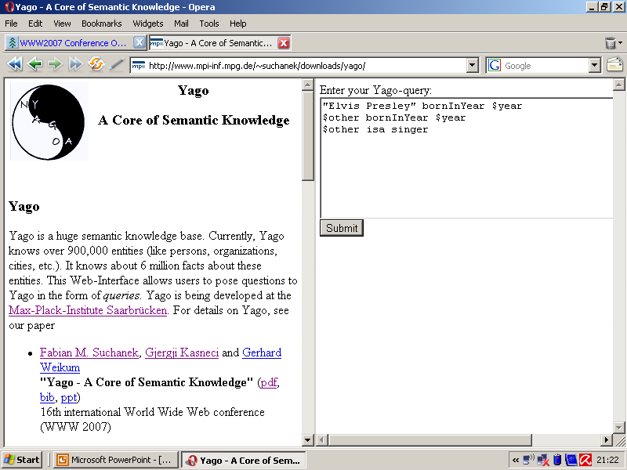

Slide 40
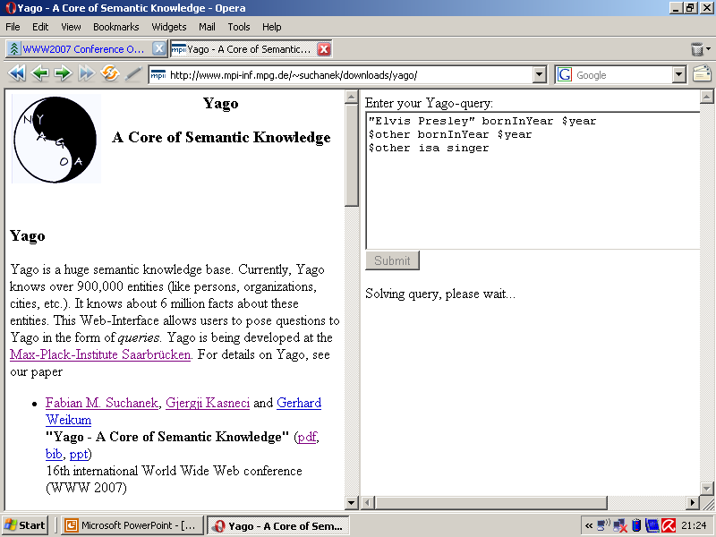

Slide 41
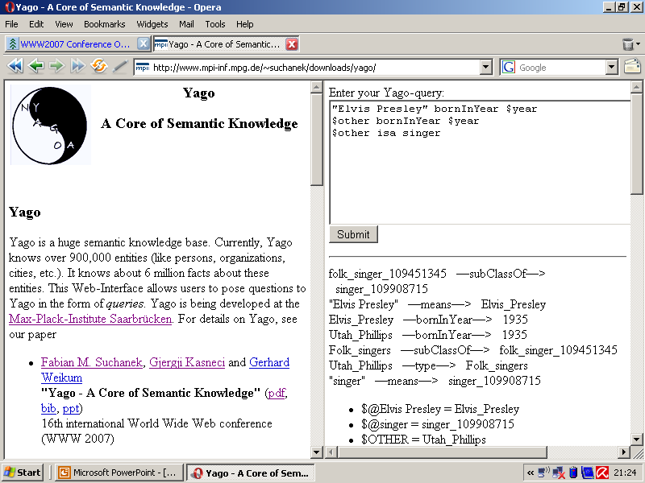
I am a screenshot
Subgraph of YAGO
Singer born in the same year as Elvis: Utah Phillips

Slide 42
Applications
What can you do with YAGO?
http://www.mpi-inf.mpg.de/yago
Query it
(See our WWW 2007 poster "How NAGA Uncoils")
Download it
(use it as "WordNet + Individuals", e.g. for disambiguation)
Find other Elvises

