Slide 1
YAGO2: Exploring and Querying World Knowledge in
Time, Space, Context, and Many Languages
Johannes Hoffart, Fabian M. Suchanek, Klaus Berberich, Gerhard Weikum
Max Planck Institute for Informatics, Germany
吴雨婷 2016.11.16
Notes:
Talk a little slower
Add more background knowledge
Explain that 6E6 facts is the base
Explain the evaluation in detail (Wilson interval)

Slide 2
Overview
ر Motivation
ر Extraction Architecture
ر Temporal Dimension
ر Geo-Spatial Dimension
ر Textual Dimension
ر Demo

Slide 3
Motivation
ر Current knowledge bases are still mostly blind to the temporal dimension and spatial dimension.
People
KB may store
Birth dates
this yields a time span demarcating the person’s existence and the events that this person can participate in
Death dates
Similar problems can be observed at the spatial level

Slide 4
Motivation
ر A time- and space-aware knowledge base could correctly locate this event on both dimensions.
a time(1969)
conveys
“Woodstock”
a place(White Lake)
a duration (a few days)
We could for example ask for “all musicians born in the vicinity of Woodstock”.

Slide 5
Extensible Extraction Architecture
ر the new architecture is based on declarative rules
ر Factual rules are simply additional facts for the YAGO2 knowledge base.
"capital” hasPreferredMeaning wordnet_capital_108518505
ر Implication rules say that if certain facts appear in the knowledge base, then
another fact shall be added.
"$1 $2 $3; $2 subpropertyOf $4;" implies "$1 $4 $3”
ر Replacement rules say that if a part of the source text matches a specified
regular expression, it should be replaced by a certain string.
"\{\{USA\}\}" replace "[[United States]]”
ر Extraction rules say that if a part of the source text matches a spec- ified
regular expression, a sequence of facts shall be generated.
"\[\[Category:(.+) births\]\]" pattern "$0 wasBornOnDate Date($1)"
ر

Slide 6
TEMPORAL DIMENSION
ر We consider temporal information for both entities and facts
ر Entities are assigned a time span to denote their existence in time
e.g. Elvis Presley is associated with 1935-01-08 as his birthdate
and 1977-08-16 as his time of death
ر Facts are assigned a time point if they are instantaneous events, or a time span if they
have an extended duration with known begin and end.
e.g. The fact BobDylan created BlondeOnBlonde is associated with the time point
1966-05-16 (the release date of this album). The fact BobDylan isMarriedTo
SaraLowndes is associated with the time span from 1965-##-## to 1977-##-##.

Slide 7
Entities and Time
ر we focused on the following four major entity types
ر People where the relations wasBornOnDate and diedOnDate
demarcate their existence times;
ر Groups such as music bands, football clubs, universities, or companies,
where the relations wasCreatedOnDate and wasDestroyedOnDate demarcate
their existence times;
ر Artifacts such as buildings, paintings, books, music songs or albums,
where the relations wasCreatedOnDate and wasDestroyedOnDate demarcate
their existence times;
ر Events such as wars, sports competitions where the relations
startedOnDate and endedOnDate demarcate their existence times.
We introduce two generic entity-time relations :
startsExistingOnDate and endsExistingOnDate
certain relations are sub-properties of the generic ones:
wasBornOnDate subpropertyOf startsExistingOnDate

Slide 8
Facts and Time
ر Facts with an Extracted Time
we introduce two new relations, occursSince and occursUntil, each with a (reified) fact and an instance of yagoDate as arguments.
#2 occursSince 2009-01-20 and #2 occursUntil 2010-01-20
If the same fact occurs more than once, then YAGO2 will contain it multiple times with different ids.
ر Facts with a Deduced Time
In some cases, the entities that appear in a fact may indicate its occurrence time.
e.g. For ElvisPresley diedIn Memphis we would want the death date of the subject as the occurrence time.
(such as wasBornIn) instances of the new class subjectStartRelation ;
(such as created) instances of objectStartRelation
Then, it suffices to introduce an implication rule to propagate the start of the existence time of the entity to the occurrence time of the fact.

Slide 9
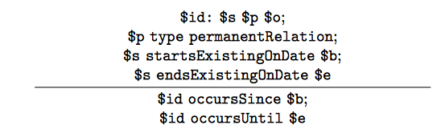
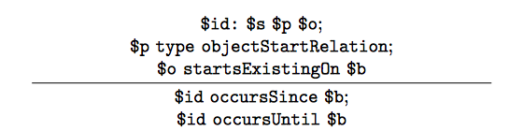
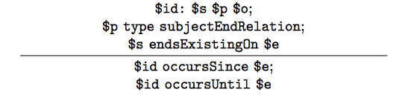
An Example
Permanent relations
Creation relations
Destruction relations

Slide 10
GEO-SPATIAL DIMENSION
ر we introduce a new class yagoGeoEntity, which groups together all geo-entities,
introduce a special data type to store geographical coordinates, yagoGeoCoordinates .
Each instance of yagoGeoEntity is directly connected to its geographical coordinates by the hasGeoCoordinates relation.
ر YAGO2 harvests geo-entities from two sources : Wikipedia and GeoNames
we need to match the individual geo-entities that exist both in Wikipedia and Geo- Names, so that we do not duplicate these entities when extracting them from the respective repositories.
ر We deal with the spatial dimension similarly to how we deal with time: a location is assigned to both entities and facts.
Entities: we have spatial data in our knowledge base for events, groups, artifacts.
We define a new relation to treat all entities in a uniform way: placedIn. Both isLocatedIn and happenedIn are defined as sub-properties of this new relation.
Facts: #1: LeonardCohen wasBornOnDate 1934, we would write its location as
#1 occursIn Montreal

Slide 11
GEO-SPATIAL DIMENSION
ر Some facts occur in a place that is indicated by their subject or object.
relationLocatedByObject (wasBornIn, diedIn)
relationLocatedBySubject (hasMayor )
We can transfer the location of the fact argument to the fact itself by an implication rule.
ر timeToLocation, which holds between two relations
diedOnDate/diedIn happenedOnDate/happenedIn

Slide 12
TEXTUAL DIMENSION
ر For each entity, YAGO2 contains contextual information.
This context is gathered by our extractors from Wikipedia.
They include the following relations, with an entity and a string as arguments:
ر hasWikipediaAnchorText links an entity to a string that occurs as anchor text
in the entity’s article.
ر hasWikipediaCategory links an entity to the name of a category
in which Wikipedia places the article.
ر hasCitationTitle links an entity to a title of a reference
on the Wikipedia page.
All of these relations are sub-properties of the relation hasContext. This relation provides a wealth of keywords and keyphrases associated with the entity. We extract more than 82 million context facts for the YAGO2 entities in total.

Slide 13
TEXTUAL DIMENSION
ر For individual entities, we extract multilingual translations from inter- language links in
Wikipedia articles.
YAGO2 represents these non- English entity names through reified facts.
For example, we have the reified fact #1: BattleAtWaterloo isCalled SchlachtBeiWaterloo with the associated fact #1 inLanguage German.
ر Multilingual class names are obtained by integrating UWN into YAGO
UWN maps words and word senses of WordNet to their counterparts in other languages, providing over 1.5 million translations and sense assignments for 800,000 words in over 200 languages at a precision of 90%.

Slide 14
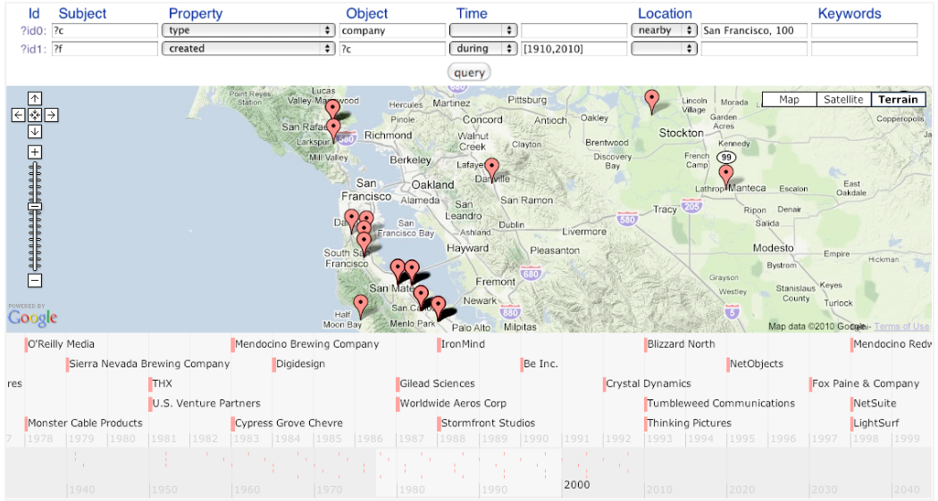
SPOTLX Representation
ر To facilitate the querying of YAGO,
we have added to each triple of Subject, Predicate, and Object in YAGO2 three more dimensions: Time, Location, and conteXt. This yields a 6-tuple representation,
which we call SPOTLX.

