Slide 1
CBD 3335 Assignment 1 Heart Disease Diagnosis & Prediction
Prasanth Moothedath Padmakumar - C0796752
Aswathy Kuttisseril Jewel – C0813455
Gayathri Ravi Nath - C0818959

Slide 2
Introduction
The dataset we have in hand is the Cleveland Heart Disease dataset taken from the UCI repository.
This project aims in classifying whether a person has heart disease based on their medical attributes by applying the Random forest Machine Learning approach.
The IDE we opted for the development is Jupyter notebook.

Slide 3
Random Forest
A random forest is a meta estimator that fits a number of decision tree classifiers on various sub-samples of the dataset and uses averaging to improve the predictive accuracy and control over-fitting.
Rather than using just one decision tree, a number decision trees are used to predict and the results are aggregated to provide one result.
The problem of using just one decision tree is that it is prone to overfitting, which means it is highly sensitive to the training data set. A slight change in the dataset can lead to change in the prediction outcome.

Slide 4
Data Set : processed Cleveland data
The data set consists of 297 rows and 14 columns. The data contains the following columns :
‘age’ – Age of the individual.
‘sex’ – Gender of the individual, value 1 relates to Male & value 0 relates to Female.
‘cp’ – Chest pain type experienced, They are of four types typical angina, atypical angina, non anginal pain, asymptotic having the values 0, 1, 2, 3 respectively
‘trestbps’ – Resting blood sugar value measured in mmHg
‘chol’ – Serum Cholestrol measured in mg/dl.
‘fbs’ – Compares the Fasting Blood Sugar value.Value 1 is given if it is greater than 120mg/dl else it is given 0.
‘restecg’ – Represents electrocardiographic result, having the value 1 for ST-T wave abnormality and 2 for left ventricular hypertrophy.
‘thalach’ – Maximum heart rate achieved.

Slide 5
Data Set : processed Cleveland data
‘exang’ – Gives the value 1 if angina is exercise induced else 0.
‘oldpeak’ – ST depression induced by exercise relative to rest.
‘slope’ – Peak exercise ST segment, They are three types upsloping, flat, downslopping having values 0, 1, 2 respectively
‘ca’ – Number of major vessels (0–3) colored by fluoroscopy
‘thal’ – displays the thalassemia. They are three types normal, fixed defect, reversible defect having values 0, 1, 2 respectively
‘target’ – Displays whether the individual has heart disease or not.

Slide 6
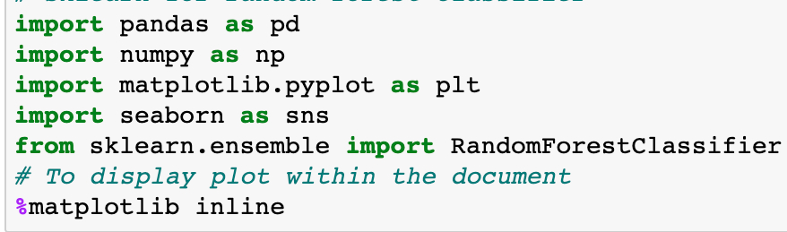
Import Libraries
‘Pandas’ library for data manipulation and analysis.
‘Numpy’ library for some standard mathematical functions.
‘Matplotlib’ library to visualize the data in the form of different plot.
‘Seaborn’ library for visualizing statistical graphics and work on top of Matplotlib.
Sklearn for random forest classifier
The purpose of ‘%matplotlib inline’ is to add plots to your Jupyter notebook.

Slide 7
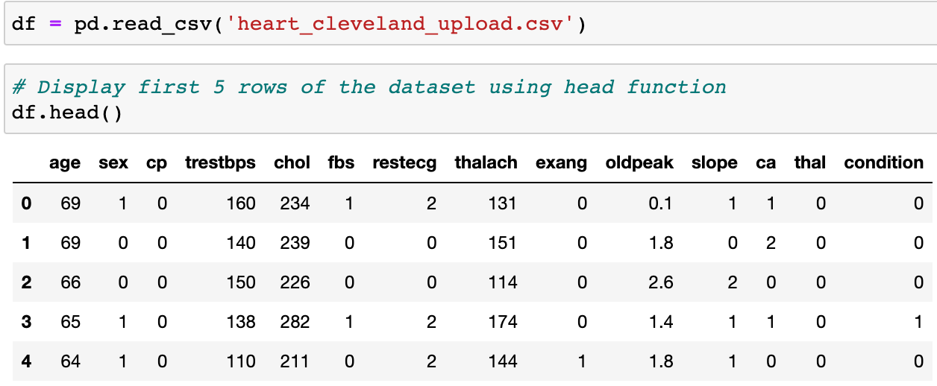
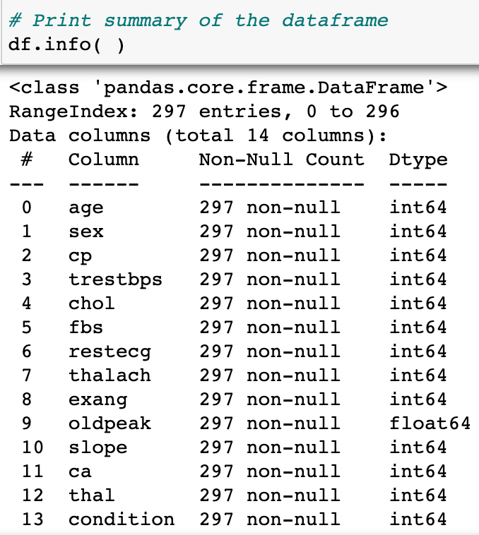
Importing Data
To read the CSV file we use pandas ‘read_csv’ function.
The ‘head’ function is used to get the first n rows of the data set, the value of n will be 5 by default.
The ‘info’ function will display the summary of the data set, it will contain details such as count, datatype, etc

Slide 8
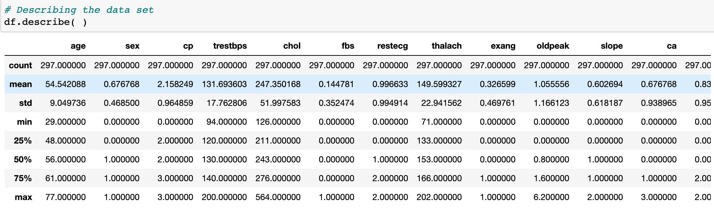
Importing Data and Checking out
The ‘describe’ function will describe the data set by providing details such as mean, std, 25%, etc.

Slide 9
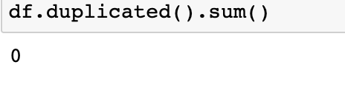
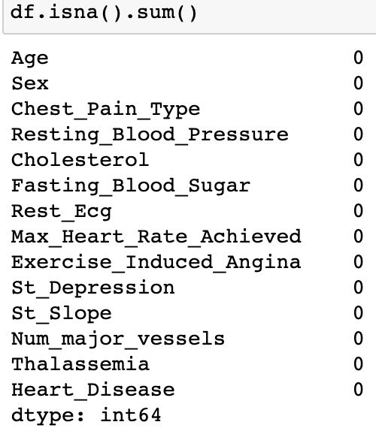
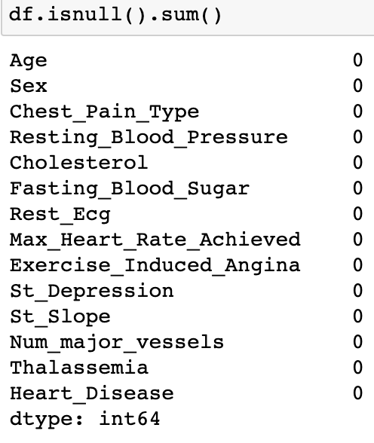
Preprocessing Steps
Simple checks on the data set is performed to check the purity of the dataset.
Check for duplicate entries, null values and missing values are checked
None of the issues were found

Slide 10
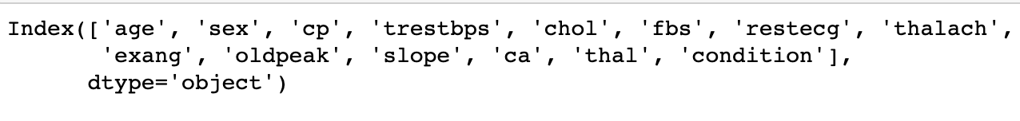
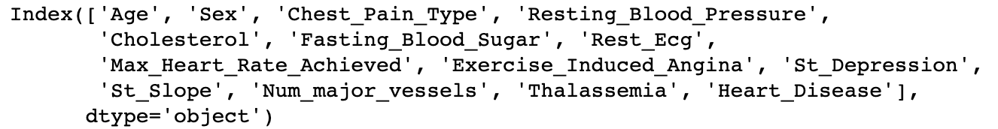
Preprocessing Steps
Columns were renamed to more readable form for better clarity and ease of use

Slide 11
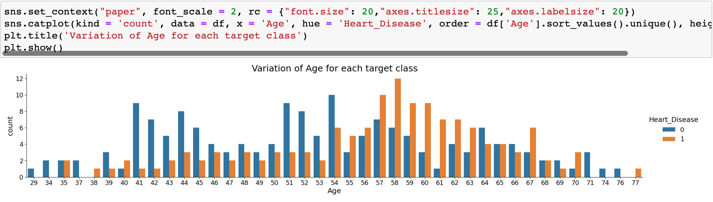
Exploratory analysis
We plotted Age of the individual against their frequency for each of the target class
It was inferred that the age which people suffer heart disease the most is 58 followed by 57

Slide 12
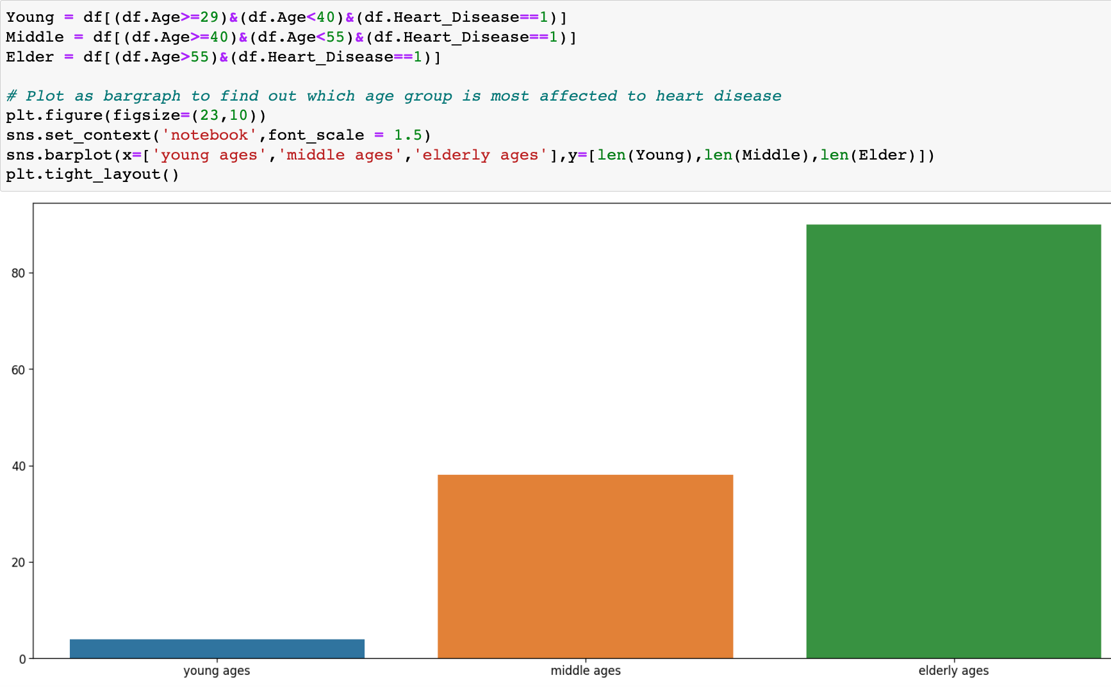
Exploratory analysis
We tried to find out which age group was at most risk to heart disease
Different age groups present in the data set was found out using min, max and mean of age column
From the bar graph it can be inferred that Older age group is more prone to heart disease

Slide 13
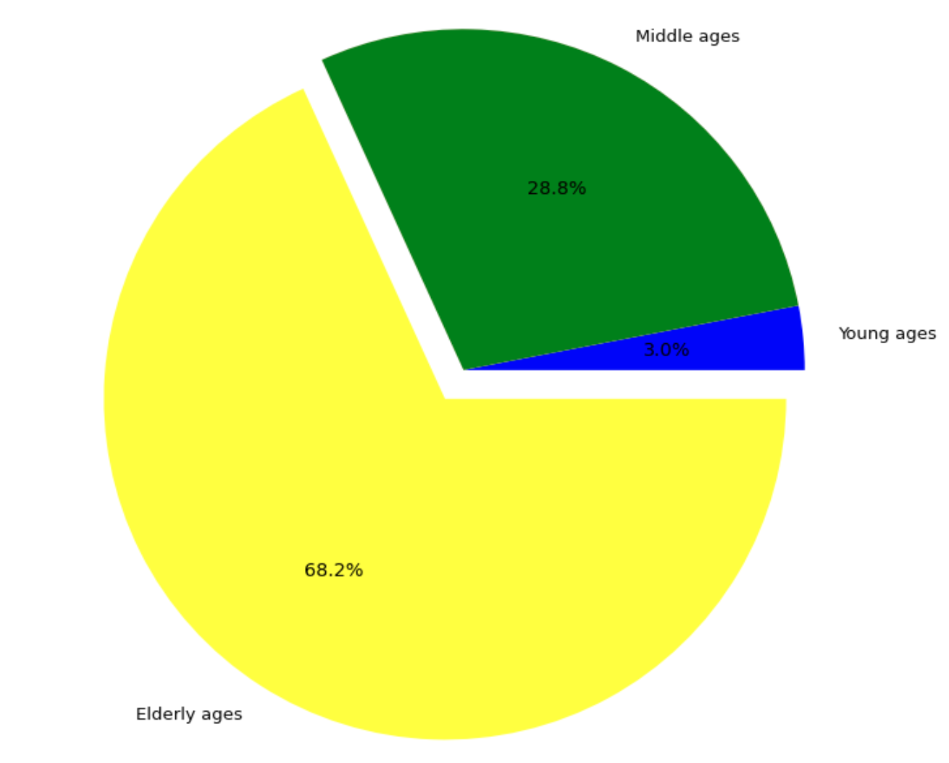
Exploratory analysis
We also used a pie chart to infer the age group analysis
68 % of the individuals effected by heart disaese are Elder people

Slide 14
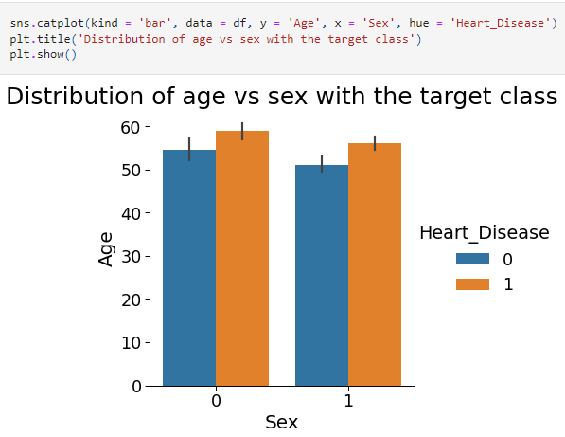
Exploratory analysis
With the help of a bar graph we plotted frequency of heart disease for each gender
It was inferred that females who are suffering from the disease are older than males

Slide 15
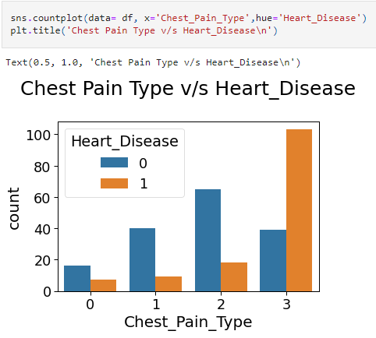
Exploratory analysis
With the help of a bar graph we plotted frequency of heart disease for different types of chest pains
It was inferred that type 3 chest pain is the most common in heart disease patients
Type 3 chest pain is asymptomatic chest pain

Slide 16
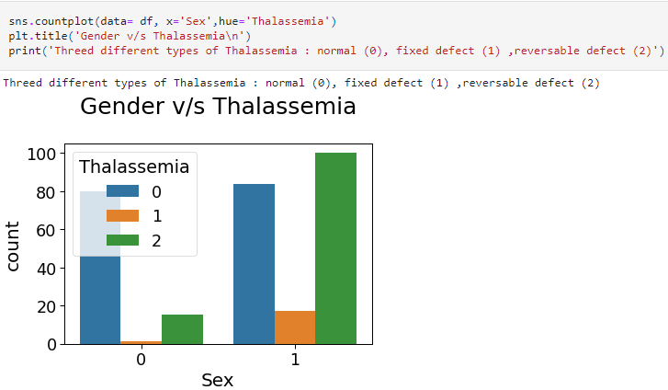
Exploratory analysis
With the help of a bar graph we plotted frequency of heart disease for different types of Thalassemia for each of the gender
Most females are showing Normal Thalassemia, while majority of males show reversible defect Thalassemia

Slide 17
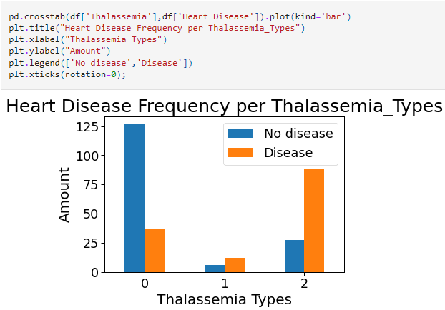
Exploratory analysis
Using a bar graph we plotted frequency of heart disease for different types of Thalassemia
Here we can that individuals with type 2 Thalassemia have most chance of heart Disease

Slide 18
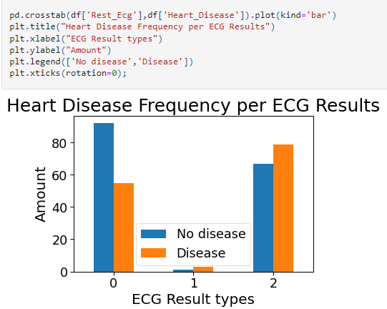
Exploratory analysis
Using a bar graph we plotted frequency of heart disease for different types of ESG results type
Here we can that individuals with ECG result type 2 followed by type 1 has most chance of heart Disease

Slide 19
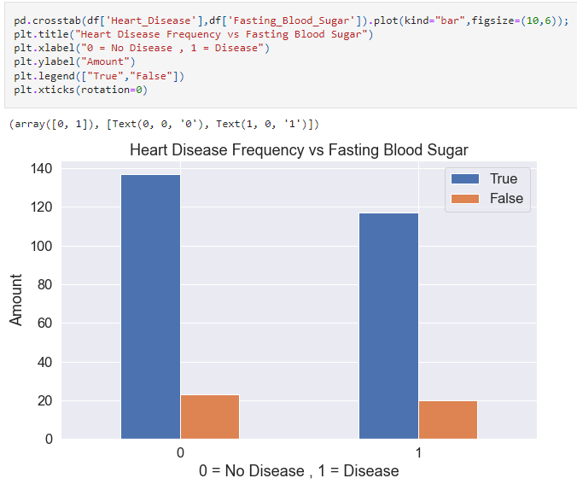
Exploratory analysis
Using a bar graph we plotted Fast blood sugar value against frequency of each of target class.
We can see that around 130 individuals having no heart disease has high blood sugar value and around 120 individuals having no heart disease has high blood sugar value.

Slide 20
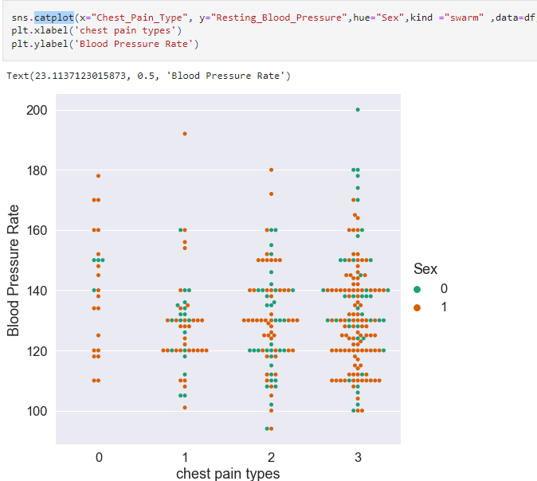
Exploratory analysis
Using cat plot the blood pressure rate of individuals was plotted against each of the chest pain types with respect to gender
It can be inferred that Catplot shows that Males with higher blood pressure have more chances of heart disease compared to females

Slide 21
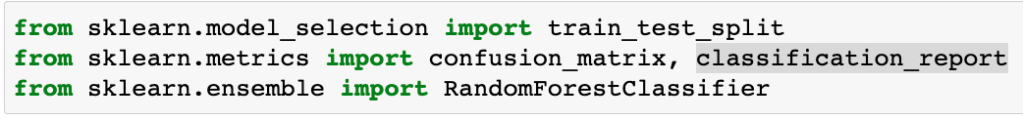

Modelling
As the first step in modelling, the necessary packages for the modelling part was imported
Next, we dropped the target feature from the data frame and assigned the new data frame to X
We performed train and test spitting on the data frame. We decided to use 80% of the data set for training and rest for testing

Slide 22
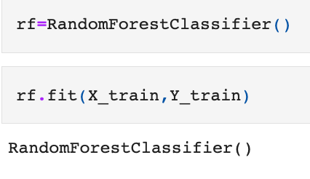
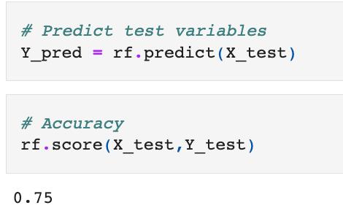
Modelling
Th
The modelling was performed using the inbuilt function from the sklearn package called RandomForestClassifier
The model was executed on the training data set using the fit function
The Prediction was performed using the predict function and stored in Y_pred variable
The accuracy score was printed using score function and it was found to be 0.75

Slide 23
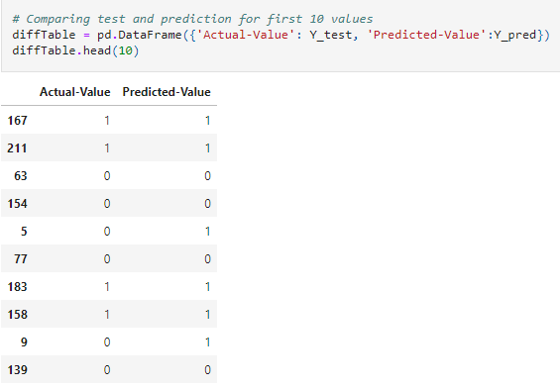
Modelling
We decided to compare the target feature value of Actual and Predicted
Out of first 10 values 8 of them was found to be correct
So it closely matches to the 75 % accuracy we calculated in the previous step

Slide 24
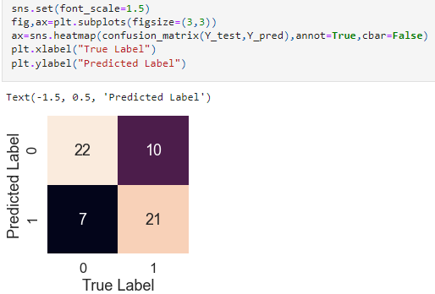
Model Evaluation
To evaluate the performance of classification model we decided to use confusion matrix.
The model predicted total of 60 individual for heart disease
Out of those 60 cases, the classifier predicted "yes" 31 times, and "no" 29 times.
In reality according the dataset, only 28 individuals have heart disease while 32 of the individuals were diagnosed as not having heart disease

Slide 25
Conclusion
The model gave an accuracy value of 75 % which is almost enough to take into consideration for implementing into practical use case. Manually calculating the chances of developing heart disease based on risk factors is tough. However, utilizing Machine Learning, we will be able to detect whether the person has heart disease in no time.

