Slide 1
ML Ops
+
Machine Learning
Data gathering
Operations
Data cleaning
Delivery
EDA
Feature Engineering
Deployment
Model Training
Maintenance-Monitoring
Model Evaluation
ML Ops engineer will maintain the entire pipeline from data gathering to deployment
Testing
Containerize entire project using docker
QA

Slide 2
Continuous Integration/Continuous Delivery/Continuous Deployment/ Continuous Training
CI/CD/CD/CT Pipelines
CI(Continuous Integration): Automatically building and testing code changes frequently to detect issues early, using GitHub action we can set up workflows that trigger builds and tests whenever changes are pushed to the repository. This ensures that the codebase remains stable and that any integration issues are caught promptly, leading to higher quality software and more efficient collaboration.
CD (Continuous Delivery & Deployment) : As soon as testing is done successfully, deliver and deploy the project using docker
CT (Continuous Training): retraining models whenever new data is available or code changes occur, ensuring that the model remains up-to-date and accurate.
- DVC: Use DVC to track datasets. When new data is pushed to the repository, it can trigger the CI/CD pipeline.
- MLFlow: Log models and their parameters, metrics, and artifacts.
- Airflow: Schedule the retraining process.

Slide 3
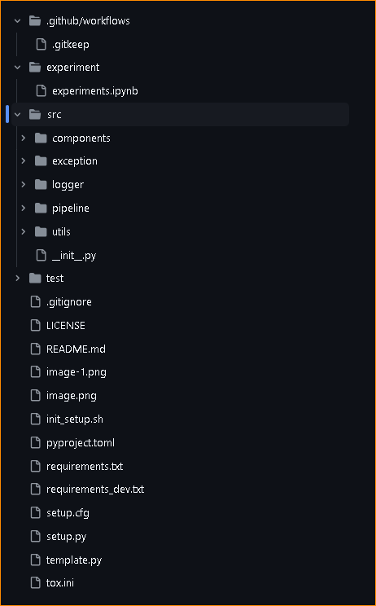
GitHub Setup of the Project
Create a GitHub repo & Clone it in local system: git clone <repo url>
Create file and folder structure using template.py
Above can be done by creating a github repo using template repo in github
CI/CD Configuration
ML Development/experiments
data ingestion, transformation, model trainer, model evaluation
Custom exception
logging
Training & prediction pipeline
Common utility functions
Unit/Integration testing
Ignore files/folders to be pushed in github repo

Slide 4
Micro Project: Deploy Python Package (CI Concepts)
We will create a unified python package to perform CRUD operations which will be hosted on github & released on
pypi repo so that people can pip install and use it in their code
Mongodb is a nosql dbs where we save data in dictionary format, we will also include cassandra, mysql etc
This package will be able to perform crud operations & connecter for all major dbs
Create folder structure using template.py
Create ci.yaml & python-publish.yaml
Generate pypi api token & add in github under setting > security > actions > new repository secret

